Slide 1
Mountains
An Introduction

Slide 2
What do you know ?
Write down anything that comes to mind when you think of the word ‘Mountain’
Have you ever visited or climbed one ?
What sorts of things would you expect to see on a mountain ?
Where are mountains ?

Slide 3
Let’s look at some mountains
While you look at the slides – think about the following
What is the weather like ?
Can you see anything growing or living ?
What shape is the mountain ?
Do people use the mountain – and if so, what for ?

Slide 4
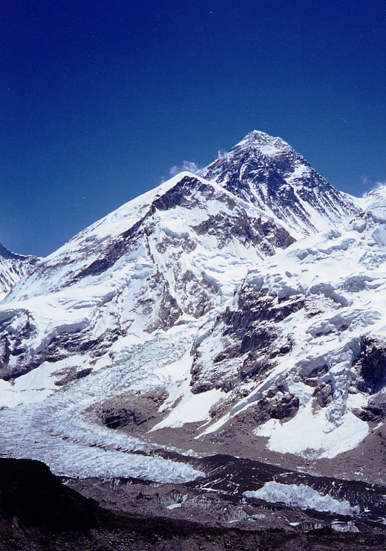
Mount Everest
Himalayan Range, Mount Everest, Nepal. 8850m
Highest peak in the world
GPS was used in 1999 to verify its height.
First scaled in 1958.
600 climbers from 20 countries have reached the peak.
100 have died.

Slide 5
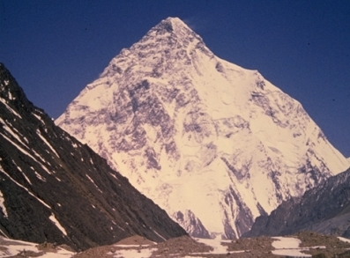
K2 – Karakoram Range Chinese/Pakistan border
World’s 2nd highest mountain at 8612m.
Named using surveyors notation.
A giant pyramid of sheer ice with a maze of precipices
Ultimate climbers peak.
Between 1900-50 many unsuccessful attempts made.
Finally scaled 1954.

Slide 6
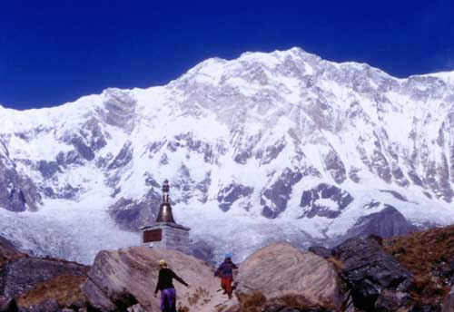
Annapurna – Himalaya, Nepal
8091meters high, 10th highest in world.
Name means ‘The Provider’
Giant glaciers empty into the Kali Gandaki river.

Slide 7
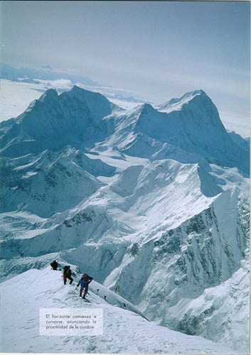
Malaku – Himalaya, Nepal.
8462m, 5th highest.
Very isolated Pyramid shape
4 sharp ridges
Picture taken from Everest.

Slide 8
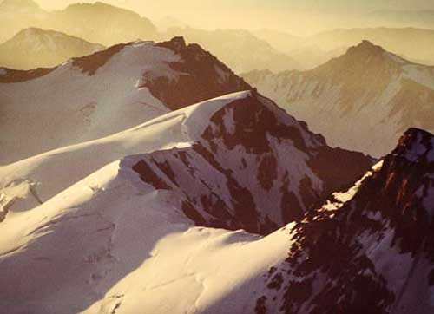
Aconcagua - Andes, Argentina.
At 6962m – the highest peak in Western Hemisphere.
Death tolls high, as climbers go up too fast.
No respect for altitude or weather.

Slide 9
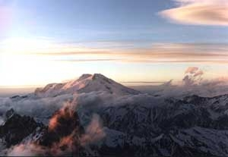
Mt. Elbrus – Caucauses, Russia.
At 5642m, Europe’s highest peak
A long extinct volcano with a distinct conical shape, gently sloping sides.
Countless glaciers
Mountain covers 56 miles.

Slide 10
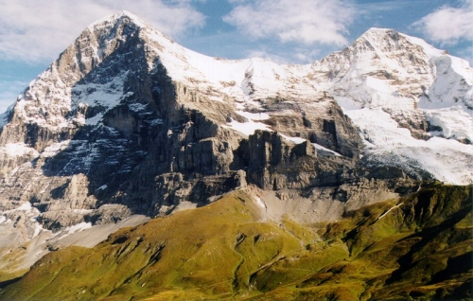
The Eiger - Swiss Alps.
At 3970m, one of Europe’s most fearsome
Peaks – extremely difficult to climb.
Its name means‘Ogre’, and it has a severely towering North face.
Has claimed the lives of many Climbers.

Slide 11
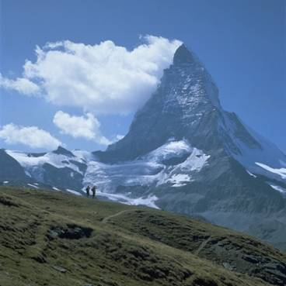
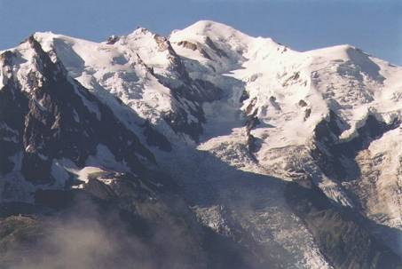
The Eiger - Swiss Alps.
The Matterhorn to the right (4476m) and Mont Blanc below (4807m) both part of the range of mountains called the Alps which runs across Europe.
M.Blanc is the highest peak in the Range. The Matterhorn was the focus
of the golden age of climbing in
the 1850’s when the sport
first got going. The British
camped out in Zermatt and
scaled all the peaks in the area.
using only the most primitive of
equipment.

Slide 12
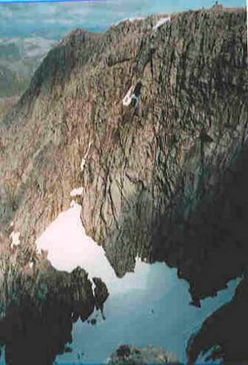
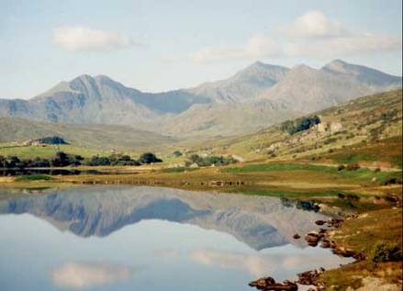
British Peaks – Ben Nevis (1343m) and Snowdonia (1085m)
Not in the same league in terms of height - but just as impressive and challenging to climbers as the changeable weather in mountain environments remains a constant danger.

Slide 13
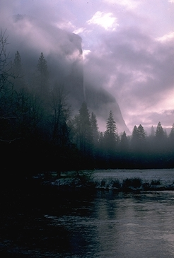
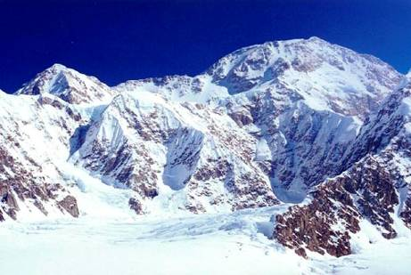
Mountains in the US McKinley(6194m) and El Capitain(2307m)
Part of the Alaskan range, McKinley is the highest mountain in the US. Known more commonly by its native name of ‘Denali’ meaning ‘The Great One’, this Giant snowy mass has 5 glaciers, and a steep southern slope 12 miles long. In the Sierra Nevadas, El Capitain dominates Yosemite Nat.Park and is a 4 day free climb.

Slide 14
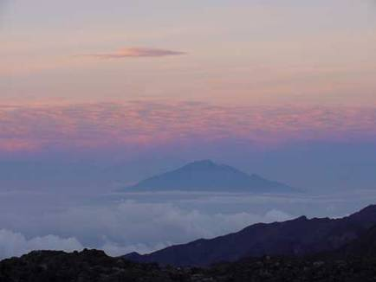
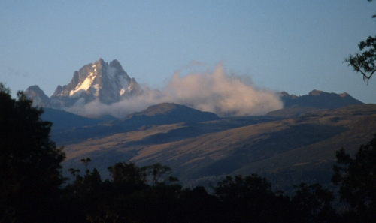
Mountains in Africa – Kilimanjaro (5963m)and Mount Kenya(5199)
Kili is the biggest extinct volcano in the world, and Africa’s highest mountain.
Mt Kenya is also an extinct volcano. Both mountains rise up from the flat plains.
Their sides are covered at lower levels in scrub which is rich in wildlife and vegetation. Elephant, leopard and rhino hide in the scrub, and bamboo and camphor grow along side alpine flowers on the upper slopes.

Slide 15
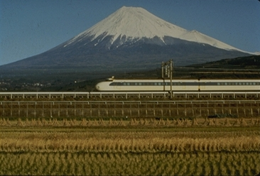
Japan’s highest mountain Mount Fuji (3776m)
What sort of mountain is this ? Look at its shape.
Close to Toyko, this mountain is a centre for winter and summer sports. Sacred to the Shinto and Buddist religions
It was first climbed by a monk in the 7th century. People still climb it today as a form of pilgrimage. There are three temples on the summit.

Slide 16
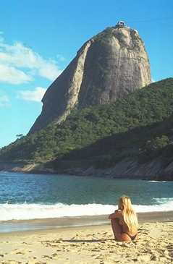
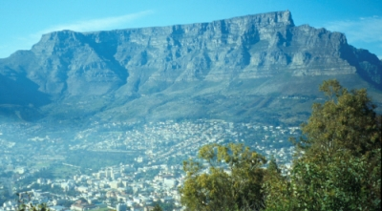
Some funny shaped examples
Known as ‘Sugar Loaf’ and ‘Table’, these mountains show the variety of shapes
That mountains come in, depending on the exact circumstances surrounding
Their creation. Some come into being as a result of tectonic plates crashing
Into each other, some due to plates pushing one under the other, and still others
From plates moving away from each other as we shall see.
Can you tell what might have caused these shapes ?

Slide 17
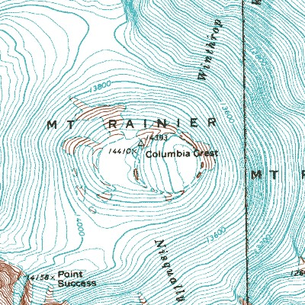
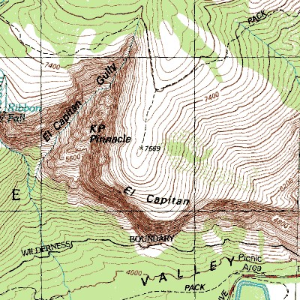
This is what a mountain looks like on a map.
What do you notice about the lines on the map ? Can you read the numbers ?
What do they mean ? Look at an atlas and find a place where the ground is
high. Can you identify a hill or a mountain ?

Slide 18
So – what have we learnt ?
There are mountains all over the world, and they come in all different shapes and sizes.
They often have mystical significance for local people.
Not much grows or survives up high on the mountains given the weather conditions
Mountains have proved to be fascinating to men who wish to scale them despite the obvious dangers.
The creation of Mountains is to do with forces below the earth’s surface
That the temperature at the bottom of the mountain is different from that at the top.
That it is important to preserve these environments as they play a key role in the water cycle, energy creation, and biodiversity.

