Slide 1




Weather

Slide 2
Can you name the weather?

Slide 3
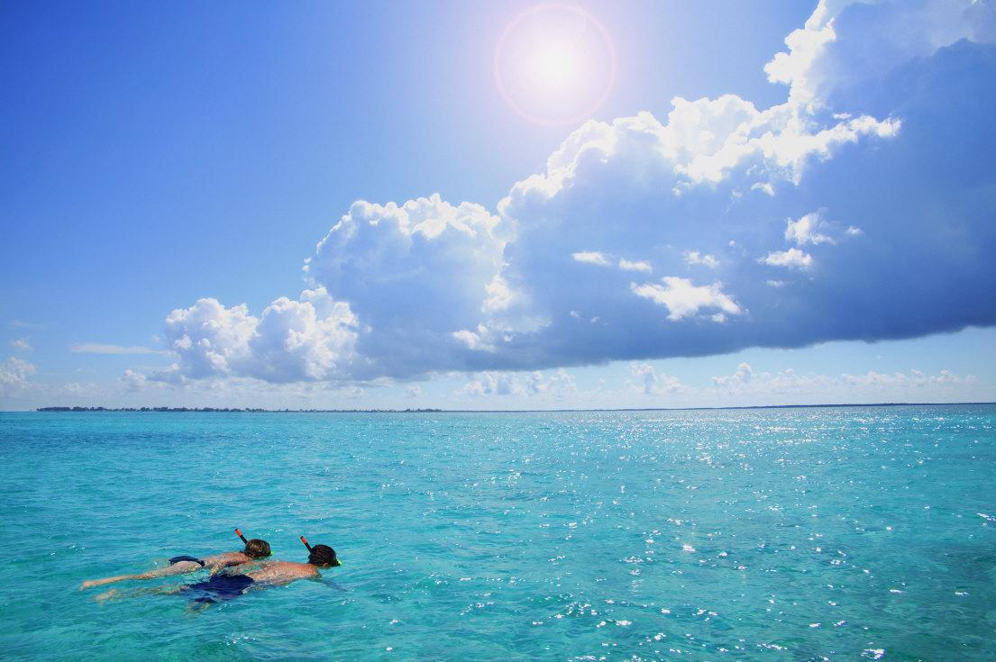
Sunny

Slide 4
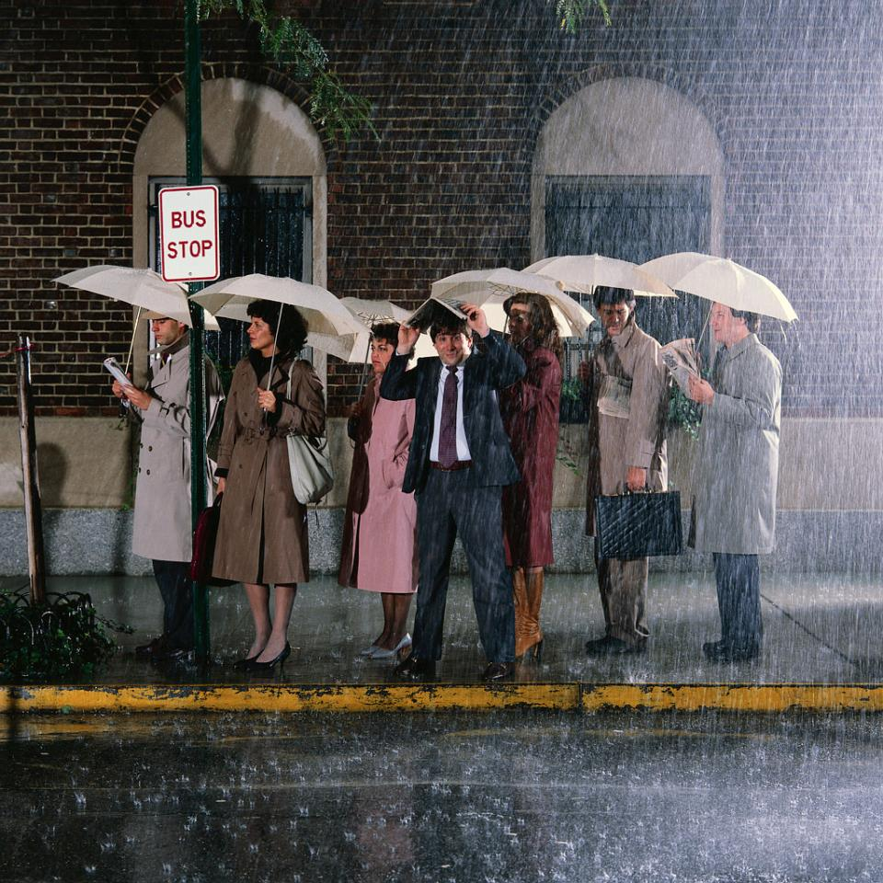
Raining

Slide 5
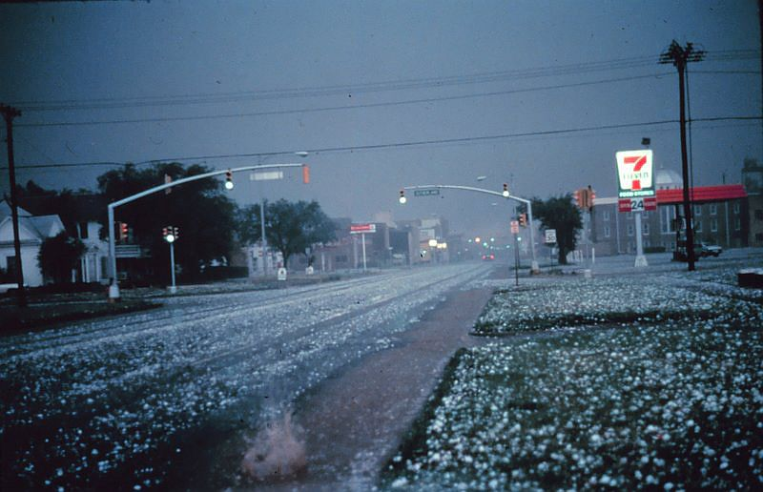
Hailing

Slide 6
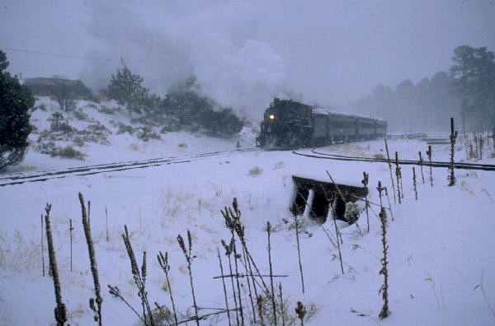
Snowing

Slide 7
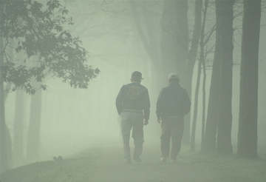
Foggy

Slide 8
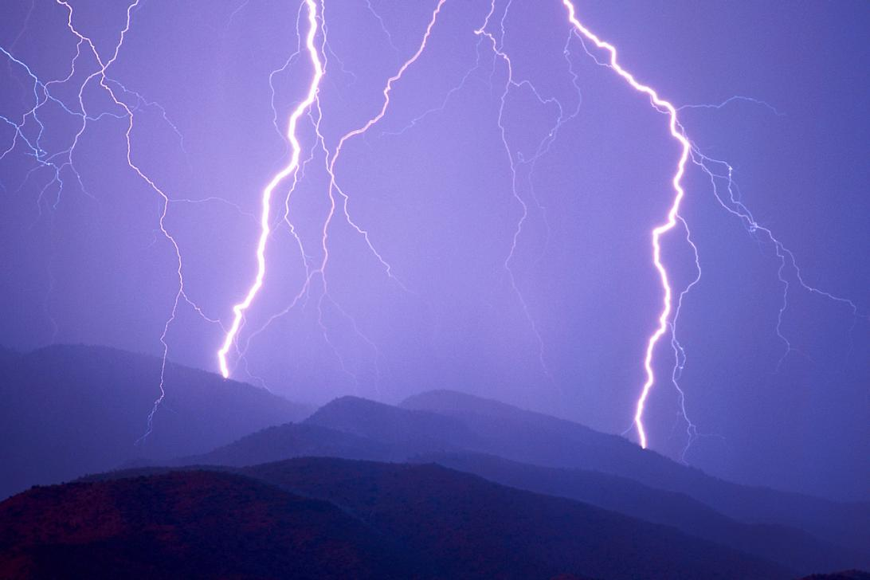
Stormy

Slide 9

Windy

Slide 10

Frosty

Slide 11

Cloudy

