Slide 1
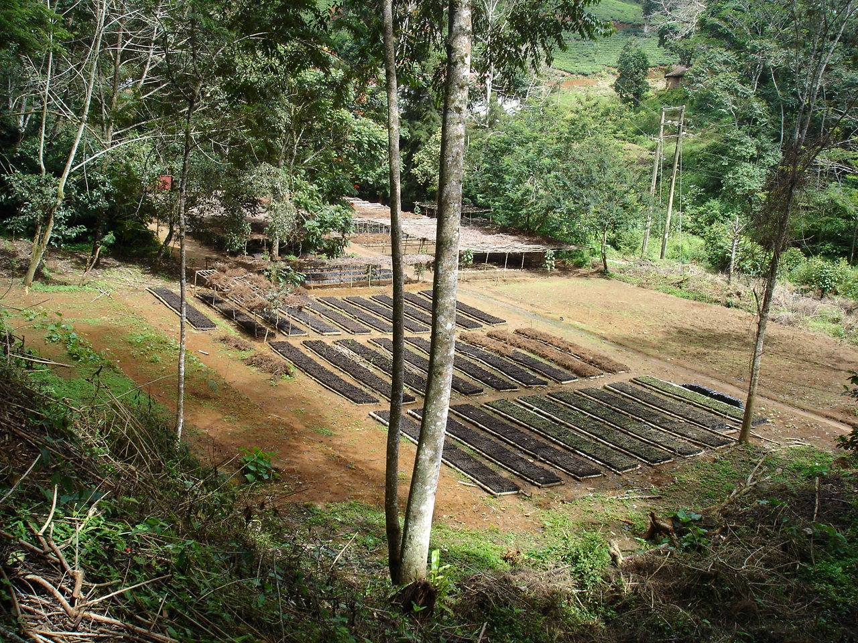
Session 3.1: Nursery production
Moses Munjuga
23rd to 27th October 2006

Slide 2
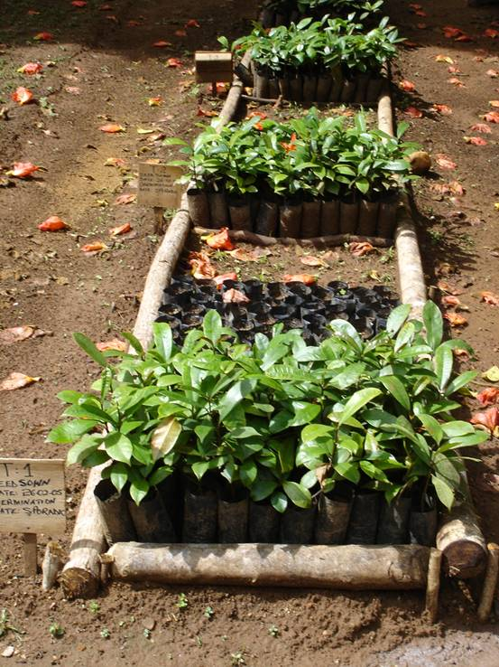
Presentation structure
What is a quality seedling?
Type of nurseries
Good nursery practices (factors to achieve quality seedlings)
Seedling production in individual country
Introduction to seedlings production practical

Slide 3
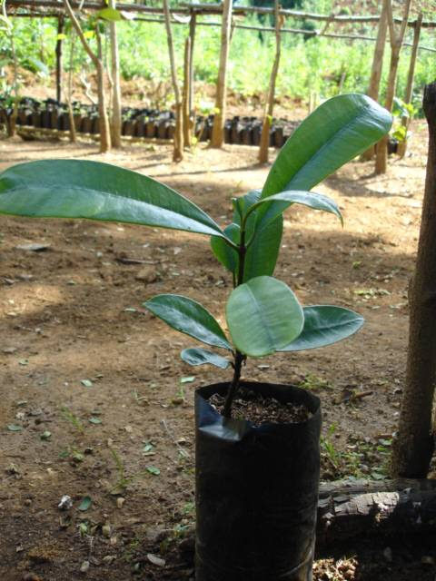
Quality seedlings
Good seedling quality is the basis for tree planting success
Seedlings adapted to the planting site condition
    Bushy site – vigorous shoot
    Dry site – good root system
Seedlings which start growing quickly after transplanting should have:
    Strong rooting system
    Adequate inoculation

Slide 4
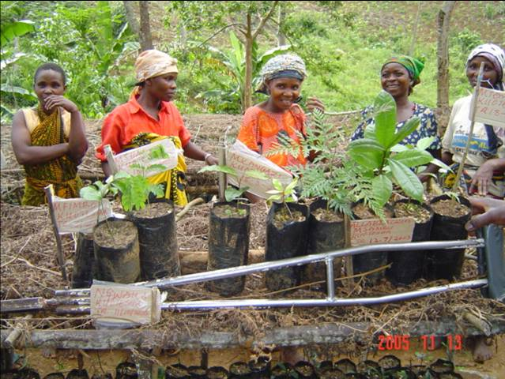
Tree nurseries categories
Nurseries are differentiated by their function and size.
  Individual or private
  Community or group
  Central
  Commercial
  Training

Slide 5
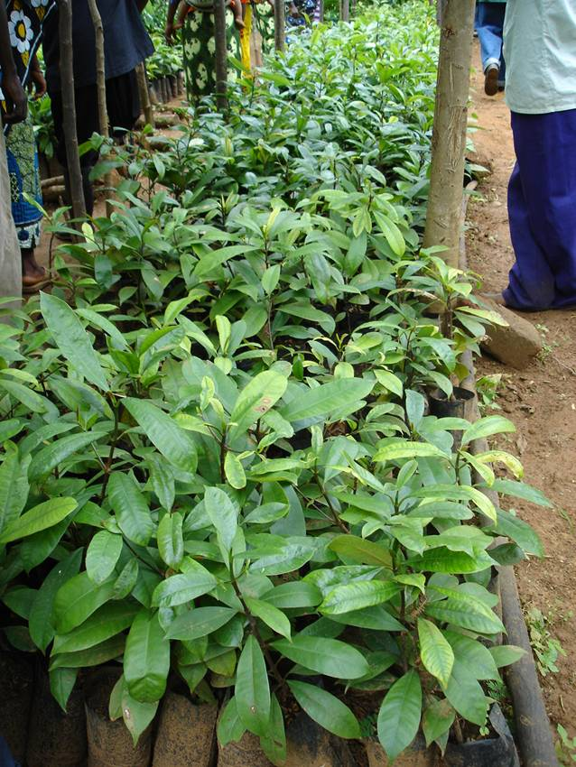
Factors affecting seedling quality
Careful seedling handling
    -pricking out
    -root pruning
    -transport
Containers
    -plastic bags
    -local materials
Optimal substrate
    -porosity
    -waterholding capacity
    -fertility
Appropriate nursery environment
    watering
    Weeding regularly
    Appropriate shading
    Hygiene
    Record keeping

Slide 6
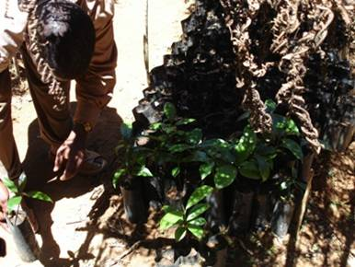
Seedling handling
Seeds are sown in seedbeds but sometimes directly into container
Carefully transplanting or pricking out
Root pruning is necessary
Ensure careful handling when transporting to field
Change the containers if it takes longer time

Slide 7
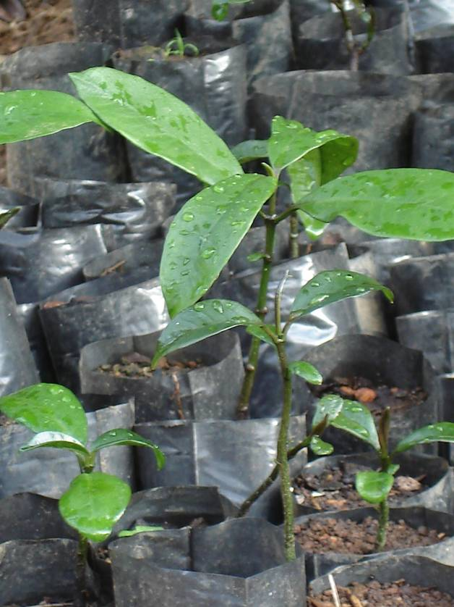
Containers
Plastic or polythene bags
Containers made from local materials
Biodegradable containers should be used

Slide 8
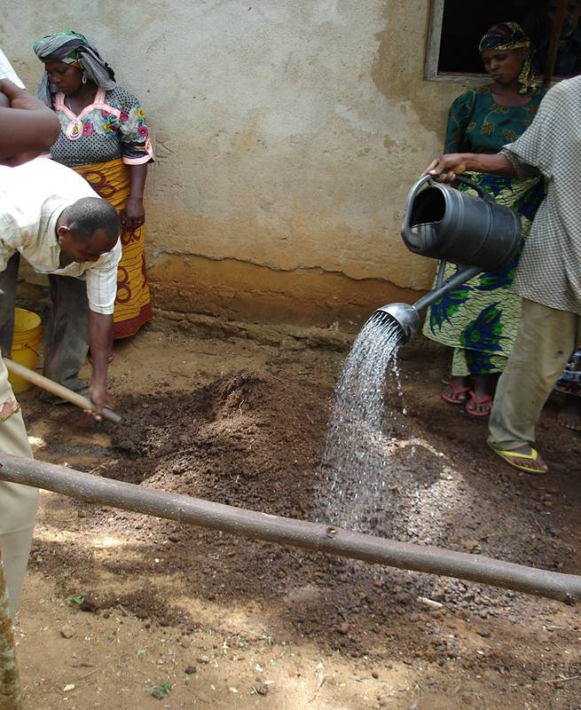
Substrate
Substrate gives the seedling stability and nourishment, therefore necessary for good seedling development
Good waterholding capacity
Porosity (root development)
Fertility (monitor for deficiency)

Slide 9
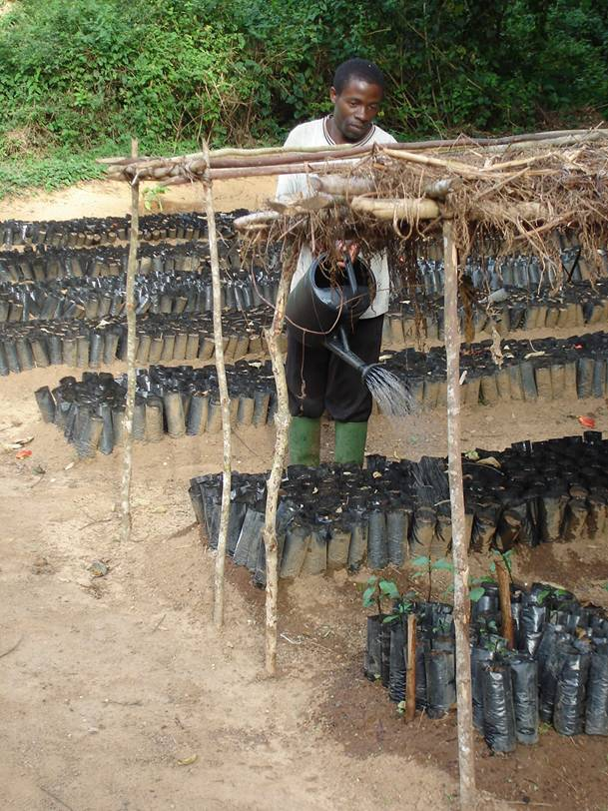
Nursery and plant hygiene
Refers to pest (rodents, insects, birds, etc.) and diseases (fungi, bacteria etc)
Always use new prepared substrate (Cleanliness)
Substrate change
Use pesticides or fungicides in case of attack

Slide 10
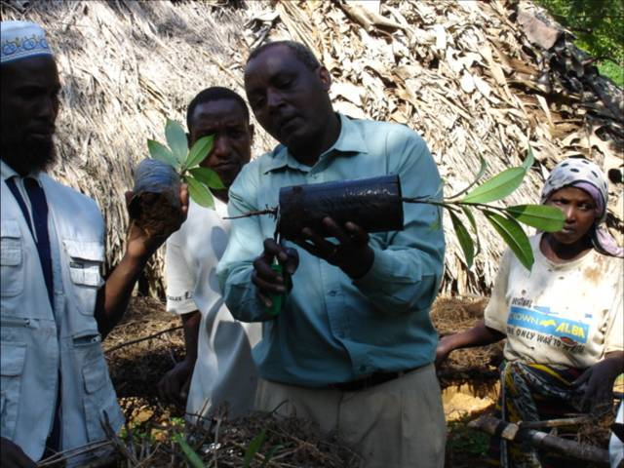
Nursery environments
Root prune seedlings and sometimes shoot prune
Water seedlings regularly
Put shade over seedlings
Weeding
Protect seedlings from animals (fence)
Keep record of all nursery activities

Slide 11
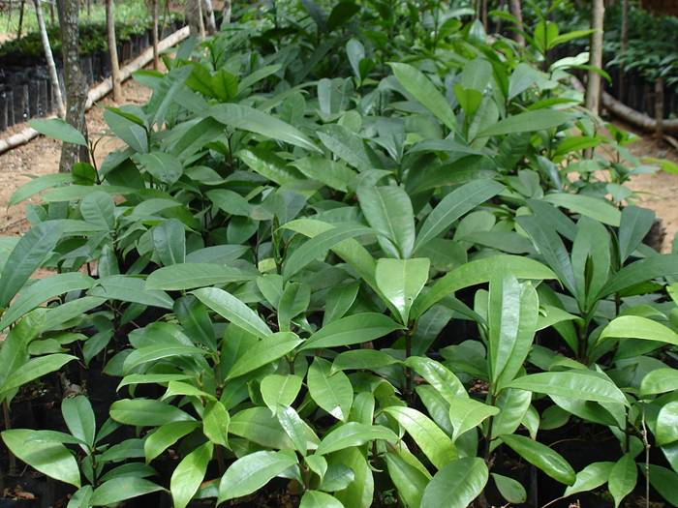
Seedlings production
Cameroon – vegetative propagation and on-station seed research
Ghana – Large scale production, community and central nurseries production. Vegetative approach is being developed
Tanzania- Central and community nurseries production

Slide 12
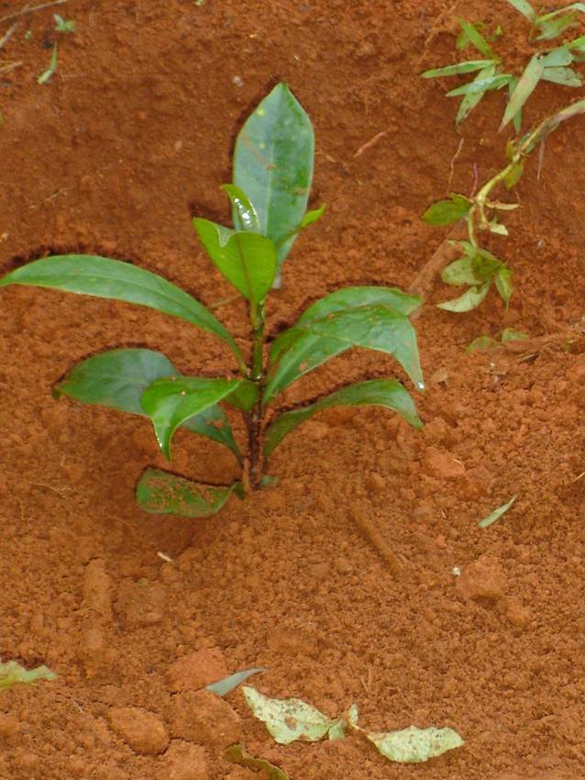
After nursery….
Seedlings from central nursery were planted in genebank in Ghana and Tanzania (two genebank)
Seedlings from community nurseries were planted in on-farm (about 5000 seedlings, in 2006)

Slide 13
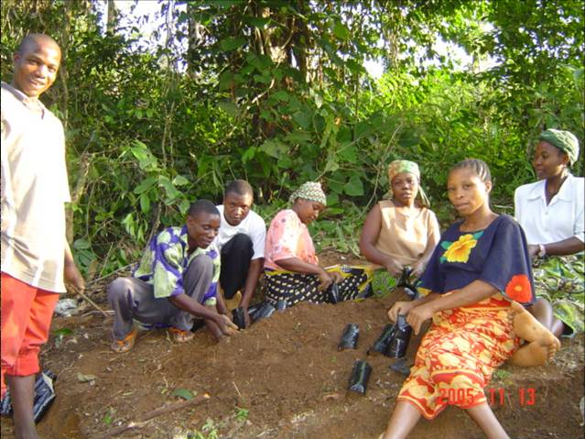
Introduction to seedlings production practical
Mixing substrate
Potting
Pricking out
Root pruning

