Slide 1
Fertilizers & Nutrients
By: Johnny M. Jessup
Agriculture Teacher/FFA Advisor

Slide 2
Essential Plant Nutrients
Macronutrients
Required in relatively large amounts.
Micronutrients
Required in small amounts.
Minor or trace elements.

Slide 3
Macronutrients
Fall into one of three categories:
Non-Mineral Elements
Primary Nutrients
Secondary Nutrients

Slide 4
Non-Mineral Elements
(C) Carbon
(H) Hydrogen
(O) Oxygen

Slide 5
Primary Nutrients
(N) Nitrogen
(P) Phosphorus
(K) Potassium

Slide 6
Secondary Nutrients
(Ca) Calcium
(Mg) Magnesium
(S) Sulfur

Slide 7
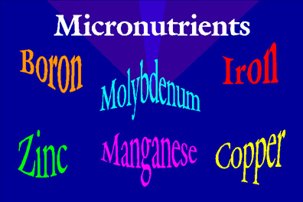
Micronutrients
(Fe) Iron
(Cu) Copper
(Zn) Zinc
(B) Boron
(Mo) Molybdenum
(Mn) Manganese
(Cl) Chlorine

Slide 8
Function & Deficiency Symptoms of Nutrients

Slide 9
Nitrogen
Function
Promotes growth of leaves and stems.
Gives dark green color and improves quality of foliage.
Necessary to develop cell proteins and chlorophyll.

Slide 10
Nitrogen
Deficiency Symptoms
Sick, yellow-green color.
Short stems, small leaves, pale colored leaves and flowers.
Slow and dwarfed plant growth.

Slide 11
Phosphorus
Functions
Stimulates early formation & growth of plants.
Provides for fast & vigorous growth and speeds maturity.
Stimulates flowering & seed development.
Necessary for the enzyme action of many plant processes.

Slide 12
Phosphorus
Deficiency Symptoms
Decrease in growth.
Slow maturity.
Older leaves are purplish color.

Slide 13
Potassium
Functions
Used to form carbohydrates & proteins.
Formation and transfer of starches, sugars, & oils.
Increases disease resistance, vigor, & hardiness.

Slide 14
Potassium
Deficiency Symptoms
Mottled, spotted, streaked or curled leaves.
Scorches, burned, dead leaf tips & margins.

Slide 15
Calcium
Functions
Improves plant vigor.
Influences intake & synthesis of other plant nutrients.
Important part of cell walls.

Slide 16
Calcium
Deficiency Symptoms
Small developing leaves, wrinkled older leaves.
Dead stem tips.

Slide 17
Magnesium
Functions
Influence the intake of other essential nutrients.
Helps make fats.
Assists in translocation of phosphorus & fats.

Slide 18
Magnesium
Deficiency Symptoms
Interveinal chlorosis.
(Yellowing of leaves between green veins)
Leaf tips curl or cup upward.
Slender, weak stems.

Slide 19
Sulfur
Functions
Promotes root growth and vigorous vegetative growth.
Essential to protein formation.

Slide 20
Sulfur
Deficiency Symptoms
Young leaves are light green with lighter color veins.
Yellow leaves and stunted growth.

Slide 21
Iron
Functions
Essential for chlorophyll production.
Helps carry electrons to mix oxygen with other elements.

Slide 22
Iron
Deficiency Symptoms
Mottled & interveinal chlorosis in young leaves.
Stunted growth & slender, short leaves.

Slide 23
Copper
Functions
Helps in the use of iron.
Helps respiration.

Slide 24
Copper
Deficiency Symptoms
Young leaves are small and permanently wilt.
Multiple buds at stem tips.

Slide 25
Zinc
Functions
Plant metabolism.
Helps form growth hormones.
Reproduction.

Slide 26
Zinc
Deficiency Symptoms
Retarded growth between nodes (rosetted)
New leaves are thick & small.
Spotted between veins, discolored veins.

Slide 27
Boron
Functions
Affects water absorption by roots.
Translocation of sugars.

Slide 28
Boron
Deficiency Symptoms
Short, thick stems tips.
Young leaves of terminal buds are light green at base.
Leaves become twisted & die.

Slide 29
Manganese
Functions
Plant metabolism.
Nitrogen transformation.

Slide 30
Manganese
Deficiency Symptoms
Interveinal chlorosis.
Young leaves die.

Slide 31
Molybdenum
Functions
Plant development.
Reproduction.

Slide 32
Molybdenum
Deficiency Symptoms
Stunted growth.
Yellow leaves, upward curling leaves, & leaf margins burn.

Slide 33
Chlorine
Functions
Essential to some plant processes.
Acts in enzyme systems.

Slide 34
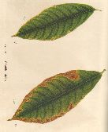
Chlorine
Deficiency Symptoms
Usually more problems with too much chlorine or toxicity than with deficiency.
CHLORINE TOXICITY

Slide 35
Types of Fertilizers

Slide 36
Complete vs. Incomplete
Complete Fertilizers
Contain all 3 primary nutrients of nitrogen, phosphorus, & potassium.
Examples:
10-10-10
15-30-15
20-5-20

Slide 37
Complete vs. Incomplete
Incomplete Fertilizers
DO NOT have all 3 primary nutrients.
Examples:
20-0-0
0-20-0
12-0-44

Slide 38
Organic vs. Inorganic
Organic Fertilizers
Come from plant or animal matter & contain carbon compounds.
Examples:
Urea
Sludge
Animal Tankage

Slide 39
Organic vs. Inorganic
Advantages of Organic Fertilizers
Slow release of nutrients.
Not easily leached from soil.
Add organic components to growing media.

Slide 40
Organic vs. Inorganic
Disadvantages of Organic Fertilizers
Hard to get.
Expensive.
Not sterile.
Low nutrient content.

Slide 41
Organic vs. Inorganic
Inorganic Fertilizers
Come from sources other than animals or plants….
Chemical products.

Slide 42
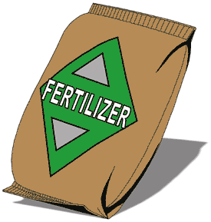
Organic vs. Inorganic
Advantages of Inorganic Fertilizers
Can make desired ratio of nutrients.
Lower cost.
Easy to get

Slide 43
Organic vs. Inorganic
Disadvantages of Inorganic Fertilizers
No organic material.
Possible chemical building up in growing media.

Slide 44
Soluble vs. Insoluble
Soluble Fertilizer
Dissolves in water & are applied as a liquid solution.
Advantages
Can fertilizer through the irrigation water in a process called fertigation.

Slide 45
Soluble vs. Insoluble
Insoluble Fertilizer
Includes granular & slow release fertilizers applied to the growing media.

Slide 46
Soluble vs. Insoluble
Granular Fertilizer
Relatively inexpensive
Easy to find
Slow Release Fertilizer
More expensive than granular because it is coated.
Gives a more uniform release of nutrients over time period.

Slide 47
Fertilizer Analysis & Ratio
Analysis
Expresses the percent by weight of nitrogen, phosphorus, & potassium.
Ratio
Is a comparison of primary nutrients
10-10-10 = 1:1:1
24- 8 -16 = 3:1:2

Slide 48
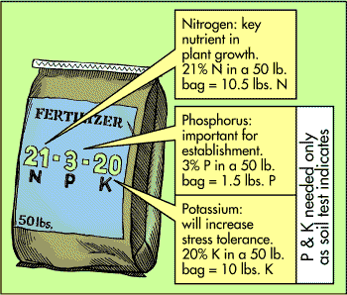
Fertilizer Analysis

Slide 49
Choosing a Fertilizer

Slide 50
Methods of Applying Fertilizers

Slide 51
General Rules
Method used should be….
Practical
Effective
Cost Efficient
Method used affects nutrient availability for plant use.
Fertilizer must be dissolved and reach plant roots.

Slide 52
Banding
Placing a band of fertilizer about 2 inches to the sides & about 2 inches below seed depth.
Do NOT place below seeds because fertilizer will burn roots.

Slide 53
Sidedressing
Placing a band of fertilizer near the soil surface and to the sides after seedlings emerge from the soil.

Slide 54
Topdressing
Mixing fertilizer uniformly into the top one to two inches of growing media around the plant.

Slide 55
Perforating
Placing fertilizer in 12 – 18” holes drilled 18 – 24” around the canopy drip line of fruit trees.
Cover the holes & the fertilizer slowly dissolves.

Slide 56
Broadcasting
Spreading fertilizer to cover the entire production area.

Slide 57
Fertigation
Incorporating water-soluble fertilizer into the irrigation system of greenhouse and nursery crops.
Concentrated solutions usually pass through proportioners or injectors to dilute to the correct ratio.

Slide 58
Types of Fertigation
Venturi-Type
Simple & inexpensive
Less accurate
Depends on water pressure in the hose & in the smaller tube to proportion.
Example:
Hozon

Slide 59
Types of Fertigation
Positive-Displacement
Physically inject & mix specific amounts of concentrated solution & water.
More expensive
Very accurate
Examples:
Commander Proportioners
Smith Injectors

Slide 60
Foliar Spraying
Spraying micronutrients in a solution directly on the plant leaves.
Used to quickly correct nutrient deficiencies, but….
If fertilizer concentration is too high, leaf burning will occur.

Slide 61
Designed By:
Johnny M. Jessup; FFA Advisor
Hobbton High School

