Slide 1
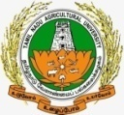
Organic farming
Next
End

Slide 2
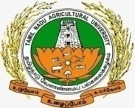
organic farming
Organic farming is a system which avoids or largely excludes the use of synthetic inputs (such as fertilizers, pesticides, hormones, feed additives etc) and to the maximum extent feasible rely upon crop rotations, crop residues, animal manures, off-farm organic waste, mineral grade rock additives and biological system of nutrient mobilization and plant protection.
Previous
Next
End

Slide 3
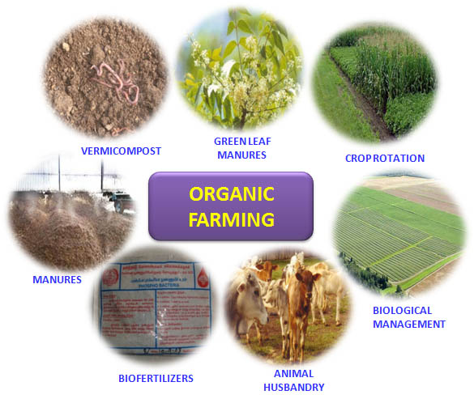
Organic farming
Previous
Next
End

Slide 4
Organic farming
Need
Increase in population make compulsion to stabilize agricultural production, but to, increase it further, in sustainable manner.
Natural balance needs to be maintained at all cost for existence of life and property.
Agrochemicals which are produced from fossil fuel and are not renewable and are diminishing in availability.
It may also cost heavily on our foreign exchange in future.
Previous
Next
End

Slide 5
organic farming
Key characteristics
Protecting the long term fertility of soils by maintaining organic matter levels, encouraging soil biological activity and careful mechanical intervention.
Providing crop nutrients indirectly using relatively insoluble nutrient sources which are made available to the plant by the action of soil micro-organisms.
Previous
Next
End

Slide 6
organic farming
Key characteristics
Nitrogen self-sufficiency through the use of legumes and biological nitrogen fixation, as well as effective recycling of organic materials including crop residues and livestock manures
Weed, disease and pest control relying primarily on crop rotations, natural predators, diversity, organic manuring, resistant varieties and limited (preferably minimal) thermal, biological and chemical intervention.
Previous
Next
End

Slide 7
organic farming
Key characteristics
The extensive management of livestock, paying full regard to their evolutionary adaptations, behavioral needs and animal welfare issues with respect to nutrition, housing, health, breeding and rearing.
Careful attention to the impact of the farming system on the wider environment and the conservation of wildlife and natural habitats.
Previous
Next
End

Slide 8
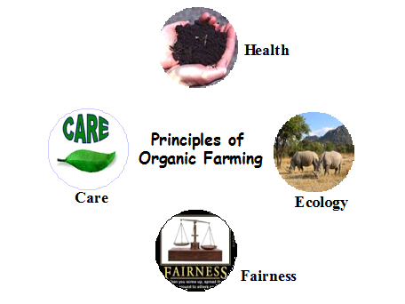
ORGANIC FARMING PRINCIPLE
Previous
Next
End

Slide 9
organic farming
Four principles
1. Principle of health
Organic Agriculture should sustain and enhance the health of soil, plant, animal, human and planet as one and indivisible
Healthy soils produce healthy crops that foster the health of animals and people.
Health is the wholeness and integrity of living systems.
The role of organic agriculture, whether in farming, processing, distribution, or consumption, is to sustain and enhance the health of ecosystems and organisms from the smallest in the soil to human beings.
Previous
Next
End

Slide 10
organic farming
2. Principle of ecology
Organic Agriculture should be based on living ecological systems and cycles, work with them, emulate them and help sustain them.
This principle roots organic agriculture within living ecological systems.
It states that production is to be based on ecological processes, and recycling
Nourishment and well-being are achieved through the ecology of the specific production environment.
Organic management must be adapted to local conditions, ecology, culture and scale.
Previous
Next
End

Slide 11
organic farming
Principle of ecology
Inputs should be reduced by reuse, recycling and efficient management of materials and energy in order to maintain and improve environmental quality and conserve resources
Organic agriculture should attain ecological balance through the design of farming systems, establishment of habitats and maintenance of genetic and agricultural diversity.
Previous
Next
End

Slide 12
organic farming
3. Principle of fairness
Organic Agriculture should build on relationships that ensure fairness with regard to the common environment and life opportunities.
This principle emphasizes that those involved in organic agriculture should conduct human relationships in a manner that ensures fairness at all levels and to all parties - farmers, workers, processors, distributors, traders and consumers
Previous
Next
End

Slide 13
organic farming
Principle of fairness
It aims to produce a sufficient supply of good quality food and other products.
Natural and environmental resources that are used for production and consumption should be managed in a way that is socially and ecologically just and should be held in trust for future generations
Fairness requires systems of production, distribution and trade that are open and equitable and account for real environmental and social costs.
Previous
Next
End

Slide 14
organic farming
4. Principle of care
Organic Agriculture should be managed in a precautionary and responsible manner to protect the health and well-being of current and future generations and the environment.
Organic agriculture is a living and dynamic system that responds to internal and external demands and conditions.
This principle states that precaution and responsibility are the key concerns in management, development and technology choices in organic agriculture.
Previous
Next
End

Slide 15
organic farming
Basic Steps of Organic Farming
Organic farming approach involves following five principles:
1. Conversion of land from conventional management to organic management
2. Management of the entire surrounding system to ensure biodiversity and sustainability of the system
3. Crop production with the use of alternative sources of nutrients such as crop rotation, residue management, organic manures and biological inputs.
4. Management of weeds and pests by better management practices, physical and cultural means and by biological control system
5. Maintenance of live stock in tandem with organic concept and make them an integral part of the entire system
End

