Slide 1
Diverse Societies in Africa
African peoples develop diverse societies as they
adapt to varied environments.

Slide 2
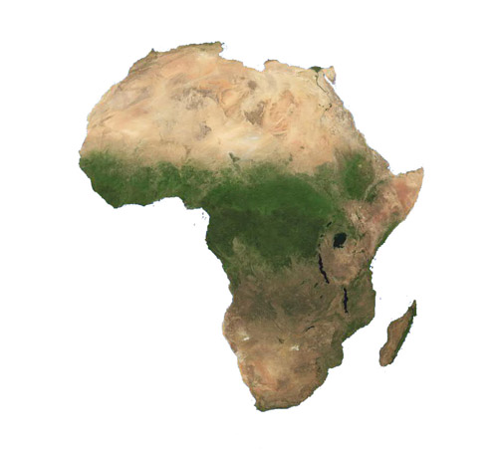

Slide 3
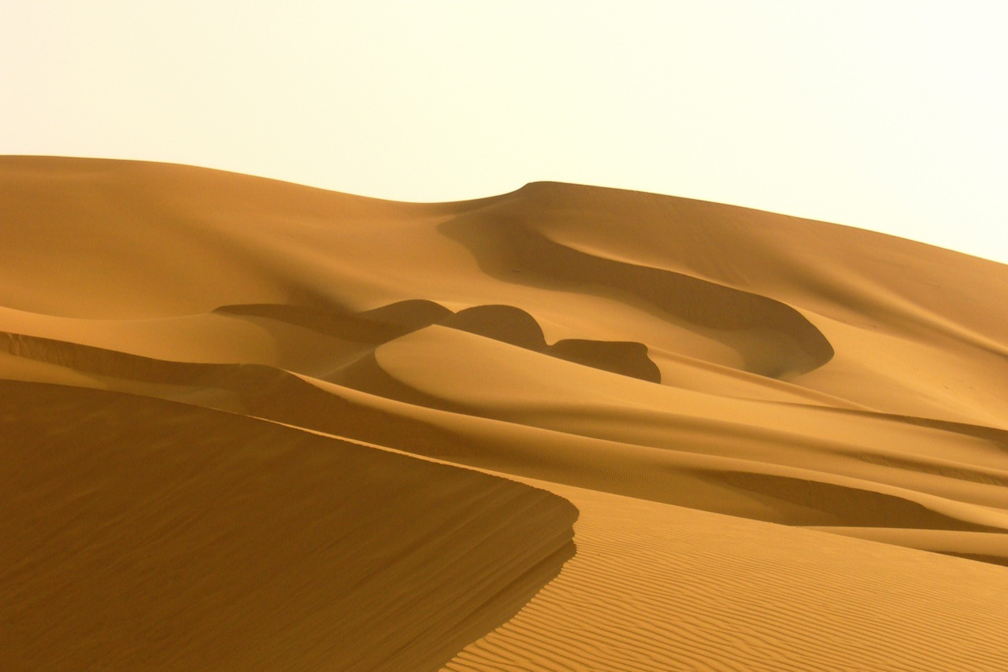

Slide 4
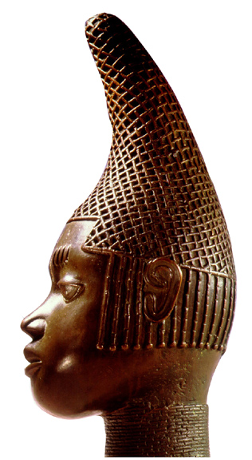
Societies and Empires of Africa,
800–1500
Empires develop in northern, western, and southern Africa. Trade helps spread Islam and makes some African empires very wealthy.
Idia, first Queen Mother of Benin and of Oba Esigie, king of Benin. Sculpture (16th century), Benin.
NEXT

Slide 5
North and Central African
Societies
North and central Africa develop hunting-gathering
societies, stateless societies, and Muslim states.
NEXT

Slide 6
Stateless Societies
Lineages
• Some societies group people in lineages—those with common ancestor
• Members of a lineage have strong loyalties to one another
• In some African societies, lineage groups take the place of rulers
• These stateless societies balance power among lineages
• Stateless societies—no centralized system of power
Continued . . .

Slide 7
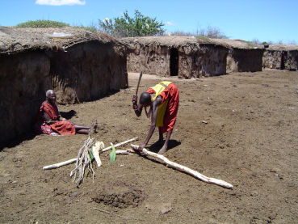
continued Stateless Societies
Tracing Family Descent
• Some societies are patrilineal—trace ancestry
through fathers
• Others are matrilineal—trace ancestry through
mothers
• Lineage determines how possessions are inherited
Age-Set System
• Age set—group of people born about same time
who form close ties
• Age sets go through life stages together, such as
warrior or elder
• Ceremonies mark the passage to each new stage

Slide 8
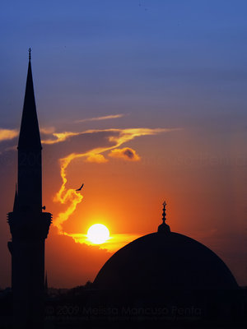
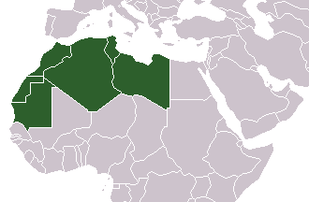
Muslim States
North Africa
• Starting in 630s, Muslims conquer North Africa
• Western part—Libya, Tunisia, Algeria, and Morocco—called Maghrib
• Many Africans convert to Islam; religious scholars advise rulers
Continued . . .

Slide 9
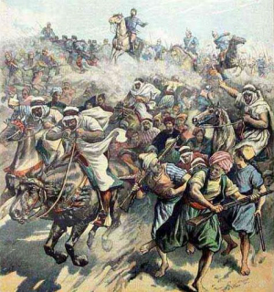
continued Muslim States
Islamic Law
• Islamic law brings order to Muslim states, especially North Africa
• Original inhabitants of North Africa are the Berbers
• Berbers convert to Islam but maintain their own
culture
• The Almoravids and Almohads, two Berber groups,
form empires
Continued . . .

Slide 10
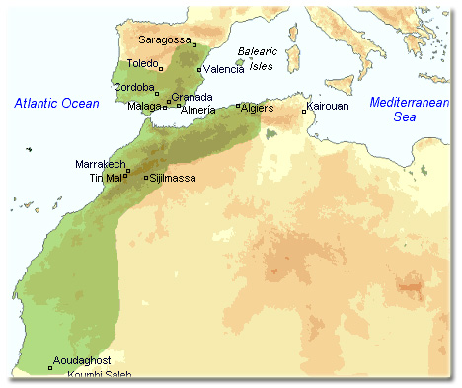
continued Muslim States
Almoravid Reformers
• In 1000s, devout Berber Muslims make hajj,
pilgrimage, to Mecca
• Muslim scholar founds Almoravids—strict religious group
• Around 1050, Almoravids begin to spread Islam
through conquest
• They conquer southern Ghana and Spain, where
they are called Moors
Continued . . .

Slide 11
continued Muslim States
Almohads Take Over
• In mid 1100s, Almohads—group of Berber
Muslims—overthrow Almoravids
• Almohads strictly obey teachings of Qur’an and
Islamic law
• By 1148 they control most of Morocco, keep
Marrakech as their capital
• Almohad Empire lasts 100 years; unites Maghrib
under one rule
African Societies, 800–1500
• From 800 to 1500 there are a variety of African
socities
- hunter-gatherers
- stateless societies
- Muslim states

Slide 12
West African Civilizations
West Africa contains several rich and powerful states, including Ghana, Mali, and Songhai.

Slide 13
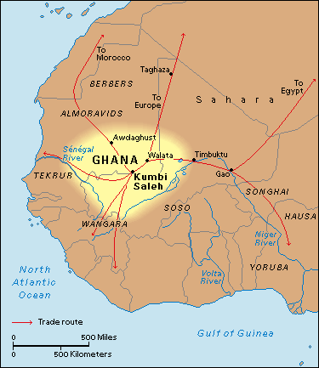
West African Civilizations
Empire of Ghana
Growing Trade in Ghana
• In 200s, Berbers begin using camels to cross Sahara for trade
• Muslims use word ghana “chief” to refer to people of that land
• By 700, trade is making people rich in the kingdom
Ghana
Gold-Salt Trade
• Gold mined in forests south of Sahara; traded to
north
• Salt mined from Sahara and carried to West Africa
• Ghana provides protection, taxes trade, and ensures fairness
Continued . . .

Slide 14
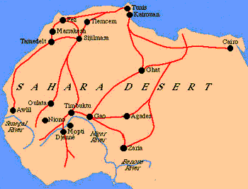
continued Empire of Ghana
Land of Gold
• By 800, king of Ghana rules an empire and taxes surrounding kings
• Only king can own gold nuggets; this keeps prices high
• King commands army, acts as chief judge and religious leader
Islamic Influences
• Islam spreads through region south of the Sahara
through trade
• In 1000s, Ghana’s rulers convert to Islam and take
Islamic advisers
• Ghana falls in 1076 to Almoravid conquest and never rises again

Slide 15
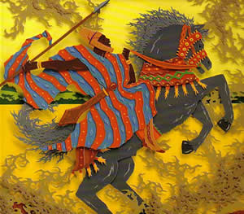
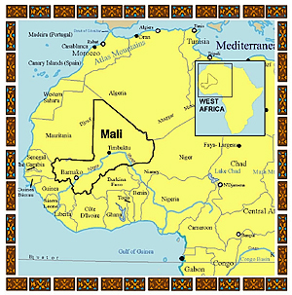
Empire of Mali
Rise of Mali
• By 1235, Ghana replaced by Mali—another kingdom based on gold trade
• Mali becomes wealthy as the gold trade routes shift eastward
Sundiata Conquers an Empire
• Sundiata becomes emperor of Mali by overthrowing unpopular ruler
• Conquers Ghana and cities of Kumbi and Walata
• Reestablishes the gold-salt trade and encourages
agriculture
Continued . . .

Slide 16
History In Music Lyrics
I got to 'pologize to Mos and Kweli (probably)
But is it cool to rap about gold
If I told the world I copped it from Ghana and Mali?
-Kanye West (Breath in Breath Out)

Slide 17
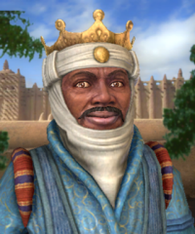
continued Empire of Mali
Mansa Musa Expands Mali
• Some later rulers become Muslim
• Most famous is Mansa Musa—rules Mali from 1312–1332
• Mansa Musa was skilled military leader and fair ruler
• After returning from hajj, he builds mosques in Timbuktu and Gao
Travels of Ibn Battuta
• In 1352, Ibn Battuta—Muslim scholar and traveler— visits Mali
• By 1400, Mali begins to decline

Slide 18
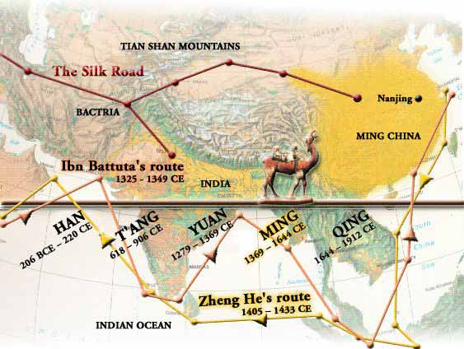

Slide 19
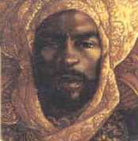
Empire of Songhai
Songhai
• Songhai—people east of Mali, control gold trade moving farther east
Sunni Ali, a Conquering Hero
• In 1464, Sunni Ali begins rule; captures cities of
Timbuktu, Djenné
Continued . . .

Slide 20
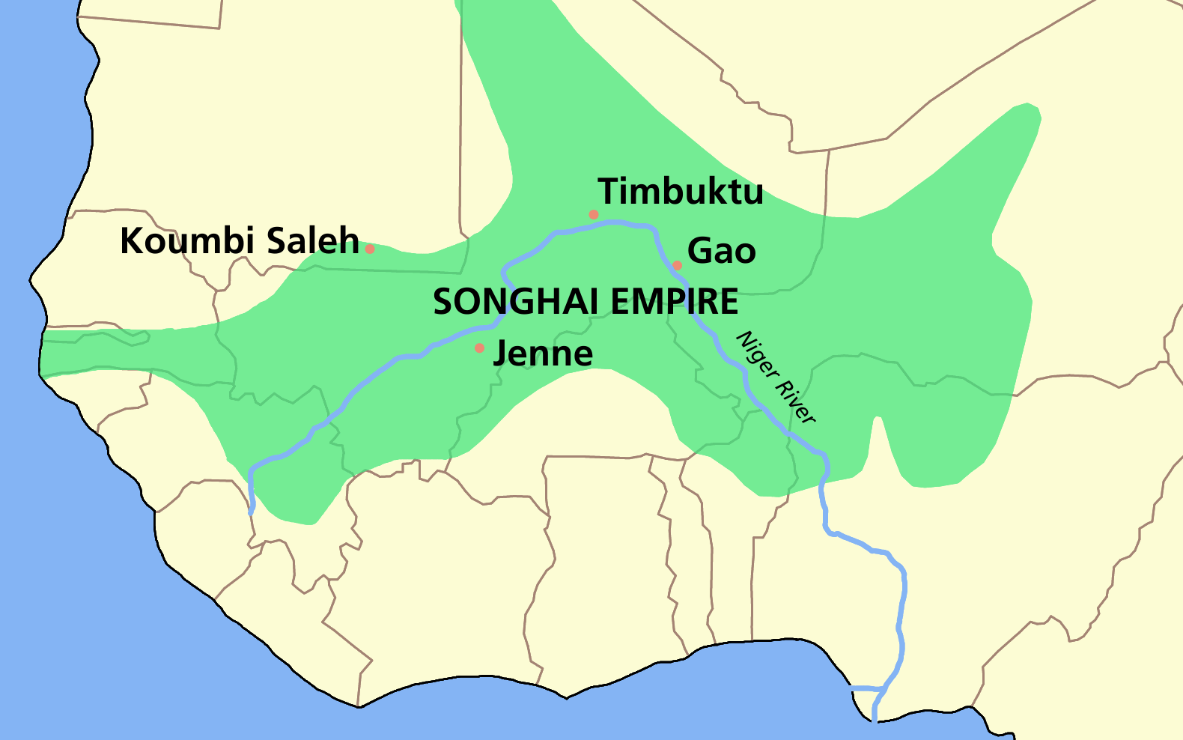
continued Empire of Songhai
Askia Muhammad Governs Well
• Sunni Ali’s son overthrown by Askia Muhammad,
devout Muslim
• Rules for 37 years; appoints ministers and governs
well
• Songhai Empire falls in 1591 to Moroccan invaders
with cannons
• Collapse of empire ends 1,000-year period of West
African empires

Slide 21
Eastern City-States and
Southern Empires
African city-states and empires gain wealth through developing and trading resources.

Slide 22
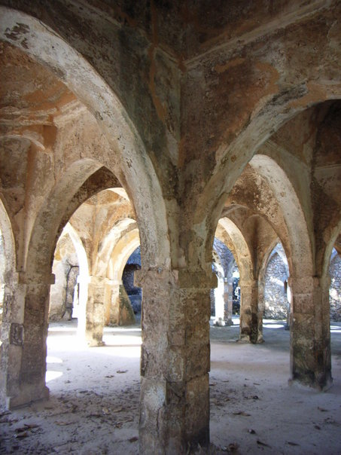
Eastern City-States and
Southern Empires
East Coast Trade Cities
Trade Builds Cities
• Seaports thrive on trade from Persia, Arabia, and
India
• New language arises—Swahili—blending Arabic
and Bantu languages
• By 1300, over 35 trading seaport cities grow wealthy
The City-State of Kilwa
• Kilwa controls trade from southern Africa to India due to location
• Seizes Sofala, port city that controls gold mines
Portuguese Conquest
• Starting in 1488, Portuguese conquer Kilwa,
Mombasa, and Sofala

Slide 23
Islamic Influences
Islam in East Africa
• Muslim merchants spread Islam as they trade on eastern coast
• Most cities governed by a Muslim sultan and officials
• Most people in the region follow traditional religions
Enslavement of Africans
• Enslaved Africans sold in Arabia, Persia, and India
• Trade in slaves fairly small, though steady
• Increases drastically in the 1700s

Slide 24
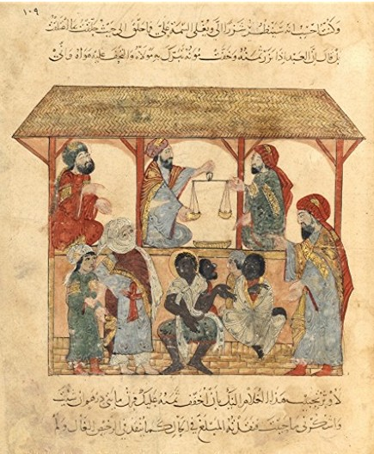

Slide 25
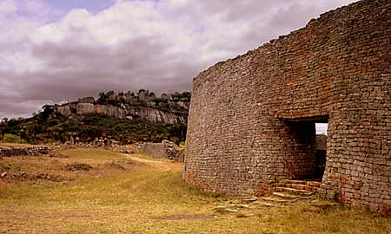
Southern Africa and Great Zimbabwe
A New City
• Shona build Great Zimbabwe—southeastern empire based on gold trade
Great Zimbabwe
• Shona farm and raise cattle between Zambezi and
Limpopo rivers
• After 1000, Great Zimbabwe controls gold trade
routes to Sofala
• Leaders gain wealth by taxing traders, chiefs
• Abandoned by 1450 for unknown reasons
• Ruins of Great Zimbabwe discovered in 1871

Slide 26
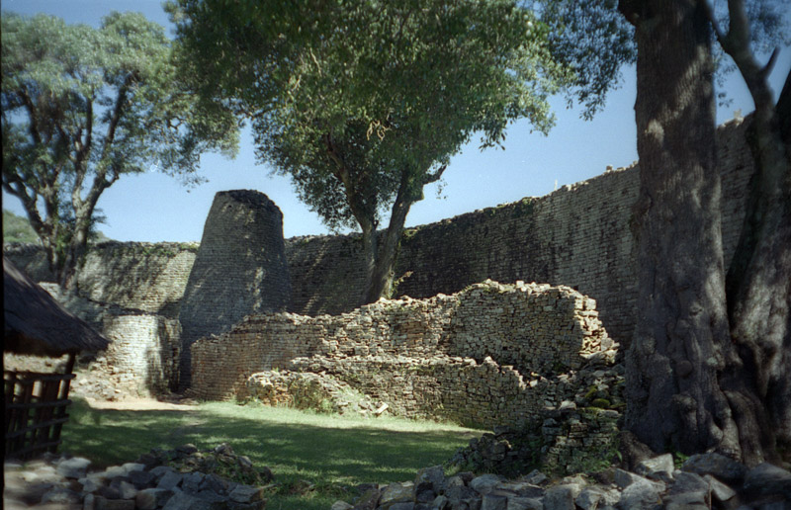

Slide 27
The Mutapa Empire
Mutota
• Mutota—Shona who leaves Great Zimbabwe and founds a new state
• Mutota’s army dominates northern Shona people, who pay him tribute
Mutapa Rulers
• The northern Shona call their rulers mwene mutapa or “conqueror”
• Mutapa—name for African empire that conquers
Zimbabwe
• By 1480 Matope, Mutota’s son held large area
inland and along coast
• Gained wealth by mining gold

Slide 28
