Slide 1
(Children are given coloured cards to hold up to indicate answer)
sieving
melting
dissolving
filtering

Slide 2
Using a tea bag
sieving
melting
dissolving
filtering

Slide 3
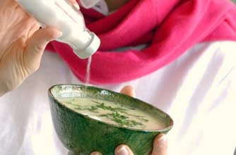
Adding salt to cooking
sieving
melting
dissolving
filtering

Slide 4
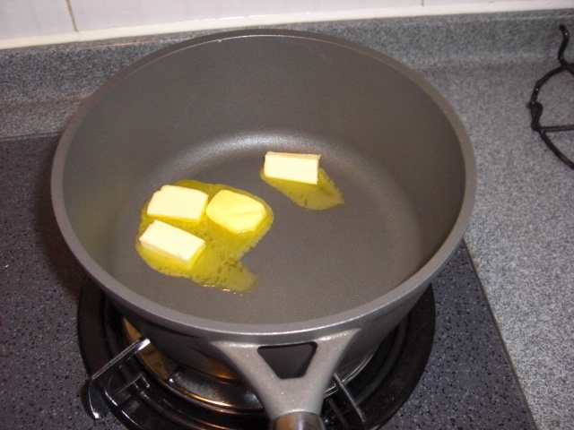
Warming fat in a pan
sieving
melting
dissolving
filtering

Slide 5
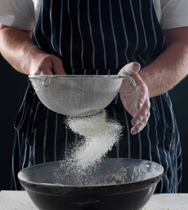
Getting lumps out of flour
sieving
melting
dissolving
filtering

Slide 6
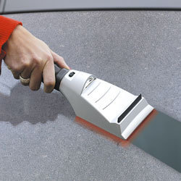
Warming a frosted windscreen
sieving
melting
dissolving
filtering

Slide 7
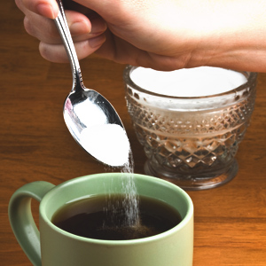
Putting sugar in tea
sieving
melting
dissolving
filtering

Slide 8
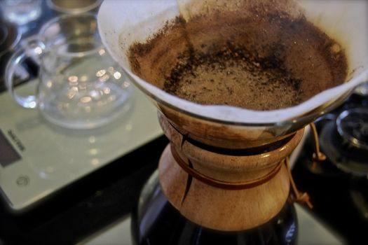
Making coffee in a jug
sieving
melting
dissolving
filtering

Slide 9
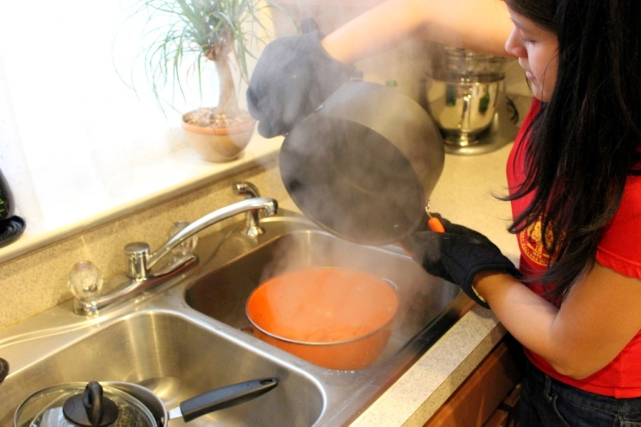
Draining vegetables
sieving
melting
dissolving
filtering

