Slide 1
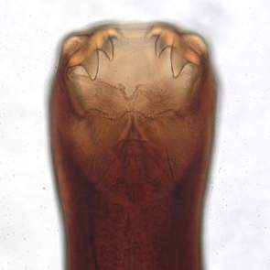
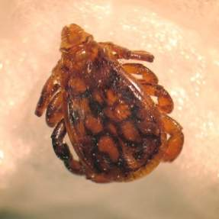
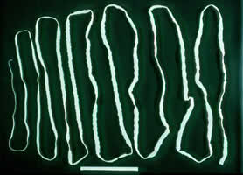
Parasites
PEER Program
College of Veterinary Medicine and Biomedical Sciences
Texas A&M University
Notes:
This presentation was initially developed by Mary Dillenbeck, 3rd Year veterinary medical student at Texas A&M University.

Slide 2
What is a Parasite?
Organism that lives within or upon a different host species and may cause harm to the host
Notes:
Ask students for their definitions, then give this one

Slide 3
Parasite Life Cycle
Development
Contact
with host
Gaining
A suitable
niche
Survival
In the
host
Reproduction
Escape
From host
Notes:
Point out that the green arrows show the general idea of a parasite life cycle and the red arrows show heartworms as a specific example

Slide 4
Parasitic Life Cycle
Why is there a stage in the cycle when the host is abandoned.
Notes:
The adults typically do NOT leave the host. But their products of reproduction (like eggs) must leave the host so that the parasites can spread to other hosts.

Slide 5
Parasite Intermediate Hosts
Why do so many parasite species need an intermediate host?
Notes:
When young parasites are maturing (after hatching from eggs, for example), they are vulnerable to hazards in the environment. They also need nurture and feeding, which intermediate hosts can provide.

Slide 6
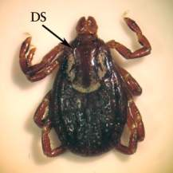
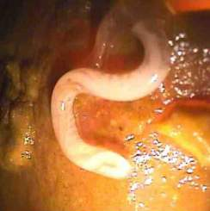
Types of Parasites
Ectoparasites
  Live on the outside or skin of the host
  Usually insects or arachnids (ticks, mites, or spiders)
Endoparasites
  Parasites found within the body of the host
  Can be in blood, tissue, or gastro-intestinal tract
  Nematodes, Trematodes, Cestodes and Protozoa

Slide 7
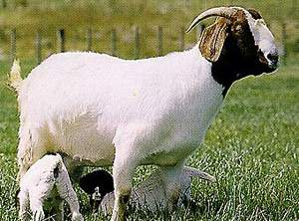

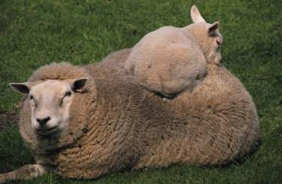

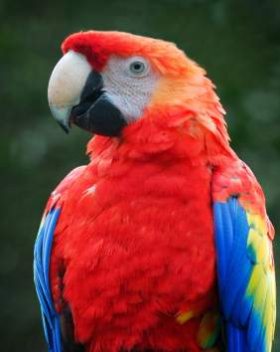
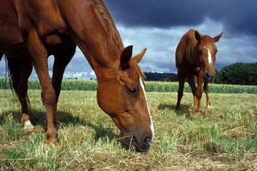
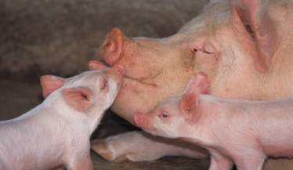
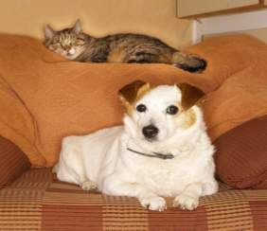
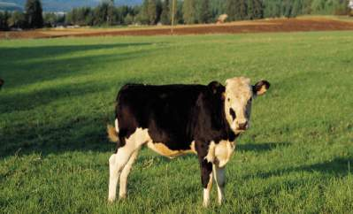
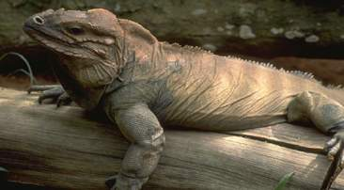
Who Gets Parasites?

Slide 8
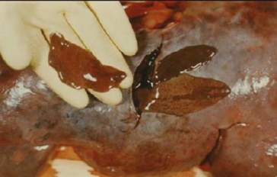
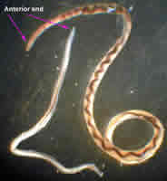
Ruminants
Biting Flies
Liver Flukes
  Migrate through the liver
Barber’s Pole Worm (Haemonchus)
  Nematode commonly found in sheep and goat small intestines
Notes:
Here and for next few slides, this is a good time to pass around jars of preserved parasites.

Slide 9
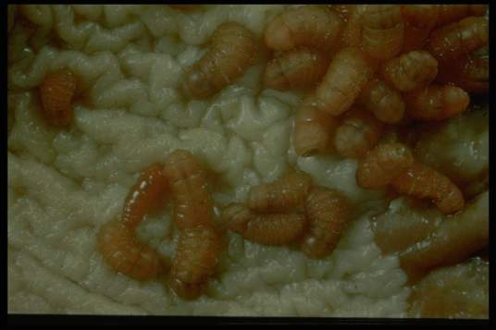
Horses
70+ species of parasites
Horse Bots
  Fly larvae that live in the stomach of horses
EPM-Equine Protozoal Myelitis (Sarcocystis neurona)
  Protozoa which lives in the nervous system
Bloodworms (Stongylus)
  Nematode that lives in the large intestines
Bot fly larvae in a horse stomach

Slide 10
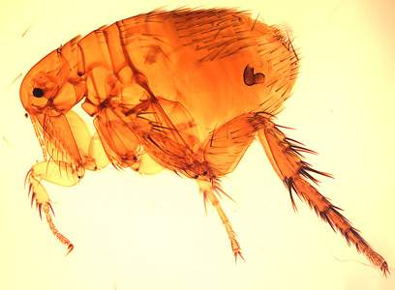
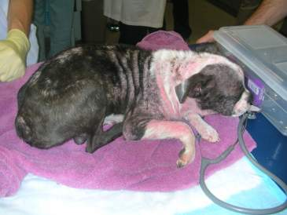
Dogs & Cats
Fleas
  Found on the skin of the dog or cat
Tapeworms
  Flatworm found in the large intestines
Mange Mites
  Found on or just below the surface of the skin
Heartworms
  Transmitted in blood by mosquitoes
Notes:
The bottom picture is a dog with mange.

Slide 11
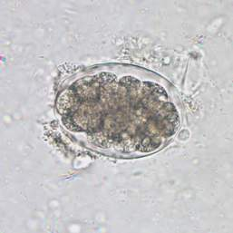
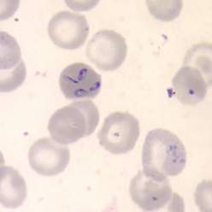
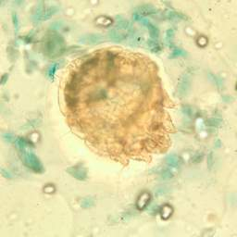
Diagnosing Parasite Infection
Direct observation
Blood antigen tests
Direct blood smears
Skin scraping
Fecal exam
Biopsy of tissues
Notes:
Pictures right to left hook worm egg on a fecal float, babesia on a blood smear, and sarcoptic mange on a skin scraping. If available bring in a heartworm or giardia test to show the students.

Slide 12

Why Do Parasites Matter
Disease and Death
Zoonotic Potential
Production Loss

Slide 13
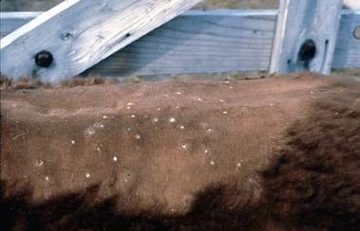
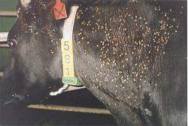
Production Loss
Major importance in large animals
Cause annoyance= poor growth and weight loss
Blood loss: anemia
Decrease intestinal absorption, poor growth & weight loss
Damage the hide or hair of the animal
Cattle Grubs
Horn Flies

Slide 14
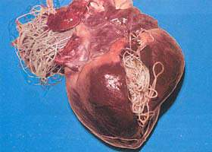
Blood Related Disease and Death
Cause major blood lose due to feeding
  Biting flies can kill an adult cow through blood loss
Blood parasites can cause heart failure
  Heart worms in dogs can cause heart disease
Notes:
Good time to pass around a dog heart with heartworms for the students to see why this could kill a dog

Slide 15
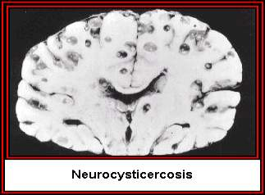
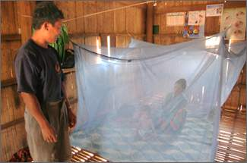
Disease and Death
Parasites in the nervous system can cause severe signs and potential death
The human parasite malaria causes more than 1 million deaths per year and is the #1 killer of people in the world
Notes:
Seeing the brain may remind students of mad-cow disease. You can talk about prions and how we don’t know enough about them to know if they qualify as parasites.

Slide 16
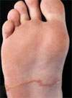
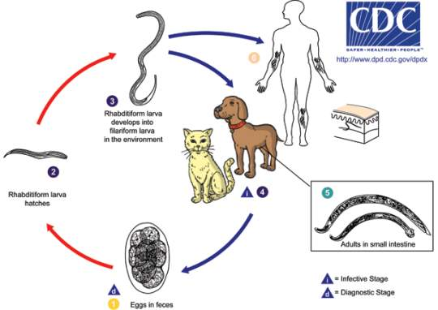
Zoonotic Potential
Many animal parasites also have the potential to infect humans
Notes:
Pass out brochures for zoonotic parasites. This is the hookworm lifecycle. People can be infected through fecal-oral ingestion of the eggs and skin penetration of the larvae from the soil it is common to see the tracts of the migrating worms on extremities such as the hands and feet.

Slide 17
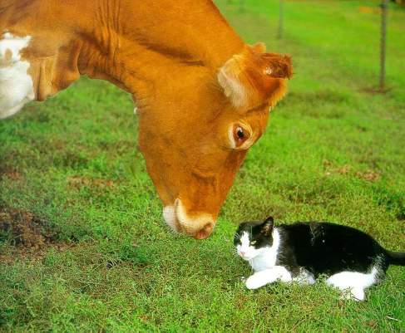
Parasite Prevention
Very different methods used in large animal versus small animal
In small animal most owners do not tolerate any parasites
In large animal it is not economical or possible to prevent all parasites. Aim is to minimize parasites to a reduce economic loss

Slide 18
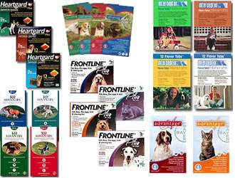
Small Animal Parasite Prevention
Ectoparasites
  Topical flea control medicines
  Dips
Intestinal Parasites
  Monthly dewormers included with heartworm preventative
Heartworms
  Monthly oral pills
  6 month injection
Notes:
Bring different parasite preventatives to show the class

Slide 19
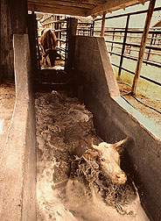
Large Animal Parasite Prevention
Spraying, Dusting, and Dipping to reduce ectoparasites
Drenching- Giving oral medications for internal parasites
Individual schedules and medications developed for the number and types of parasites in an area
Notes:
Bring different products or tools used to treat large animals

Slide 20
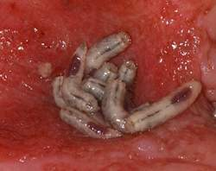
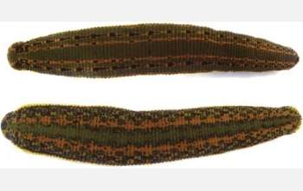
Parasites In Human Medicine
Medicinal leeches are being used to decrease swelling and improve blood flow in surgery sites including skin grafts and reattachments.
Medicinal maggots are being used to clean wounds that contain dead tissue. This photo shows the healthy pink tissue after maggots have been used
Notes:
The use of leeches in medical treatment is believed to date back to ancient India however the first documented uses were in 130 B.C. in ancient Greece. Blood letting was a common practice to treatment a variety of diseases and uses leeches to collect blood reached a peak in the 1830’s. For most medical conditions this is a bad practice and loss of blood only makes the disease worse. Today scientists have discovered that leech saliva contains anticoagulants, vasodialators, anesthetics, and natural antibiotics. Medicinal maggots are raised in sterile environments to prevent contamination of the wounds. They are capable of removing debris (debriding) from a wound on a microscopic level that surgical debridment cannot achieve.

Slide 21
Parasite Research
Parasite Resistance
  Increased numbers of parasites resistant to current drugs
  Documented problem in small ruminants
  Growing problem in horses and cattle
  No new anthelminthics on the horizon
  Management practices are more important than ever to reduce parasite loads
Notes:
This would be a good spot to discuss personal experiences with the use of anthelminthics and any resistances you have encountered in your practice, so the students understand this is a very real problem.

Slide 22
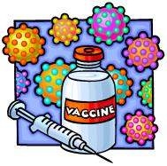
Parasite Research
Parasite vaccines
  None currently on the market
  Difficult to develop because of complex anatomy of parasites
  Close to developing a vaccine for malaria

Slide 23
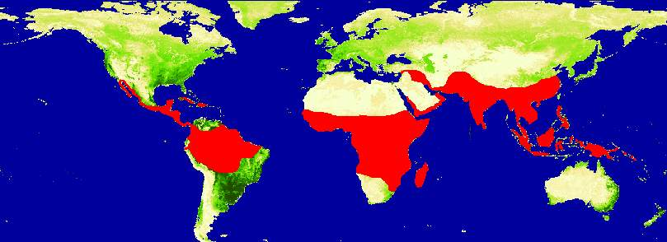
Parasite Research
Abolishing Malaria
  Novel methods to control malaria
  Latest research to control malaria involves killing the mosquito vector
  Use a naturally occurring fungus and bacteria to kill mosquitoes before they can transmit the disease
Notes:
Areas in red are where malaria is endemic. You can also mention that malaria is hard to control because many insects have become tolerant to insecticides, and the one that works best, DDT, is banned because of its effects on bird eggs.

Slide 24
References
www.entomology.cornell.edu
www.ansi.okstate.edu/breeds
www.usda.gov
www.dpd.cdc.gov/DPDx
www.nihrecord.od.nih.gov
www.insects.tamu.edu

