Slide 1
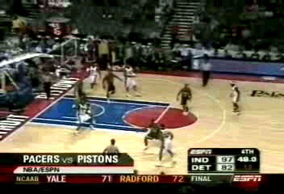
Pistons / Pacers Brawl

Slide 2
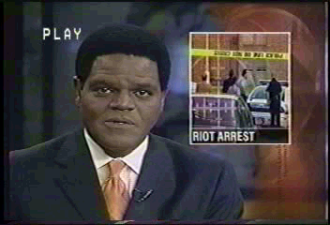
Prattville Basketball Brawl

Slide 3
PEER MEDIATION
Win-Win Problem Solving
For Students and Adults

Slide 4
BENEFITS OF PEER MEDIATION
Decreases number of discipline problems
Reduces time spent on discipline
Gives more time for teaching.
Increased attendance due to decreased suspensions
Builds self-esteem
Builds skills for positive problem-solving
Teaches positive communication
Builds responsible, productive citizens
Builds integrity and mutual respect

Slide 5
HOW PEER MEDIATION
WORKS
Peer mediation teaches students to solve their problems without fighting.
20-25 students from each school level are trained to be mediators and mediate disputes between fellow students.
Mediators allow parties to vent anger.
Mediators ask questions about the situation.
Mediators identify issues and feelings.

Slide 6
HOW PEER MEDIATION WORKS
Mediators facilitate discussion with disputants regarding solutions.
Disputants reach a mutual agreement.
Mediators put student agreements in writing.
Disputants sign the agreement.
Most mediated disputes are settled.

Slide 7
RULES FOR FAIR FIGHTING
No name-calling or put-downs.
Do not interrupt when someone else is talking.
Only one person speaks at a time.
Be as honest as you can
Everything discussed will be kept confidential…..except drugs, alcohol, weapons on school property and abuse.

Slide 8
COMMON CAUSES OF CONFLICT
Name-calling
Put-downs
Rumors
Picking or aggravating
Making disparaging remarks about family members
Boyfriend-girlfriend problems
Accusations

Slide 9
SUMMARY:
Schools need peer mediation programs.
Why? ..because conflict is a normal part of life.
Proper conflict management skills aren’t taught in most schools.
Productive conflict management is essential for success.
Violence among youth is increasing.
Today’s youth are tomorrow’s leaders.

Slide 10
PEER MEDIATION PROGRAMS
IN MADISON COUNTY SCHOOLS
Madison City 4
Madison County 7
Huntsville City 7

Slide 11
PEER MEDIATION PROGRAM
STATISTICS
Decrease: Fights *Referrals Suspensions
Meek Elementary 6% 32% 67%
Winfield Middle 20% 10% 30%
Madison Co. Mid. 18% 5% 0
Ed White Middle 10% 47% 20%
Ohatchee High 40% 40% 40%
Other schools reporting had successful mediation programs but did not have the figures to report percentages.
*Office referrals for discipline problems.

Slide 12

COMMON OBJECTIONS TO ADDING PEER MEDIATION PROGRAMS IN SCHOOLS.
Funding
Resistance to adding another program and/or responsibility
Idea that only schools with great discipline problems need peer mediation
Perception that peer helping programs are the same as peer mediation

Slide 13
SOLUTIONS:
Find funding.
Peer mediation programs require very little teacher time for coordination.
All schools need peer mediation programs to teach students anger management, positive communication and self-control.
Peer mediation is a type of peer helping program but its focus is teaching peaceful conflict resolution skills.

Slide 14
TEACHER QUOTES
“I absolutely LOVE this program & would HIGHLY recommend it to other schools!”….Melissa Butler, Liberty Middle School, Madison, AL.
“I highly recommend this program. It does work!”….Jennifer S. Roach, Morris Avenue Intermediate School, Opelika, AL.
“This is a great program.”….Michael Laney, Ohatchee High School, Ohatchee, AL.
“I believe peer mediation is excellent training for middle school students. They learn to resolve problems by talking rather than fighting. It is excellent leadership and life skills training.”…. Martha McInnish, Riverton Middle School, Huntsville, AL.

