Slide 1
EARLY EAST AFRICA

Slide 2
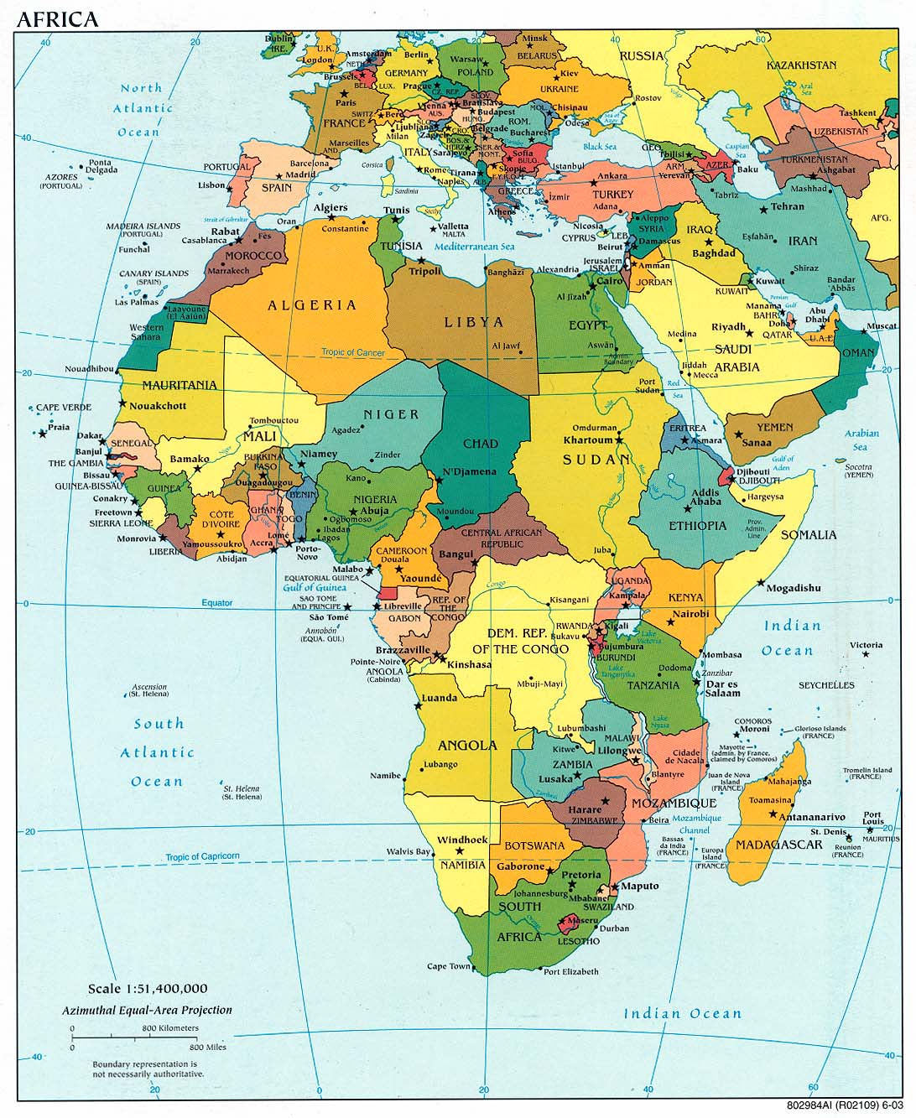

Slide 3
The Historiography
The question of sources
  The Coast – abundance of written sources
  The Interior – little written sources until the 19th c

Slide 4
Language and Peoples of E. Africa
1. The Khoisan
2. The Southern Cushites
3. The Nilotes
4. Bantu-speakers

Slide 5
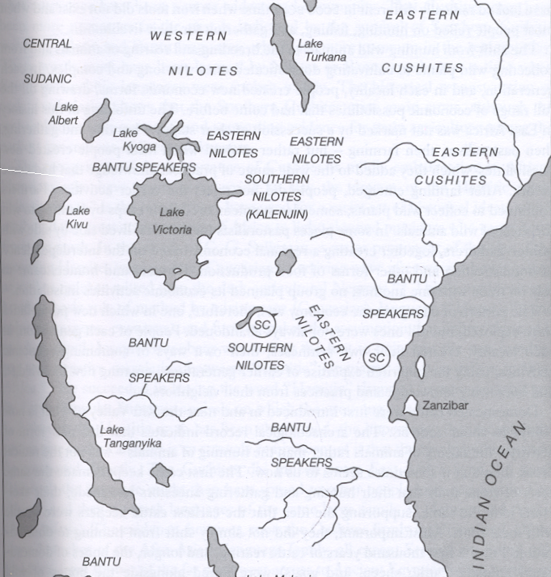

Slide 6
3. The Nilotes
3 (i) Western Nilotes
  The Luo
    Jo Bito Luo in Uganda
    Acholi in Uganda
    Luo in Kenya
3 (ii) Southern Nilotes
  Kalenjin of Kenya
  Okiek of Kenya
  Nandi of Kenya
3 (iii) Eastern Nilotes
  Maasai of Kenya
  Samburu of Kenya

Slide 7
Some major centralized states in pre-colonial East Africa
Bunyoro Kingdom
Buganda Kingdom
Rwanda Kingdom
Burundi Kingdom

Slide 8
The Swahili City-States

Slide 9
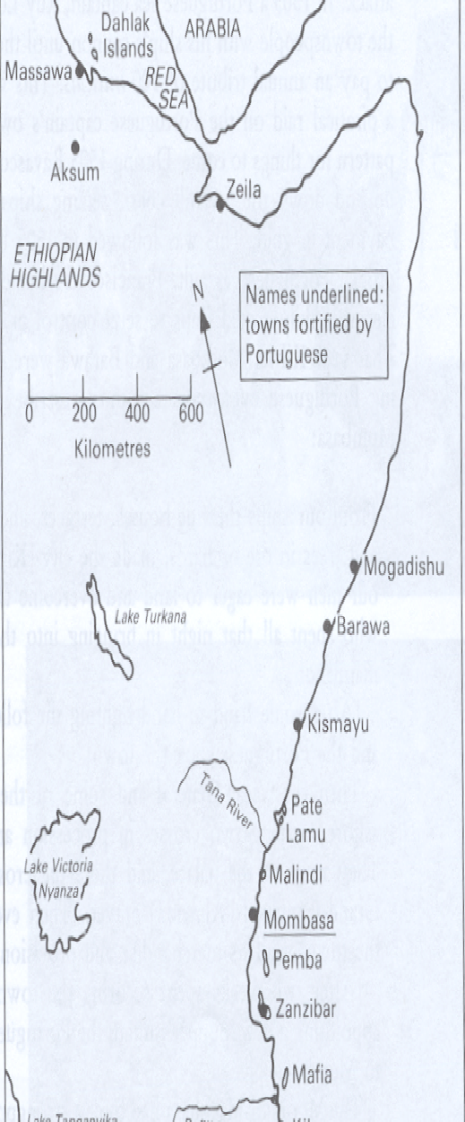
The Swahili City-States

Slide 10
Introduction
Long history of contacts with outside world
  Greeks and Romans
  Persians
  Arabs
  Indians
  Portuguese
The Periplus of the Erythraean Sea

Slide 11
The Indian Ocean Commerce
Vast commercial and social network that connected East Africa the Arabia, the Mediterranean, the Persian Gulf, India, Southeast Asia and China

Slide 12
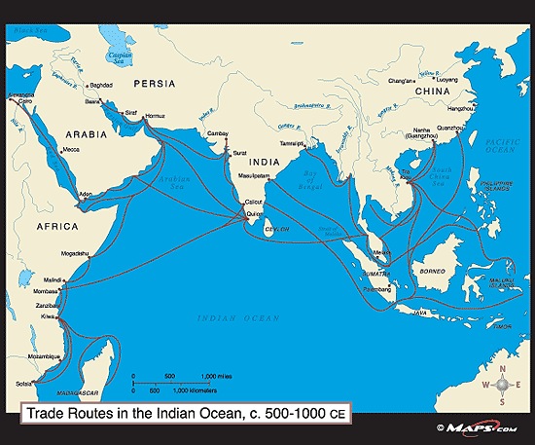
Indian Ocean Trade

Slide 13
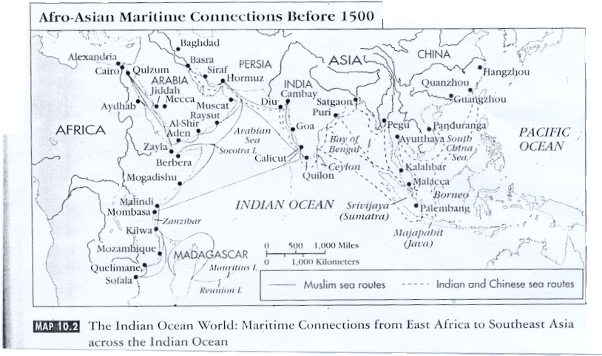

Slide 14
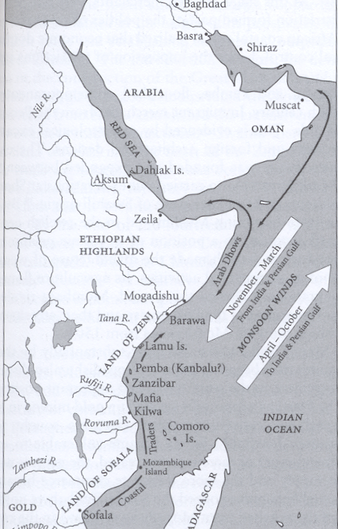
Indian Ocean Trade
Monsoon Winds
  Nov-Mar – From Indian & Persian Gulf to East Africa
  Apr-Oct – from East Africa to India & Persian Gulf

Slide 15
The Island of Madagascar

Slide 16
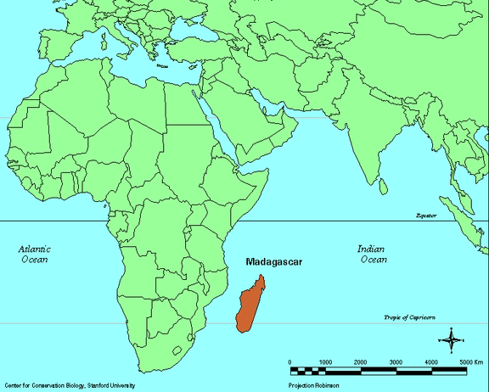
Madagascar

Slide 17
Rise of Islam
Gave a big boost to the Indian Ocean commerce
Arab – Islamic writers and scholars
Expansion of Islamic religion and Arabic civilization into East Africa

Slide 18
Origins of Swahili
“Swahili” means “People of the Coast” – derived from the Arabic word ‘sahil’
“Kiswahili” – basically a Bantu language with several Arabic words
Kiswahili today widely spoken in eastern Africa

Slide 19
Swahili Trading States
Mogadishu
Mombasa
Kilwa
Pemba
The Comoros Island
Zanzibar

Slide 20
The Portuguese in E. Africa, 1498-1690s
Quest for sea-route to India
1503 – bombardment of Zanzibar
1505 – sacked Kilwa and Mombasa
1599 – completed the Fort Jesus
Commerce and Christianity
Brutal rule
Swahili resistance

Slide 21
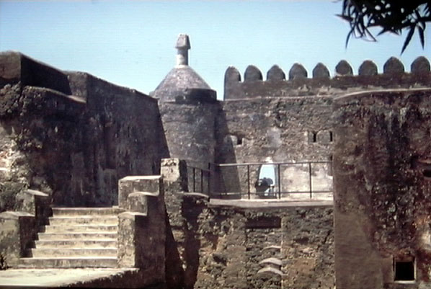
Fort Jesus (Mombassa, Kenya)

Slide 22
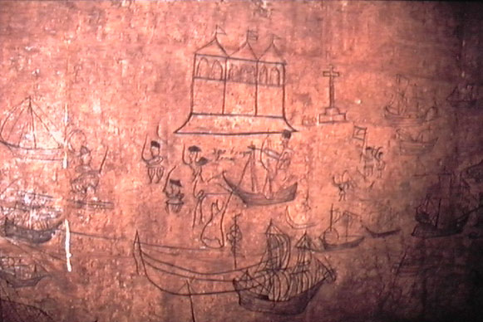
17th century graffiti by Portuguese prisoners at Fort Jesus

Slide 23
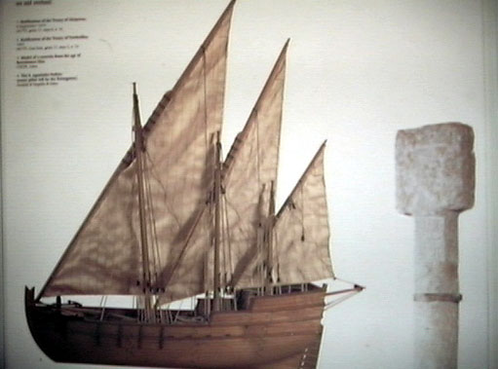
Model of 16th century Portuguese ship, Mombassa, East Africa

Slide 24
The Omani Rule in E. Africa
Sultan ibn Saif of Oman sent warships to attack the Portuguese on the E. African coast
Captured Fort Jesus in 1698
Portuguese out, Omanis in

Slide 25
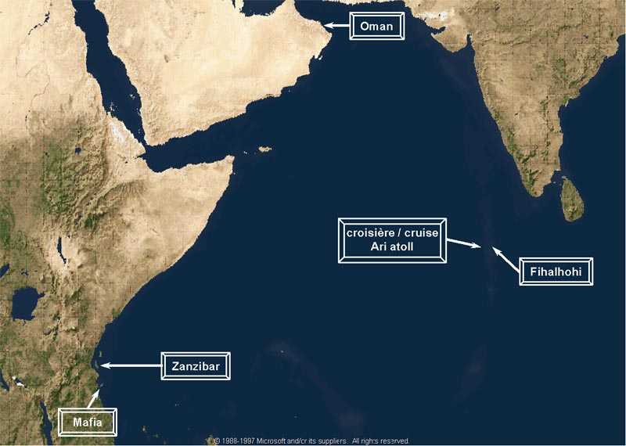
Oman and East Africa

Slide 26
Sultan Seyyid Said (r. 1806-1856)
Brought all the key city-states of Swahili under his control
1840 – transferred his capital from Muscat to Zanzibar
Zanzibar was to dominate the Indian Ocean commerce in the 19th century

Slide 27
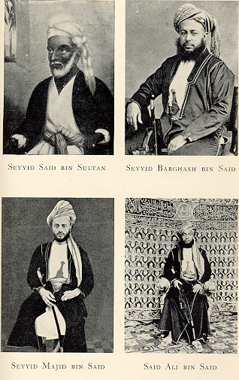
Sultan Seyyid Said (r. 1806-1856)

Slide 28
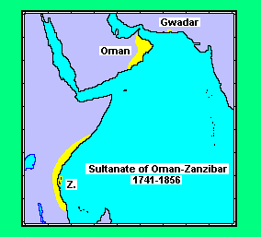
The Omani Empire in East Africa
Sultan Seyyid Said transferred his capital from Muscat to Zanzibar in 1840

Slide 29
Cloves, slaves and ivory
Extensive trading network between the coast and the interior
Extensive European and American interests
Finally, European colonization in the 19th century

Slide 30
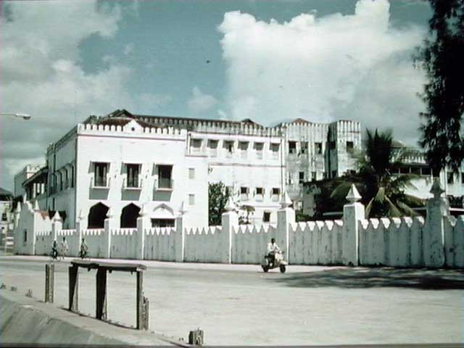
Sultan Said’s Palace in Zanzibar

Slide 31
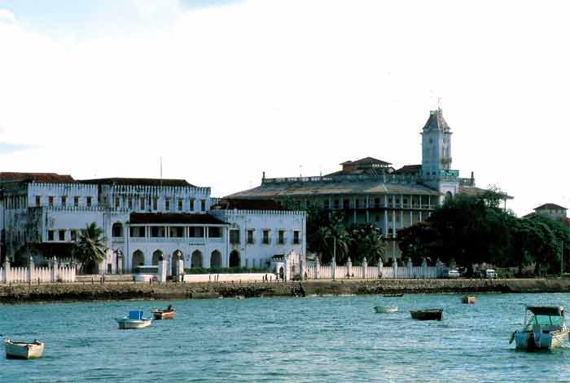

Slide 32
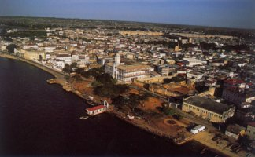
Modern Zanzibar

Slide 33
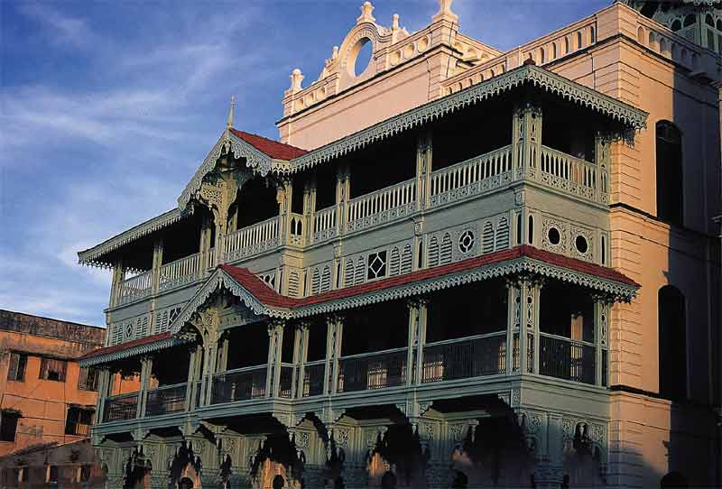
Zanzibar Old Dispensary

