Slide 1
Getting Started in the Vegetable Garden
Karen Delahaut
Fresh Market Vegetable Program Coordinator

Slide 2
Site Selection & Preparation
Light
≥6 hours
Soil
Access
Air Drainage
Proximity to Trees & Shrubs
Notes:
When selecting a location for a vegetable garden, you should take into consideration several site characteristics such as the amount of light the site receives, the soil type, and the microclimate of the location. Vegetables should be planted in a place that is sunny, level, and protected from frost pockets or excessive wind.

Slide 3
Access
Near the house.
Easy to get to when harvesting.
Accessible for weeding, cultivating, & staking plants.
Close to water.
May deter vermin.
Notes:
You will also want to locate your vegetable garden relatively close to the house so you have access to water if irrigation is needed and so you won’t have to haul your bountiful harvest a great distance to the kitchen. Likewise, a vegetable garden nearby will encourage you to spend a few minutes here and there weeding, cultivating, and staking plants as needed. Finally, a garden near the house may deter some of the wildlife that may find your garden appealing such as rabbits, raccoons, deer, woodchucks, various birds, and stray dogs. In some cases, the garden may need to be fenced to keep out all four-legged vermin.

Slide 4
Air Drainage
Low-lying areas are subject to unseasonable frosts & water-logged soils.
South-facing slopes warm more quickly.
Wind protection is desirable in rural gardens.
Prevents physical damage to plants.
Reduces water loss.
Preserves heat that may be lost through transpiration.

Slide 5
Proximity to Trees & Shrubs
Unwanted shade.
Competition for water and nutrients.
Juglone toxicity.
Site the garden at least 10 feet from any tree or shrub.

Slide 6
Weed Control
Compete with plants for sunlight, water, nutrients, & space.
Reduce perennial weeds before planting.
Solarization with black plastic.
Herbicides.
Hoe regularly to keep annual weeds under control.
Carrots, onions, radishes, & beets need more vigilant weed management because of their small canopy.

Slide 7
Physical Requirements: Day Length
Increasing or decreasing day length affects
Flower initiation
Bulbing & tuber development
Short day plants:
Sweet potato
Long day plants flower when light exceeds a certain number of hours.
Lettuce
Spinach
Radish
Day neutral plants – flowering not related to light
Cucumber
Peas
Beans
Peppers
Notes:
Increasing or decreasing daylength, depending on the plant species, promotes development of reproductive structures — often in conjunction with other factors, such as temperature. Daylength also affects other processes, such as bulbing in onions and tuber development in potato. The time of year when specific vegetables are planted can therefore influence whether the plants produce the appropriate edible parts (reproductive or vegetative).

Slide 8
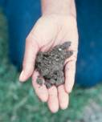
Physical Requirements: Soil
Well-drained. Solutions for clay soils:
Add organic matter
Raised beds
Work soils down to 6-7 inches.
Remove large stones, clods, or plant debris. Particularly important with root crops.
Notes:
Few vegetable plants tolerate soggy soil, so good drainage is essential. However, sandy soils may dry out too quickly, leaving plants susceptible to drought.
The level of essential soil nutrients is of less importance, since they can be amended with a wide variety of natural or synthetic fertilizers.

Slide 9
Physical Requirements: Nutrients & Organic Matter
Soil test
Done the fall before planting and every 3 years thereafter.
Sample 6-7 inches deep in 5 areas of the garden.
pH – 6.0-6.8
Phosphorus
Potassium
Organic matter
Notes:
Fertilizers can come from organic or inorganic sources. With adequate environmental conditions, soil microbes break down organic matter and supply the chemicals that plants need to their roots. Organic fertilizers can also improve soil structure and health, as well as fertility. The nutrients released from the breakdown of organic amendments is made available over a longer period of time. Inorganic fertilizers can be used to quickly supply nutrients to plants that are suffering a deficiency.

Slide 10
Physical Requirements: Compost
Benefits:
Improves water retention
Promotes soil structure
Increases fertility
Increases cation exchange
Reduces fertilizer requirements up to 50%
Enhanced microbial activity
Suppresses pathogens
Accelerates the breakdown of pesticides & other synthetic compounds
Notes:
Composting is controlled decomposition or the natural breakdown of organic residue.
The supply of carbon to nitrogen is important when adding materials to compost.
The ideal C:N Ratio is 25:1 to 35:1
High C:N ratios will use up all the nitrogen to break down the carbon while low C:N ratios will have excess nitrogen which may lead to ammonia gas production and odor problems.
Fruit and vegetable waste is easily composted because they are comprised mostly of simple carbohydrates.
Water requirements are between 45-60% - >60% will lead to anaerobic conditions while <45% will slow decomposition.

Slide 11
Physical Requirements: Temperature
Cool season crops
Develop best <50°F
Tolerate frost.
Quality deteriorates under warm conditions.
Peas, spinach, cole crops
Warm season crops
Develop best at temps >50°F.
Killed by frost.
Beans, tomatoes, peppers, eggplant, sweet corn, cucurbits.
Notes:
Every plant’s rate of growth, water and nutrient uptake, flowering and fruit set, and quality and yield are affected by temperature. Temperatures above 85ºF can cause blossoms of peppers and tomatoes to abort.
Frost tolerance varies among vegetable plants. Warm season crops will be heavily damaged from a light frost (28-32ºF), while cool season crops can survive moderate frosts down to about 24ºF. Below this temperature most plants not in a dormant condition will be killed.

Slide 12
Physical Requirements: Soil Temperature
“Plant corn when oak leaves are the size of squirrel’s ears”.
Rotting seed of warm-season crops planted in cold soil.
Soil temp should be >60°F
Heat-induced dormancy for fall crops.
Notes:
Soil temperatures at planting greatly influence germination, and some plants will develop at much cooler temperatures than others. Most cool season crops can be sown as soon as the soil is workable and they will germinate and grow. Wait until the soil temperature is above 60ºF to direct seed or transplant warm-season crops.

Slide 13
Variety Selection
Size of Mature Plant
Days to Harvest
Heirlooms
Disease Resistance
Saving Seed
Notes:
Cultivar selection should be based on the growth habit of the plant, characteristics of the plant part eaten, disease resistance, and how well suited it is to Wisconsin’s growing conditions.
Make sure you consider how much space you have when selecting varieties. Standard variety vine crops can cover enormous spaces, while bush types are better suited to small gardens. Similarly, determinant varieties of tomatoes are smaller in size than their indeterminate relatives. Dwarf types are particularly suited for container culture.
You should also be aware that if you save your own seed from one year to the next that some plant diseases are carried on, or in, the seed and this is one way for diseases to survive from year to year.

Slide 14
Variety Selection: Days to Harvest
Southern WI has 120-180 frost-free days.
Northern WI has 90-120 frost-free days.
Pay particular attention to long-season crops – pumpkins or corn.
Planting date for fall crops should be counted backward from the average date of 1st frost. Additional days should be added because of cool nights and shorter days.

Slide 15
Variety Selection: Heirlooms
Old-fashioned varieties.
Selected for their flavor.
No disease resistance, not uniform in appearance, and don’t store well.
Seed Savers Exchange
http://www.seedsavers.org/Home.asp
Notes:
Growing heirloom varieties has become popular in recent years. Heirloom varieties are old-fashioned varieties that haven’t been significantly changed by plant breeding. Most have been selected for their flavor without regard for other characteristics such as disease resistance, uniformity, or storage life.

Slide 16
Variety Selection: Disease Resistance
Select resistant varieties if practical.
No one variety is resistant to all diseases of that vegetable.
Seed catalogs will indicate what varieties are resistant.
Notes:
Many fruit & vegetable varieties are resistant to, or tolerant of, specific plant diseases. Resistance is not immunity – these cultivars will still develop some disease but yield and quality won’t be greatly affected. Check seed catalogs for disease resistance ratings.

Slide 17
Variety Selection: Saving Seed
Some diseases are carried on or in the seed.
Don’t save seed from cross-pollinated plants – vine crops in particular.
Self-pollinated crops include
Beans
Eggplant
Peas
Pepper
Tomato

Slide 18
Planting
Timing
Direct Seeding
Transplants
Starting Seeds
Spacing & Thinning
Sequential Planting
Crop Rotation

Slide 19
Timing
Soil temperature
Cool-season crops = 40°
Warm-season crops = 50-60°
Avoidance of pest problems
Onions – onion maggot
Cole crops – cabbage maggot, flea beetles
Seed corn maggots

Slide 20
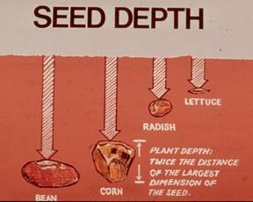
Direct Seeding
Plant seed as deep as the seed is wide.
Seed packets will tell you how far to space the seed.
Keep seed moist until plants germinate.
Lettuce seed requires light to germinate.

Slide 21
Transplants
Some vegetables must be started indoors because they require a long season.
Transplants can be started indoors several weeks before they are moved outside.
Vegetables include
Onions & leeks
Tomatoes, peppers, eggplant
Cole crops

Slide 22
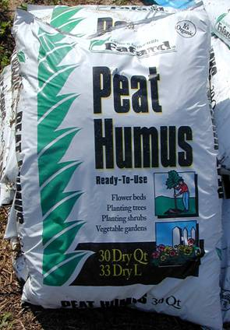
Starting Seeds
Plant at the appropriate time so plants don’t get too leggy.
Containers can be plastic pots, soil blocks, peat pots, home-made newspaper pots, Jiffy-7.
Plastic containers previously used should be sterilized in a 10% bleach solution.
Notes:
For large-seeded crops, sow individual seeds in each pot.
Use seed starting mix or other indoor planting medium. You can purchase soilless mixes or create your own from one part each of vermiculite, perlite and either sphagnum peat moss or potting soil. Moisten the growing medium well so it is evenly moist, not soggy.

Slide 23
Starting Seeds: Heat & Light Requirements
Bottom heat will speed up germination.
Electric heating mat.
Radiator
Remove once seeds sprout.
Supplemental light from fluorescent lights is necessary.
18 hours is optimum
Place lights 6 inches from top of plant
Can place in sunny window but turn regularly to prevent lopsided growth.
Notes:
Keep seeds and young seedlings constantly moist, but not wet to avoid disease problems. Water carefully to prevent displacing seeds or knocking over tiny seedlings. After one set of true leaves emerges, thin the pots to one plant each. Fertilize seedlings once or twice a week with a water-soluble fertilizer (less if there is soil in the planting medium).

Slide 24
Hardening Off
Decrease watering & stop fertilizing 2 weeks before transplanting.
Lower temperature before transplanting.
Harden off to acclimate to
Wind
Intense light
Fluctuating temperatures

Slide 25
Transplanting
Transplant on cloudy days to minimize sun scald.
Water well after transplanting.
Plant at the same depth as in the pot.
Exception, tomatoes

Slide 26
Spacing & Thinning
Space seeds as recommended on the packet.
Dense planting will promote disease.
Small-seeded crops will need thinning:
Carrots
Radishes
Beets
Lettuce

Slide 27
Succession Planting
Necessary to provide an extended season of crop availability.
Look at days to harvest.
Three types:
Planting late-season crops after early season ones have been harvested – peas followed by beans.
Multiple plantings of a single crop.
Planting different cultivars with different maturity dates – cabbage & corn.
Notes:
Succession planting is done so garden space is put to its most efficient use. With this method, there is never an unplanted area in the vegetable plot. As soon as one crop is harvested, the space is immediately replanted with a different crop. This method of succession planting uses groupings of cool-season and warm-season crops. In the simplest scheme, succession planting involves planning for spring, summer, and fall crops.

Slide 28
Early Season Crops
Early Beets
Early Cabbage
Lettuce
Onion Sets
Peas
Radishes
Early Spinach
Mustard
Turnips
Long Season Crops
Beans
Cabbage
Celery
Sweet Corn
Cucumbers
Eggplant
Muskmelons
Peppers
Potatoes
Pumpkin
Squash
Swiss Chard
Tomatoes
Watermelon
Late Season Crops Bush Beans Beets Broccoli Chinese Cabbage Carrots Cauliflower Endive Kale Kohlrabi Lettuce Radishes Spinach Turnips

Slide 29
Crop Rotation
Potatoes, tomatoes, peppers, and eggplant are all members of the solanaceous family.
Beans and peas are legumes.
Cucumbers, melons, pumpkins, and squash are all cucurbits.
Radishes, rutabagas, and turnips are all cole crops just like cabbage, broccoli, cauliflower, and Brussels sprouts.
Onions, garlic, leeks, shallots, chives are alliums.
Crop rotations of at least 4 years are recommended.
Notes:
Avoid pest problems or depleting nutrients.
Plan ahead before planting — determine where vegetables were planted the previous season and make a plan to put each in a different location in the upcoming season. It may be beneficial to draw a map of your garden with the location of each crop and save this map to avoid planting the same crop in that location the next year.

Slide 30
Why Rotate Crops?
Insect & disease management
Weed management
Nutrient demands
Increased soil nitrogen
Benefits of the preceding crops
Improved physical condition of the soil
Increased microbial activity
Increased release of CO₂
Excretion of beneficial substances
Notes:
A good rotation spaces pest susceptible crops at intervals the will hinder the buildup of pests in the field.
Rotations can also be used to control weeds.
“Cleaning crops” such as potatoes, pumpkins and winter squash eradicate problem weeds through hilling or the extensive crop cover.
Herbicides may be used in some crops to control weeds that are problematic to other crops in which the herbicide is not registered.
Some crops are more efficient at using less soluble forms of plant nutrients.
Less-evolved crops such as cabbage are more efficient at doing this than highly developed crops like lettuce and cucumbers.
The variety in rooting depths and the extent of the root system will improve and maintain good soil structure.
Sweet corn and squash require deep cultivation and a high level of soil organic matter. Beans and peas are legumes capable of fixing nitrogen from the atmosphere, so they will not need additional fertilizer but still require deep cultivation. Root crops such as radishes, carrots, beets, turnips, and rutabagas also require deep cultivation for proper root development, but the addition of manure and too much organic matter will cause the roots to become disfigured. And cabbage and other cole crops require a firm soil with an alkaline pH to avoid succumbing to clubroot.
Also, try to plan the rotation so that successive crops benefit from their predecessor. For example, sweet corn is a heavy feeder so it’s best to plant sweet corn in an area where peas or beans were the previous year because these crops add nitrogen to the soil. Potatoes and vine crops are easy to weed and will “clean” the soil, thereby reducing weed problems in subsequent onion and root crops that are not easily weeded and have a small canopy to shade out weeds.

Slide 31
Watering
Matching water application to plant needs.
Based on
Soil type
Rainfall
Crop requirements
Growth stage
Experience and soil examination are best measures.
Rain gauge
Don’t base watering on crop appearance.
Notes:
The best way to determine if a crop needs water is to measure rainfall, evaporation, and the feel of the soil. This, along with experience will provide crops with the necessary water they need. Don’t rely on the look of the crop. Often they’ve passed the critical wilting point before they show symptoms of water stress.

Slide 32
Mulching
Organic – breaks down
Straw
Chopped leaves
Wood chips
Grass clippings
Inorganic
Plastic
Benefits
Weed suppression
Temperature moderation
Soil moisture moderation
Sanitation
Add nutrients
Notes:
With the exception of plastic mulch used to warm the soil, all mulches should be applied after the soil warms up in the spring and after the seedlings have emerged or transplants have become established. Make any fertilizer or organic matter applications before applying mulch to a garden so you don’t have to remove the mulch later to do so.
The thickness of the mulch will vary depending on type. Plastic or paper mulches will be relatively thin while organic mulches must be applied in a layer thick enough to suppress weeds. Two to three inches is typically recommended for organic mulches; the exception is straw, which is light and airy initially, but will compact with time. Straw mulches may be applied as thick as 6 inches initially.
If you choose to use grass clippings as mulch, do not do so if you have applied a broadleaf weed killer to the lawn within the last 4-6 weeks. Residual herbicide will be in clippings and may cause abnormal growth of susceptible plants, particularly tomatoes.

Slide 33
Pest Control
Cultural control is 1st line of defense
Chemical control should be used only as a last resort.

Slide 34
Physiological Disorders
Blossom end rot
Insufficient calcium
Forking
Manure, debris
Ricey cauliflower
Excessive heat
Sunscald
Defoliation exposing fruit to hot sun.
Catfacing
Cold night temperatures
Notes:
Not all maladies that affect vegetables are the result of insects or plant diseases. In fact, some problems arise because of improper cultural practices or environmental conditions to which the crop is subjected. Because these problems are not caused by living organisms, and because they disrupt the normal structure or functioning of the plant, such maladies are called “physiological disorders.”

Slide 35
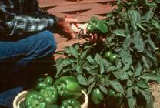
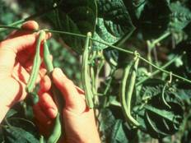
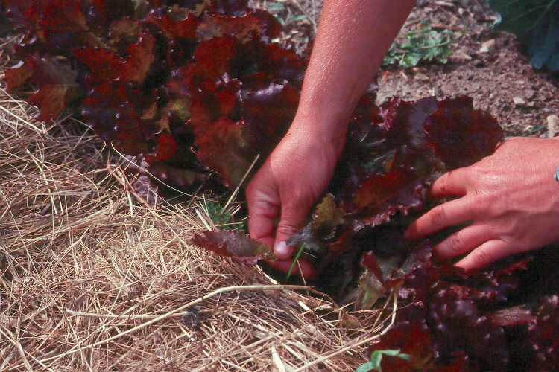
Harvest
Timing
Harvest early in the day
Prevent wounds
Discard culls
Cool the vegetables quickly & thoroughly
Quality is reduced by
Improper temperature
Drying
Mechanical injury
Disease
Respiration leads to
Drying out
Reduced food value
Less sweetness (CHO broken down)
Less dry weight
Notes:
When vegetables are harvested, some life processes continue. The warmer the conditions in which the crop is harvested and subsequently stored, the higher the rate of respiration (loss of water) and the more rapidly the quality deteriorates. Ideally, vegetables should be harvested in the morning while they are still cool and haven’t absorbed the day’s heat. However, to prevent the spread of plant diseases, it is best to wait until the plants are dry before performing any activity in the garden. For perishable vegetables, remove any excess soil in the garden, bring the plants into the house immediately and wash off any remaining soil or debris and refrigerate those vegetables that require cool storage conditions. Some vegetables, such as carrots, need to be stored near 32ºF or they will continue growing.

Slide 36
Season Extension: Coldframes
Miniature greenhouse
Can add up to 45 days to growing season.
Typically 3’ wide by 6’ long; 18” high in back & 12” high in front.
Faces south or west with glass or plastic top at a 30-45° angle.
Open top on sunny days.
Notes:
Plants can be planted directly in the soil beneath or potted plants placed within it. Cold frames are ideal for hardening off flats of tender young vegetable transplants in the spring, or for a wonderful fall crop of lettuce, spinach and radishes.
The hardest part of using a cold frame is keeping it from getting too hot. When the sun is bright, the temperature inside can climb quickly and injure the plants if the cold frame is not vented. Placing shade cloth or floating row cover over the top of the cold frame can help prevent overheating. On warm days it may be necessary to prop the lid an inch or more to let heat escape, but remember to close the lid before the sun sets. A thermostatically controlled vent opener can be purchased to do this automatically.

Slide 37
Season Extension: Floating Row Covers
Frost protection
Warmer microclimate
Wind protection
Excludes insect pests
Reduced evapotranspiration
Good for beans, beets, carrot, cole crops, corn, lettuce, parsley, potato, radish, scallions, and spinach
Notes:
Floating row cover is a spun-bonded polyester fabric that is light enough to be placed directly on top of plants. These fabrics, which come in different weights for different purposes, allow water and air to penetrate, but they don’t cause excessive heat buildup when it’s warm. They do trap some heat – providing three or four degrees of protection – as well as providing protection from insects, and won’t impede upward plant growth.
To hold the floating row cover in place, use wire anchors or mound soil along the edges of the fabric to hold it down. Alternatively, the fabric can be draped over supports to create a tunnel. This works especially well for tall plants or for a few plants, such as spinach, whose delicate leaves can be abraded by the fabric when it moves in the wind.
Remember to remove floating row covers on those crops requiring pollination by bees to produce the vegetable you will sell.
One downside of row covers is they may tear (or blow away) in the wind.

Slide 38
Season Extension: Plastic Mulch
Polyethylene plastic
Retains moisture
Warms the soil
Weed suppression
Clear, colored, black, or infrared-transmitting
UV light will break down
Disposal issue
Good for cucumber, eggplant, melons, pepper, summer squash, tomato

Slide 39
Season Extension: Individual Plant Covers
Cloches
Glass or plastic mini-greenhouses.
Wall-o-Water
Plastic with baffled chambers filled with water.
Will protect plants down to the teens.

