Slide 1
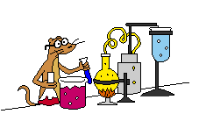
Welcome to Science!
Can you please do this task – without talking and without waiting to be asked:
On your whiteboards, write down the four main requirements plants need to survive.

Slide 2
On your whiteboards, write down the four main requirements plants need to survive.
OK, let’s see what you can remember….
Water
Light
Nutrients
Warmth
BBC - KS2 Revisewise - Science: Living Things

Slide 3
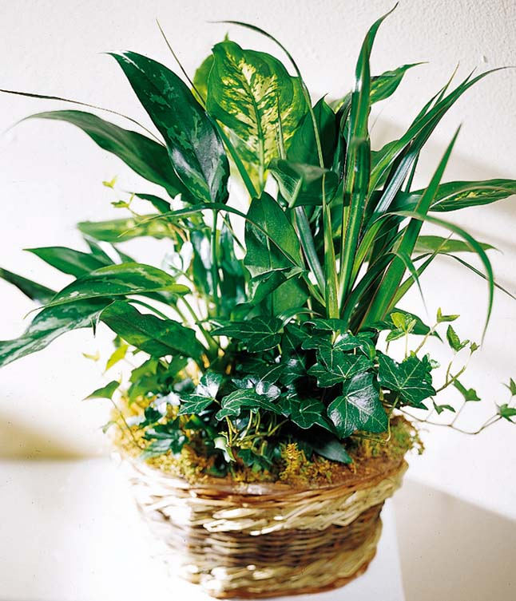
Lesson Objectives
To state and explain what plants need to grow and be healthy.
To design and conduct a fair investigation.

Slide 4
TASK
Read page 4/5 of Exploring Science.
How could we investigate scientifically what plants need to be healthy?
What would our variables be?
What would we need to keep the same in order to create a fair test?
Working in your table groups – brainstorm some ideas.
Be prepared to feedback to the class.

Slide 5
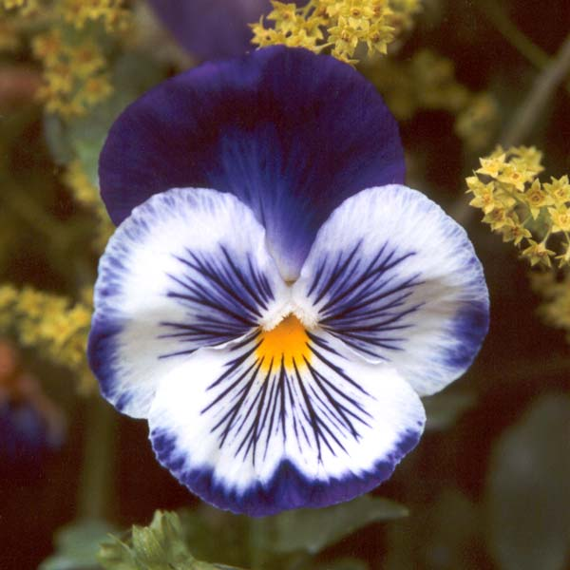
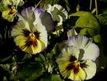
Predictions
Work through the table of predictions and make decisions about the health of the pansy for each condition.
Stick this table in your book.

Slide 6
Recording Results
How could we monitor the plants over the half term?
What should we record or note?
What measurements should we take?
How often?
Who should make the observations?
Could you design a results table?
Working in your table groups – jot down your ideas.
Be prepared to feedback to the class.

Slide 7
How do green plants grow?
Title: Plant Nutrition
Date: Tuesday 16 September 2006
In your books, copy and complete the paragraph ‘Plant Nutrition’. Use Exploring Science to help you.
Extension: Can you explain the term ‘photosynthesis’?

Slide 8
AND Finally……
What is a variable?
What is a fair test?
What is a prediction?

Slide 9
Lesson Objectives
To state and explain what plants need to grow and be healthy.
To design and conduct a fair investigation.

