Slide 1
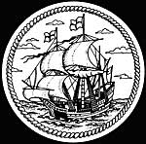
The Age of Exploration
Making a Flow Chart and Mapping

Slide 2
FC.81 THE AGE OF EXPLORATION (c.1400-1550)
Eur’s position at W. end of Eurasia
Medieval religious fervor
Towns & trade revive in 1100s (FC.64)
Middlemen raise cost of Asian goods
Good for exploring Afr. & Atl.
Ships & navig. tech. to sail ocean
Desire to convert other cultures
Interest in other cultures
Secular ideas of Renaissance (FC.76)
Desire for Eastern luxuries
Incentive & means to find new route to Asia
Desire to find Afr. source of Arab gold & legendary Chr. Kgd of Prester John
Spain & Portugal lead the way thanks to:
Belief in round, but smaller world that is 7/8 land→ Trip to Asia only 3500 miles
Heritage of Arab geogr. knowledge
Geogr. position on Atlantic & Medit.
Portuguese, led by Prince Henry the Navigator, explore Afr. Coast to find gold
Christopher Columbus, seeks backing for voyage to reach Asia by sailing west
Portuguese reach part of coast turning E. → Think they can sail around Afr. to India
Castile & Aragon preoccupied until 1492 with driving out Moors → Can’t back him
Even after coast turns S. again, Portuguese continue exploring → Dias rounds S. Afr.
Spain, wanting to beat Portugal to Asia, backs Columbus who discovers America instead
Fearing Spain will reach India 1st, Port. sends Vasco da Gama around Afr. To India (1498)
Spain, realizing this is a new continent, tries to find way through or around it to Asia
Serrao discovers Pacific Ocean for Portugal from the W. end (1513) while Balboa discovers it for Spain from the E. end in the same year
See credits Slide 24
Portuguese reach China (1513) & Japan (1542) & establish missionaries & trade there
Magellan sails around the world (1519-22) → World much bigger than previously believed
Portugal builds SE Asian Empire to control spice trade (FC.82)
Explorers still seek Great S. Continent & easy way to Asia (FC.83)

Slide 3
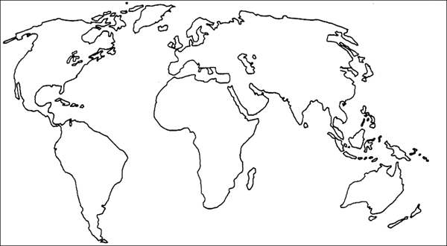
See credits Slide 24

Slide 4
THE AGE OF EXPLORATION (c.1400-1550)
Europe’s position at west end of Eurasia
Medieval religious fervor
Towns & trade revive in 1100s

Slide 5
THE AGE OF EXPLORATION (c.1400-1550)
Europe’s position at west end of Eurasia
Medieval religious fervor
Towns & trade revive in 1100s
Desire to convert other cultures
Middlemen raise cost of Asian goods
Good for exploring Africa & Atlantic
Ships & navigation technology to sail oceans
Desire for Eastern luxuries
Interest in other cultures
Secular ideas of Renaissance (FC.76)
Incentive & means to find new route to Asia

Slide 6
Trade existed between the Middle East and Asia, but the Middle East merchants acted as middlemen

Slide 7
THE AGE OF EXPLORATION (c.1400-1550)
Incentive & means to find new route to Asia
Desire to find African source of Arab gold & legendary Christian Kingdom of Prester John
Belief in round, but smaller world that is 7/8 land → Trip to Asia only 3500 miles
Spain & Portugal lead the way thanks to:
Heritage of
Arab geographic knowledge
Geographic position
on Atlantic & Mediterranean
Portuguese, led by Prince Henry, explore African Coast to find gold
Christopher Columbus, seeks backing for voyage to reach Asia by sailing west

Slide 8
THE AGE OF EXPLORATION (c.1400-1550)
Incentive & means to find new route to Asia
Desire to find African source of Arab gold & legendary Christian Kingdom of Prester John
Spain & Portugal lead the way thanks to:
Belief in round, but smaller world that is 7/8 land → Trip to Asia only 3500 miles
Heritage of
Arab geographic knowledge
Geographic position
on Atlantic & Mediterranean
Portuguese, led by Prince Henry, explore African Coast to find gold
Christopher Columbus, seeks backing for voyage to reach Asia by sailing west
Portuguese reach part of coast turning East. → Think they can sail around Africa to India
Castile & Aragon preoccupied until 1492 with driving out Moors → Can’t back him

Slide 9
Portuguese, led by Prince Henry, explore African Coast to find gold
Christopher Columbus, seeks backing for voyage to reach Asia by sailing west
Portuguese reach part of coast turning East. → Think they can sail around Africa to India
Castile & Aragon preoccupied until 1492 with driving out Moors → Can’t back him
Even after coast turns South again, Portuguese continue exploring → Dias rounds South Africa

Slide 10
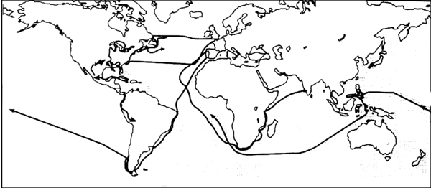
Portuguese explored ways to reach Asia by going south around Africa

Slide 11
Portuguese, led by Prince Henry, explore African Coast to find gold
Christopher Columbus, seeks backing for voyage to reach Asia by sailing west
Portuguese reach part of coast turning East. → Think they can sail around Africa to India
Castile & Aragon preoccupied until 1492 with driving out Moors → Can’t back him
Even after coast turns South again, Portuguese continue exploring → Dias rounds South Africa
Spain, wanting to beat Portugal to Asia, backs Columbus who discovers America instead

Slide 12
Spain looked for a westward route to Asia

Slide 13
Portuguese, led by Prince Henry, explore African Coast to find gold
Christopher Columbus, seeks backing for voyage to reach Asia by sailing west
Portuguese reach part of coast turning East. → Think they can sail around Africa to India
Castile & Aragon preoccupied until 1492 with driving out Moors → Can’t back him
Even after coast turns South again, Portuguese continue exploring → Dias rounds South Africa
Spain, wanting to beat Portugal to Asia, backs Columbus who discovers America instead
Fearing Spain will reach India 1st, Portugal sends Vasco da Gama around Africa To India (1498)

Slide 14
The Portuguese reached India by going around Africa, but after Columbus had accidentally discovered the “New World” while looking for a westward route to Asia

Slide 15
Portuguese, led by Prince Henry, explore African Coast to find gold
Christopher Columbus, seeks backing for voyage to reach Asia by sailing west
Portuguese reach part of coast turning East. → Think they can sail around Africa to India
Castile & Aragon preoccupied until 1492 with driving out Moors → Can’t back him
Even after coast turns South again, Portuguese continue exploring → Dias rounds South Africa
Spain, wanting to beat Portugal to Asia, backs Columbus who discovers America instead
Fearing Spain will reach India 1st, Portugal sends Vasco da Gama around Africa To India (1498)
Spain, realizing this is a new continent, tries to find way through or around it to Asia

Slide 16
The Spanish sailed south hoping to get around the Americas and reach Asia, the Portuguese developed trade in Africa and India while sailing east.

Slide 17
Portuguese, led by Prince Henry, explore African Coast to find gold
Christopher Columbus, seeks backing for voyage to reach Asia by sailing west
Portuguese reach part of coast turning East. → Think they can sail around Africa to India
Castile & Aragon preoccupied until 1492 with driving out Moors → Can’t back him
Even after coast turns South again, Portuguese continue exploring → Dias rounds South Africa
Spain, wanting to beat Portugal to Asia, backs Columbus who discovers America instead
Fearing Spain will reach India 1st, Portugal sends Vasco da Gama around Africa To India (1498)
Spain, realizing this is a new continent, tries to find way through or around it to Asia
Serrao discovers Pacific Ocean for Portugal from the west end (1513) while Balboa discovers it for Spain from the east end in the same year

Slide 18
The Spanish discovered the “South Sea” by going west, and the Portuguese discovered it by going east.

Slide 19
Even after coast turns South again, Portuguese continue exploring → Dias rounds South Africa
Spain, wanting to beat Portugal to Asia, backs Columbus who discovers America instead
Fearing Spain will reach India 1st, Portugal sends Vasco da Gama around Africa To India (1498)
Spain, realizing this is a new continent, tries to find way through or around it to Asia
Serrao discovers Pacific Ocean for Portugal from the west end (1513) while Balboa discovers it for Spain from the east end in the same year
Portuguese reach China (1513) & Japan (1542) & establish missionaries & trade there
Magellan sails around the world (1519-22) → World much bigger than previously believed
Portugal builds Southeast Asian Empire to control spice trade
Explorers still seek Great Southern Continent & easy way to Asia

Slide 20
Explorers still seek Great Southern Continent and a easy way to Asia
Spain Builds a “New World” Empire in the Americas
Portugal builds Southeastern Asian Empire to control spice trade

Slide 21
FC.81 THE AGE OF EXPLORATION (c.1400-1550)
Eur’s position at W. end of Eurasia
Medieval religious fervor
Towns & trade revive in 1100s (FC.64)
Middlemen raise cost of Asian goods
Good for exploring Afr. & Atl.
Ships & navig. tech. to sail ocean
Desire to convert other cultures
Interest in other cultures
Secular ideas of Renaissance (FC.76)
Desire for Eastern luxuries
Incentive & means to find new route to Asia
Desire to find Afr. source of Arab gold & legendary Chr. Kgd of Prester John
Spain & Portugal lead the way thanks to:
Belief in round, but smaller world that is 7/8 land→ Trip to Asia only 3500 miles
Heritage of Arab geogr. knowledge
Geogr. position on Atlantic & Medit.
Portuguese, led by Prince Henry the Navigator, explore Afr. Coast to find gold
Christopher Columbus, seeks backing for voyage to reach Asia by sailing west
Portuguese reach part of coast turning E. → Think they can sail around Afr. to India
Castile & Aragon preoccupied until 1492 with driving out Moors → Can’t back him
Even after coast turns S. again, Portuguese continue exploring → Dias rounds S. Afr.
Spain, wanting to beat Portugal to Asia, backs Columbus who discovers America instead
Fearing Spain will reach India 1st, Port. sends Vasco da Gama around Afr. To India (1498)
Spain, realizing this is a new continent, tries to find way through or around it to Asia
Serrao discovers Pacific Ocean for Portugal from the W. end (1513) while Balboa discovers it for Spain from the E. end in the same year
Portuguese reach China (1513) & Japan (1542) & establish missionaries & trade there
Magellan sails around the world (1519-22) → World much bigger than previously believed
Portugal builds SE Asian Empire to control spice trade (FC.82)
Explorers still seek Great S. Continent & easy way to Asia (FC.83)

