Slide 1
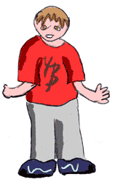
What is it?
A possessive apostrophe is an apostrophe that shows who or what has or owns something.
,
You must use an apostrophe to show possession.
Possessive Apostrophes
For example:
My brother’s shirt is red

Slide 2
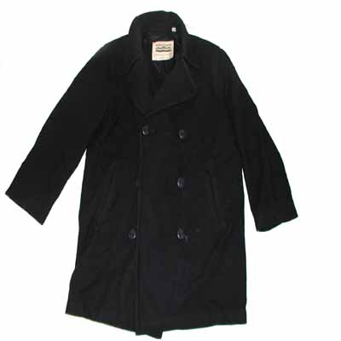
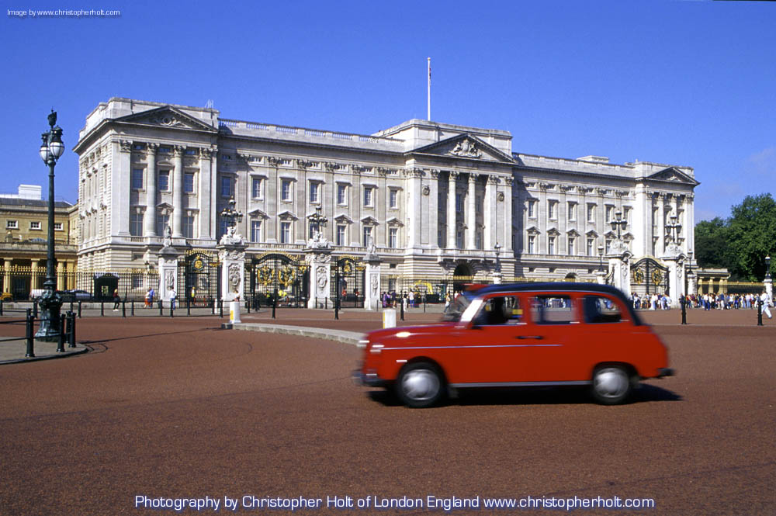
But where should the apostrophe go?
The apostrophe is placed after the name of the owner…
for example: my sister’s cat is fat!
Click to find out where the apostrophe should be placed in the sentences below.
‘
My mum s cooking is amazing!
“Is this Jessica s coat?” the teacher asked the class.
England s weather is usually cold and wet!
My sister s bedroom is a huge mess!
Andrew said that his dad s car is faster than my dad s car.
One of the Queen s homes is called Buckingham Palace.
‘
‘
‘
‘
‘
‘

Slide 3
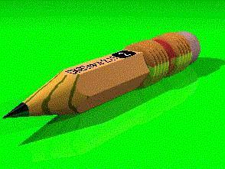
Write some possessive nouns of your own!
Click to see the correct possessive noun in each sentence.
Mr. Usher’s
______________ class is learning about apostrophes.
(The class belonging to Mr. Usher)
I found ___________ pencil on the floor last night!
(pencil belonging to Robert)
_______________ ruler measures 12 inches long.
(Ruler belonging to Courtney)
I found ________________ dog running around in the street today.
(dog belonging to Miss Smith)
“I am going to ______________ house tonight!” yelled Mark.
(house belonging to Kessler)
Robert’s
Courtney’s
Miss Smith’s
Kessler’s

Slide 4
If a noun is plural – that means there is more than one – for example boys then the apostrophe goes on the outside of the s.
’
’
The boys shoes
The boy s shoes
This means the shoes belong to one boy
This means the shoes belonged to more than one boy.
’
The Doctor s surgery
’
The Doctors surgery
This means the surgery belonged to one doctor
This means the surgery belonged to more than one Doctor.
’
The teacher s lounge
’
This means the lounge belonged to one teacher
The teachers lounge
This means the lounge belonged to more than one teacher

Slide 5
Write these sentences and remember to put in the possessive apostrophes.
’
1. The hairdressers salon. (There is more than one hairdresser)
2. The shopkeepers till.
3. Ipswich Town are Mr. Bensons favourite football team.
4. "Is that Johns bike you're riding?" asked Peter.
5. This is the farmers land.
6. "Where is the doctors surgery?" asked the sick man. (There is more than one doctor)
7. The Queens place is beautiful.
8. Johns new bike is really good.
’
’
’
’
’
’
’

