Slide 1
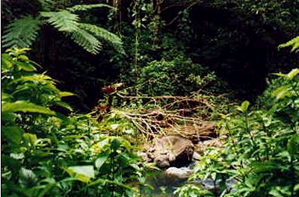
Which foods
come from
RAINFORESTS?

Slide 2
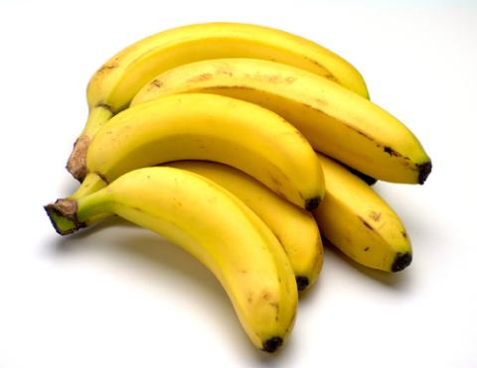
Where do bananas originally come from?
Rainforests of Asia

Slide 3
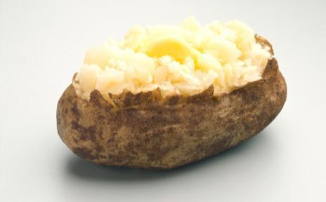
Where do potatoes
originally come from?
Andes Mountains in Peru

Slide 4
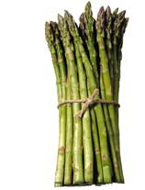
Where does asparagus
originally come from?
Mediterranean Greece

Slide 5
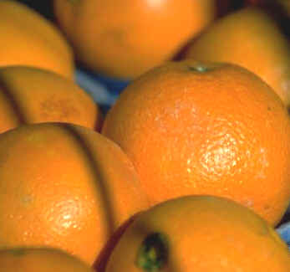
Where do oranges
originally come from?
Rainforests of China

Slide 6
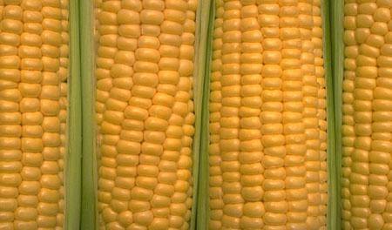
Where does corn
originally come from?
Temperate America

Slide 7
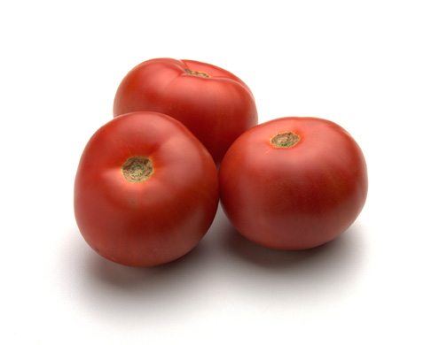
Where do tomatoes
originally come from?
South America

Slide 8
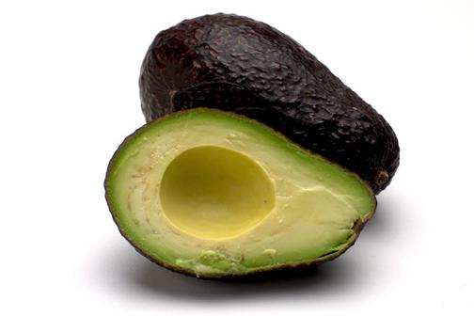
Where do avocados
originally come from?
Rainforests of Mexico

Slide 9
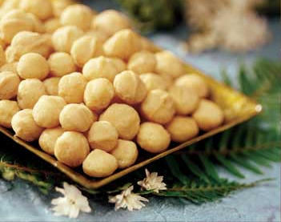
Where do Macadamia nuts
originally come from?
Rainforests of Australia

Slide 10
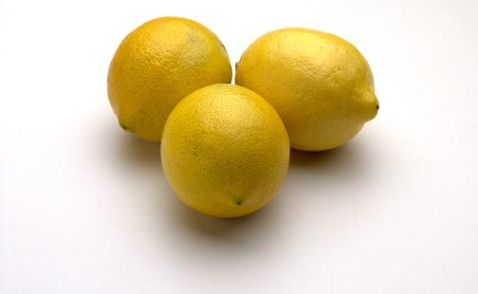
Where do lemons
originally come from?
Rainforests of India

Slide 11
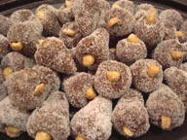
Where do cashew nuts
originally come from?
Rainforests of Brazil

Slide 12
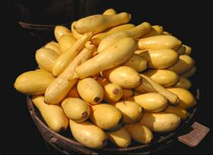
Where does squash
originally come from?
Temperate America

Slide 13
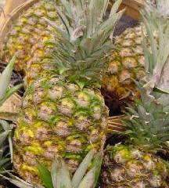
Where do pineapples
originally come from?
Rainforests of Brazil

Slide 14
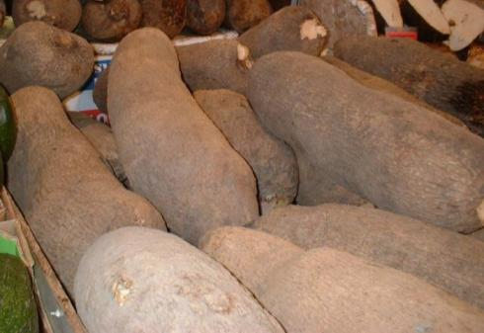
Where do yams
originally come from?
Rainforests of West Africa

Slide 15
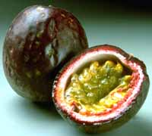
Where does the passion fruit
originally come from?
Rainforests of South America

Slide 16
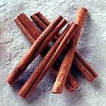
Where does cinnamon
originally come from?
Rainforests of Sri Lanka

Slide 17
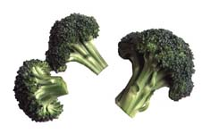
Where does broccoli
originally come from?
Mediterranean Italy

Slide 18

Where do coconuts
originally come from?
Rainforests

Slide 19
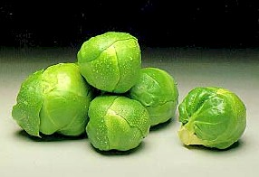
Where do brussel sprouts
originally come from?
Temperate Belgium

Slide 20
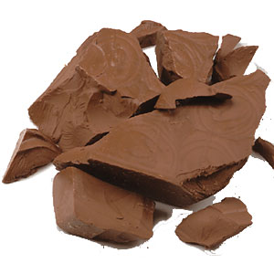
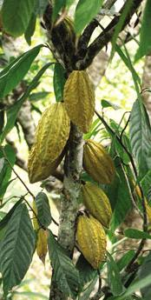
Where does chocolate (cacao)
originally come from?
Rainforests of South America

Slide 21
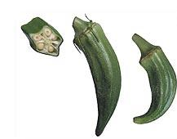
Where does okra
originally come from?
Rainforests of West Africa

Slide 22
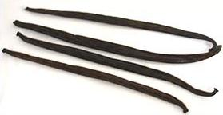
Where does vanilla
originally come from?
Rainforests of
Central America & Mexico

Slide 23
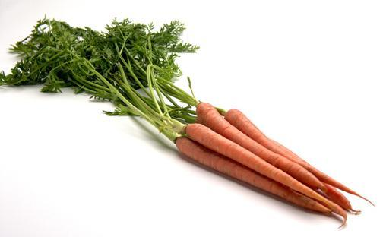
Where do carrots
originally come from?
Temperate Afghanistan

Slide 24
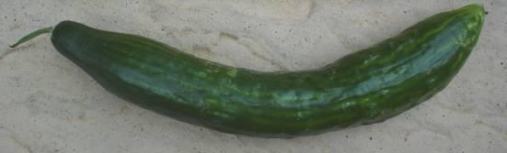
Where do cucumbers
originally come from?
Rainforests of India

Slide 25
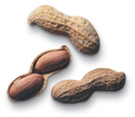
Where do peanuts
originally come from?
Rainforests of South America

Slide 26
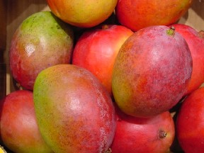
Where do mango fruits
originally come from?
Rainforests of East India

Slide 27
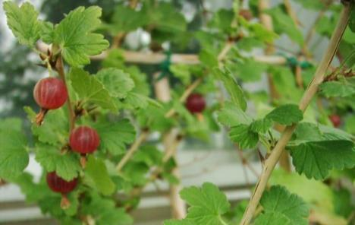
Where do gooseberries
originally come from?
Temperate Caucasus Mountains in Former Soviet Union

Slide 28
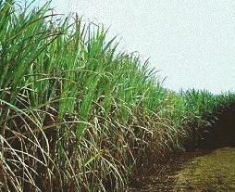
Where does sugar cane
originally come from?
Rainforests of New Guinea

Slide 29
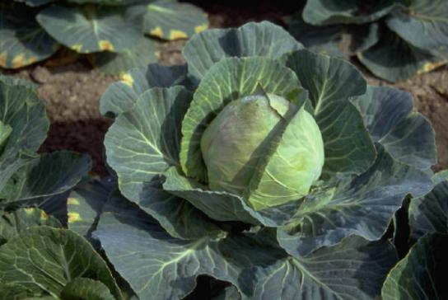
Where does cabbage
originally come from?
Temperate Western Europe

Slide 30
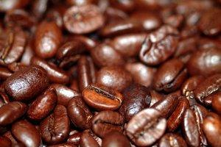
Where do coffee beans
originally come from?
Rainforests of Ethiopia

Slide 31
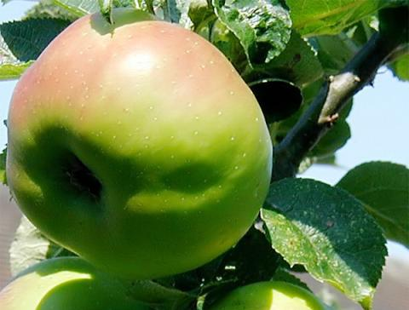
Where do Bramley apples
originally come from?
Temperate Great Britain

Slide 32
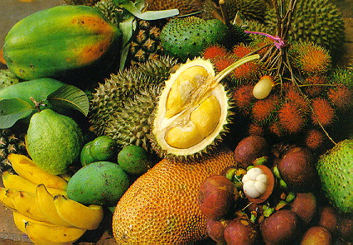
We enjoy many foods from
RAINFORESTS!

