Slide 1
Rainforests
Lesson 2
WALT: to know where the rainforest is

Slide 2
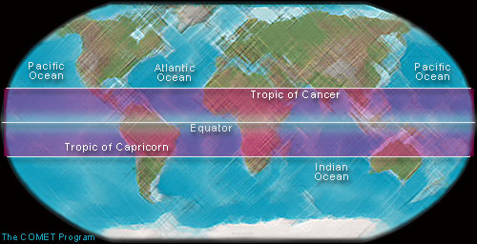

Slide 3
Almost all Tropical Rainforests lie between two imaginary lines north and south of the Equator called the Tropic of Cancer and the Tropic of Capricorn
This is why they are often called tropical rainforests
It has been hot and wet in the Tropics for millions of years
Use your atlas to identify the countries found between these lines

Slide 4
