Slide 1
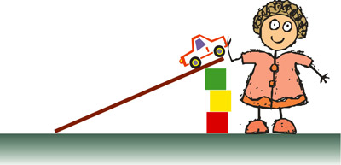
Name:___________________
Question:
When I change ____________________
_________________________________,
what happens to ___________________
_________________________________?
Getting Evidence:
Car Ramp Investigation
Prediction:
A fair test:
The ________ the ramp, the __________ the car will go.
We will keep these things the same:
We will only change:

Slide 2
How do I choose the right equipment for my investigation?
surface
length
ramp
height
size
Equipment
car
other equipment
wheels

Slide 3
Why is it a good idea to take repeat readings?
Making a table for repeat readings:
THINK…
Which heights to test?
Units
Repeats
Average

