Slide 1

UNIVERSITY OF AGRICULTURE, ABEOKUTA
DEPARTMENT OF ANIMAL PRODUCTION AND HEALTH
APH302 (NON-RUMINANT PRODUCTION)

Slide 2
Poultry Production
By
Dr. O.M. Sogunle

Slide 3
Management of Layers (Laying birds)
Stages of Life:
Pullet chicks: day-old to 8weeks (fed on chick mash)
Growing stage: 8-20weeks (Point of cage – 12 to 14 weeks & Point of Lay (POL) – 14-16weeks. (fed on grower’s mash)
Laying stage: 20 to 72weeks (fed on layer’s mash)
Birds should be transferred to the laying quarters (deep litter or battery cages) at 15 to 17 weeks old. The pen must have been cleaned, disinfected and made to rest for about 2 days.
Birds are transferred in well-aerated crates in the morning or evening.
The birds should be without feed for 4 to 6 hours before been transferred.

Slide 4
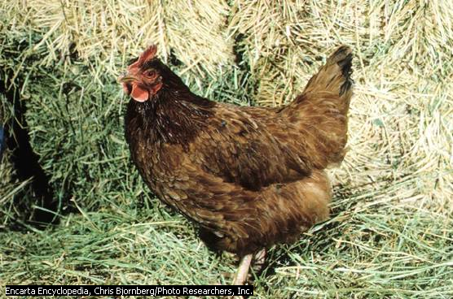
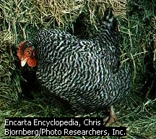
Pictures showing Rhode Island Red Hen & Barred Plymouth Rock Hen

Slide 5
Advantages & Disadvantages of Battery Cage
Advantages
More pullets may be kept/unit area in battery cages that are 3 or more tiers high.
Broodiness is eliminated
Culling (removal of unproductive birds) is made easier.
Less feed may be required per dozen egg.
Eggs can be collected less frequently
Disadvantages
The initial capital outlay is higher because of the cost of the cages and house construction.
Higher percentage of blood spots in eggs
Internal egg quality drops off more quickly
Fly problems are higher with the cage system

Slide 6
Management of layers (Provision of Nest Boxes)
Nest boxes are provided for layers that will be maintained on deep litter.
Nest are preferably lined up near side of the pen away from the sun ray.
Wood shavings should be placed on the floor of the nest box to protect the eggs against breakage and to produce clean eggs.
SIGNS OF ONSET OF LAYING
Birds will start to cackle (make noise with their throat
The combs and wattles will be bright red and when touched, the bird will tend to stoop.

Slide 7
Routine Management Operations on Layers
Dead birds are removed to prevent contamination of other birds that may peck on them.
Fresh feed is added to the stale feed in the trough.
Water troughs are moved out and thoroughly cleaned and replenished with clean and cool water.
Eggs should be collected at least 3 times a day; once at 8-9am, 12-1pm & 4-5pm. Frequent collection of eggs prevents egg breakages and help keeps eggs clean.
Note: 1. Eggs collected should be kept in egg trays or cartoons and should be packed with the small end down.
2. Cracked eggs, leakers and thin-shelled eggs should be kept separate after gathering.
3. Eggs should not be stored for longer than 2 weeks at room temperature to avoid spoilage.

Slide 8
Occasional Management Operation
Culling: This refers to the removal of sick, injured, unproductive and poor producing birds from the flock.
The advantages derivable from culling of birds are:
Prevention of spread of diseases.
Increase in the quality of the stock.
More space is allowed for the remaining birds.
Increase in profits principally by reducing feed required to produce a dozen eggs.

Slide 9
Culling Chart
Part | Laying | Not laying
Pubic Bone | Thin, spread apart (takes 3 to 4 fingers) | Blunt, rigid & close together (takes 2 or less fingers
Vent | Large, smooth, moist | Small, shrunken & dry
Abdomen | Full, soft, pliable | Contracted, hard, fleshy
Comb | Large, smooth, bright red, glossy & soft | Shrivelled, dry, dull and scaly
Ear lobes and wattles | Smooth, soft | Rough, dry

Slide 10




Correct method of catching and carrying poultry (Click on images for larger version) | Holding a hen in a comfortable position | Checking a hen for laying status by measuring the spread of the pubic bones | Checking a hen for laying status by examining the colour and condition of the vent

Slide 11
Management of Breeders
Chickens are also kept as breeders for production of day-old chicks
Breeding stock should be reared far apart from other poultry stock. Breeder may either be for the production of broiler chicks for meat production or for the production of pullets for egg.
NB. Most of the mgt. principles discussed for chickens also apply.
Additional Mgt. & Feeding Principles
Breeding chickens are mainly reared on floors. From the rearing to adult stage, they are given more floor space, more feeds and water.
To prevent indiscriminate mating, males and females are managed separately till maturity.

Slide 12
Additional Mgt. & Feeding Principles
The recommended ratios between males and females in the flock are:
1 male to 12 females – for light birds
1 male to 10 females – for medium-sized birds
1 male to 8 females – for meat-type birds
Breeders may be revaccinated for IBDV at 14-16 weeks of age.
If movement to a separate layer house is necessary, they are moved at 10 to 12 weeks. Movement at a young age prevents stress and ensure possible breaks in Mycoplasma gallisepticum and Mycoplasma synoviae clean status.
The enclosure where the birds (males & females) are kept (though separately)should be made of wire netting so that the birds can see and get used to themselves.
The males should be introduced into the female pens about one hour before dark in order to allow little time for fighting that may ensue.
Note that cockerels (male birds) attain peak fertility at 24 to 26 weeks of age. Only intact males are used for breeding.
The first eggs for incubation should be collected at least 2 weeks after the onset of egg production. Hatching eggs weighing between 50 to 54g should be collected and fumigated immediately.
The diets of the males and females are changed to breeders diets (15% CP & 2850kcal/kg ME) at maturity (24th week for male and Point of Lay for female)

Slide 13
Management of Broiler Chicken
Management similar to that of pullet chicks during brooding but it requires a higher ventilation because they are stocked at a higher density (0.06sq m) from day-old to market weight.
High stocking density informed by the need to ensure profit from floor space and restrict extensive movement which is accompanied by the wasteful dissipation of energy.
The birds are fed broiler starter (0-4weeks) with 23-24% CP and 3200Kcal/kg ME and finisher (5-8weeks) with 20-22% CP and 3200Kcal/kg ME.
A broiler chicken consumes about 2.5 to 4kg or more feeds from day-old to market weight. The FCR is between 2:1 to 5:1.
Under good management, mortality should not exceed 5%.

Slide 14
Management of Turkey
Reared primarily for meat or as breeders to produce hatching eggs. They are rarely kept for the production of table eggs though the eggs are edible.
The facilities required for a certain number of chickens should be doubled for the same number of turkeys. The stocking density is 0.12 sq metre.
Desnooding i.e removal of the snood (a tubular fleshy appendage on the head near the front) is done to prevent head injury due to pecking and also reduce the spread of a disease known as erysipelas.
The vaccination schedule for chickens is also suitable except that turkeys are not vaccinated against IBDV. However, they are vaccinated against blackhead (histomoniasis) disease.
The feeding regime for turkeys reared intensively is as shown below:
Turkey starter diet : 0 -8weeks
Turkey grower diet : 8 – 16 weeks
Turkey finisher diet : 16 – 20 weeks
Turkey roaster diet : > 20 weeks of age.
Turkeys are marketed as meat birds any time from 16 weeks of age. The CP of starter is 28% while finisher has CP of 18 – 20%. The feed intake up to 24 weeks of age is about 25kg/bird.

Slide 15
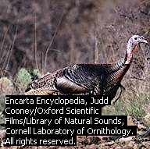
Domesticated Turkey

Slide 16
Management of Turkey (Contd.)
Extensive mgt of turkey requires the establishment of well-managed fenced pasture having ranged shelter.
Wing clippings are practised when the birds are placed on range usually at 15 weeks of age in order to prevent flight.
Toe clipping is also done with the aid of a surgical shears in order to prevent back scratching and tearing of flesh during mating.
Note: Breeding males should not be wing-clipped after 16 weeks as this may toss them off balance.

Slide 17
Management of Breeding Turkey
Turkey starts to produce eggs at about 32 weeks of age.
Potential female breeders and males should be reared separately to allow for the following advantages:
To reduce injury to female due to bruising in the latter stage of growth.
To reduce fighting among the males because they fight less in the absence of females.
To increase the efficiency of feeding the sexes separately
The same diets fed meat turkeys are suitable for breeding turkeys up to the 28th week.
SELECTION OF BREEDERS
Breeders are selected for vigour at 12-16 weeks, 22-24 weeks and 7 months.
The criteria for selection are:
Straight and strong legs (not crooked, no swollen hock, etc)
Potentiality for early market finish: plump well, meaty drumsticks, good breast muscle, rapid feathering, bright round head, good health and livability, good egg production and fertility.

Slide 18
Management of Breeding Turkey
The recommended male to female ratio are as follows:

Slide 19
Ducks and Geese Production
These are known as ‘water fowls’ because of their love for swimming water, though they can be raised without access to swimming water.
They can raised for meat, table eggs and as breeders to produce hatching eggs for ducklings and goslings.
Ducks are mainly kept as free-ranging birds in Nigeria.
Ducks and geese reared for meat may be finished on pastures. They may be allowed outdoors at 4 to 6weeks of age or at 2 weeks in warm weather.
Ducks are not good foragers as geese. It is economical to rear ducks without access to pasture though they can be let out into a yard. Floor space of 0.12sq meter is adequate for fast-growing ducks, 0.45sqmeter for breeders and 100ducklings per hectare on range. Swimming water is essential from 6weeks of age.
Geese are best finished on pastures since they are excellent foragers and weeders. They are stocked at 40-50 birds/hectare. Floor space required is 0.1sq meter.

Slide 20
Management of Broiler Ducks and Geese
They are managed essentially in the same way as chickens. However, the points outlined below are specific for broiler ducks and geese:
They do well in simpler houses since they are fairly hardy and can protect themselves better against marauders.
Less brooder heat (30⁰C)is required during brooding.
Dim all night lights.
Drinking water must be changed frequently (at least 4 times a day) than in the case with chickens.
Water troughs are more suitable . They should be emptied at night and refilled in the morning.
Since duck droppings is extremely wet, more care should be taken to remove wet litter promptly. Mouldy litter should be avoided in order to reduce mortality.
Vaccination (except IBDV ) schedule for chickens adequate..
Ducks and geese should be caught by picking them up by the neck rather than the legs since the legs are easily sprained by handling.

Slide 21
Feeding of Broiler Ducks and Geese
These birds are reared intensively and fed ad libitum.
Ducks and geese starter diets from day old to 3 weeks of age.
Ducks and geese grower diets from 3 weeks to market age (8 or 9 weeks for ducks /12 to 16 weeks for geese).
*Where ducks and geese diets are not available, the respective diets for chickens may be used. At feeding time, the feed could be damped just sufficiently to make it crumble.
Management of Laying Ducks and Geese
Ducks would start laying eggs at between 28 and 33 weeks of age. Sexual maturity is attained at 5 to 7months of age. It is encouraged to bring the birds into production earlier than 7 months because of small egg production and low hatchability.
Geese begin to lay when they are a year old. Young geese lay for only 4-5mths. 15-35eggs/year for Toulouse and 60 eggs/year for Roman & Chinese geese.
In ducks, egg production increases rapidly once sexual maturity is attained. E.g. 250 -360eggs /laying cycle for Khaki Campbell, 80-160eggs for White Pekins & 40 to 130eggs for Muscovies depending on the system of management and feeding. Note that most duck eggs are laid at night and in early morning, hence, ducks should be confined to pens at night.

Slide 22
Feeding of Laying Ducks & Geese
Ducks and Geese can be fed the same diets.
Four types of diets may be used viz.,
Starter diets
Grower diets
Breeder developer: fed at 200 to 250g/bird/day to about 3 to 4weeks before eggs are expected.
Breeder diet fed during the laying period
Note: At 8-10weeks of age, a duck attains 3kg weight with feed efficiency of 0.26 to 0.33.
Mortality can be less than 5%.

Slide 23
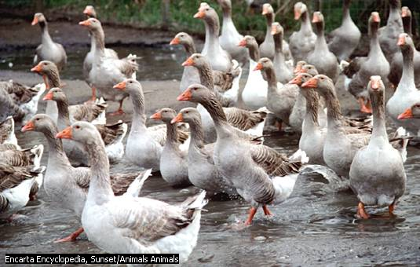
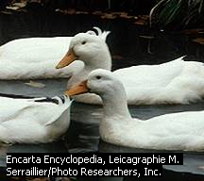
Pictures showing White Pekin duck and Greylag goose

Slide 24
Management of Guinea Fowls
Can be raised intensively though mainly raised extensively or semi-intensively.
The meat has a ‘gamey taste’.
They are not as fast growing as chickens.
They are ready for the table at 12 to 16 weeks of age.
In Nigeria, guinea fowl meat and eggs are from five main colour types or varieties of the helmeted guinea fowl, viz.,
Pearl or grey (Sake), 2. Lavender (Hurudu), 3. Black (Agulu),
4. White (Parareu Zabi) and 5. Grey breasted (Hankaaka)
Guinea fowls are mostly reared on deep litter although they can also be reared in cages.
They retain their ‘feral’ (flighty and wild) behaviour. It is necessary to cut off the last portion of one wing (pinioning) before 2 weeks of age and to clip the flight feathers once every 3 to 5weeks starting from the 4th week of age.
Live weight is about 0.5kg at 6weeks, 0.9kg at 8weeks and 1.3 to 1.5kg at 10 to 12weeks. Subsequent weight gain to maturity is very small.
Floor space is about 0.1sq meter from day-old to market age of 12weeks.
Note: the same health management procedure recommended for chickens should be strictly adhered to for guinea fowl. Mortality is very high in keets.

Slide 25
Feeding of Guinea Fowls
Feeders used for chickens are suitable for guinea fowls.
The following feeding regime is required:
Guinea fowl starter diet : day-old to 8weeks
Guinea fowl finisher diet: 8 weeks to 12-16weeks of age
Guinea grower diet fed to pullets: 8weeks to Point of Lay
Laying diet fed to laying guinea fowls
*In the absence of guinea fowl diets, the respective diets meant for chickens can be used.
Management of Laying Guinea Fowls
They are kept in battery cage or on deep litter.
Egg production begins from 26 to 32 weeks of age. This is seasonal in the indigenous guinea fowls. It begins in March or April and stops in October of the same year thereby laying about 80 to 120 eggs each year.
If they are reared in range, it is important to leave at least one egg in the nest during collection to prevent the birds from making a new nest.
The mating ratio for breeding guinea fowl is 1male to 3 or 4 females. Though they prefer to mate in pairs.
On range, they tend to be monogamous.

Slide 26
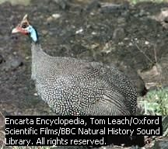
Helmeted Guinea Fowl

Slide 27
Light Management
The effect of light on growth and production is a very important factor. Chicks should be placed on 24 hours of light for the first week. Broilers and capons can then be allowed to follow the natural day length as long as there is at least 14 hours of light provided.
Day length control is very critical for attaining maximum egg production. A basic rule is: Never decrease day length for laying hens.
General guidelines for total of natural and artificial light could be as follows:
  First week after chicks are housed – 24 hours of light
  Two to 6 weeks – 16 hours of light
  Six to 12 weeks – 13 hours of light
  Twelve to 18 weeks – 10 hours of light
  At 18 weeks, increase day length one half hour per week until 15 hours of day length is reached. Laying hens much have a minimum of 8 continuous hours of rest (blackout) per 24 hour period.
Use one 60 watt bulb for laying hens or very young birds. One 25 watt bulb (per 200 square feet of floor space) is adequate for growing pullets, broilers and capons.

Slide 28
Record Keeping
Keep daily, weekly, monthly or yearly records for all types of birds to provide information for:
Acquisition of loan
Allocation of resources in the case of budgeting
Statistical purpose
Future reference or for making projections.
Example: Egg Production Record:
It will include: Number of birds stocked, Mortality or culls, total eggs collected (crates and pieces), eggs sold and amount.
The record may also include:
Items purchased, cost of items, drugs and vaccines used, treatment and date, and balance of returns over expenditure.

Slide 29
Terminologies
Chick: A young chicken less than 6 weeks of age.
Day-old chick: A chick that is 24 hours or less old.
Pullet: refers to a female bird up to the end of her first laying year.
Hen: refers to mature female poultry after the first adult shedding of feathers (female birds in her second or subsequent years of laying)
Cockerel: refers to a male chicken less than a year old
Cock: a male chicken over a year old
A rooster: a fully grown cock with prominent comb and spur
A capon: a castrated male chicken
Table eggs: eggs produced for consumption
A broiler: chicken bred specifically for meat production
A roaster: a young male meat-type chicken grown to heavier weight and it is usually between 12 and 16 weeks of age.
Poussin: refers to poultry bred to be killed at tender age for the table.
Tom: a male turkey (female is hen)
Spent hen/Old layer: refers to female chickens that are disposed off after laying eggs for at least a cycle.

Slide 30
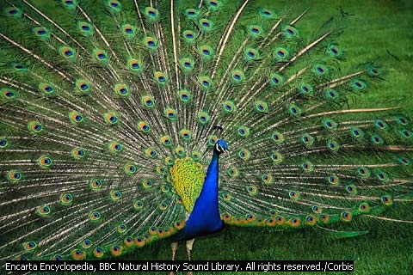
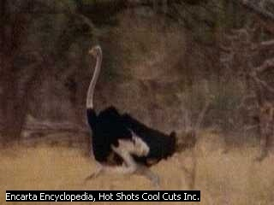
Pictures on Peacock and Ostrich

Slide 31
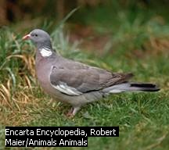
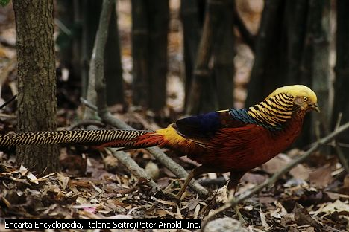
Pictures on Wood Pigeon & Golden Pheasant

Slide 32
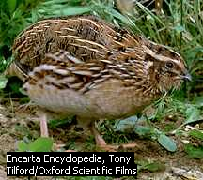
Japanese Quail

