Slide 1
Rabbit Production
By Josh Schaeffer

Slide 2
Types of Rabbit Production
Fanciers
Pets, Breeding Stock, and Show Animals
Laboratory
Fur/Hair
Angora
Rex
MEAT
Largest Rabbit Market

Slide 3
Basics Of Raising Meat Rabbits
Breed Selection
General Management Techniques
Understanding Rabbits
Housing
Feeding
Breeding
Health
Marketing

Slide 4
Breed Selection
Meet demands
White
Fine-boned
Expected litter size
8-10 kits
Personal preference

Slide 5
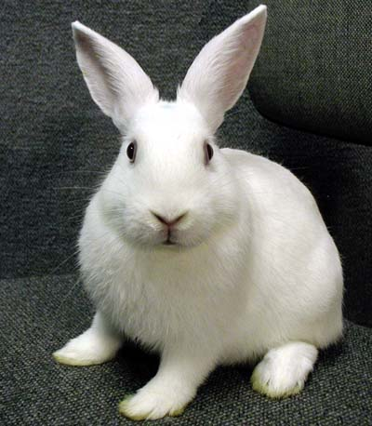
3 Most Popular Meat Breeds
New Zealand (white)

Slide 6
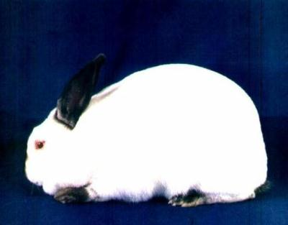
Californian

Slide 7
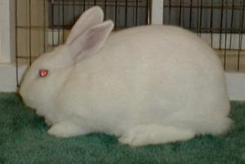
Florida White

Slide 8
General Management Techniques
Understanding Rabbits
Behavior
Normals
Temp. 103.1 degrees F
Heart rate 180-350 beats per minute
Respiratory rate 40-65 breaths per minute
Hair coat
Mucous membranes

Slide 9
General Management Techniques
Housing
Sanitary
Climate Control
Owner-friendly
Types- If you can imagine it, then it exists!
Hanging Hutches
Slants
Stacked

Slide 10
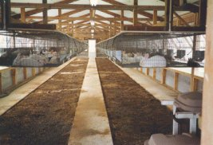
Hanging Hutches

Slide 11
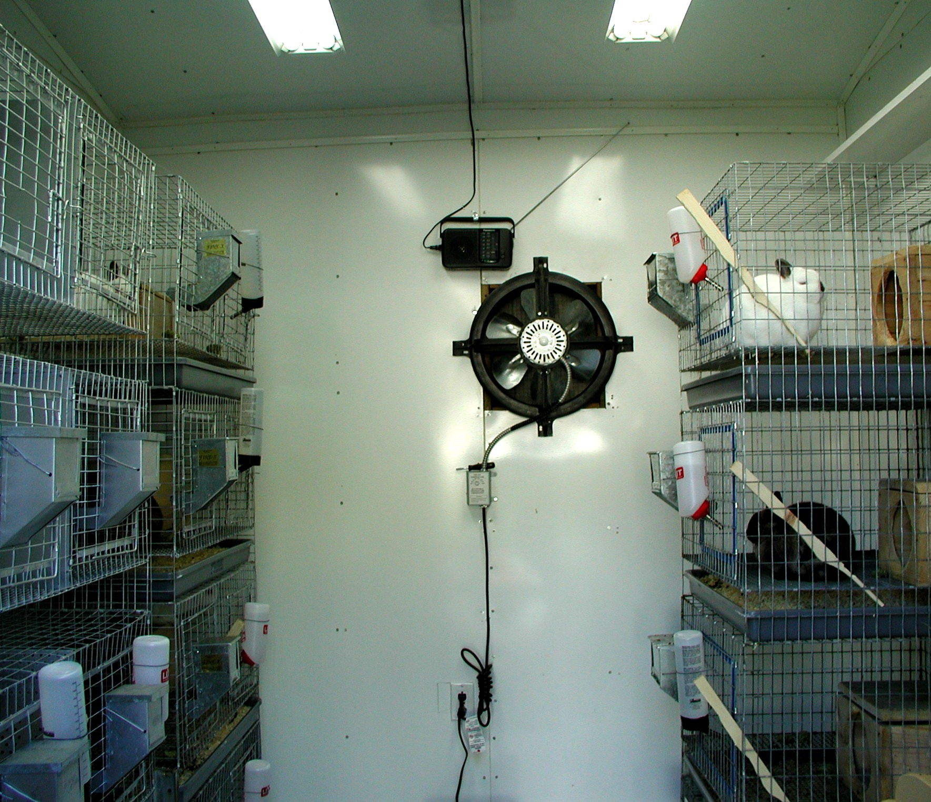
Stacked---Climate Controlled

Slide 12
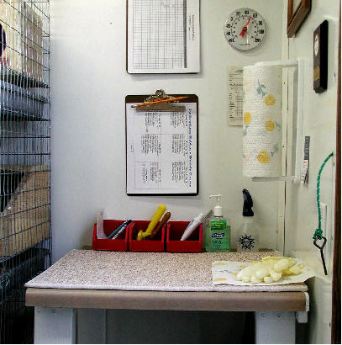
Sanitary & Organized
Recording
Keeping

Slide 13
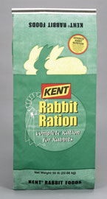
General Management
Techniques
Feeding
Fresh, Clean Water is essential
Pellets
Usually all that is needed
Hay not necessary
Formulated to meet rabbit needs
Hay and Grains

Slide 14
Feed Efficiencies of Common Meat Animals
BEEF | LAMB | HOG | CHICKEN | RABBIT
6-8 lbs feed/lb gain | 4 lbs feed/lb gain | 2.5-3 lbs feed/lb gain | 2 lbs feed/lb gain | 4 lbs feed/lb gain

Slide 15
General Management Techniques
Breeding
KEEP RECORDS!!!!!!
Doe is induced ovulator
In heat 14 out of 16 days
Gestation = 31-33 days
Breeding Schedule
Take doe to buck
Day 10-16: palpate
Day 28: add nest box
Day 31-33: doe kindles

Slide 16
General Management Techniques
Post-kindling
Observe and count kits
Remove dead
Remove nest box 15 to 21 days post-kindling
Wean and rebreed on ~ day 30
Allows for 5 litters per year

Slide 17
General Management Techniques
Health
Sanitation
Pasteurellosis multocida
External parasites
Flies
Fleas
Mites
Internal parasites
Not a major problem

Slide 18
General Management Techniques
Marketing
Pricing
Live sale
Butchered rabbit
Health regulations

Slide 19
The Rabbit Industry
GROWING
Especially in developing countries
Current production estimated at 1.5 million tons
Not large N. American market
No need for animal raised in confinement
Low demand-consumer ignorance

Slide 20
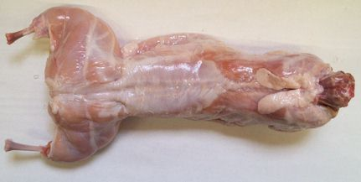
MMMMMMM…….It’s GOOD
Highly nutritious
Fine Grained
Mild flavored
Fryer
Roaster
Inspection
Voluntary
Grading

Slide 21
Rabbit vs. the Rest
This is based on 1 pound of raw meat.
MEAT | PROTEIN | FAT | CALORIES
Rabbit | 20.8 | 10.25 | 795
Chicken | 20.0 | 11.0 | 810
Veal | 18.8 | 14.0 | 910
Turkey | 20.1 | 22.2 | 1190
Beef | 16.3 | 28.0 | 1440
Lamb | 15.7 | 27.7 | 1420
Pork | 11.9 | 45.0 | 2050

Slide 22
NOT get Rich Quick!!
Initial costs are high
Housing
Breeding Stock
Supplies
Annual Costs
Feed
Health program
Upkeep
Labor intensive

Slide 23
Works Cited
Bennet, Bob. Strorey’s Guide to Raising Rabbits.
Pavia, Audrey. Rabbits for Dummies.
“Rabbits.” The Merck Veterinary Manual. pg. 1386-1402.
Food and Agriculture Organization of the United Nations. http://www.fao.org 23 April 2004.
Food Safety and Inspection Service. http://www.fsis.usda.gov 23 April 2004.
Agricultural Alternatives: Rabbit Production. Penn State, 1994.

