Slide 1
Rabbit Production
By Josh Schaeffer

Slide 2
Types of Rabbit Production
Fanciers
  Pets, Breeding Stock, and Show Animals
Laboratory
Fur/Hair
  Angora
  Rex
MEAT
  Largest Rabbit Market

Slide 3
Basics Of Raising Meat Rabbits
Breed Selection
General Management Techniques
  Understanding Rabbits
  Housing
  Feeding
  Breeding
  Health
  Marketing

Slide 4
Breed Selection
Meet demands
  White
  Fine-boned
Expected litter size
  8-10 kits
Personal preference

Slide 5
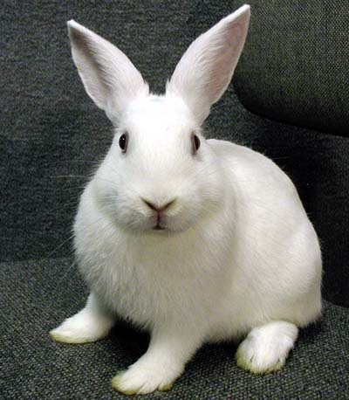

3 Most Popular Meat Breeds
New Zealand (white)

Slide 6
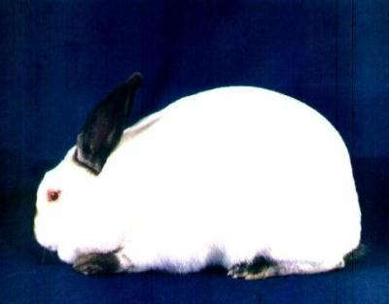
Californian

Slide 7
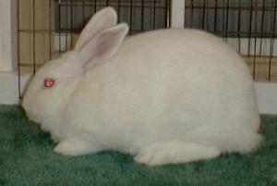
Florida White

Slide 8
General Management Techniques
Understanding Rabbits
  Behavior
  Normals
    Temp. 103.1 degrees F
    Heart rate 180-350 beats per minute
    Respiratory rate 40-65 breaths per minute
    Hair coat
    Mucous membranes

Slide 9
General Management Techniques
Housing
  Sanitary
  Climate Control
  Owner-friendly
  Types- If you can imagine it, then it exists!
    Hanging Hutches
    Slants
    Stacked

Slide 10
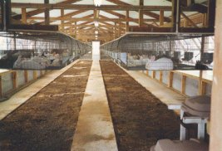
Hanging Hutches

Slide 11
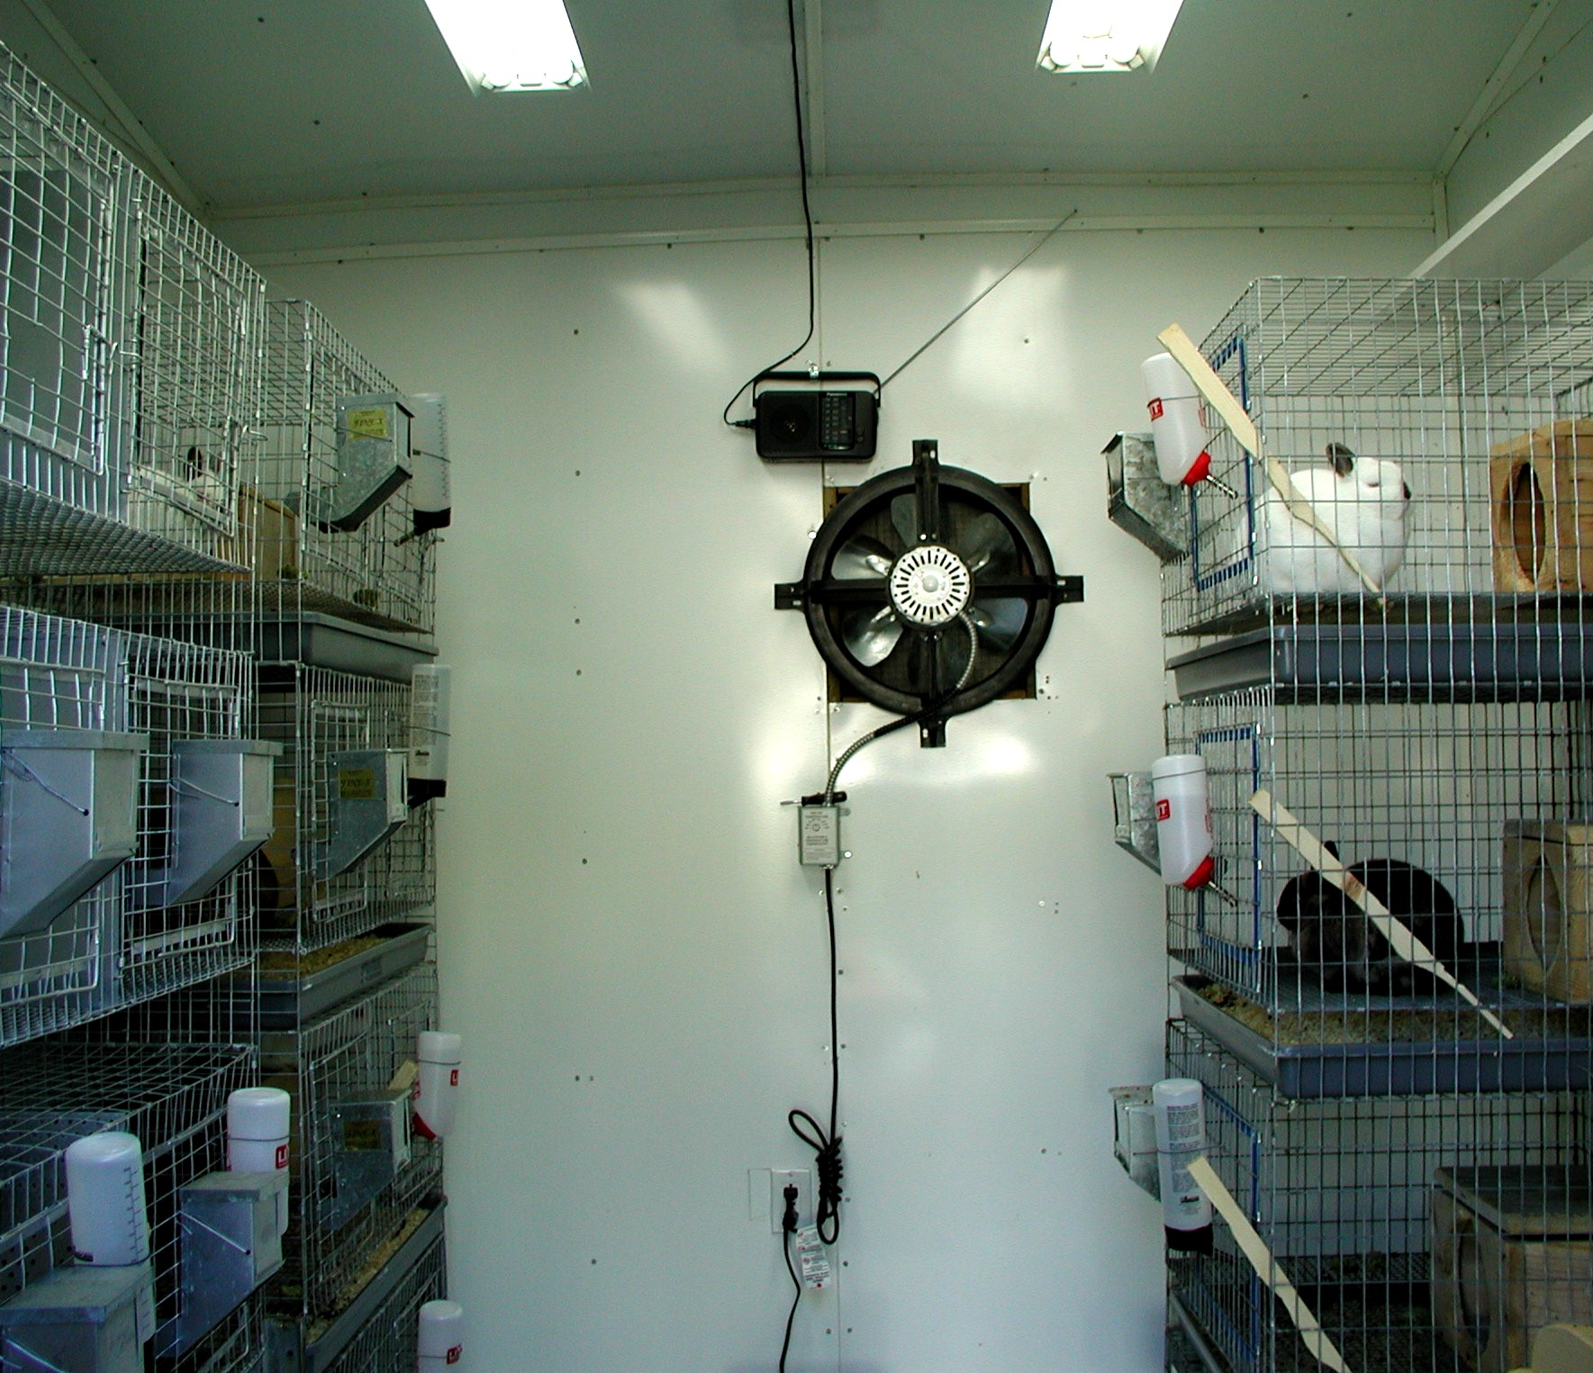
Stacked---Climate Controlled

Slide 12
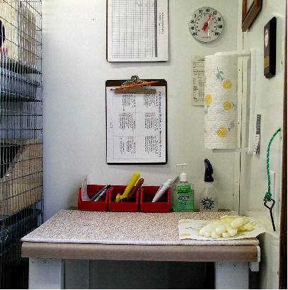
Sanitary & Organized
Recording
Keeping

Slide 13
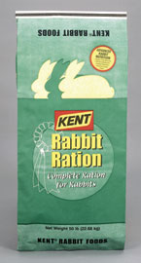
General Management
Techniques
Feeding
  Fresh, Clean Water is essential
  Pellets
    Usually all that is needed
    Hay not necessary
    Formulated to meet rabbit needs
  Hay and Grains

Slide 14
Feed Efficiencies of Common Meat Animals
BEEF | LAMB | HOG | CHICKEN | RABBIT
6-8 lbs feed/lb gain | 4 lbs feed/lb gain | 2.5-3 lbs feed/lb gain | 2 lbs feed/lb gain | 4 lbs feed/lb gain

Slide 15
General Management Techniques
Breeding
  KEEP RECORDS!!!!!!
  Doe is induced ovulator
    In heat 14 out of 16 days
  Gestation = 31-33 days
  Breeding Schedule
    Take doe to buck
    Day 10-16: palpate
    Day 28: add nest box
    Day 31-33: doe kindles

Slide 16
General Management Techniques
Post-kindling
  Observe and count kits
  Remove dead
  Remove nest box 15 to 21 days post-kindling
  Wean and rebreed on ~ day 30
    Allows for 5 litters per year

Slide 17
General Management Techniques
Health
  Sanitation
  Pasteurellosis multocida
  External parasites
    Flies
    Fleas
    Mites
  Internal parasites
    Not a major problem

Slide 18
General Management Techniques
Marketing
  Pricing
  Live sale
  Butchered rabbit
    Health regulations

Slide 19
The Rabbit Industry
GROWING
  Especially in developing countries
Current production estimated at 1.5 million tons
Not large N. American market
  No need for animal raised in confinement
  Low demand-consumer ignorance

Slide 20
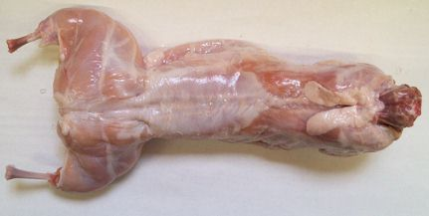
MMMMMMM…….It’s GOOD
Highly nutritious
Fine Grained
Mild flavored
Fryer
Roaster
Inspection
  Voluntary
  Grading

Slide 21
Rabbit vs. the Rest
This is based on 1 pound of raw meat.
MEAT | PROTEIN | FAT | CALORIES
Rabbit | 20.8 | 10.25 | 795
Chicken | 20.0 | 11.0 | 810
Veal | 18.8 | 14.0 | 910
Turkey | 20.1 | 22.2 | 1190
Beef | 16.3 | 28.0 | 1440
Lamb | 15.7 | 27.7 | 1420
Pork | 11.9 | 45.0 | 2050

Slide 22
NOT get Rich Quick!!
Initial costs are high
  Housing
  Breeding Stock
  Supplies
Annual Costs
  Feed
  Health program
  Upkeep
Labor intensive

Slide 23
Works Cited
Bennet, Bob. Strorey’s Guide to Raising Rabbits.
Pavia, Audrey. Rabbits for Dummies.
“Rabbits.” The Merck Veterinary Manual. pg. 1386-1402.
Food and Agriculture Organization of the United Nations. http://www.fao.org 23 April 2004.
Food Safety and Inspection Service. http://www.fsis.usda.gov 23 April 2004.
Agricultural Alternatives: Rabbit Production. Penn State, 1994.

