Slide 1
Relationship formation
(and breakdown)
Foundations in Psychology (C80FIP)
Dr. Fenja Ziegler
Student Office Hours:Thursdays: 1 – 3pm
Psychology, C54

Slide 2
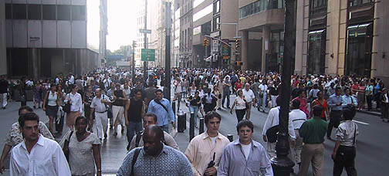

Living in a Social World
Beginning and ending of (romantic) relationships
Interpersonal attraction
Culture and sub-culture

Slide 3
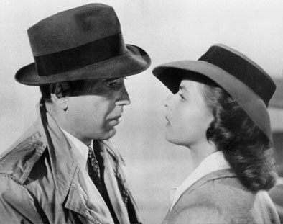
Interpersonal Attraction –
Why do we like some people?
Physical Attractiveness
  The Matching Hypothesis

Slide 4

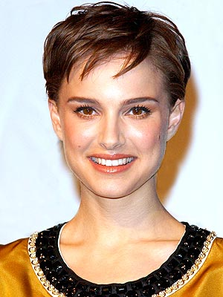

Physical Attractiveness
First impression
Women:
  Large and widely separated eyes, small nose, small chin (like children) – but also wide cheekbones and narrow cheeks (not like children)
Men:
  Square jaw, small eyes, thin lips (not like children)
Halo effect

Slide 5
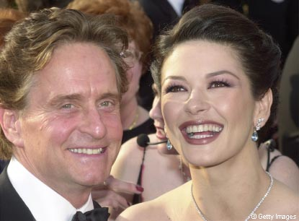
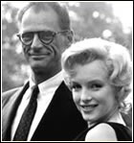
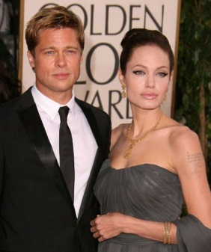
The Matching Hypothesis
Not the most attractive person but a match in attractiveness
  Fear of rejection
  Balance
  Not just physical

Slide 6
Interpersonal Attraction
Physical Attractiveness
  The Matching Hypothesis
Proximity
Familiarity
Attitude
Similarity
Demographic Similarity
Similarity in Personality

Slide 7
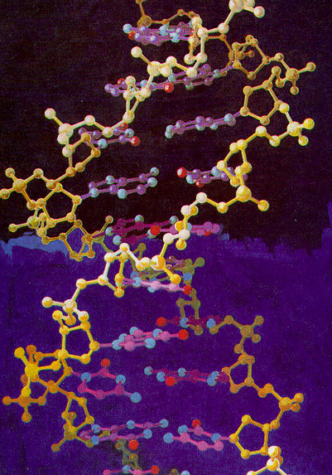
Why do we form Relationships?
– Is it in our genes?
Study experimentally?
Relationships costly:
  Evolutionary adaptive: survival and reproduction
  “Blood is thicker than water” – closeness of families

Slide 8
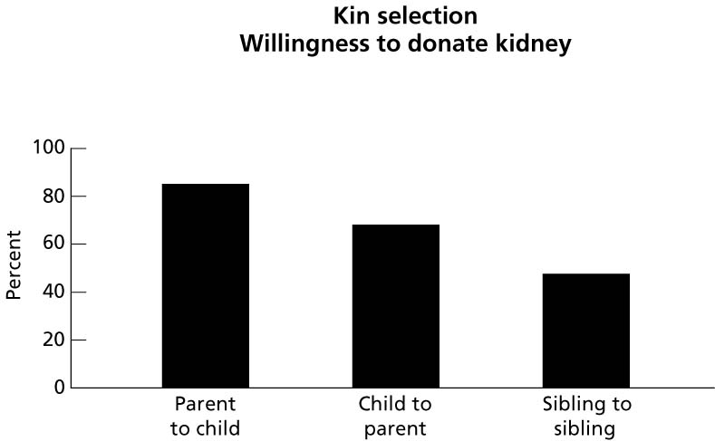
Relatedness drives Helping
See also:
Selfish Gene theory (Richard Dawkins)

Slide 9
Why do we form Relationships? – Is it in our genes?
Study experimentally?
Relationships costly:
  Evolutionary adaptive: survival and reproduction
  “Blood is thicker than water” – closeness of families
Non-reproductive relationships? Non-romantic relationships?

Slide 10
Why do we form relationships?
- Reward, reinforcement, satisfaction
Form friendships/ relationships for rewards and reinforcement
  Approval, smiling, (sex, love, money, etc)
Classical condition
  Neutral stimulus + reward → positive feeling
More time with people who reward
Less time with people who punish
Relevant to early stages, parents/ children?, selfish?, context of reinforcement, individualistic/ male?

Slide 11
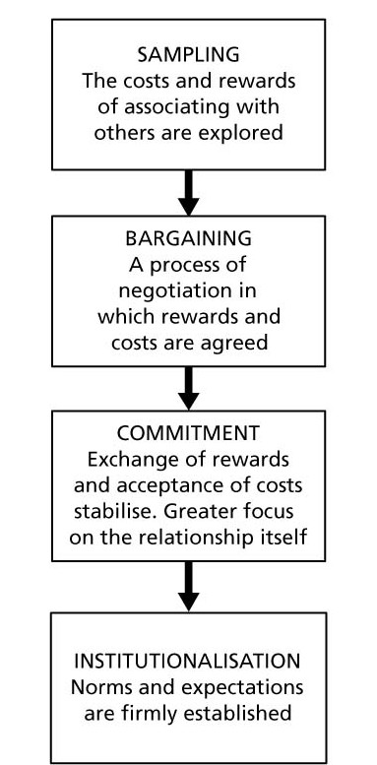
Economic Theories
4 Stages of Relationships/ Friendship
Maximise rewards, minimise the costs:
  Cost:reward ratio
  Thibault and Kelley, 1959
  Comparison level (previous experience)
  Comparison level for Alternatives
Equity theory (stresses fairness)
Descriptive, but research not informative

Slide 12
Maintenance of Relationships
Self-disclosure
  Sternberg (1986)
  Social penetration theory (Altman & Taylor, 1973)
Commitment
  Investment model (Rusbult, 1980)
  Maintenance strategies
    voice • loyalty
    neglect • exit

Slide 13
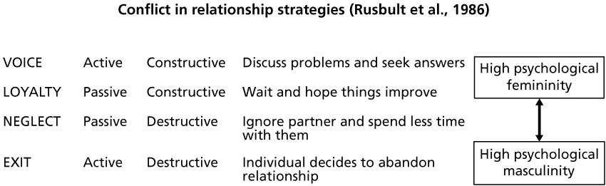

Slide 14
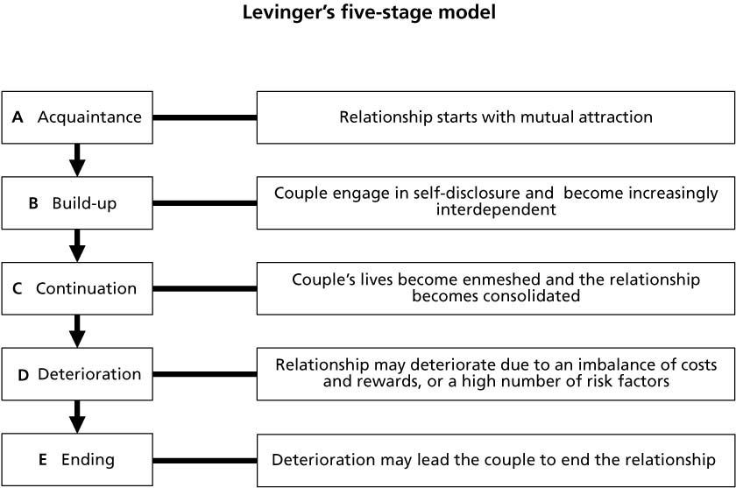

Slide 15
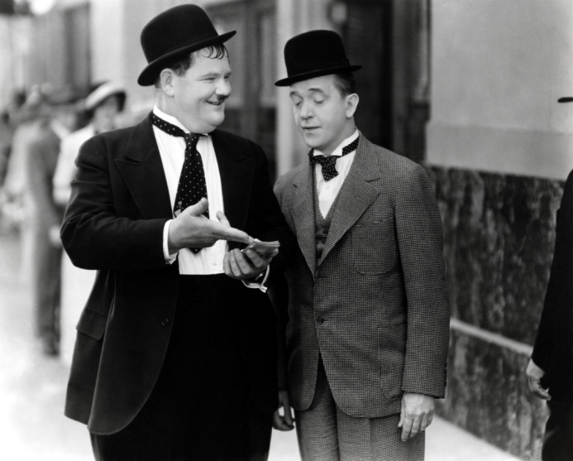
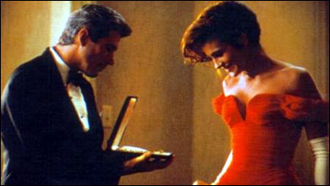
Relationship rules
Argyle and Henderson (1984) 6 rules:
    1. Trust and confide in the other person
    2. Show emotional support
    3. Share news of success
    4. Strive to make the friend happy
    5. Volunteer help in time of need
    6. Stand up for a friend in his or her absence

Slide 16
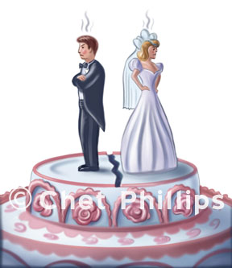
Breakdown of Relationships
Many reasons for break-up
Reasons depend on
  The particular circumstances
  Their particular characteristics
Some end in bitter recrimination
Others are handled in a civilised way
Similar processes tend to be involved in all break-ups

Slide 17

Relationship Survival
Social exchange theory (Levinger, 1976)
Marriage survival depends on 3 factors
  the attractions (sexual and emotional)
  the barriers to leaving the marriage
  the presence of attractive alternatives
Can explain why not all unhappy relationships end in breakdown
But why do they become unhappy?

Slide 18

Psychological Explanations of Love
Sternberg’s (1986) triangular theory
  Love consists of three components
    intimacy, passion, and decision/commitment
Liking and loving
  The love quiz (Hazan & Shaver, 1987)
Romantic and companionate love
  Berscheid and Walster (1978)

Slide 19
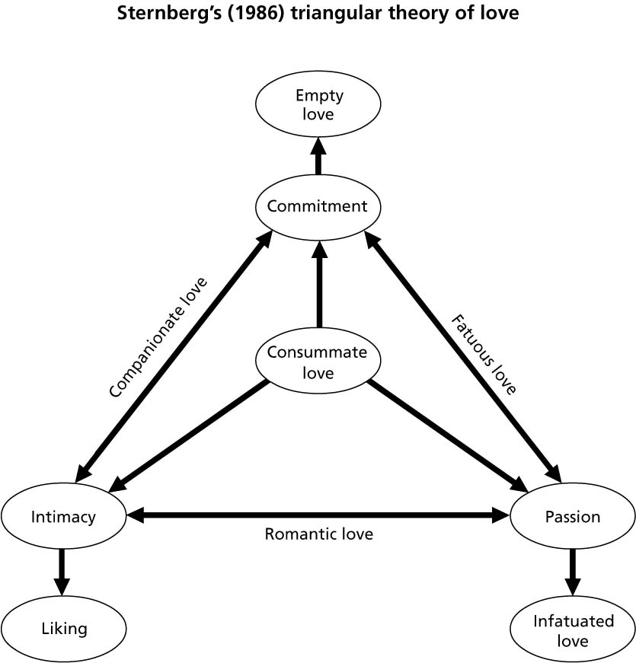
Commitment; No passion, Intimacy
Commitment, passion; No intimacy
Intimacy, commitment; No passion
Intimacy, passion;
No commitment
Intimacy;
No passion, commitment
Passion; No commitment, intimacy

Slide 20
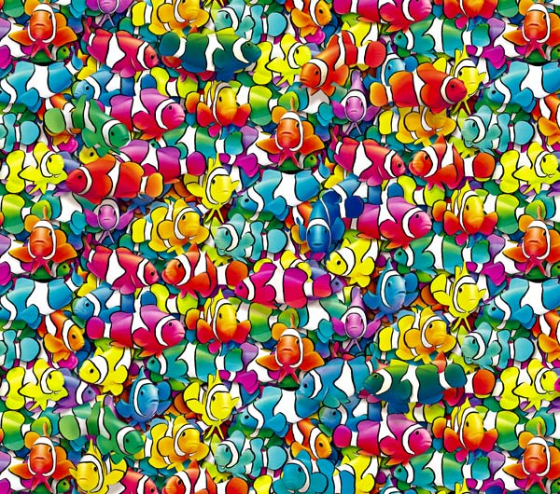
Relationships in Cultures
Individualist and collectivist cultures (Goodwin, 1995)
Romantic love (Levine et al., 1995):
  More important individualistic
Friendships:
  Fewer but closer in collectivist
Voluntary and involuntary relationships (Shaver et al., 1991)
  About the same level of happiness
Permanent and impermanent relationships (Simmel, 1971)
  Divorce rare higher in individualistic cultures

Slide 21

The End…
Reading: Chapter 2

