Slide 1
Peer Pressure and Refusal Skills
Your friends are trying to persuade you to go to a party, but you aren’t sure because you don’t know the person who’s throwing the party.
What will you do?

Slide 2
Lesson Objectives
In this lesson, you’ll learn to:
Demonstrate refusal strategies and apply skills for making responsible decisions under pressure.
Classify forms of communication such as passive, aggressive, or assertive.
Analyze the relationship between the use of refusal skills and the avoidance of unsafe situations.

Slide 3
Peer Pressure
Peer Pressure
Your peers can sometimes influence how you think, feel, and act.
Peer pressure can have a positive or negative influence on your actions and behaviors.
It is useful to learn to evaluate forms of peer pressure and develop healthful strategies for responding to it.

Slide 4
Peer Pressure
Positive Peer Pressure
Peers can influence you in many positive ways.
Positive peer pressure may involve not participating in risky behaviors or activities.
You can also use positive peer pressure to influence others in healthful ways.
You can be a role model by inspiring peers to take part in a positive act or a worthwhile cause.

Slide 5
Peer Pressure
Negative Peer Pressure
Peers sometimes pressure others to take part in behaviors or accept beliefs that have negative consequences.
Negative peer pressure can involve harassment, which includes name-calling, teasing, or bullying.
Negative peer pressure may also lead some teens to engage in behaviors that go against their values.
Manipulation is another way of exerting negative peer pressure on others.

Slide 6
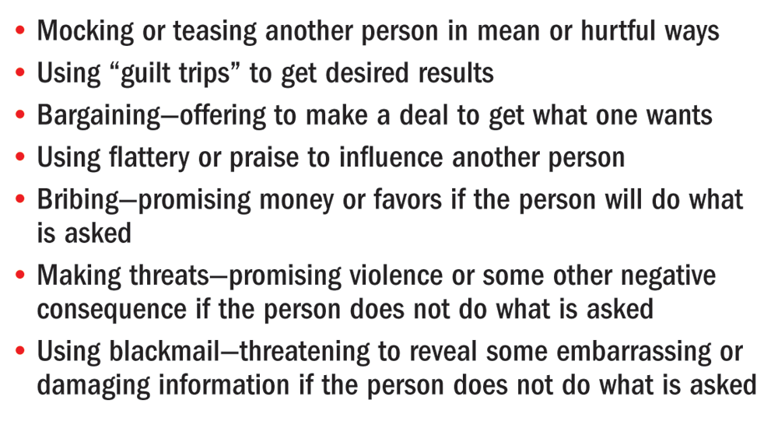
Peer Pressure
Common Methods of Manipulation

Slide 7
Resisting Negative Peer Pressure
How to Resist Peer Pressure
One way to resist negative peer pressure is to avoid it.
Develop friendships with people who share your values and
interests.
Have friends who stand by you and support your decision.

Slide 8
Resisting Negative Peer Pressure
Things to Remember When Faced with Peer Pressure
It is important to
remain firm and stay
true to yourself.
Make decisions that
have the best possible
effect on your
well-being.
Your health and
safety come first.
Respect yourself,
stand by your values,
and be assertive in
your refusal.

Slide 9
Resisting Negative Peer Pressure
Assertive Refusal
Assertive communication is when you state your position and stand your ground while acknowledging the rights of others.
This is the most effective approach when facing negative peer influences.

Slide 10
Resisting Negative Peer Pressure
Refusal Skills
Effective refusal skills involve a three-step process.
State your position. Give an honest reason for your response.
Offering a legitimate reason will help strengthen your refusal.
Suggest alternatives. Your suggestion is most effective if it takes you away from the dangerous or unpleasant situation.
Stand your ground. Use strong body language and maintain eye contact.

Slide 11
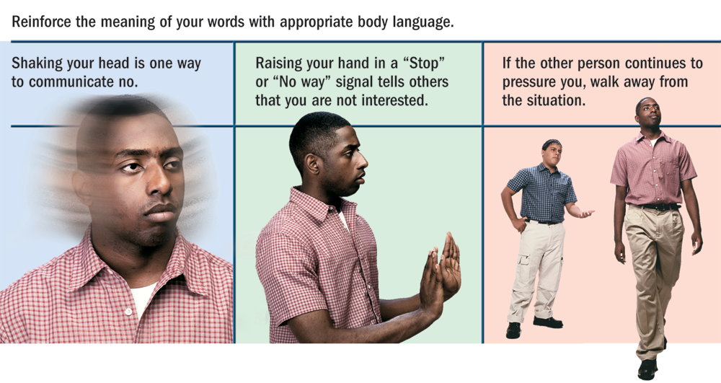
Resisting Negative Peer Pressure
Body Language and Assertive Refusal

Slide 12
Resisting Negative Peer Pressure
Passive and Aggressive Responses
To some people, a passive response to negative peer pressure seems more natural.
Teens who respond passively to peer pressure may believe they are making friends by going along.
Passive people may be viewed as pushovers who aren’t worthy of respect.
Passive Responses
Aggressive
Responses

Slide 13
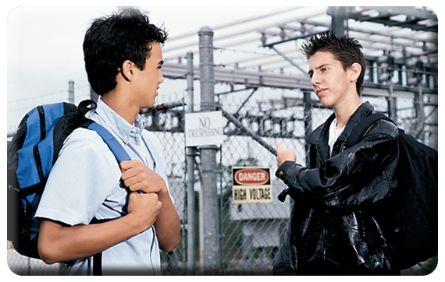
Resisting Negative Peer Pressure
Assertive Communication
Learning and practicing assertive communication is the most effective way to deal with peer pressure.
Being assertive will help you resist negative peer pressure today, and it will also serve as a useful skill throughout your life.

