Slide 1
The River Thames
What do we know?

Slide 2
Vocabulary
Meander
Tributary
Source
Mouth
Tidal

Slide 3
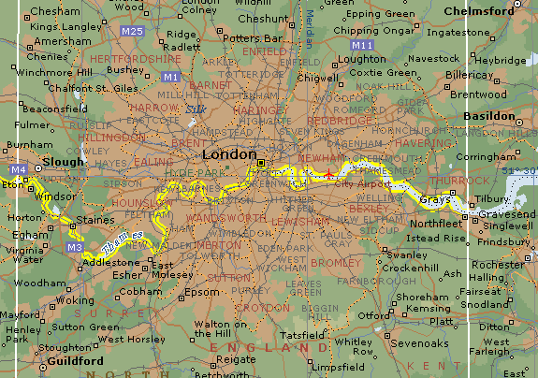
A map of the River Thames Does the path of the river run from West to East or North to South?

Slide 4
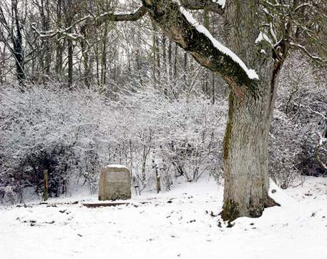
Have you any idea what this might be?

Slide 5
The source of the River Thames
You will find this simple monument about a quarter of a mile across the fields from the King's Head pub in Kemble, near Cirencester in the Cotswolds. It bears this inscription:
THE CONSERVATION OF THE RIVER THAMES 1857-1974 THIS STONE WAS PLACED HERE TO MARK THE SOURCE OF THE RIVER THAMES

Slide 6
Where does the Thames end?
The Thames is 344km long and its mouth is near Southend where it flows into the the North Sea
As the mouth of the Thames is very wide it is also called an estuary

Slide 7
Can we see the River Thames?
The Thames

