Slide 1
Seaside
Destinations

Slide 2
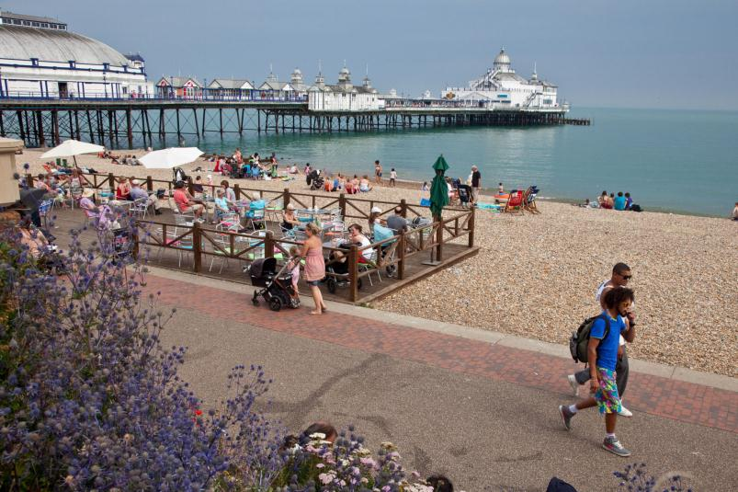
Eastbourne

Slide 3
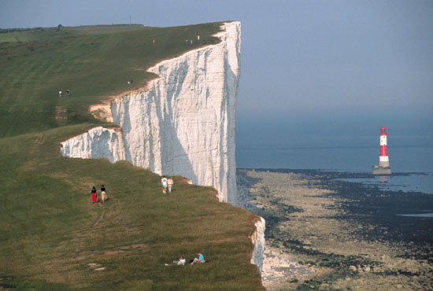
Dover

Slide 4
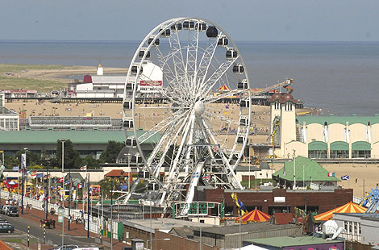
Great Yarmouth

Slide 5
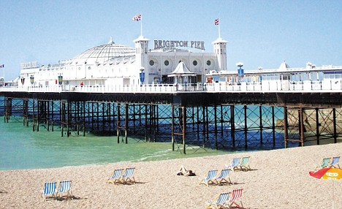
Brighton

Slide 6
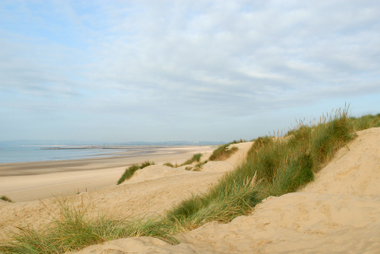
Camber Sands

Slide 7
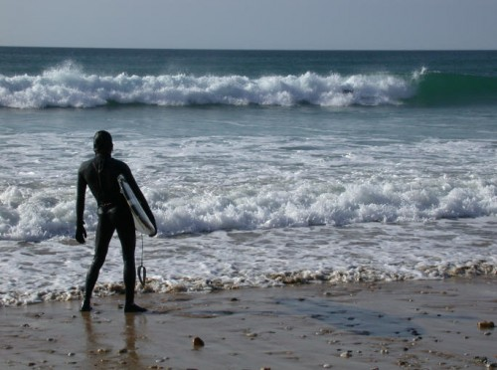
Newquay

Slide 8
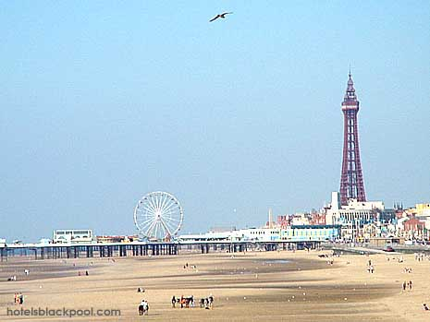
Blackpool

Slide 9
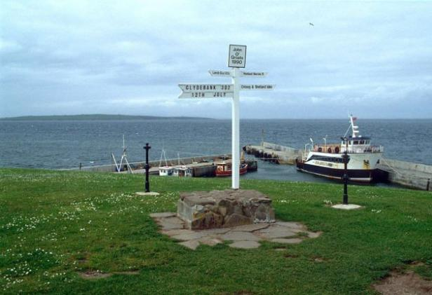
John O'Groats

Slide 10
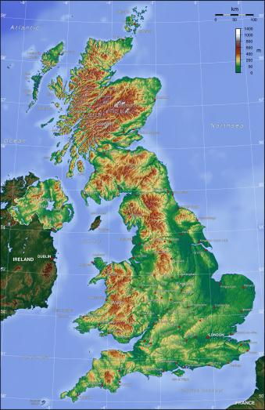
The United Kingdom
John O’Groats
Blackpool
Redhill
Dover
Newquay
Brighton

Slide 11
Where is West Wittering?
West Wittering

