Slide 1

Seasons

Slide 2

Do you know the season?

Slide 3

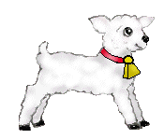

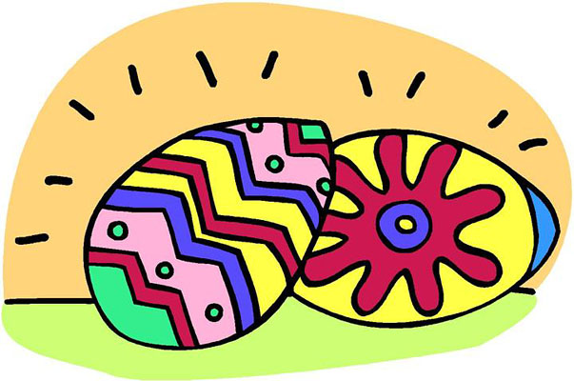
Spring

Slide 4
Summer

Slide 5
Autumn

Slide 6

Winter

Slide 7
Do you know the season?

