Slide 1
Dairy Cattle
Introduction

Slide 2
Unit Map: Follow Along in your packet
WHAT ARE YOU LEARNING? AS.06.02 Basic: Recognize, ID, and Eval disease and parasites in animals
AS.03.01: ID breeds and species

Slide 3
Know Understand Do!
Know
Types of Dairy Cattle
Industry Procedures
Care Procedures
Understand
Variation in cattle purposes
Milking and Dairy Food Processing
Disease Prevention Methods
Do
Profile Dairy Cattle
Outline Milking
ID common Diseases

Slide 4
Key Learning: Dairy Cattle Industry
Unit EQ: How can consumers influence the Dairy Industry?
Concept : Types
Lesson EQ:
How are dairy breeds selected?
Vocab
Concept : Industry
Lesson EQ:
How is the Dairy industry so efficient
Vocab
Iodine Solution,
Concept : Care and Diseases
Lesson EQ:
How can disease effect industry?
Vocab

Slide 5
Dairy Cattle
Breeds

Slide 6
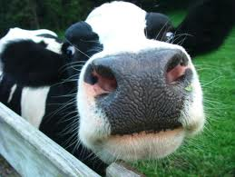
Warm-up
First thing that comes to mind when you see….

Slide 7
Lesson Essential Question
How are Dairy Breeds Selected?

Slide 8
Holstein
Dominate the industry
+90% of the dairy cattle in the US
Officially known as Holstein-Fresians
From Netherlands and Northern Germany
Arrived in US in mid-1800s
Typically black and white in color
Total milk solids % are lower
Solids refer to milk fat solids found in milk. These are used to determine quality and use of the milk produced by that breed of cattle

Slide 9
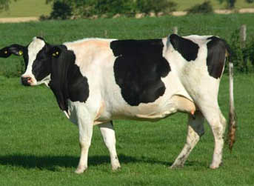
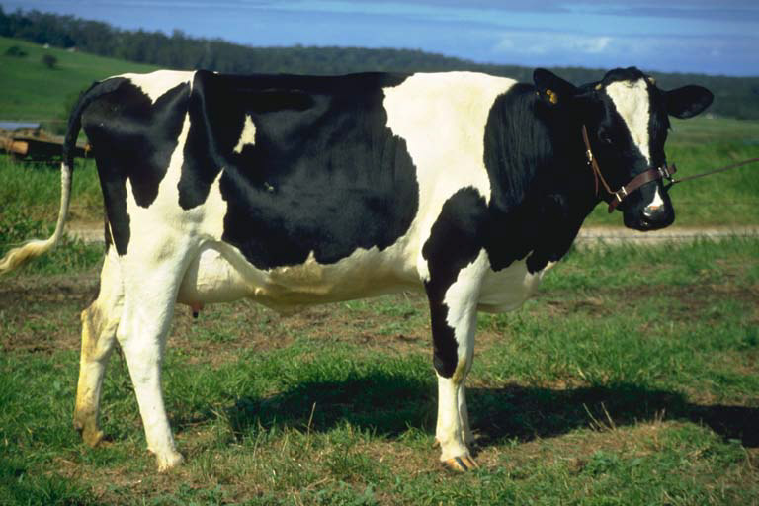
Holstein

Slide 10
Jersey
2nd in popularity
Developed on the island of Jersey, off the coast of France
First imported early 1800s
Coat color ranges from light tan to almost black
Ability to efficiently convert feed to milk
Lower body maintenance needs
Amount of milk produced per cow is lower
Total solids %- highest of all breeds

Slide 11
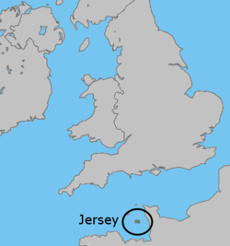
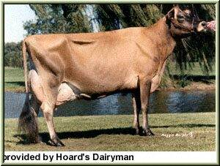
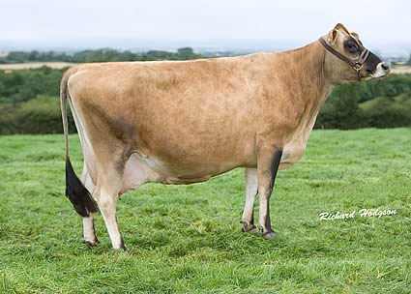
Jersey

Slide 12
Brown Swiss
3rd most popular
Originated Switzerland
Came to US in mid-18002
Normally brown to gray
Similar to Holsteins in size
Known for ability to produce milk in hot climates
2nd in milk production
Total solids % in middle of all breeds

Slide 13
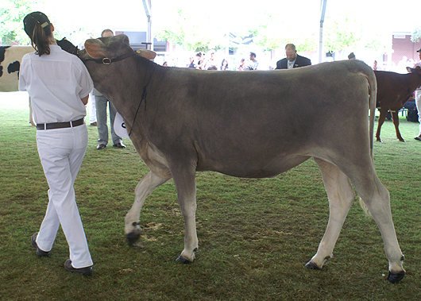
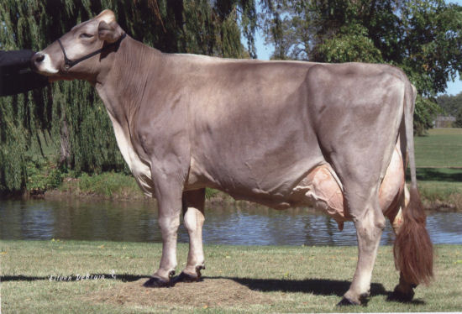
Brown Swiss

Slide 14
Ayrshire
Red and white
Imported early 1800s
Milk production midrange of all breeds
Total solids % low
Originated Ayr district of Scotland

Slide 15
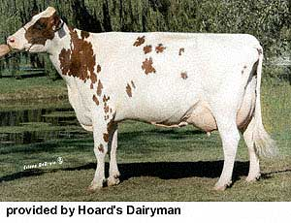
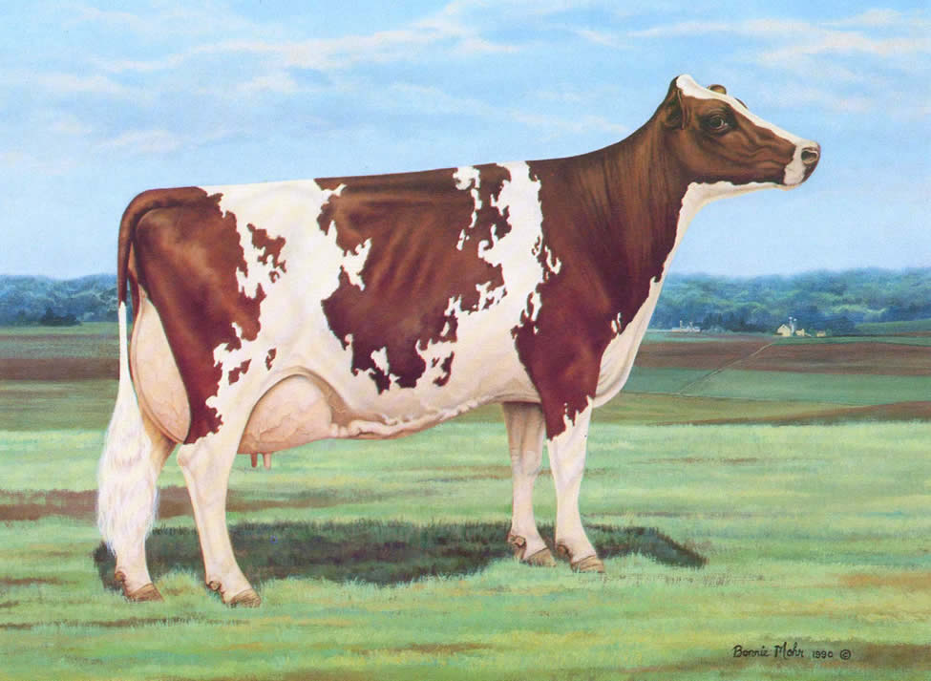
Ayrshire

Slide 16
Guernsey
Developed Island of Guernsey (coast of France)
Imported early 1800s
Medium sized red and white breed
Golden Guernsey milk lower in total solids then Jersey milk
Deep yellow/golden milk due to beta carotene (precursor to vitamin A)

Slide 17
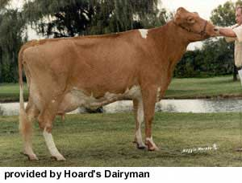
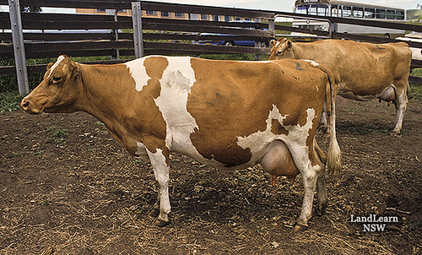
Guernsey

Slide 18
Milking Shorthorn
3,150 in 2008
Originated from base stock of beef shorthorns and may be red, white, red and white or roan.
Known for high levels of fertility, grazing efficiency, and ease of management

Slide 19
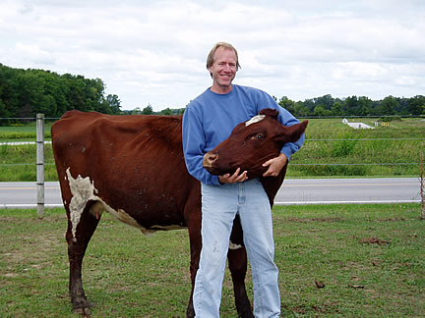
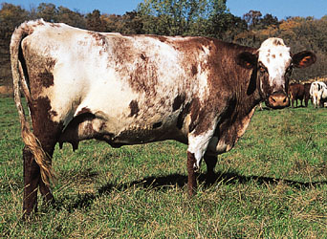
Milking Shorthorn

Slide 20
ID- Tell me what breed the picture is

Slide 21
ID- Tell me what breed the picture is

Slide 22
ID- Tell me what breed the picture is

Slide 23
Dairy Judging for Production
Competition between farmers
Compete for money and prestige within the industry
Dairy Cattle Judged On:
Physical Appearance
Fore legs, Rear Legs, Utter, Hooks, Pins, Top Line (Spine)
Other areas to consider when choosing cattle for production:
Mothering ability, efficiency on feed and grass, Quality of Milk, Milk solids and fat

Slide 24
Activity
Students will be given a packet on how to judge dairy cattle. They will answer the questions and then judge the pictures they are given.
Answer the following summary questions
Who designed the judging booklet?
What categories are dairy cattle judged on? (in the front of the packet)
Explain what the judge would be looking at/for each of the 4 categories.
Write a sentence using the following for each of the 4 categories
Positive Term
Negative Term
What should you do when placing a heifer class?
What do we find on dairy scorecard?
What is the typical judging format for a contest?
Give one helpful hint in deciding a placing
Explain how someone would present and prepare oral reasoning when judging cattle
Why would we have these contests?

Slide 25
Dairy Cattle
Industry Overview

Slide 26
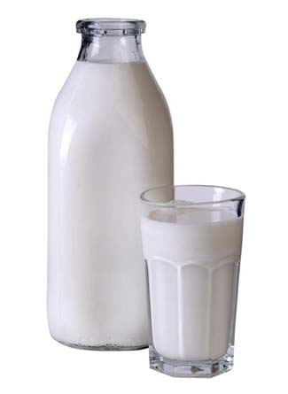
Warm-up
What do you think of when you
see this?

Slide 27
Essential Question
How is the Dairy industry so efficient ?

Slide 28
Dairy Cattle Industry
Most difficult to manage
High producing dairy cows bred to give large amounts of milk that can overwhelm the animal without proper management
Value of dairy products exceeded $37 billion nationally
Most labor intensive
Milking 2-3 times a day, 7 days a week
Consumer demand lower fat diets
Food scientists respond with specialty items
Ex: Fat-free yogurt, cream cheese, and frozen dairy deserts

Slide 29
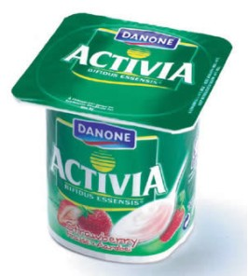
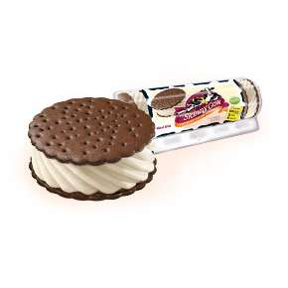
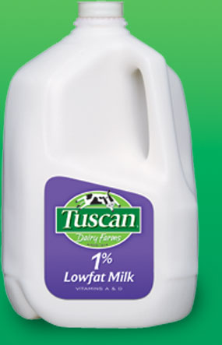
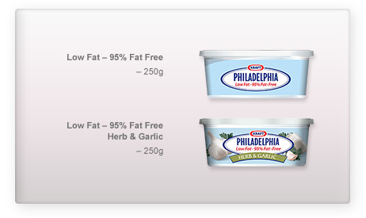

Slide 30
Dairy Cattle Industry
Rank in Production- top 5
California
Wisconsin
New York
Pennsylvania
Idaho

Slide 31
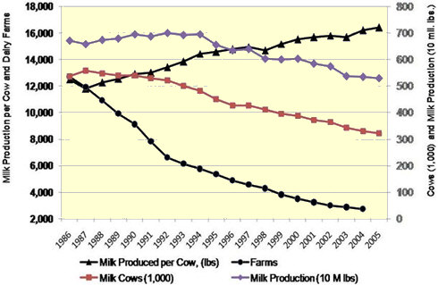
Dairy Cattle Industry

Slide 32
Dairy Cattle Industry: Important Trend
Fewer dairy farms own more cows but still more milk per farm because of more milk per cow

Slide 33
Dairy Cattle Industry
2008- 70,000 operational dairy farms
40 years ago- 2 million dairy farms
# of farm declines, but pounds of milk increased by 20,000 pounds per cow
2009- 9.2 million dairy cows in the US produced over 185 billion pounds of milk worth over $37 billion
US leads the world in milk production per cow and in total milk production

Slide 34
Hoard’s Dairyman Activity
Choose your magazine.
Answer the following:
What is the Hoard’s Dairyman?
Why would this magazine be produced?
Choose an article in the magazine. Read the magazine. Provide a summary. Include something interesting you learned in the article. Why do you think this article was written.
Find 3 patterns you notice throughout the magazine. Explain the patterns
What sort of products do you see? What are they used for?
These magazines contain research related articles. Find a research related article and explain what was researched, why it was researched, and why dairy farmers might find the information useful. Does the research suggest a change in practices? If so, what changes?
Why would this periodical (magazine regularly printed) be an asset to the Dairy industry?

Slide 35
Dairy Cattle
Milking

Slide 36
Milking
Cows are milked 2 times a day, some 3 times
Fill in organizer as we go

Slide 37
The Milking Process
1. At milking time, wash the teats, wear gloves
Disinfecting the teats and triggers the release of oxytocin, which initiates milk let-down

Slide 38
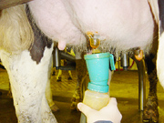
The Milking Process

Slide 39
The Milking Process
2. Teats are then dried with individual paper towels

Slide 40
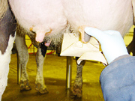
The Milking Process

Slide 41
The Milking Process
3. One inflation of the milking claw is placed on each teat or quarter

Slide 42
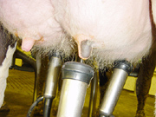
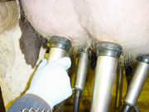
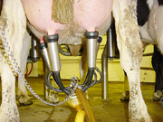
The Milking Process

Slide 43
The Milking Process
4. Vacuum applied to claw, which draws the milk from the udder. Flow meter determines amount of milk being produced by cow

Slide 44
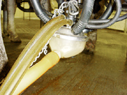
The Milking Process

Slide 45
The Milking Process
5. When milk stops, flow meter reads 0 milk intake and milking claw falls off automatically

Slide 46
The Milking Process
6. Each teat is then dipped in Iodine to prevent bacterial invasion
Total time: 7 minutes

Slide 47
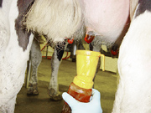
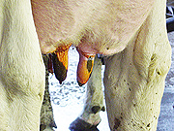
The Milking Process

Slide 48
Let’s Practice!
Milking Lab
Gloves, Cotton Balls
What does the glove represent?
What does the cotton ball represent?
Why is this an accurate representation for milking?
Why might this NOT be an accurate representation for milking?

Slide 49
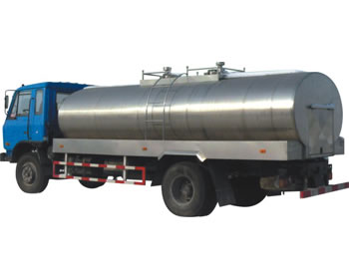
Now What?
Milk from all cows is collected into a large vat (holding container)
Normally underground to protect from extreme temperatures
Milk is transferred to a transport truck and taken to the processing plant.

Slide 50
Milk Processing Procedures
Read your Article
Answer your Questions
Make a graphic organizer outlining the milking process

Slide 51
Dairy Cattle
Parasites and Diseases

Slide 52
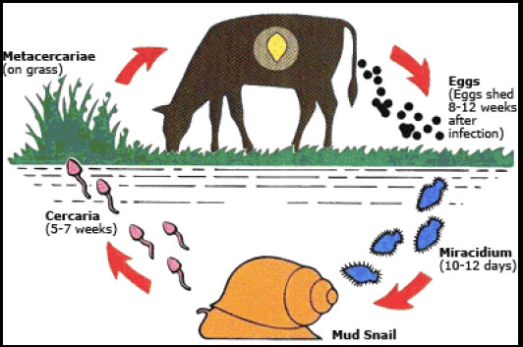
Warm-up
What does this explain?

Slide 53
Lesson Essential Question
How can disease influence the dairy industry?

Slide 54
Mastitis
Infection and inflammation of the udder
Causes greatest economic loss to the industry
Acute-hot, swollen udder-drop in milk production
Treated with antibiotics

Slide 55
Ketosis
Metabolic disorder with a negative energy balance
Caused by underfeeding, stress, other infections
Treated by IV of glucose injections

Slide 56
Displaced Abomasum
“twisted stomach”
When abomasum moves to an abnormal position
Caused by feeding too much silage or concentrate before calving
Veterinarian consulted for treatment

Slide 57
Milk Fever
Imbalance of calcium
muscle paralysis and prevents cows from standing
calcium and phosphorus supplements to prevent
Treated with infusion of calcium salts

Slide 58
Retained Placenta
Placenta not expelled after birth
Quickly become infected
Vet remove or allow it to hang and it will release
Caused by heat stress, low vitamin E, and selenium in bloodstream

Slide 59
Metritis
Resulting infection of a retained placenta
Abnormal discharge from vulva, go off feed, and stand with backs arched
Antibiotics treat

Slide 60
Prolapsed Uterus
Uterus muscles become weak during parturition process (birthing)
Uterus flips inside out
Uterus exits the animal
If this happens multiple times, the animal will be culled (kicked out of the herd)

Slide 61
Disease Activity
Work in groups
Use your article reading to complete the questions in your packet

Slide 62
Dairy Cattle
Anatomy

Slide 63
Warm-up
How is a dairy cow able to produce so much milk?

Slide 64
Lesson Essential Question
What are the parts of a dairy cow?

Slide 65
Activity!
Fill in the pictures as we go.

Slide 66
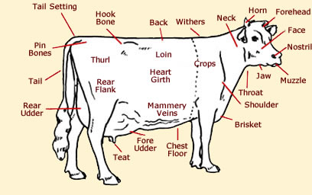
Anatomy

Slide 67
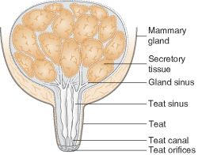
Anatomy: Udder
Cows udders have four compartments with one test hanging from each
Cells remove water and nutrients and convert it to milk
The milk drips into a cistern which holds the milk
When teat is squeezed, milk is released

Slide 68
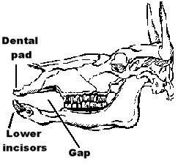
Anatomy: Oral
Mouth is adapted for grazing
Top part of mouth is a hard pad
Bottom part is a row of flat-topped teeth
Grind food between two parts

Slide 69
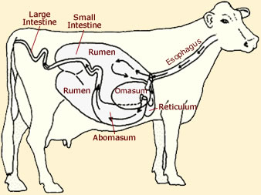
Anatomy

Slide 70
Stomach and Digestion
4 parts
Cows swallow their food and then regurgitate a “cud” which is then chewed well and swallowed
Rumen- largest part, holds up to 50 gallons of partially digested food
Good bacteria here help break down
Reticulum- if cow eats something it shouldn’t have, it goes here
Where ‘cud’ comes from

Slide 71
Stomach
Omasum- the filter.
Some water absorbed
Filters through all the food the cow eats.
Cud is pressed and broken down further
Abomasum- this part like the humans stomach
“True Stomach”
Food is finally digested here
Essential nutrients are passed to the bloodstream
Remainder passed to the intestines

Slide 72
Digestion in Ruminants 10 Step Program
1. Forage- Find food
2. Masticate- Chew Food
3. Swallow
4. Rumen: Food fermented and broken down
5. Reticulum: cud thrown up into mouth
6. Remastication: rechewed and re swallowed
7. Omasum: food broken down more, some water absorbed
8. Abomasum: True Stomach, digestion starts here
9. Intestines
10. Out as manure

Slide 73
Activity
Compare/Contrast
Bovine, Canine, and Human dental anatomy

Slide 74
Dairy Cattle
Management

Slide 75
Management Sections
Housing
Milking
Nutrition
Breeding

Slide 76
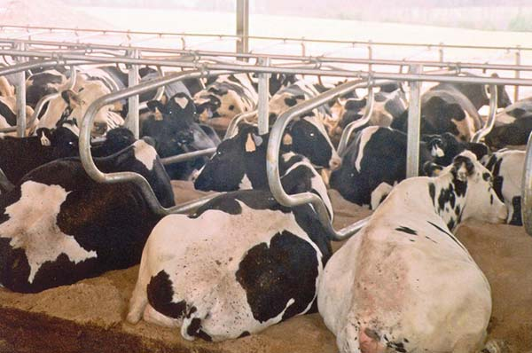
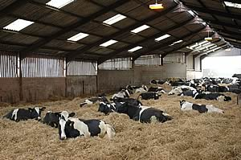
Warm-up
Why might we use these types of housing?

Slide 77
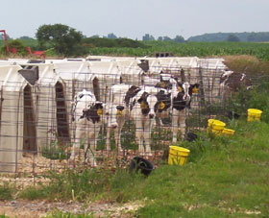
Newborn and Young Calves Housing
Individual stalls, inside or outside
Better ventilation outside
Less respiratory disease
Calf hutches popular after weaning
At 8 weeks, heifers normally grouped with other heifers of similar age
Separate heifer growing barn
Open front sheds are also popular

Slide 78
Traditional Housing: One year +
Tie-stall barns- tied to individual stalls during milking and the rest of the day released into pasture at night in summer
Free-stall housing- allow cows to enter and leave as they wish. Feed bunk at center. Milked in tie-stalls or a milking parlour

Slide 79
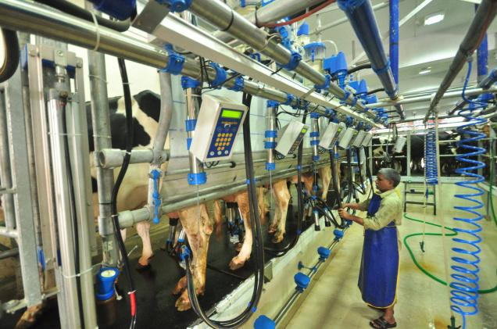
Traditional Milking
Parlour System- cows come to the milker.
Group enters at a time- udders at chest level for milker in a pit. All cows washed and milked at same time. Increase # of cows a person can milk per hour
Robotic Milking system- reduce milking labor requirements. Allow cows access 24 hours a day. Sensors

Slide 80
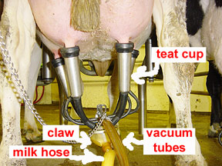
Robotic Milker “anatomy”

Slide 81
Calf Care/Nutrition
Starts within 24 hours of birth
Colostrum- first milk
Calves are weaned immediately after receiving colostrum
Cows returned to the milking herd after parturition
Parturition- giving birth in cows
Calves raised by humans
Replace milk with water gradually
12 weeks to 1 year- fed a grain mix

Slide 82
Heifer Nutrition
Heifer: Female who has not given birth yet (1 to 2 years old)
After breeding, heifers fed free-choice, high-quality forage
Grain mix may be added to ensure proper development and provide minerals and vitamins since farmer is “hoping” heifer is preg
High protein food allows for cow to “carry” her calf nutritionally

Slide 83
Lactating Dairy Cows
Lactating: producing milk
Lactating cows require high quality food to sustain good milk production
Normally lasts about 10 months
Nutritional needs dependent on body size and milk production
Cows are “dry” (milking stopped) about 60 days before the next expected calf
Dry cow: not producing milk. This is a “rest” period

Slide 84
Dry Dairy Cattle
Cows are “dry” (milking stopped) about 60 days before the next expected calf
Dry cow: not producing milk. This is a “rest” period
Dry cows fed a diet of forages. Not high quality
Often fed grain to provide vitamins, minerals and salt

Slide 85
Activity IT IS ON YOUR TEST!!
Graphic organizer/Representation
Dairy farms work on a cycle of activity. Depict this cycle and use the following vocabulary words
Parturition, AI, Milking, Lactating, Dry, Heifer, Calf, Weaned, Colostrum, Pregnancy, High Protein Diet, Milk Replacer, Grass (not high quality)
START WITH HEIFER

Slide 86
Breeding
Most dairy cows in the US are purebreds
First to adopt artificial insemination on a large scale
Most dairy cows are a result of artificial insemination
Artificial insemination (AI)- placing of sperm in the reproductive tract of the female by means other than that of the natural breeding process
Producers using AI release cows to watch for standing heat at least twice a day
Standing heat- animal will “stand” and accept being mounted as a sign of being ready to mate

Slide 87
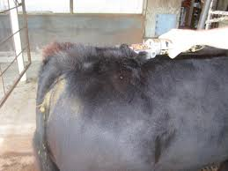
Breeding
After Heat is detected:
Animal will be separated and AI-ed with chosen semen
Based on the mother’s cow “defects”, appropriate semen will be chosen from a stockpile/bank to improve the next generation (her calf)
Example: Too high in the tail, bull semen from a bull with a lower tail head would be used to ensure the calf has a low tail head.

Slide 88
Book Work
Page 50, True or False, Fill in the Blank, and the Discussion Questions
SHARE BOOKS!

Slide 89
Test Review
Define: Ruminant, Dairy Cow, Iodine Solution, Parturition, Free Range, Heifer, Lactating, Dry Cow, Inflation, Claw, AI
Explain the 10 steps in ruminant digestion.
What are the 2 types of Free Range Housing?
Why would a farmer use a tie method for housing his cattle?
What are the steps in the milking process?
What is the current trend in the dairy industry?
Put the “steps” of a cows life in order. (Calf, Weaned, Colostrum, Heifer, AI, Parturition, Pregnency, Lactating, Dry)
Dairy Gross External Anatomy
Top producing states
Top Dairy Breeds
Explain the Dairy FFA CDE. What are the parts?

