Slide 1
Unit 4: Genetic Selection & Mating
Chapters 13 & 14

Slide 2
Objectives
Understanding of the concept of genetic variation
Knowledge of quantitative vs. qualitative traits
Appreciation for genetic change in the livestock industry
Advantages, disadvantages of linebreeding, inbreeding, crossbreeding, and outcrossing
Describe heritability, heterosis, and calculating the percent heterosis
Role of hybrid and composite breed formation

Slide 3
Continuous Variation & Many Pairs of Genes
Most economically important traits controlled by multiple pairs of genes
Estimate >100,000 genes in animals
Example 20 pairs of genes affecting yearling weight in sheep can result in:
1 million different egg/sperm combinations
3.5 billion different genotypes
Producers often observe continuous variation
Can see large differences in performance

Slide 4
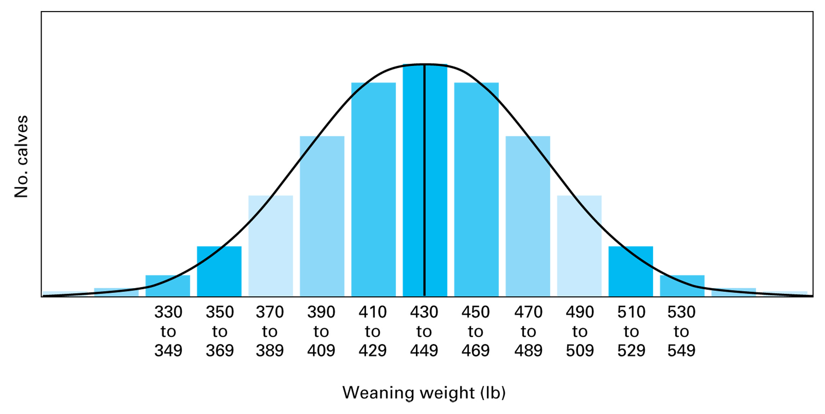
Figure 13.1 Variation or difference in weaning weight in beef cattle. The variation shown by the bell-shaped curve could be representative of a breed or a large herd. The dark vertical line in the center is the average or the mean–in this example, 440 lb.

Slide 5
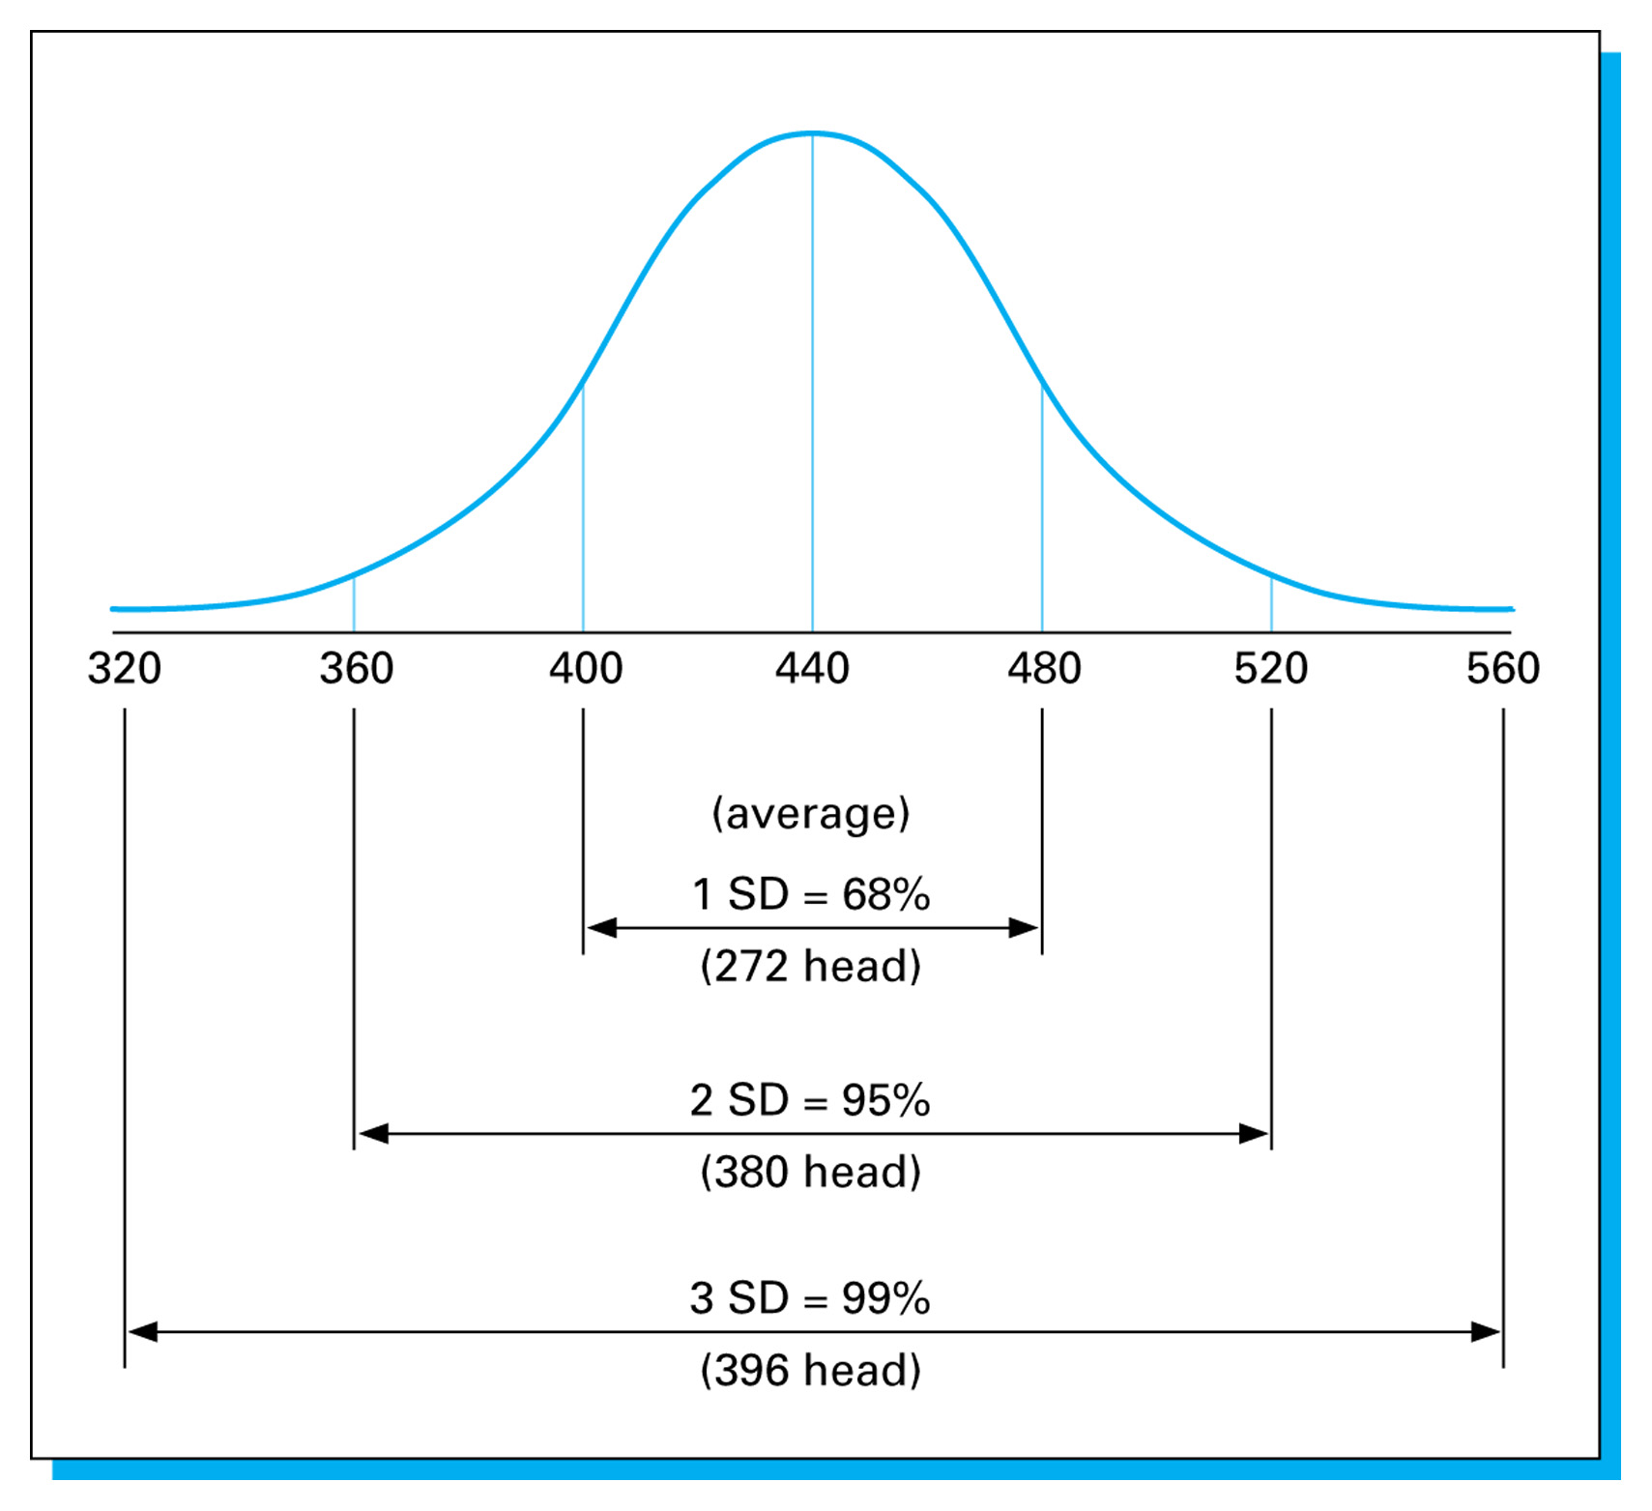
Figure 13.2 A normal bell-shaped curve for weaning weight showing the number of calves in the area under the curve (400 calves in the herd).

Slide 6
Continuous Variation & Many Pairs of Genes
Quantitative traits
Objectively measured traits
Observations typically exist along a continuum
Example: skeletal size, speed, etc.
Qualitative traits
Descriptively or subjectively measured
Example: hair color, horned vs. polled, etc.
Often times many gene pairs control quantitative traits while few influence qualitative traits

Slide 7
Continuous Variation & Many Pairs of Genes
Phenotype is influenced by both genotypic combinations and environmental influences
Many mating systems utilize formulas to minimize variation and increase the ability to make comparisons
Ex. Adjusted weaning weight for beef cattle
{(actual weaning wt – birth wt / age in days at weaning) * 205} + birth wt + age of dam adjustment
Predicting the outcomes of the influence of genotypes is estimating as heritability

Slide 8
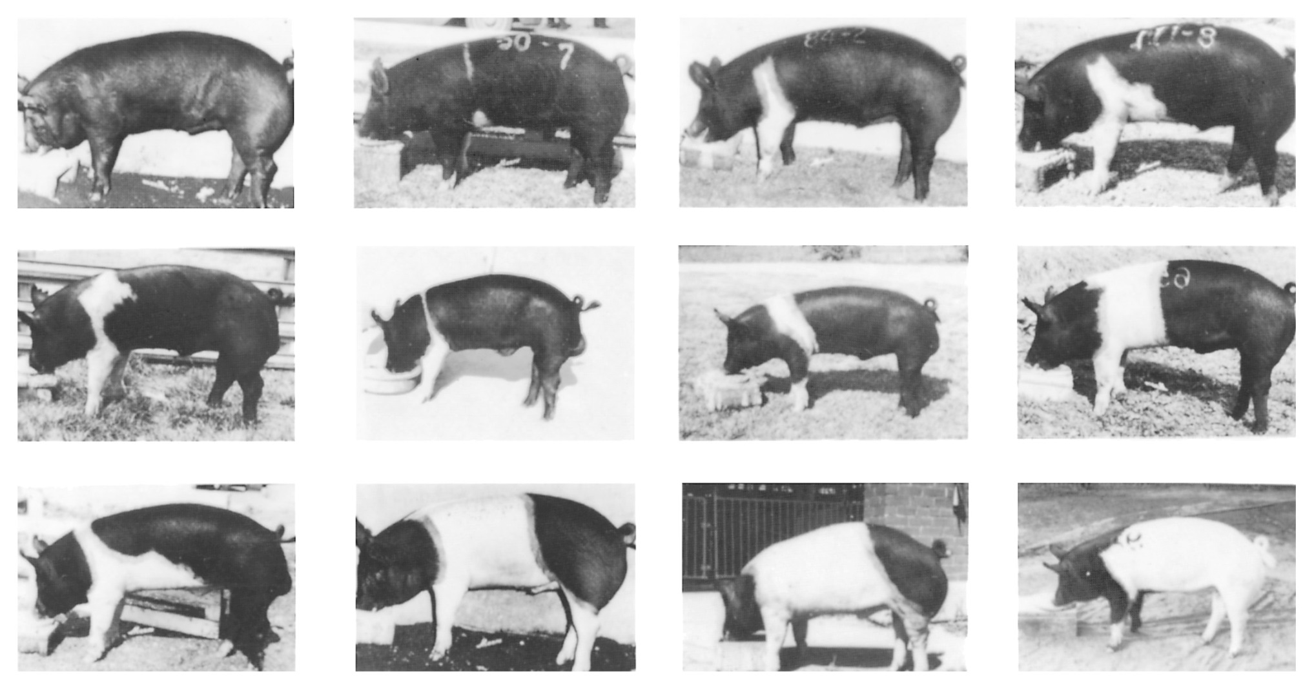
Figure 13.4 Variation in belt pattern in Hampshire swine. Courtesy of National Swine Registry.

Slide 9
Selection
Differential reproduction – prevents some animals from reproducing while allow others to have offspring
Allows producer to select genetically superior animals

Slide 10
Selection Differential
A.k.a. – reach
Defined as superiority (or inferiority) of selected animals to the herd average
Ex. Average weaning weight of a group of replacement heifers is 480 lbs and the herd average is 440 lbs – selection differential is 40 lbs
40 lb difference is due to:
Genetics
Environmental influences

Slide 11
Heritability
The portion of selection differential that is passed from parent to offspring
If parent performance is good estimate of progeny performance for a trait – heritability is high
Realized heritability is what is actually passed on vs. what was selected for
Example: swine producer has average postweaning ADG of 1.8 lb/d
He selects a group of females with PW ADG of 2.3 lb/d and breeds them shooting for an increase of .5 lb/d increase
Their offspring average 1.95 lb/d PW ADG

Slide 12
Heritability
1.95 – 1.8 = .15 actual increase in PW ADG
.15 actual increase in PW ADG/ .50 target increase PW ADG = .3 * 100 = 30% Heritability
Heritabilities
% Heritability | Heritability Characteristics
40% + | Highly heritable traits
20-39% | Medium heritability traits
<20% | Low heritability traits

Slide 13
Predicting Genetic Change
Genetic change per yr = (heritability * selection differential)/generation interval
Allows producers to calculate the amount of change expected per generation
Generation interval
Average age of parent when offspring is born
Add average age of all breeding females to average age of all breeding males divided by 2
Typical generation intervals:
Swine – 2 yrs
Dairy – 3-4 yrs
Beef – 5-6 yrs

Slide 14
Predicting Genetic Change
Genetic change for Multiple Trait selection
Typically, more than 1 trait affects productivity
Must take into account the number of traits in selection program to accurately predict change
Ex. If genetic change per year for weaning weights was 4 lbs; but if there are 4 traits in the selection program you must take that into consideration
1/√4 = ½ ----only ½ the amount of original change can be expected…so only 2lbs/generation

Slide 15
Evidence of Genetic Change
We’ve seen many examples of marked improvements in productivity due to genetic change…so it is not just theoretical
Ability to produce a 22 lb dressed-wt turkey in 5 mo
11,000 lb increase in milk production of dairy cows in 50 yrs

Slide 16
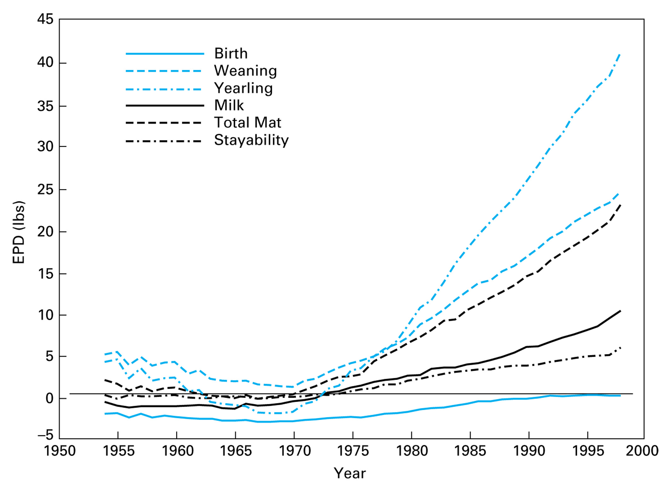
Figure 13.5 Genetic trends since 1954 for the six traits presented in this sire evaluation.

Slide 17
Genetic Improvement through AI
Responsible for the greatest amount of genetic progress
Close second is environment/management conditions
Allows producers to select genetically superior parents to mate

Slide 18
Selection Methods
Tandem
Selection of one trait at a time
Appropriate if rapid change in one trait is needed quickly
Can result in loss of genetic progress of other traits
Typically, not recommended
Independent Culling
Minimum culling levels for each trait in the selection program
Second-most effective type of selection method, but most used

Slide 19
Selection Methods
Most useful when number of traits in selection is relatively few
Disadvantage – may cull genetically superior animals for marginal performance of a single trait
Selection Index
Recognizes the value of multiple traits with and economic rating related to each trait
Allows for ranking of individuals objectively
Difficult to develop
Disadvantages – shifts in economic value of some traits over time, failure to identify defects or weaknesses

Slide 20
Basis for Selection
Effective selection requires that traits be:
Heritable
Relatively easy to measure
Associated with economic value
Genetic estimates are accurate
Genetic variation is available
Notion of measureable genetic progress is basis for breed organizations and performance data
Today’s producers rely less of visual appraisal and more on selection tools and data

Slide 21
Basis for Selection
Predicted Differences or Expected Progeny Differences (EPD’s)
Calculated on a variety of traits
Use information from:
Individuals
Siblings
Ancestors
Progeny
As amount of data collected increases, accuracy of the data increases

Slide 22
Basis for Selection
Dairy industry has been the leader, beginning data collection in 1929
Early efforts focused on measuring individual sires, boars, etc. for performance parameters
Now has evolved into primary testing of progeny of those males
BLUP – Best Linear Unbiased Predictor
Data compiled and used to compare animals across herds
Poultry and dairy led the pack in its development
Swine began data collection and reporting on terminal sires in 1995 and maternal sow lines in 1997

Slide 23
Basis for Selection
Ex. – Statistically dairy herds on DHIA have a clear productive advantage over herds not on DHIA

Slide 24
Mating Systems
Seedstock/Purebred producers – pure lines of stock from which ancestry can be traced via a pedigree by a breed organization
Commercial breeders – little/no emphasis on pedigree in selection
Three critical decisions by breeders:
Individuals selected to become parents
Rate of reproduction from each individual
Most beneficial mating system

Slide 25
Mating Systems
Two main systems:
Inbreeding
Animals more closely related than the average of the breed
Outbreeding
Animals not as closely related as the average of the population
Producer must understand the relationship of the animals being mated to be effective

Slide 26
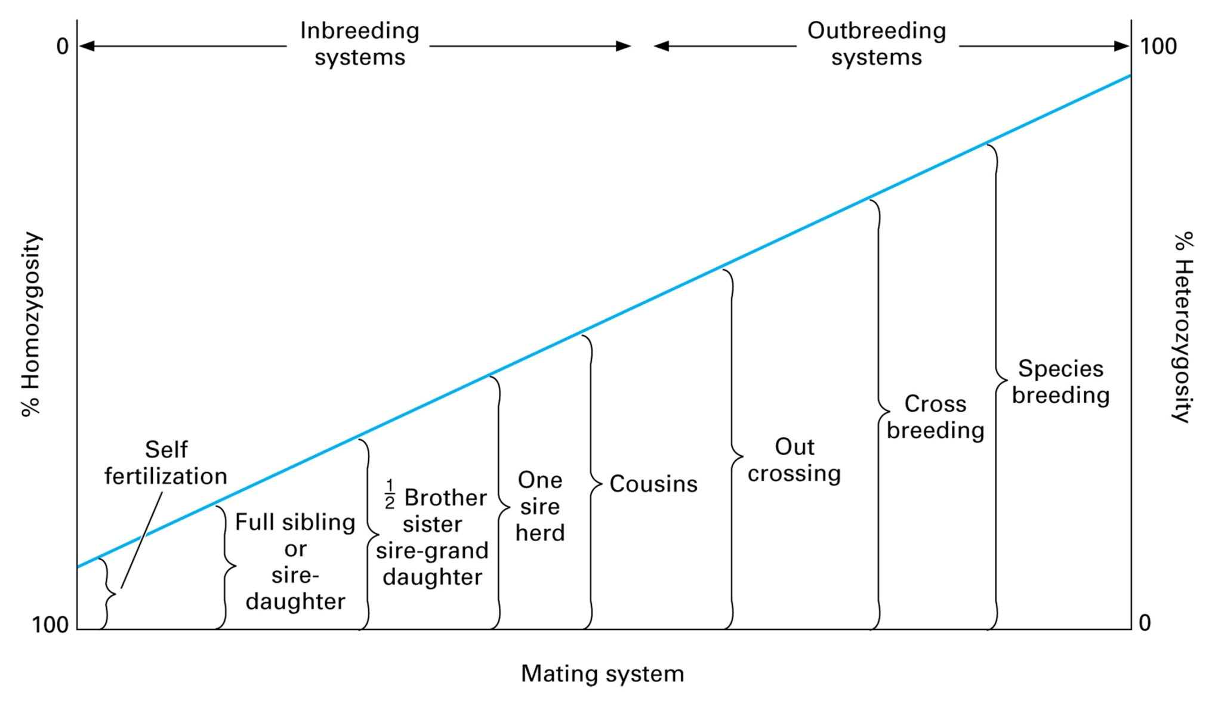
Figure 14.2 Relationship of the mating system to the amount of heterozygosity or homozygosity. Self fertilization is currently not an available mating system in animals.

Slide 27
Inbreeding
Breeder cannot control which traits will be beneficial when there’s a close genetic relationship, and which will be detrimental
Two forms:
Intensive inbreeding – mating animals closely related whose ancestors have been inbred for several generations
Linebreeding – inbreeding is kept low, while a high genetic relationship to an ancestor or line of ancestors is maintained

Slide 28
Inbreeding
Intensive Inbreeding results:
Usually detrimental to reproductive performance, more susceptible to environmental stress
Less advantage from heterosis
Quickly identifies desirable and detrimental genes that may stay hidden in heterozygote crosses
Uniform progeny
Crossing inbred lines can result in heterosis improving productivity

Slide 29
Outbreeding
Species cross
Crossing animals of different species
Horse/donkey
Widest possible kind of outbreeding
Can you give another example?
Crossbreeding
Two reasons for crossbreeding:
Take advantage of breed complementation
Differences complement one another
Neither breed is superior in all production characteristics
Can significantly increase herd productivity

Slide 30
Outbreeding
Take advantage of heterosis
Increase in productivity above the average of either of the two parental breeds
Marked improvement in productivity in swine, poultry, and beef
Amount of heterosis related to heritability of the desired traits
Superior selection will outperform crossbreeding alone
Combination of both will result in largest improvement
Why is crossbreeding little used in the dairy industry?

Slide 31
Outbreeding
Outcrossing
Most widely used breeding system for most species
Unrelated animals of same breed are mated
Usefulness dependent upon accuracy of mating

Slide 32
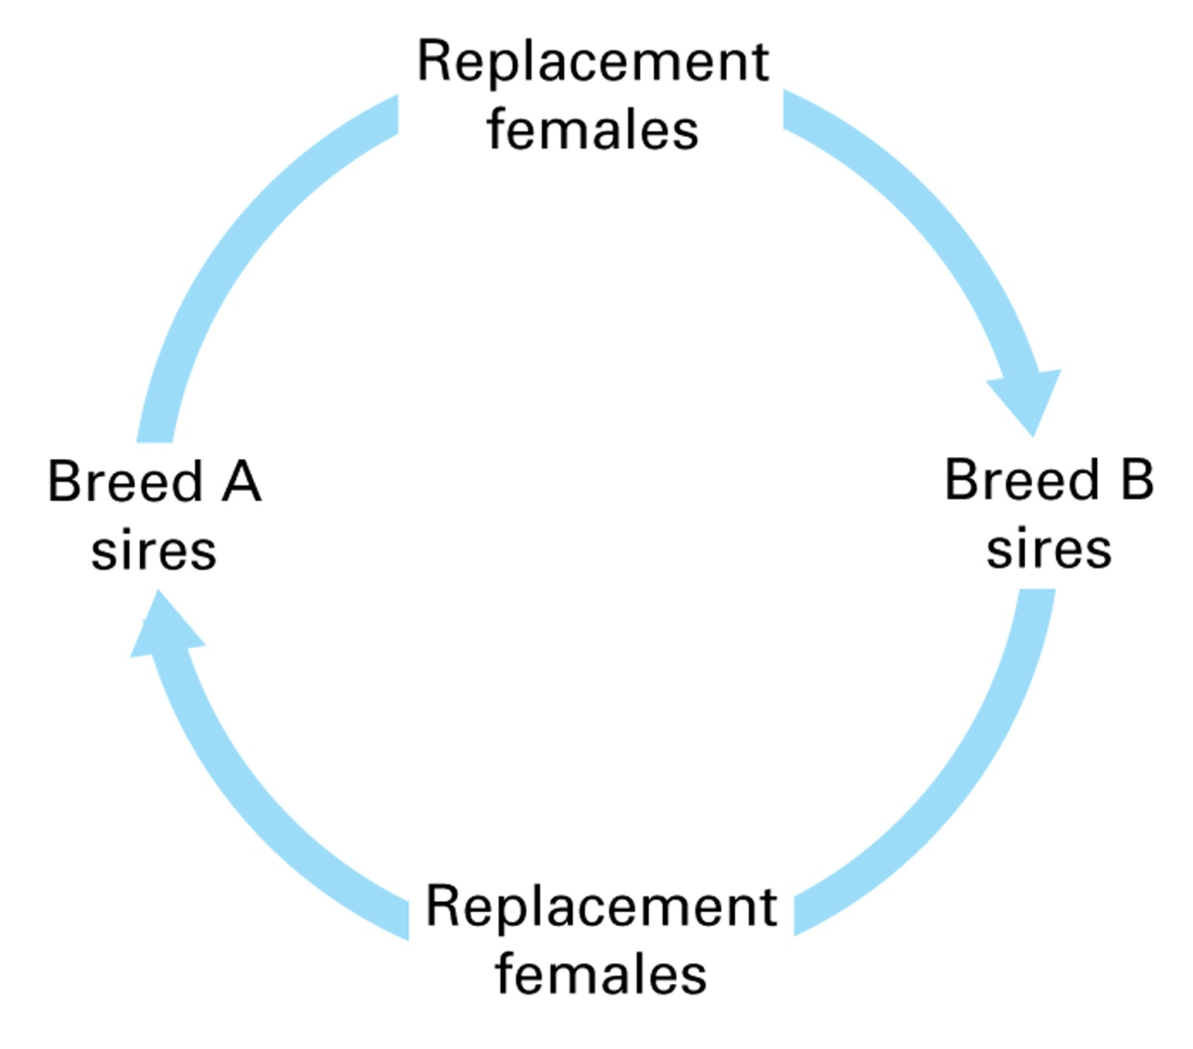
Figure 14.11 Two-breed rotation cross. Females sired by breed A are mated to breed B sires, and females sired by breed B are mated to breed A sires.

Slide 33
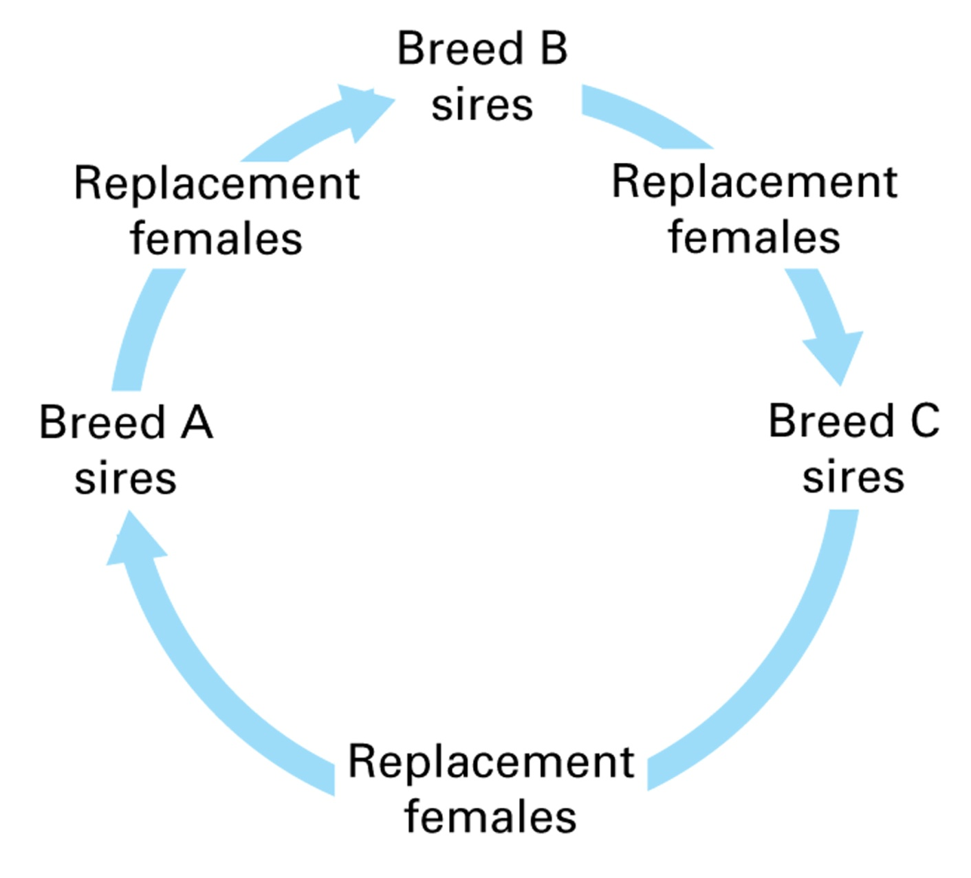
Figure 14.12 Three-breed rotation cross. Females sired by a specific breed are bred to the breed of sire next in rotation.

Slide 34
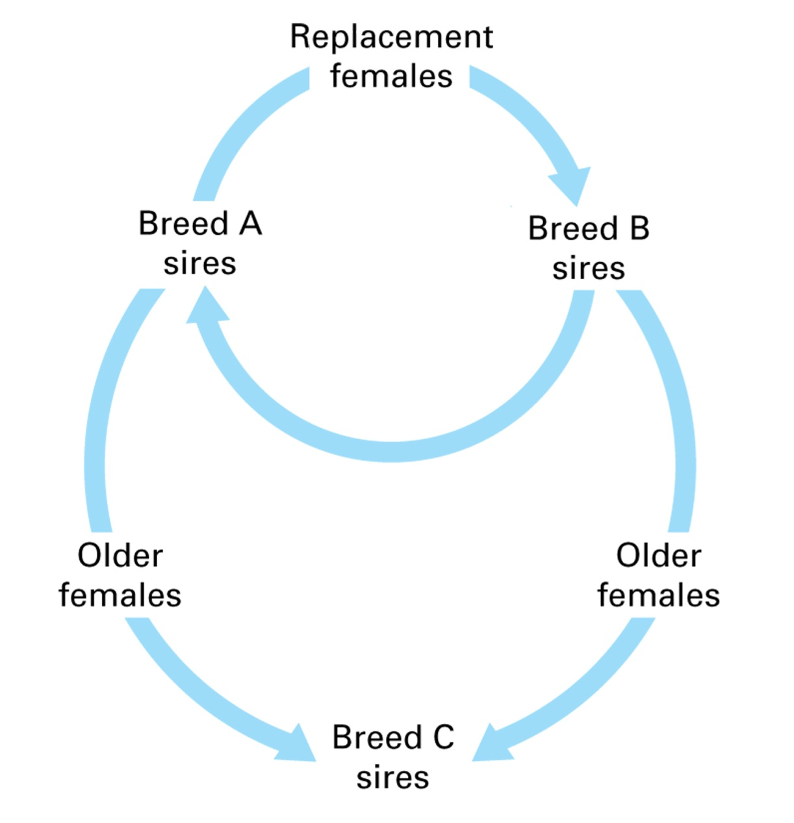
Figure 14.13 Terminal (Static) or modified-terminal crossbreeding system. It is terminal or static if all females in herd (A × B) are then crossed to breed C Sires. All male and female offspring are sold. It is a modified-terminal system if part of females are bred to A and B sires to produce replacement females. The remainder of the females are terminally crossed to breed C sires.

Slide 35
Outbreeding
Grading up
Continuous use of purebred sires of the same breed in a grade herd
By 4th generation, reach purebred levels

Slide 36
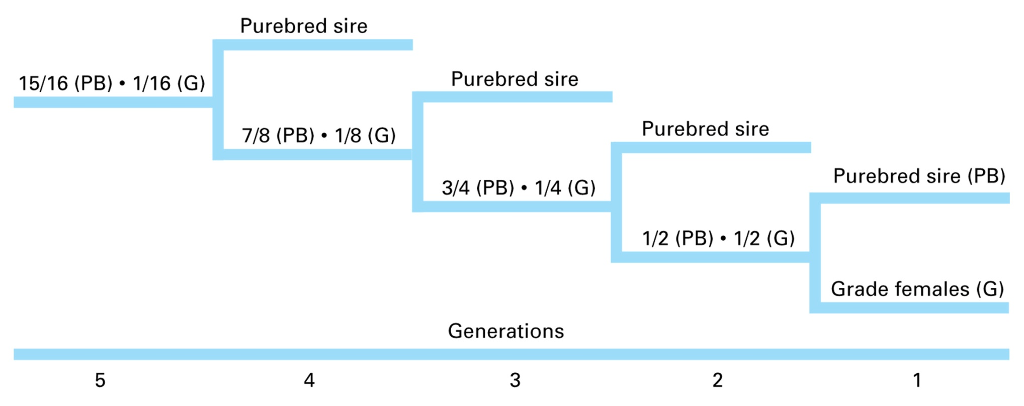
Figure 14.14 Utilizing grading up to produce purebred offspring from a grade herd.

Slide 37
Forming New Lines or Breeds
A.k.a. – composite or synthetic breeds
Ex. – Brangus, Beefmaster, Santa Gertrudis
Hybrid boars extensively used in swine production

