Slide 1
What is a settlement?
A settlement is any form of human dwelling, from the smallest house to the largest city.
﻿

Slide 2
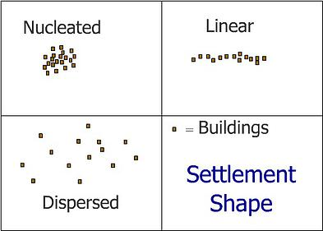
Recap! Settlement patterns
Settlements come in many shapes and sizes depending on the situation. There are some common patterns that emerge and these can be seen in the diagram beside.
Nucleated settlements are ones that have buildings packed close together.
Linear settlements will follow a road, coastline or river and have their buildings in a long line.
Dispersed settlements are ones that have their buildings spread out over a large area.

Slide 3
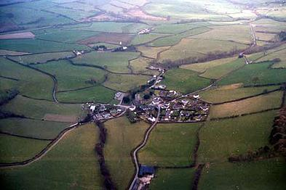
NUCLEATED
This nucleated settlement centres on a road junction

Slide 4
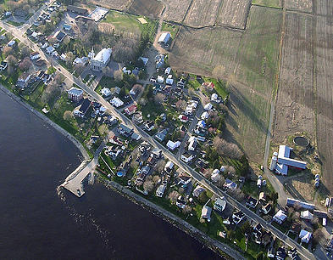
LINEAR
This linear settlement follows a road and a shoreline (can you spot which way the line is going?)

Slide 5
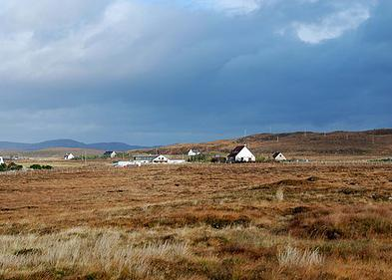
DISPERSED
This dispersed settlement has its houses spread out over a wide area.

Slide 6
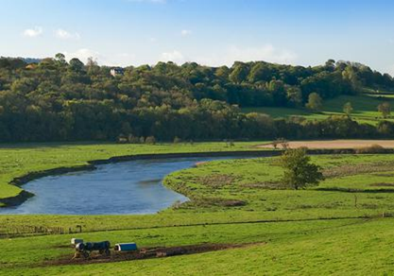
Factors affecting the location of settlements
We call the place where a settlement starts the site of a settlement and settlement sites are chosen because they have lots of good reasons for locating a settlement there.
Flat land is a good reason for locating a settlement in a particular place.
Flat land is easier to build on and it is good for growing crops.

Slide 7


Can you think of any more reasons?
Building supplies
﻿Building supplies are needed for homes but they are also needed to build farm buildings. A good supply of wood and stone helps
Water supplies
Water is essential as it is needed for cooking, washing, cleaning and drinking. It is also heavy to move around so you want a water supply close by to your house.
Flat land
Flat land is good for crowing crops such as wheat and vegetables. It is also easier to build houses on flat land and it is easier to travel around
Protection
Villages a long time ago were sometimes attacked by invaders. Being on a hill made the settlement easier to defend and see your enemies coming
Bridging point
It is hard to imagine now with our modern wide bridges crossing rivers wherever we want but many years ago, rivers proved to be huge obstacles preventing easy movement of goods and people. Where rivers were easier to cross, many people met there which made it a good place to have a market.

Slide 8


Can you think of any reasons why you wouldn’t want to build a settlement?
Land that floods
Flat land is great but if it is next to a river and floods every year, it is no good.
Marshy land
Marshy land is bad for two reasons. It is difficult to build on and it is difficult to grow crops on.
Poor quality farmland
When we are hungry, we want to eat but if we haven't grown much food through the year, come winter time, we will starve. Placing a settlement near poor farmland isn't going to help the settlement to grow.
No water supply
Cooking, washing, cleaning and drinking all become much more difficult without water. Similarly, we cannot irrigate our crops during any dry periods. So locate your village near a river, stream or spring.

Slide 9

CAUSES OF DISPERSED SETTLEMENTS
Mountainous areas that are hard to build on and hard to build good transport links to.
Severe weather conditions e.g. extremely hot or cold or wet.
Mainly farm land
Floodplain or coastal area that is vulnerable to flooding
No entertainment
Only limited natural resources
No job prospects
No nearby schools and hospitals
No electricity supply

Slide 10
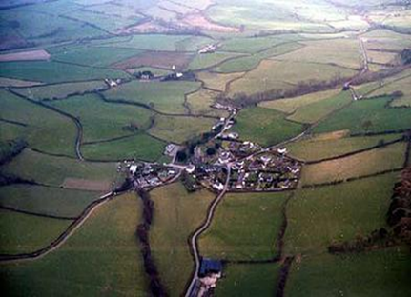
CAUSES OF A NUCLEATED SETTLEMENT
Good transport links (road, rail, river)
Good fertile land nearby to grow food.
Flat land, that is easy to build on
Stable weather that is good for growing.
Nearby natural resources e.g. fuel
Good job prospects
Good schools and hospitals
Good and reliable supply of electricity, gas and water.
Varied entertainment

Slide 11

CAUSES OF A LINEAR SETTLEMENT
In the case of settlements built along a route, the route was probably there before the settlement and then the settlement grew up at some way station or feature, growing along the transport route.
Often, it is only a single street with houses on either side of the road.
Later development may add side turnings and districts away from the original main street.

Slide 12
QUICK QUESTIONS…
What is a Nucleated settlement?
What is a Linear settlement?
What is a Dispersed settlement?
Which sort of settlement would a Farm be classed as?
Name 2 good reasons for why you would want to create a settlement somewhere
Which 2 things would you avoid if you wanted to create a settlement?

