Slide 1

Leaving Certificate
Agricultural Science
Sheep – 3 - Diseases

Slide 2
Sheep Diseases
As species, sheep are much better adapted to life on hills (their natural habitat).
Therefore, keeping them on lowland farms causes health conditions that would not otherwise arise.
Specifically, lowland sheep suffer more from maggots, internal parasites and footrot.
The main reasons these conditions arise on lowland flocks are climate and stocking rate.

Slide 3
Sheep Diseases
Maggots are prevented on hills because the harsh conditions simply do not allow them to thrive.
Footrot is controlled on farms because sheep’s hooves are naturally stronger due to more use and wear.
Maggots / Fly Strike
Maggots are the larvae (young) of the blowfly or the Green Bottle Fly.
The fly is attracted to odours in the fleece, and they lay their eggs on dung–soiled wool.

Slide 4
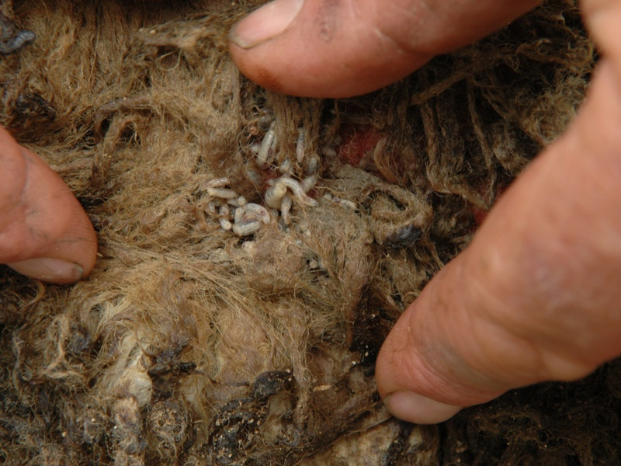

Slide 5
Sheep Diseases - Flystrike
Fly strike can be prevented by
  Dipping in the Summer
  Trimming excess wool around the tail
  Tail docking
  Grazing management (to prevent scour)
An affected sheep is usually quite restless and scratches the affected area frequently.
The area may appear green and wet.
Maggots should not be ignored and can often be fatal!

Slide 6
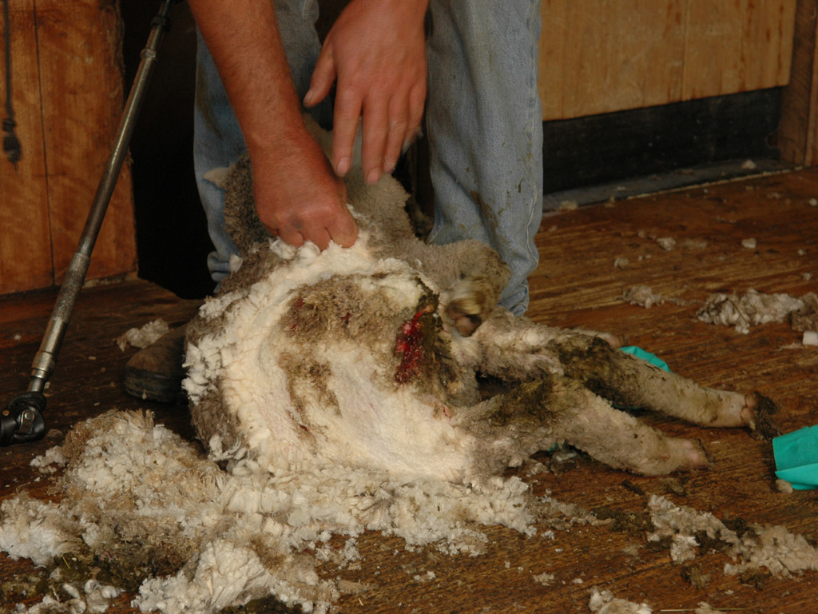

Slide 7
- Worms
Worms
Nearly all sheep carry intestinal parasites / worms.
The older / more mature the animal the less worms.
This is because older animals develop a certain immunity to worms.
Worms can only be controlled effectively with both drugs and good pasture management.
All sheep should be dosed regularly and pastures managed as to prevent the spread of worms.

Slide 8

Dosing Sheep

Slide 9
Sheep Diseases
Liver Fluke
This is a “flat worm” which can cause death to sheep or simply reduce thriftiness and lower the quality of the carcase.
Both worms and liver fluke cannot reproduce inside the sheep (host) so the number of larvae eaten determine the extent of the disease.
Footrot
Footrot is a very serious problem on Irish Farms.
Footrot is caused by a bacteria, in fact many different types of bacteria.

Slide 10
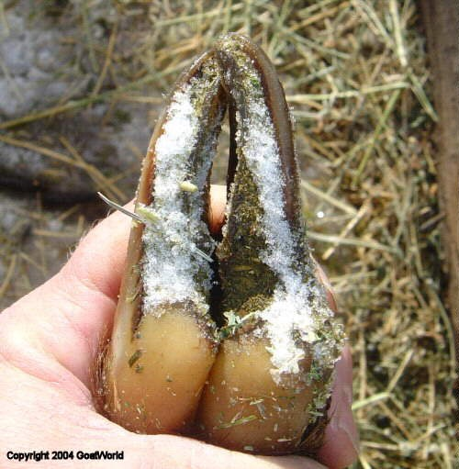

Slide 11
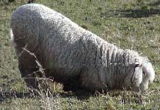
Foot rot
Footrot causes lameness, serious pain, reduced food intake, in-activity and can lower fertility in rams.
You can spot an affected sheep by seeing them kneeling down while grazing.

Slide 12
Sheep Disease - 7
Bluetongue:
Bluetongue is an insect–transmitted, viral disease of sheep, cattle, goats, and other ruminants.
It is particularly damaging in sheep; half the sheep in an infected flock may die.
A bluetongue virus infection causes inflammation, swelling, and haemorrhage of the mucous membranes of the mouth, nose, and tongue.
Inflammation and soreness of the feet also are associated with bluetongue.
In sheep, the tongue and mucous membranes of the mouth become swollen, hemorrhagic, and may look red or dirty blue in colour, giving the disease its name.
Bluetongue viruses are spread from animal to animal by biting gnats.
Animals cannot directly contact the disease from other animals.

Slide 13
