Slide 1
Mapwork skills:
Six-figure grid references
c. R. Langley

Slide 2
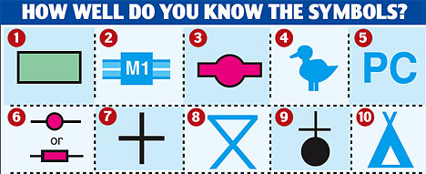
Here is one square from a map.
What do these OS symbols stand for?
26
25
77
78

Slide 3
The four-figure grid reference for this square is 7725
26
Lines meet at bottom left.
25
77
78

Slide 4
In order to give something a six-figure grid reference, imagine the larger square split into one hundred smaller squares.
26
25
77
78

Slide 5
Then add numbers 1 to 10 between the main lines.
26
9
8
7
6
5
4
3
2
1
25
1
2
3
4
5
6
7
8
9
77
78

Slide 6
To work out the six-figure grid reference, first go along the bottom line and calculate the first three figures.
26
9
8
7
6
5
4
3
2
1
25
1
2
3
4
5
6
7
8
9
77
78

Slide 7
The church’s first three figures are ......
773
26
9
8
7
6
5
4
3
2
1
25
1
2
3
4
5
6
7
8
9
77
78
773

Slide 8
Next, work out the last three figures
by going up the side of the square.
26
9
8
7
6
5
4
3
2
1
25
1
2
3
4
5
6
7
8
9
77
78
773

Slide 9
The last three figures are ......
253
26
9
8
7
6
5
4
253
3
2
1
25
1
2
3
4
5
6
7
8
9
77
78
773

Slide 10
So, the six-figure grid reference for the church is .....
773253
26
9
8
7
6
5
4
253
3
2
1
25
1
2
3
4
5
6
7
8
9
77
78
773

Slide 11
What is the six-figure grid reference for the bus station?
26
9
258
8
7
6
777258
5
4
3
2
1
25
1
2
3
4
5
6
7
8
9
77
78
777

Slide 12
What is the six-figure grid reference for the picnic area?
26
9
8
7
6
5
4
3
2
1
25
1
2
3
4
5
6
7
8
9
77
78

Slide 13
There are no lines in the squares on a real OS map!
You have to estimate. What is the grid reference for parking?
26
Do you agree with me?
P
I think it’s
774257.
25
77
78

Slide 14
Can’t remember which lines to use first?
Try to remember this phrase:
‘Go along the corridor,
then up the stairs’.
c. R. Langley

