Slide 1
Solids, Liquids and Gases
March 2006

Slide 2
By the end of this lesson you will know:
what a ‘material’ is
what we mean by ‘property’
what the properties of solids, liquids and gases are

Slide 3

Materials
Everything is made from some sort of ‘material’
Materials are made up of lots and lots of tiny pieces
These tiny pieces are known as particles
Solids, liquids and gases are all made of lots of particles

Slide 4
Properties
The property of a material tells us something about what it is like…
Materials may be hard, soft, shiny, rough
Can you think of any more?

Slide 5
Solids
A solid is something that we can hold on to
A solid keeps its shape, unless we cut it or shape it ourselves
In a solid, all of the particles are packed together very tightly

Slide 6

Liquids
Liquids are runny
They can be poured
The particles are less tightly
packed, so they can move about
If poured from one container
to another, they will take the
shape of their new container

Slide 7

Gases
The particles in gases have lots of room to move
Gases are all around us
They spread into all of the empty places they can
Most are invisible

Slide 8
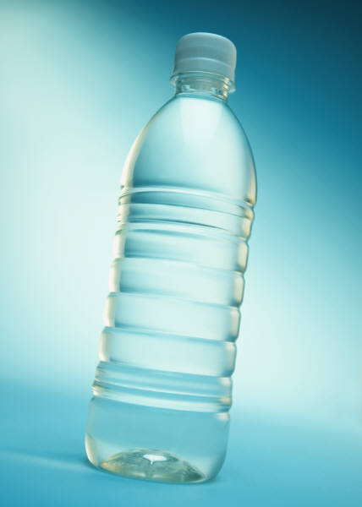
An example – water
Water can be a solid, a liquid or a gas
When it is cold it is solid – ICE
When it is at room temperature it is a liquid – WATER
When it is hot it is a gas – STEAM

Slide 9
Your turn!!
Having learned about the properties of solids, liquids and gases I’ like you make a list of all of those you know about already

