Slide 1
Small Creatures in the Home
WALT: to know about small creatures that live in our homes

Slide 2
There are lots of small creatures that live in our homes
Can you think of any?
Spiders Flies

Slide 3
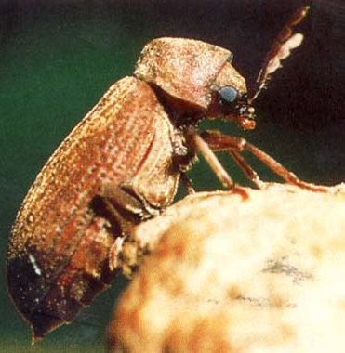
Furniture Beetle

Slide 4
About Furniture Beetle
Length: 2.5 – 5 mm. Very few people have actually seen them
They are pests to timber in buildings and old furniture
The larvae develop inside the timber, burrowing in and feeding on the wood.
The time taken for development depends on the type of wood and temperature
It usually takes more than 2 years for the adult to emerge
New adults eat their way out with their jaws
These can be the first sign of woodworm

Slide 5
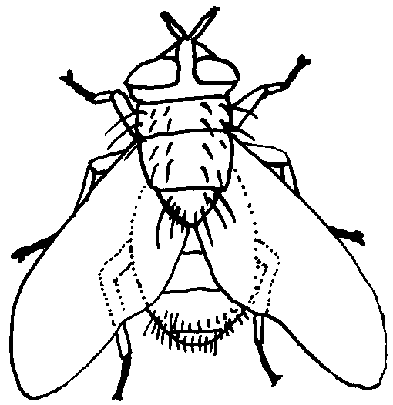
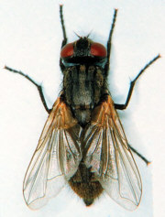
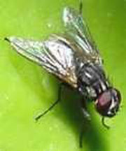
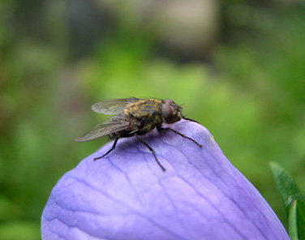
Housefly

Slide 6
About the Housefly
The housefly is 6 to 7 mm long and is found in most parts of the world.
It does not bite living animals but is dangerous because it carries bacteria (germs) that cause many serious diseases e.g. typhoid fever
Disease is transmitted on the fly's sticky foot pads and hairy body.
Each female lays from 100 to 200 eggs in the garbage or manure on which the white larvae feed. With good temperatures, one generation or more per month may be produced.

Slide 7
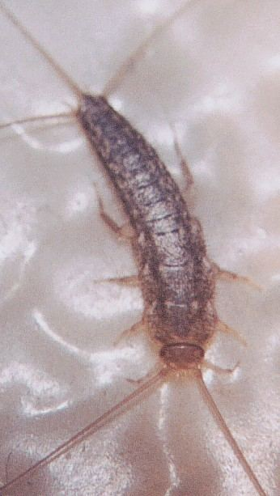
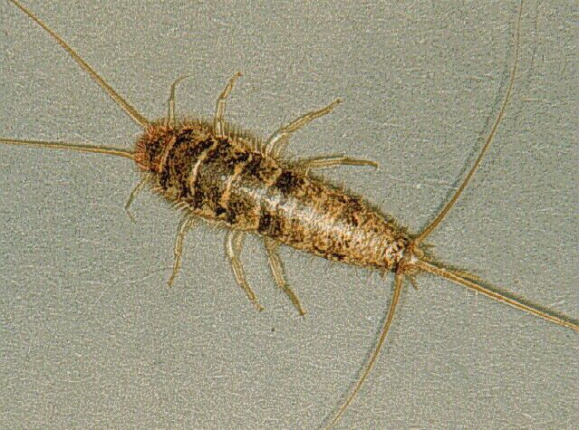
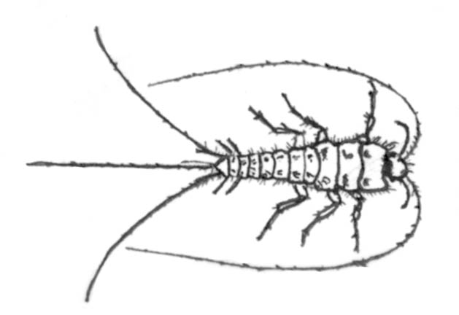
Silverfish

Slide 8
About the Silverfish
Sometimes called bristletail
They are about 1/2 to 1 inch (12.7-25.4mm)
It is a wingless insect, the young look similar but have no scales
Some are found outside, many are found in houses and are a pest or nuisance
Usually they are found trapped in a bathtub, sink, or washbasin.
They feed on cereals and non-food items such as paste, paper, starch in clothes, and dried meats.
They can go for up to one year without food.

Slide 9
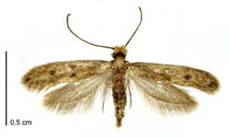
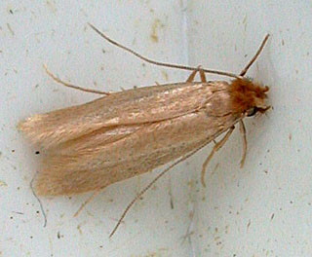
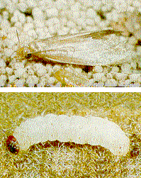
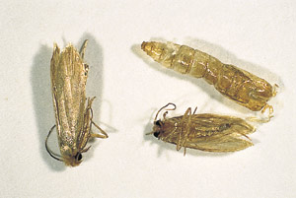
Clothes Moth

Slide 10
About the Clothes Moth
Clothes moth larvae feed on wool, feathers, fur, hair, leather, dust, paper, and occasionally cotton, linen, silk, and synthetic fibers.
Most damage is done to articles left undisturbed for a long time.
Damaged fabrics have holes eaten through them by small, white larvae
Moths are destructive during the larvae stage. Adult "millers" or moths are entirely harmless.

Slide 11
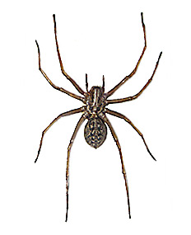
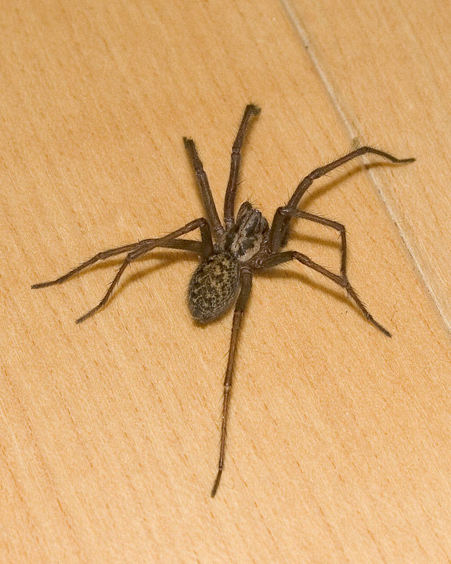
House Spider

Slide 12
Housespider
The female can reach a size of 18 mm, with the male being about 4 mm smaller
The spider spins a sticky thread web to catch other creatures which it then kills
Without spiders the world would probably be overrun with insects

Slide 13
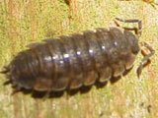
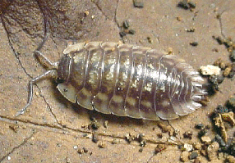
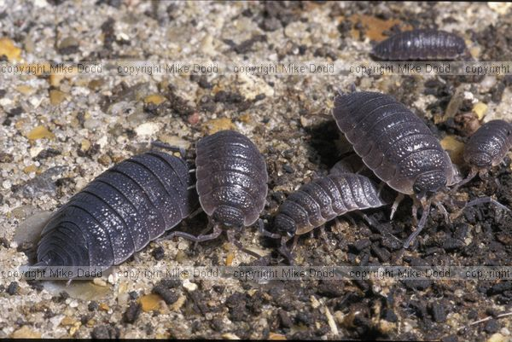
Woodlouse

Slide 14
All about the Woodlouse
Woodlice may look like insects, but in fact they're crustaceans and are related to crabs and lobsters. They are about 3-30mm in size
Woodlice are sometime called pill bugs and slaters
They like the damp, and hide away during the day
They like to eat rotting plants and wood

Slide 15
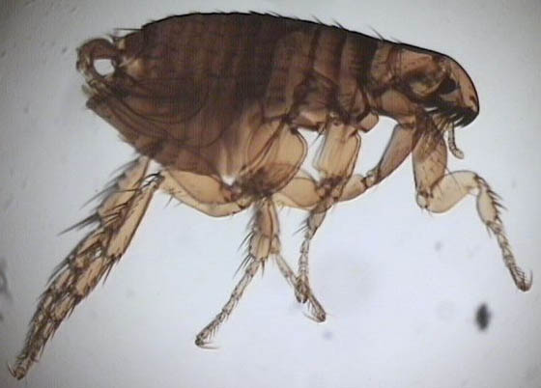
Animal flea

Slide 16
About the animal flea
Adult fleas are about 1/8 of an inch long
Animal fleas feed on blood
They may bite you and leave an itchy bump
They have no wings
They can jump high and far for their size

Slide 17
Well done!
Now you know about lots of creatures that could be in your home!

