Slide 1
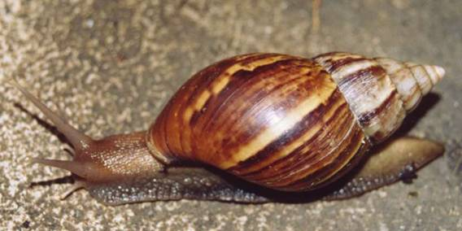
Snails

Slide 2
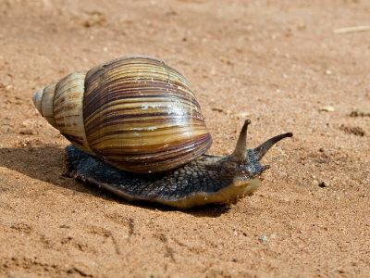
Snails are molluscs. They have soft bodies protected by a hard shell. The body of the snail is usually moist and often slimy.

Slide 3
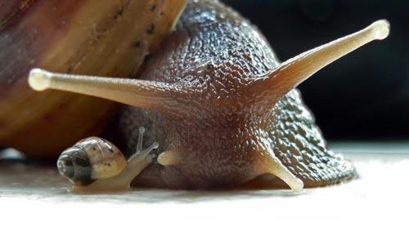
The snail has two pairs of tentacles on its head. One pair is longer than the other pair. The eyes are on the longer pair.

Slide 4
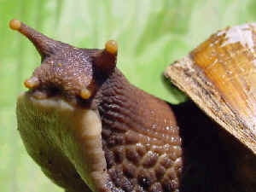
The shorter pair is used for smelling and feeling its way around.

Slide 5
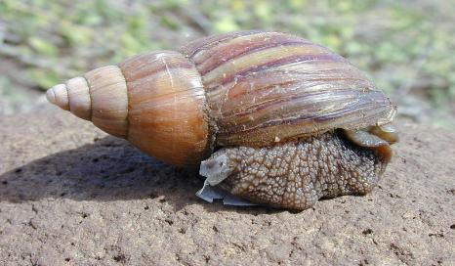
If a snail is disturbed, it pulls its body back into its shell. The snail then seals the entrance with a mucus plug.

Slide 6
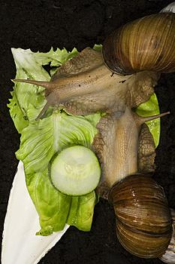
A snail has a fingernail file like tongue called a radula in its mouth for scraping food particles off.

Slide 7
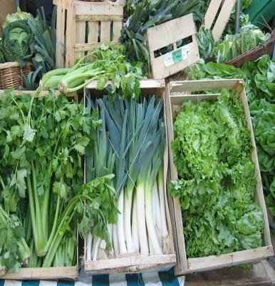

Snails eat mostly living plants and some fruits.

Slide 8
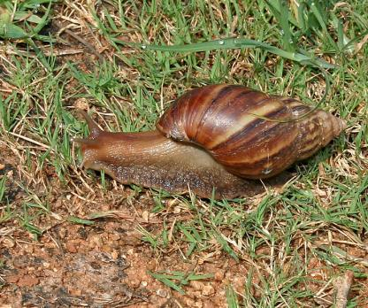
The snail moves by creeping or gliding along on a flat "foot" underneath it's body.

Slide 9
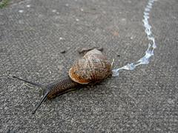
The "foot" has a special gland that produces slimy mucus to make a slippery track. You can often see these silvery tracks in the garden.

Slide 10
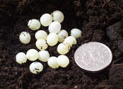
A snail lays its eggs in in the soil or under tree bark or leaves.
A snail can lay about 85 eggs. They hatch in 2 to 4 weeks.

Slide 11
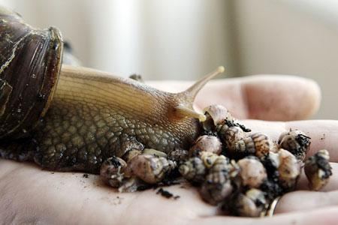
The first thing that a newly hatched snail does is to find food. It will eat whatever is left of its eggshell too.

Slide 12
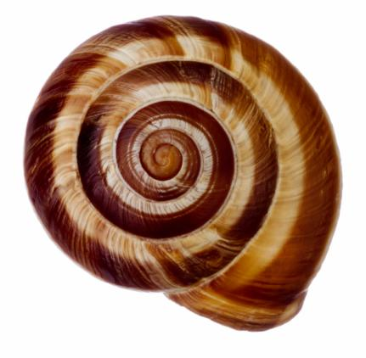
As the snail grows, its shell grows too, in a spiral shape.

Slide 13
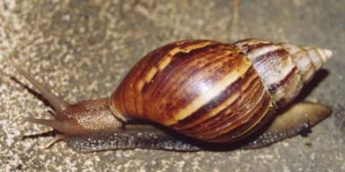
Tell your friend what you know about snails!

