Slide 1
The Solar System and Beyond
This has been made especially for Mr B and his wonderful aliens
Mr Buckley

Slide 2
There are nine planets in our solar system:
Mercury
Venus
Earth
Mars
Jupiter
Saturn
Uranus
Neptune
Pluto

Slide 3
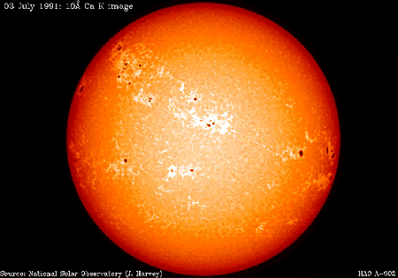
The Earth orbits the sun every…
…year (365 ¹/₄ days)

Slide 4
The Earth is kept in orbit by the force of…
Gravity
…and by the fact that is is moving at a high velocity

Slide 5
Gravity also keeps the moon in orbit around the Earth. The moon orbits the Earth every…
…month (28 days)

Slide 6
Gravity is ________ if the planet has more mass:
Earth
Jupiter

Slide 7

How much of the moon we see depends on where the moon is in its orbit:
Appearance:

Slide 8
Appearance:

Slide 9
Appearance:

Slide 10
The moon is a “natural satellite”. A satellite is anything the orbits the earth
Artificial satellites have four main uses:
  Communications
  Monitoring the weather
  Observing the Earth
  Exploring the solar system

Slide 11
The Earth is tilted on an axis
North pole
South pole

Slide 12
The Earth spins on its axis every ___ (__ hours)

Slide 13
Because of this spin the sun rises in the ______ and sets in the ______

Slide 14
The sun appears lower in the _______ than it does in the ______:
Summer
Winter
Longer shadows in winter

Slide 15
While the Earth is spinning the side that faces the sun is in ________

Slide 16
The Earth is divided up into the northern hemisphere and the southern hemisphere:
Northern hemisphere
Southern hemisphere
Equator

Slide 17
The tilt of the Earth on its axis is also responsible for the seasons:

Slide 18
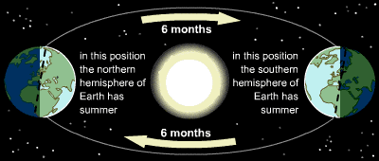
Two things happen because of this tilt:
The days are longer during the summer
The weather is warmer during the summer

Slide 19
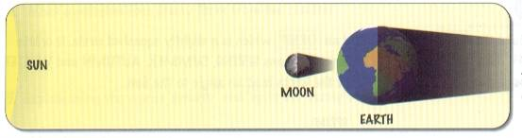
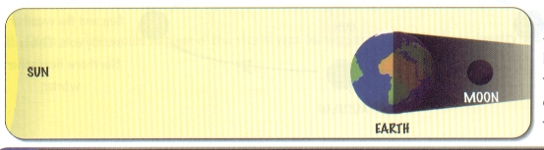
Eclipses
1. A solar eclipse:
2. A lunar eclipse:

Slide 20
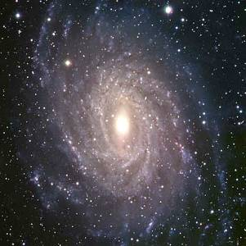
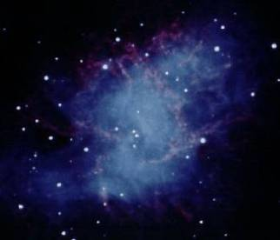
Solar systems, galaxies and the Universe
(Basically, everything in the universe orbits around something else)
OUR SUN is one of millions of stars that orbit the centre of…
THE MILKY WAY, which is one of a billion galaxies that orbit AND move away from the centre of…
THE UNIVERSE

