Slide 1
SOLIDS
LIQUIDS
GASES

Slide 2
SOLIDS
LIQUIDS
GASES
The molecules are held together with strong bonds. They don’t move very easily so SOLIDS can keep their own shape and size
The molecules have weaker bonds. They can move around slightly so LIQUIDS can flow. They can’t keep their shape unless they’re in a container.
The molecules are free to move around. They can spread around an open space quickly and freely. GASES can’t keep their shape unless they are kept in a sealed container.

Slide 3
melt
evaporate
HEAT
HEAT
STEAM
(WATER
VAPOUR)
ICE
WATER
COOL
COOL
freeze
condense

Slide 4
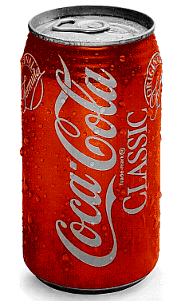
What has caused the droplets of water to appear on the side of the cold Coke can?

Slide 5
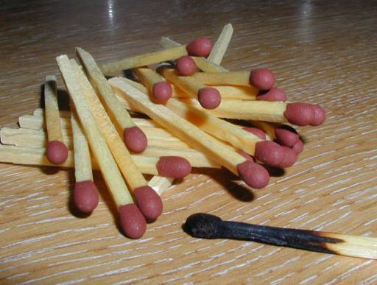
Burning is a non-reversible change

