Slide 1


Sources of Light
Look at the pictures.
Can you say which ones are a source of Light?

Slide 2
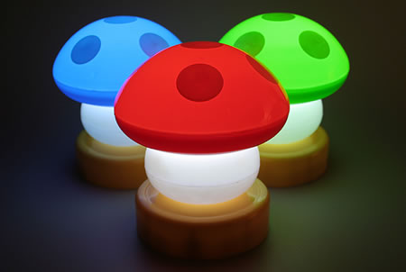
A Lamp

Slide 3
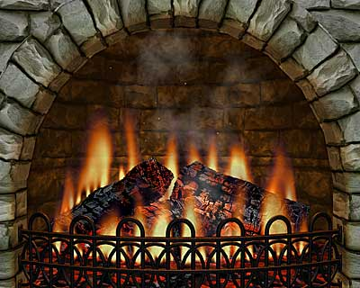
Fire Place

Slide 4

Glitter ball

Slide 5
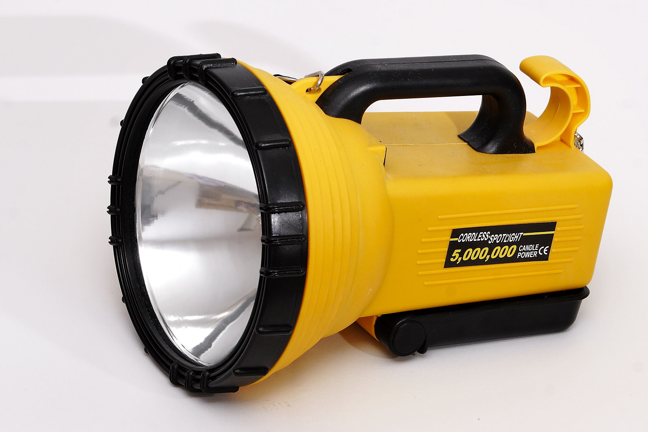
Torch

Slide 6
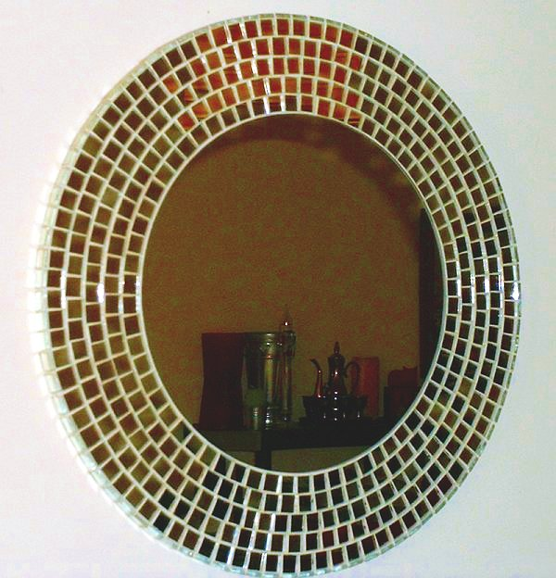
Mirror

Slide 7
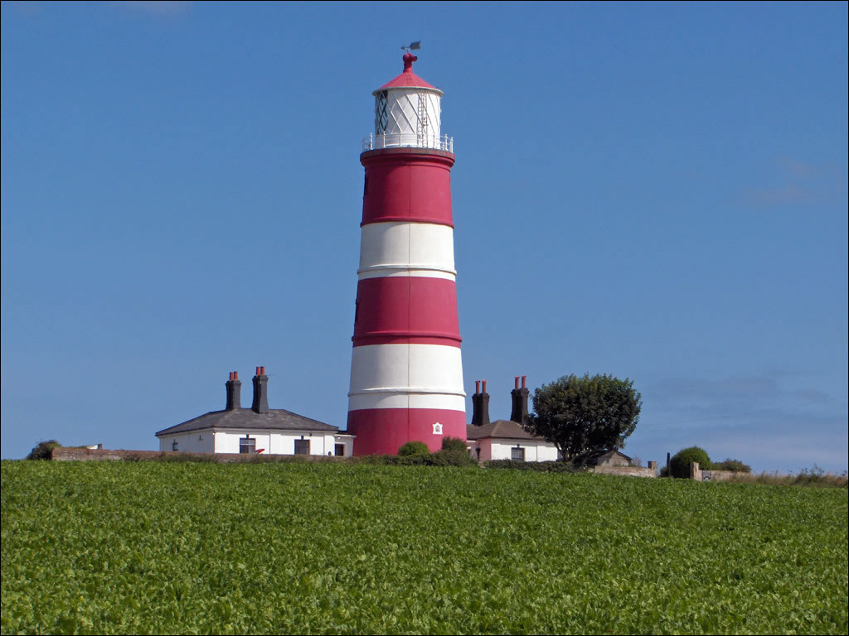
Lighthouse

Slide 8
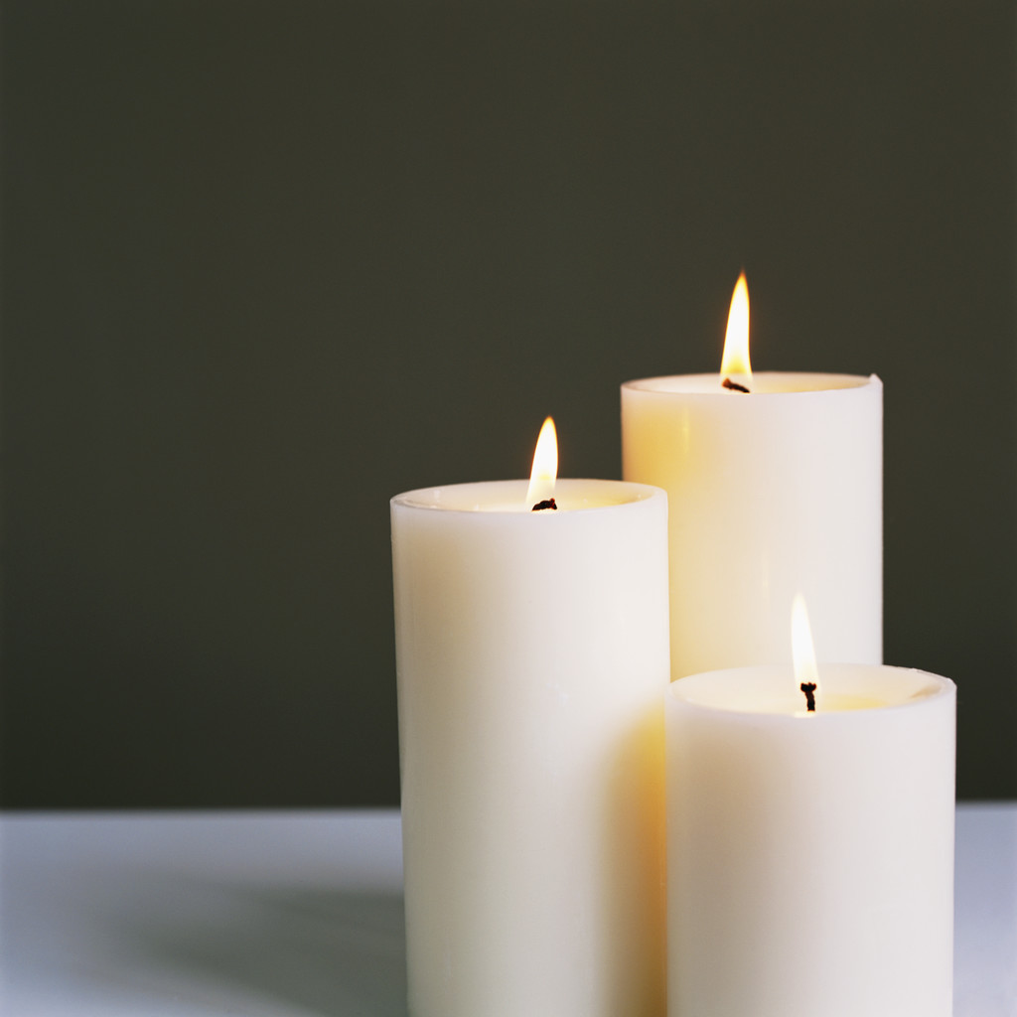
Candles

Slide 9
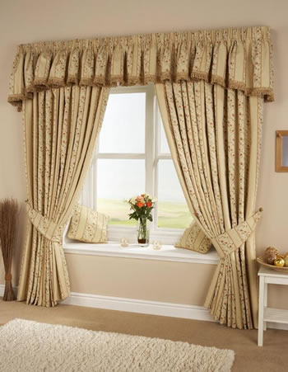
Curtains

Slide 10
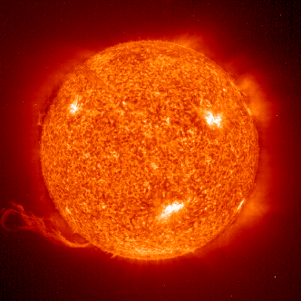
Sun

Slide 11
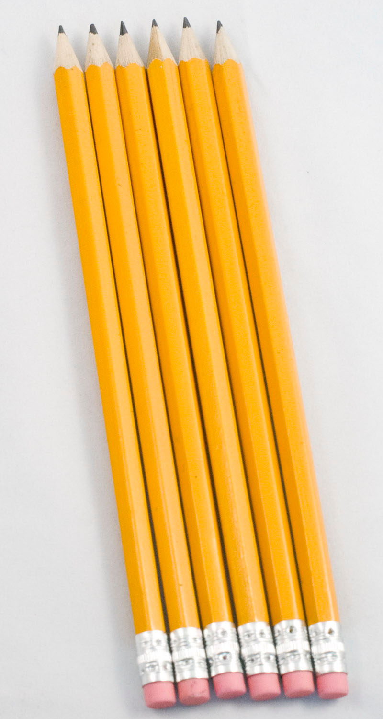
Yellow Pencils

Slide 12

Window

Slide 13
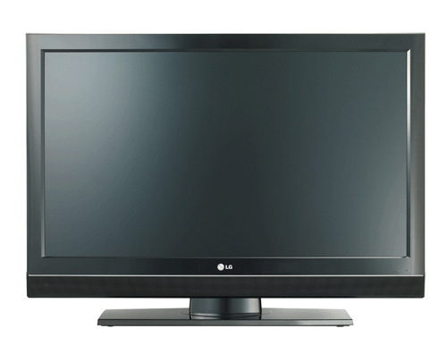
Television

Slide 14
Where did these light sources come from?
Can you think of any others? With your talking partners talk about the sources of light we have just seen and where the light comes from.

