Slide 1
“Oink Oink!” said the little pig.
Oink Oink!

Slide 2
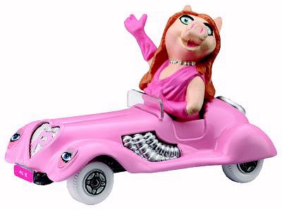
“I like driving my pink car!” said Miss Piggy.
I like driving my pink car!

Slide 3
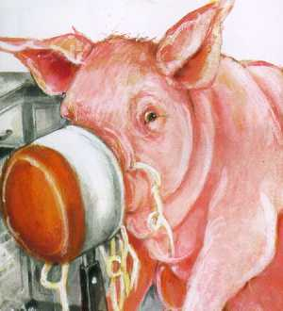
“Oh dear, my big nose is stuck!” said Daddy pig.
Oh dear, my big nose is stuck!

Slide 4
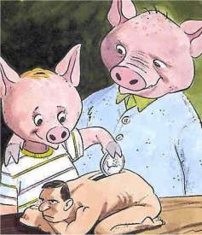
“I like to save money!” said the little pig to his Daddy.
I like to save money!

Slide 5
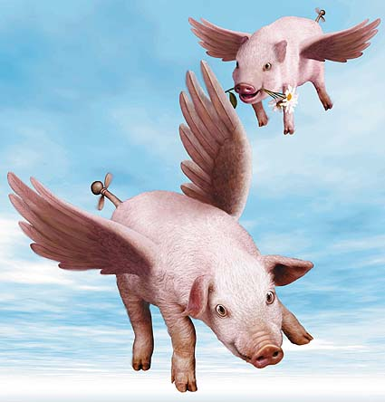
“We can fly high in the sky!” shouted the pigs.
We can fly high in the sky!

