Slide 1
Speech marks
‘‘ ’’

Slide 2
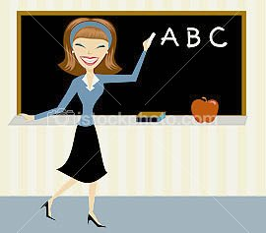
Very good! said Miss McCrum.
Very good!
“Very good!” said Miss McCrum.

Slide 3

I like sweets! said the little boy.
I like sweets!
“I like sweets!” said the little boy.

Slide 4
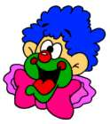
I am really happy! said the clown.
I am really happy!
“I am really happy!” said the clown.

Slide 5

The little girl shouted, I like toys!
I like toys!
The little girl shouted, “I like toys!”

Slide 6
1st: who is speaking?
2nd: what are they saying?
Put speech marks around
what they are saying.

