Slide 1
Spelling Plurals
WALT use the correct way to write plurals.
s
ies
es
Year 3 Term 2

Slide 2
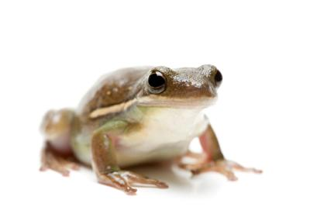
frog

Slide 3
frogs

Slide 4
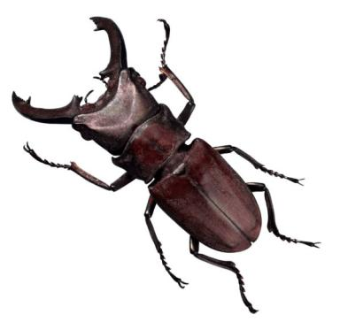
beetle

Slide 5
beetles

Slide 6
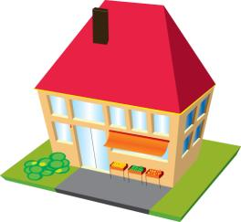
building

Slide 7
buildings

Slide 8
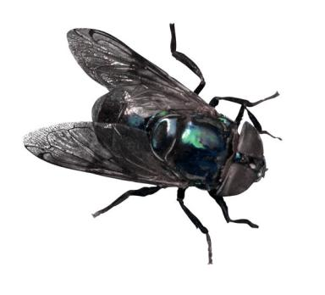
fly

Slide 9
flies

Slide 10
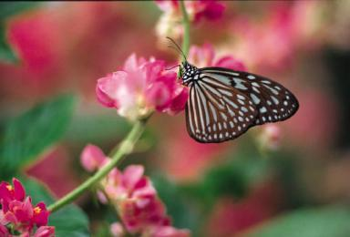
butterfly

Slide 11
butterflies

Slide 12
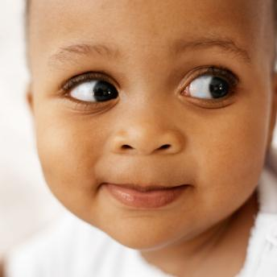
baby

Slide 13
babies

Slide 14
lady

Slide 15
ladies

Slide 16
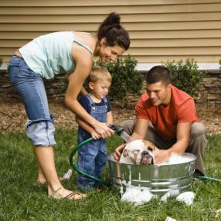
family

Slide 17
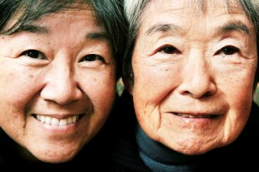
families

Slide 18
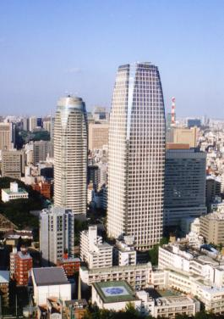
city

Slide 19
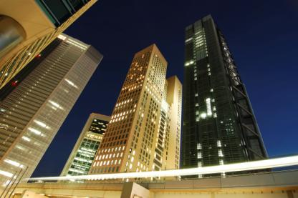
cities

Slide 20
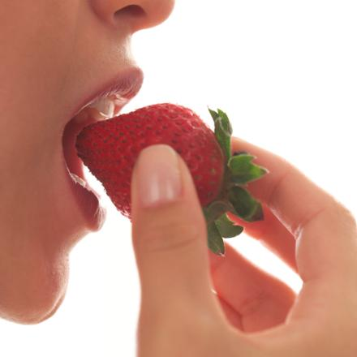
berry

Slide 21
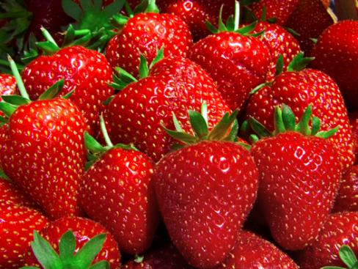
berries

Slide 22
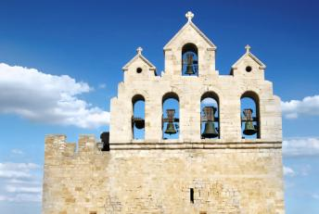
church

Slide 23
churches

Slide 24
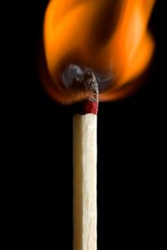
match

Slide 25
matches

Slide 26
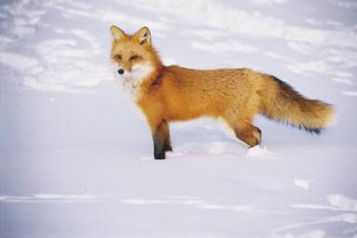
fox

Slide 27
foxes

Slide 28
box

Slide 29
boxes

Slide 30
bush

Slide 31
bushes

Slide 32
kiss

Slide 33
kisses

Slide 34
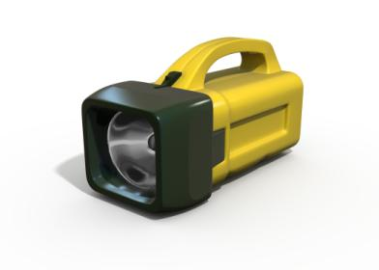
torch

Slide 35
torches

Slide 36
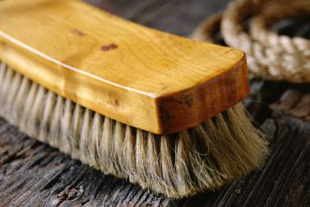
brush

Slide 37
brushes

