Slide 1

Springs

Slide 2
Learning Objectives:
Springs are used in a variety of ways.
Make and test predictions about which springs are the strongest.
Understanding the principles of a fair test.
Springs and their forces act in particular directions.

Slide 3
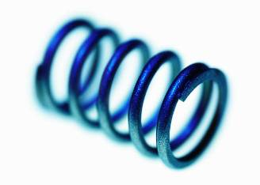

Think about……
uses of springs

Slide 4
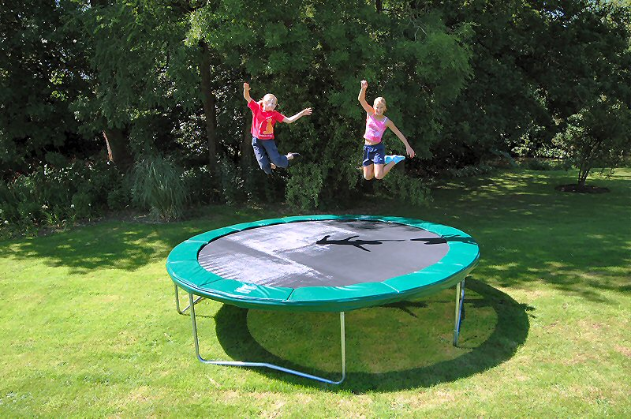
trampoline

Slide 5
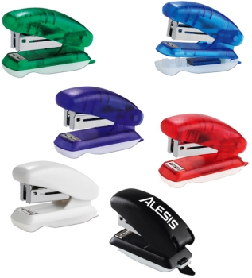
stapler

Slide 6
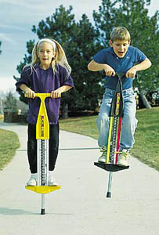
Pogo stick

Slide 7
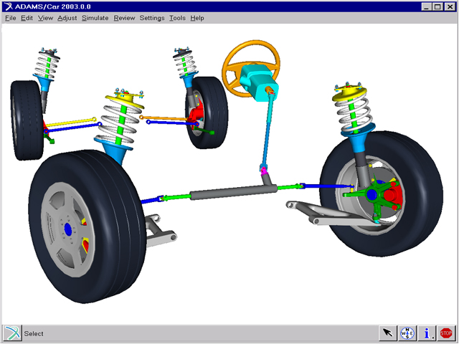
suspension

Slide 8
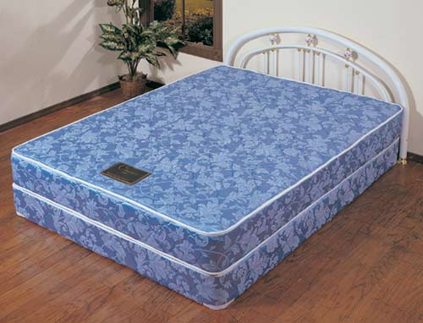
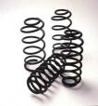
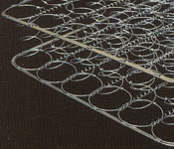
mattress

Slide 9
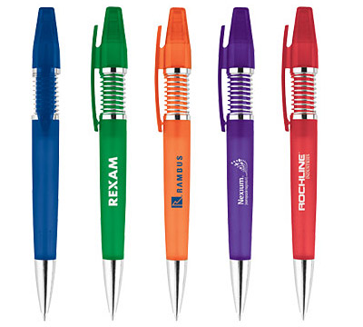
pens

Slide 10
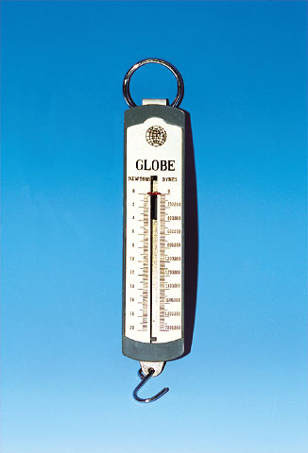
A Newton
meter

Slide 11
compressing
springs use forces
stretching

