Slide 1
St Lucia Quiz

Slide 2
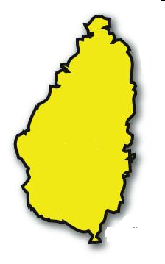
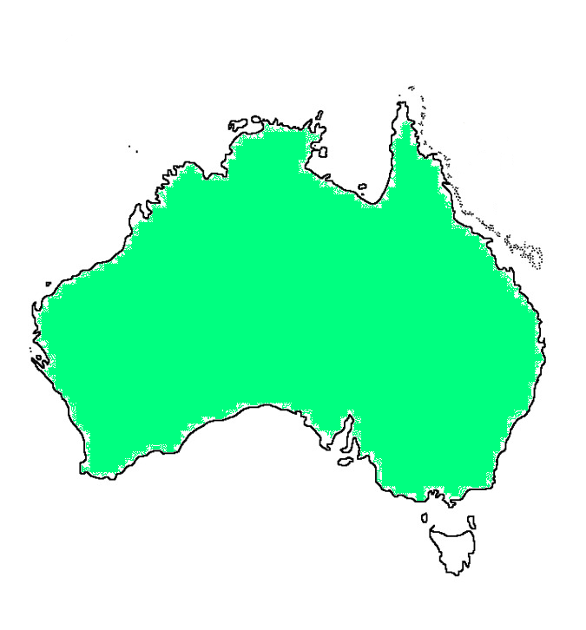
Which map shows St Lucia?
A.
B.
C.
A

Slide 3
What is the capital city of St Lucia?
A. Caribbean
B. Castries
C. Canaries
B

Slide 4
What sea surrounds St Lucia?
A. St Lucia Sea
B. North Sea
C. Caribbean Sea
C

Slide 5
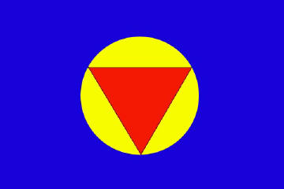
What is the flag for St Lucia?
A.
B.
C.
C

Slide 6
How can you not travel to St Lucia?
A. Airplane
B. Train
C. Boat or ferry
B

Slide 7
What do they grow the most of in St Lucia?
A. Bananas
B. Mangos
C. Grapes
A

Slide 8
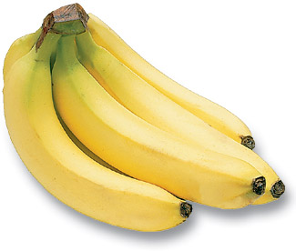
What do the locals call bananas?
A. Green Jewels
B. Golden Fruit
C. Green Gold
C

Slide 9
Why?
A. They are hard like gold.
B. They are green when they are picked.
C. They are gold when they are picked.
B

Slide 10
What is the name of the growing industry in St Lucia beginning with T?
A. Tourist
B. Tourism
C. Turtle tours
B

Slide 11
Would you like to go on holiday to St Lucia?
A. Yes
B. No
C. Maybe
A

Slide 12
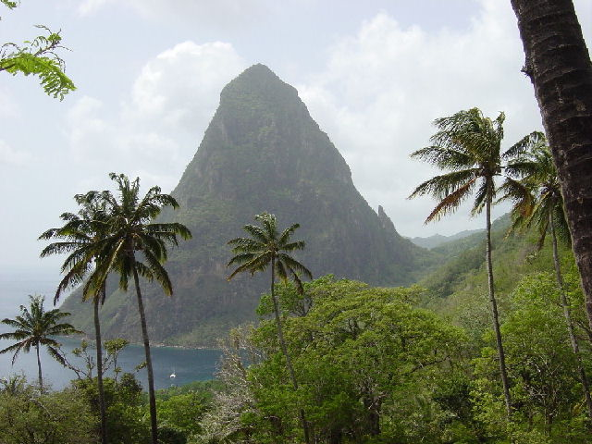
WOW!!!! You did fantastic! You are all St Lucia EXPERTS!!!!

