Slide 1

Testing Solutions
Can we use filters to take salt and sugar out of a liquid?

Slide 2
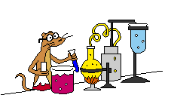
What happens when we put salt or sugar into water?

Slide 3
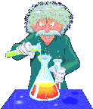
Could we use a filter to separate it?

Slide 4

How can we test if it worked?

Slide 5

Can you solve this problem?
Mr Sourface has a terrible allergy to salt and sugar- if he eats any he will begin to fizz and dissolve completely away! Have a look at the three liquids that Mrs Kimberley has got for him to drink. Your job is to be his special tester….. which liquid is safe for him to drink?

