Slide 1
The rainforest
South America

Slide 2
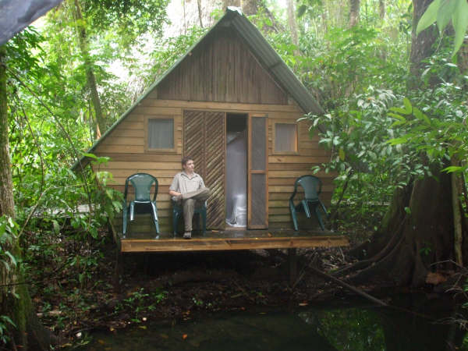
Travellers can stay in lodges in the rainforest.

Slide 3
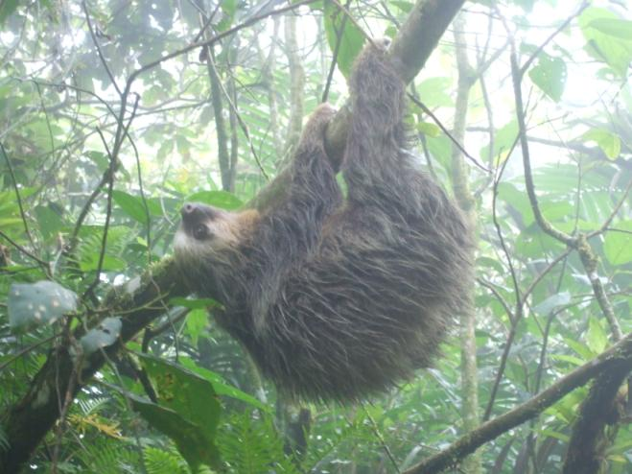
With guides, visitors can see the wild life.

Slide 4
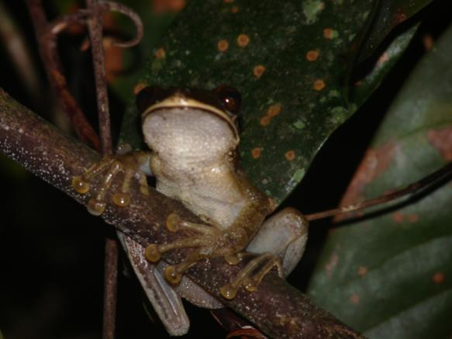

Slide 5
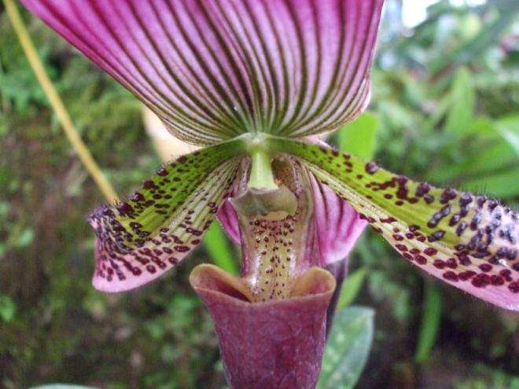
Flowers are brightly coloured.

Slide 6
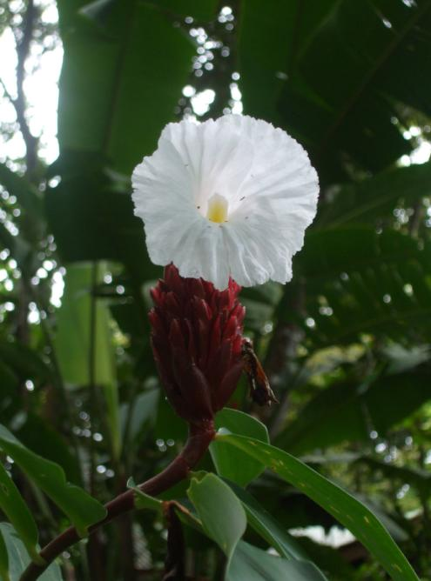

Slide 7
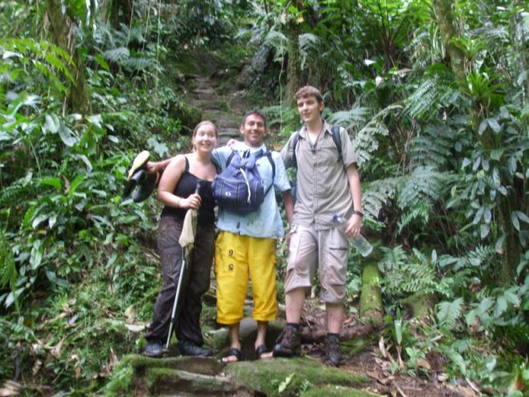
You need to dress carefully to walk through the dense undergrowth.

Slide 8
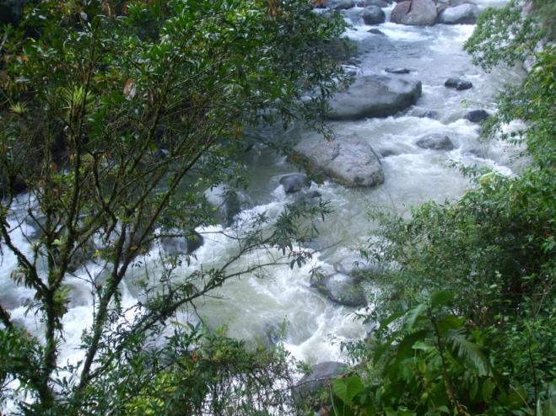
The rainforest has many rivers.

Slide 9
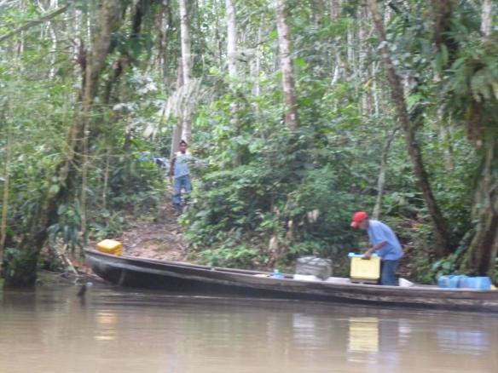
To travel by boat is easier than walking through the forest.

Slide 10
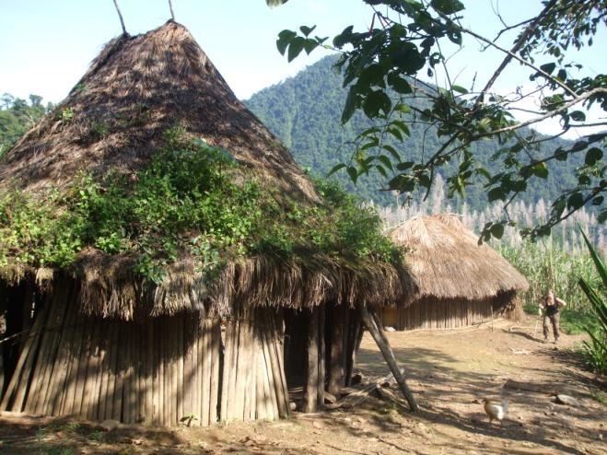
These are local houses in the rainforest.

Slide 11
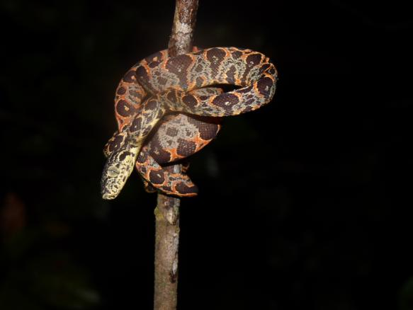
Beware snakes!

Slide 12
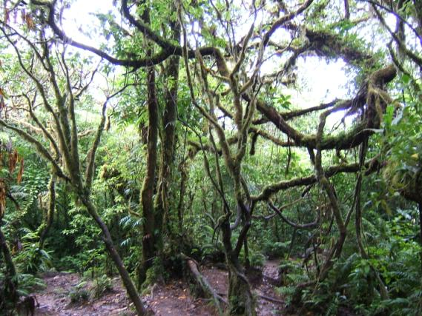
The rainforest is full of life.

Slide 13
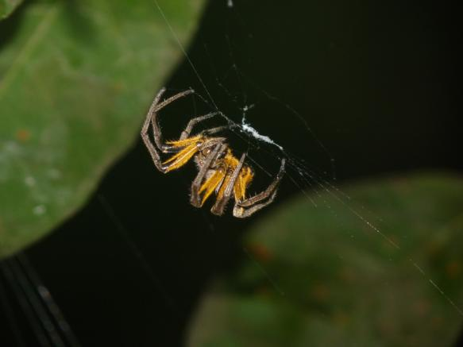

Slide 14
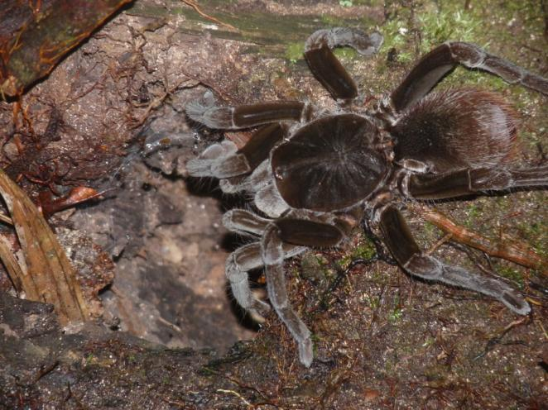

Slide 15
