Slide 1
Tillage, cultivation and crop establishment
Introduction
Tillage is a general term for modifying the soil.
Primary tillage refers to ploughing.
Cultivation can be used as a synonym for tillage but is
often used in a technical sense of weeding with an implement.

Slide 2
Want to cover:
brief discussion of mechanisation issues
overview of factors affecting emergence and
establishment
ploughing,
harrowing,
planting,
cultivation for weeding,
use of ridging

Slide 3
Mechanisation
Mechanising farm operations can :-
  reduce drudgery
  increase output per person-hour
  improve timeliness
  reduce spoilage, waste and other losses of produce
  increase yields by faster sowing / weeding or deeper
tillage or faster harvesting

Slide 4
But:
fragmented and small holdings,
agronomic practices such as mixed cropping,
inadequate repair and maintenance facilities, spare parts,
insufficient trained machinery operators
inadequate extension services
insufficient encouragement of local innovations in designs – industrial sector favours larger farmers
poor infrastructure – related to maintenance
may be problem in tying up capital in machinery that is not often used
main problem for ox-drawn equipment generally seems to be finance rather than availability of technologies.

Slide 5
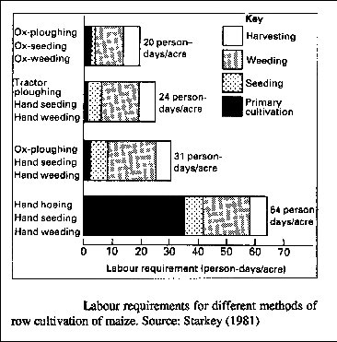
Impact of
mechanisation
on labour

Slide 6
Labour requirement for different activities and different crops grown in India where land is ploughed with ox-plough and weeded by hand

Slide 7
Labour requirement for different activities and different crops

Slide 8
  Bulk density and porosity
  definitions
  reduces root development
  decreases aeration but in some instances may increase
  AWC – see figs
  decreases infiltration
  tolerance to high BDs has been ranked
  (increasing tolerance) as :
    maize;
    groundnuts;
    sorghum;
    soybean
    mung bean
    cowpea

Slide 9
  deep rooting crops such as pigeon pea may reduce
bulk density and have a beneficial effect on
subsequent crops
  increasing porosity by 12 to 15 % may double maize
  yields or increase g-nut yields by 10%
  BD affects root development and yield – see fig.

Slide 10
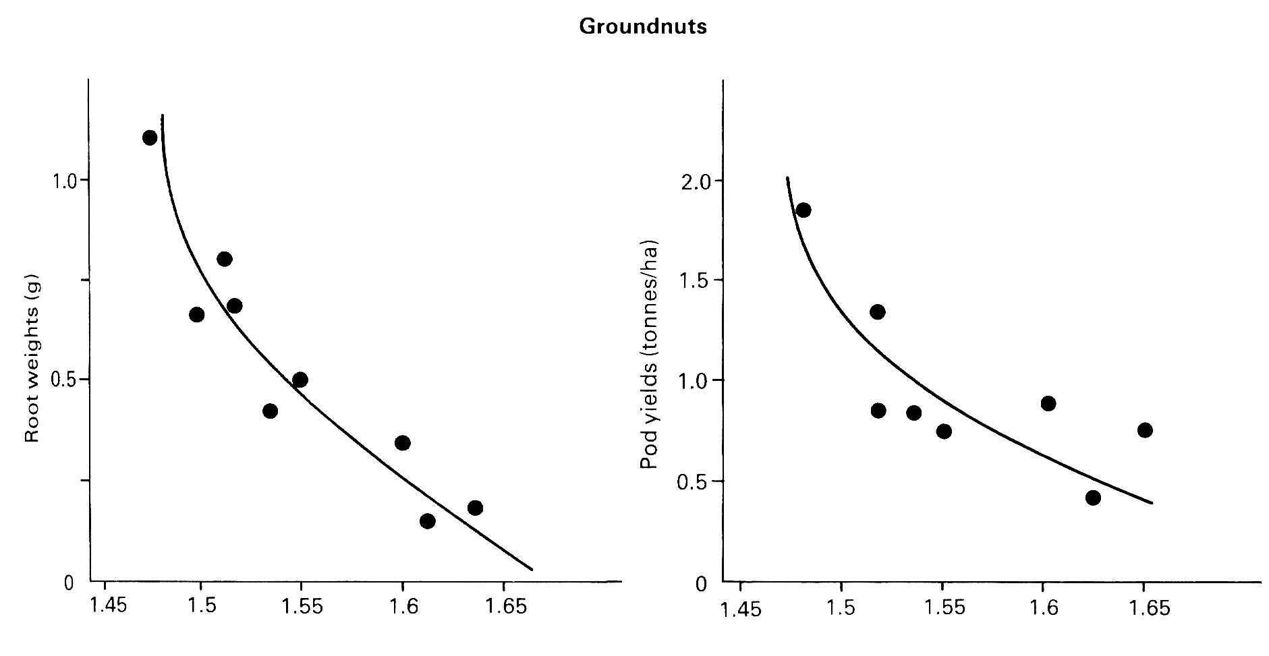
Bulk density g cm⁻³

Slide 11
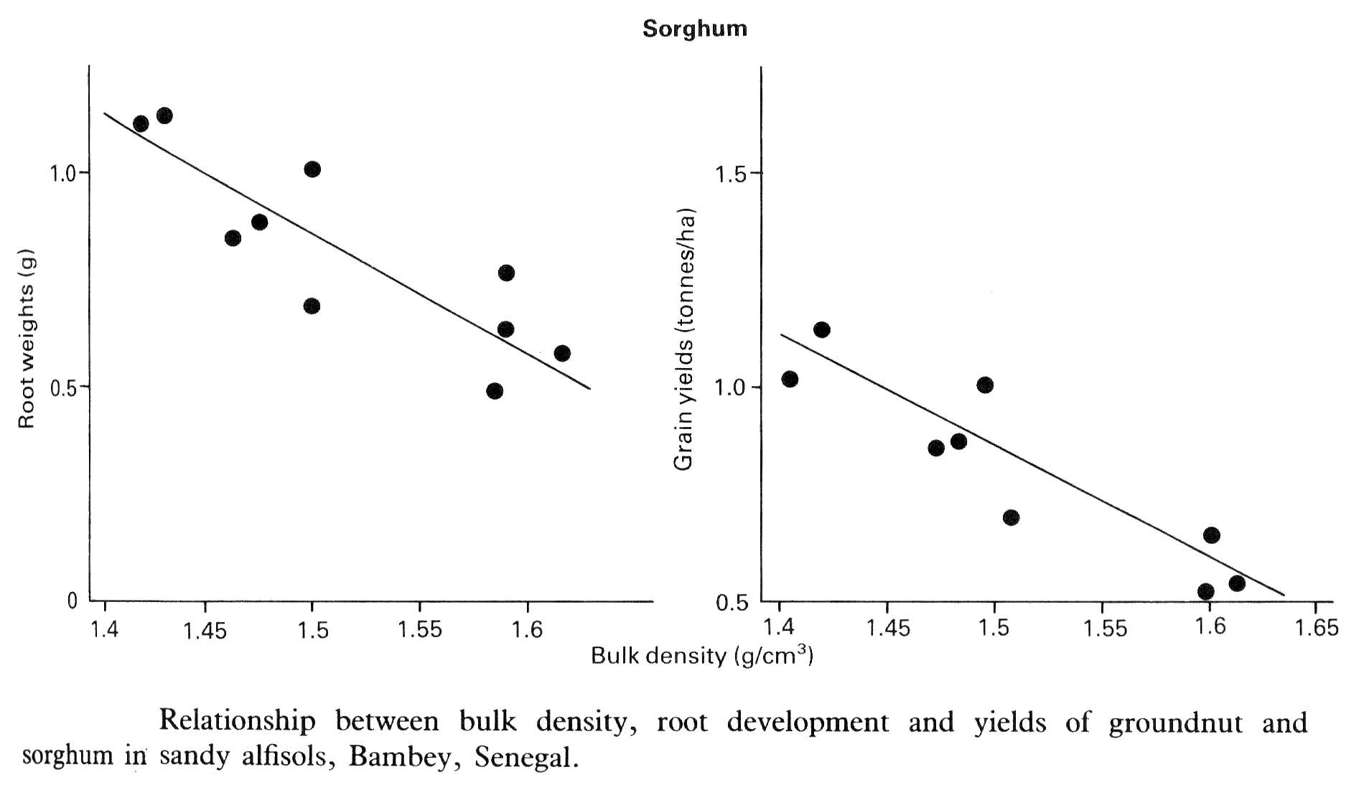

Slide 12
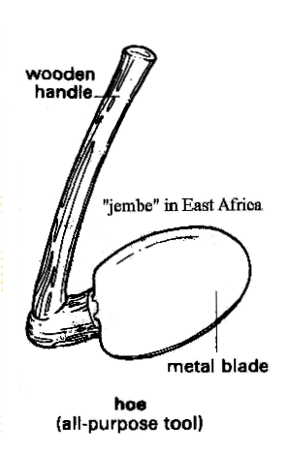

Hand tools
Primary cultivation - mainly hoe, mattock
15 cm
head of “ring” hoe

Slide 13
Message from Uganda about hoes
“Just as the hoes made from the ore of Mount Toror ruptured the earth which gave life to the sorghum grain, the spears made from same ore pierced the bodies of the warriors and released their spirits. The soul of iron ore is an important metaphor for death and life. For example, the people of NE Uganda buried a hoe at the beginning of harvest and a spear to initiate war.
Akisil remembers buried spears and hoes. Karamojong elders question the spirituality and social implications of automatic weapons, while spears blessed by the ancient spirits of the iron-makers in Alerek brought victory and justice to those who used them.
Many Karamojong elders agree that a spear made from the soil of Mount Toror releases the spirit of the killed person which goes to the grazing land to join the rest of the ancient spirits in seeking justice.”

Slide 14
Ploughing – general comments
ploughing can increase infiltration by up to 3 x and increase aeration by as much as 50%
aim for large clods to maximise roughness and thus infiltration of ponded water;
best not to bring subsoil to surface as subsoil may be unstable or infertile - so usually adopt 15 cm maximum depth for mouldboard ploughs or up to 20 cm for disk ploughs as they do not invert soil;
best time to plough is at end of harvest when still some soil moisture but often this is time for celebrations & so “no time” for ploughing;

Slide 15
if early ploughing can be carried out, moisture can build up from occasional showers in dry season & at start of rainy season;
increased risks of soil erosion after harvest ploughing especially on steep land;
early ploughing may cause oxidation of organic matter if soil is inverted;
oxen or tractors may enable hard dry soil to be ploughed before the rains;

Slide 16
soil fauna (especially termites) help in availability of N and other nutrients, improving structure and water movement because of holes and aggregation of particles, aeration though fauna can also increase erosion
ploughing may have negative effect on soil fauna which would otherwise help to turn over the soil – fauna also effected by land clearing, use of heavy machines and chemicals

Slide 17
  Types of plough
  Mouldboard
  Chisel
  Disk
    also sub-soilers

Slide 18
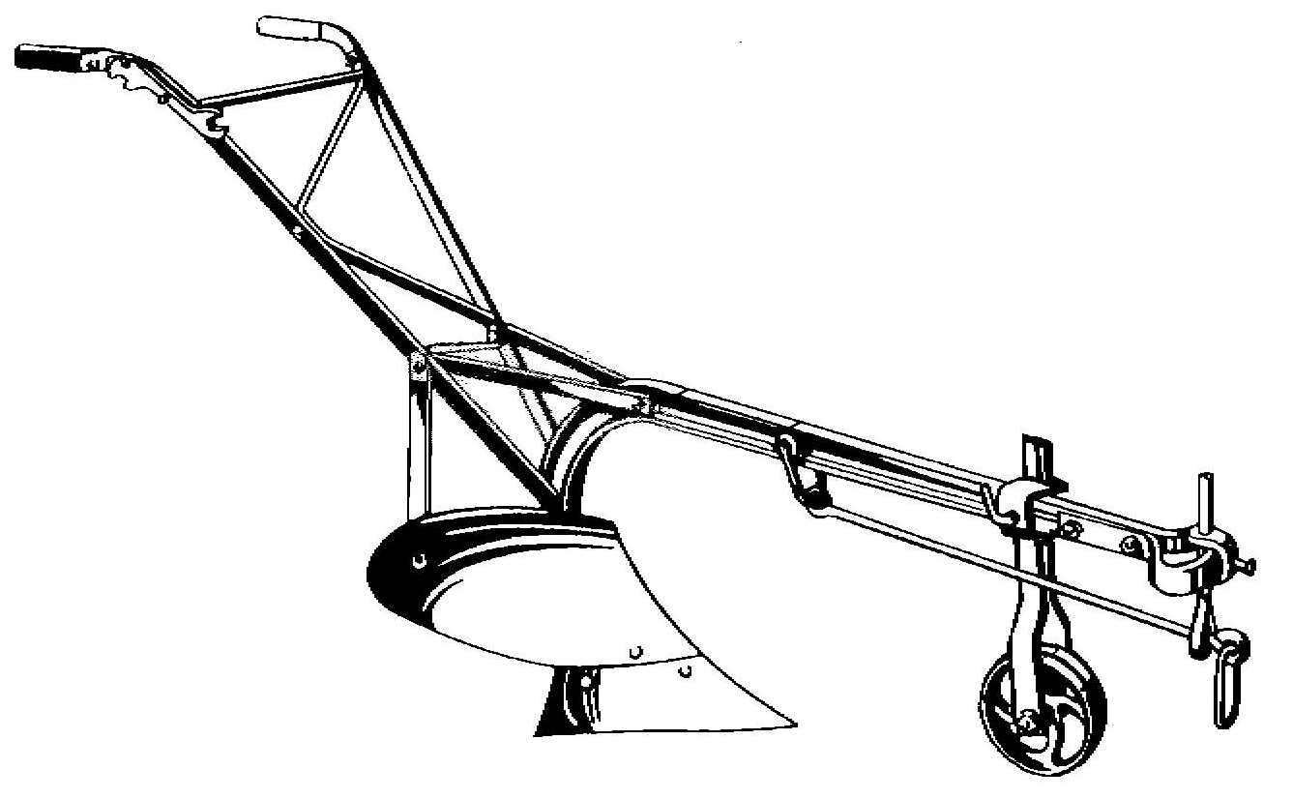
Ox-drawn mouldboard plough

Slide 19
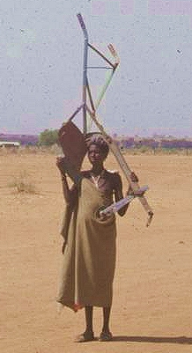
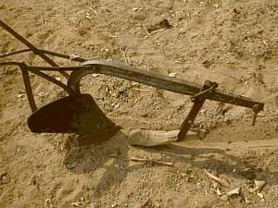

Slide 20
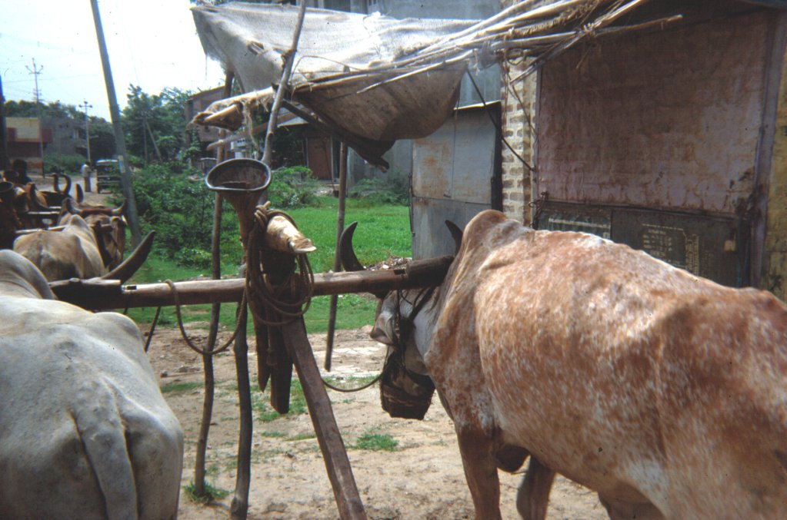

Slide 21
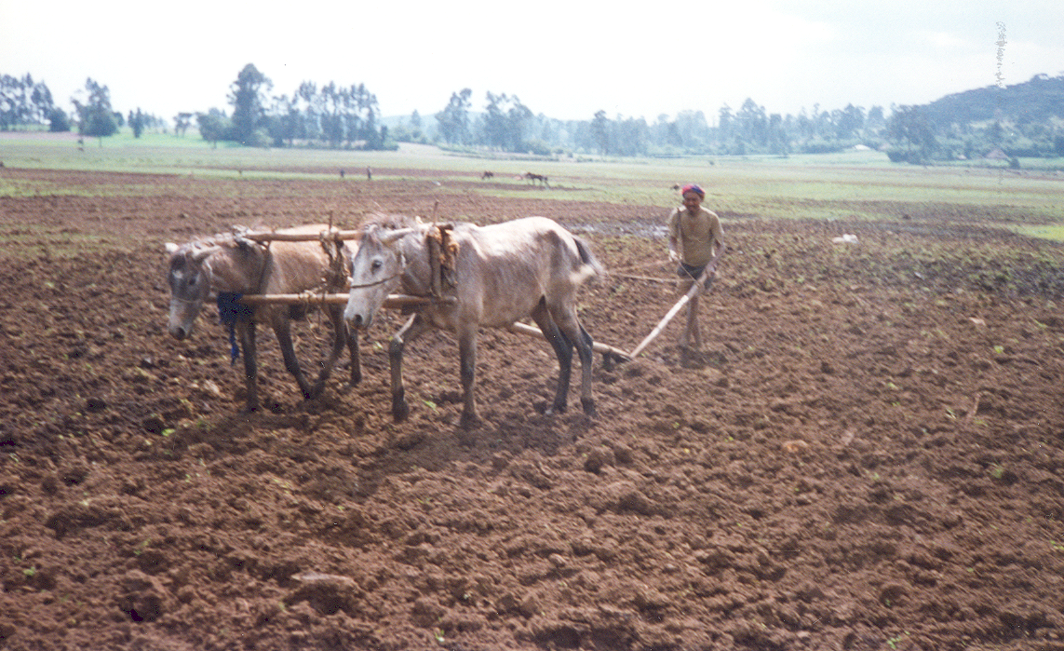
Ploughing with horses in Bolivia

Slide 22
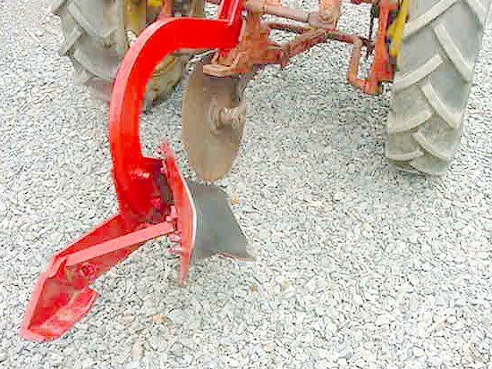
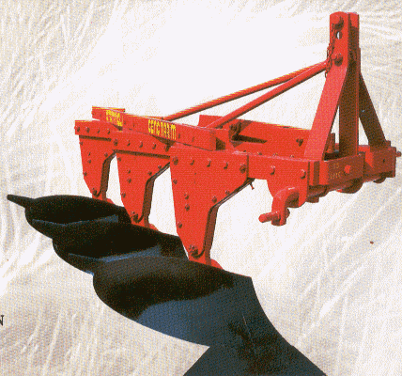
Ox-drawn mouldboard ploughs OK but larger mouldboards drawn by tractor invert the soil and so are not recommended for tropical conditions where there are low levels of inputs.
Inversion also leads to increase in moisture loss

Slide 23
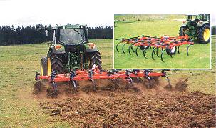
Chisel plough

Slide 24
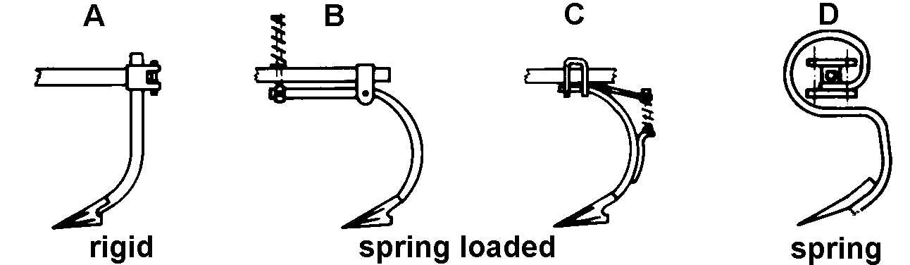
Chisel ploughs good for breaking up hard soils

Slide 25
Subsoilers
pans – compaction below plough layer - can develop if soil is ploughed when wet
compaction also from heavy equipment
ripping with sub-soiler may then be necessary;
large chisels
ox-drawn rippers benefit – increases infiltration (+ 50% ?)
subsoiling can give up to 25% increases in yield of maize
duration of effects of ripping with a subsoiler is debated

Slide 26
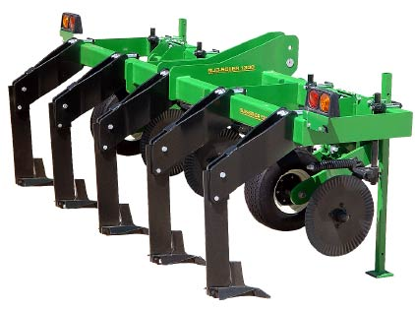
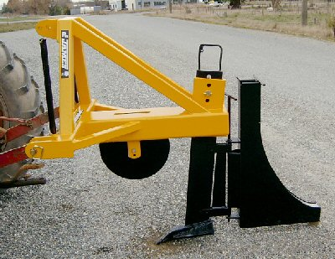

Slide 27
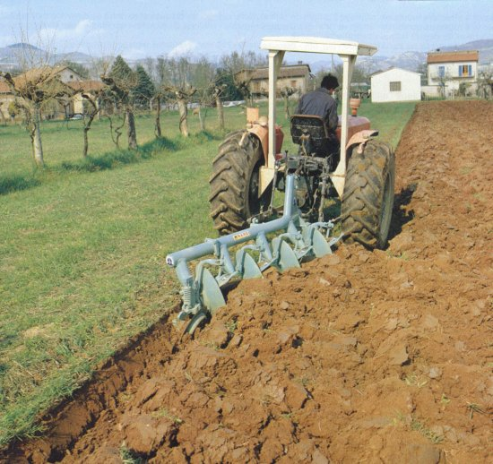
Disk plough

Slide 28
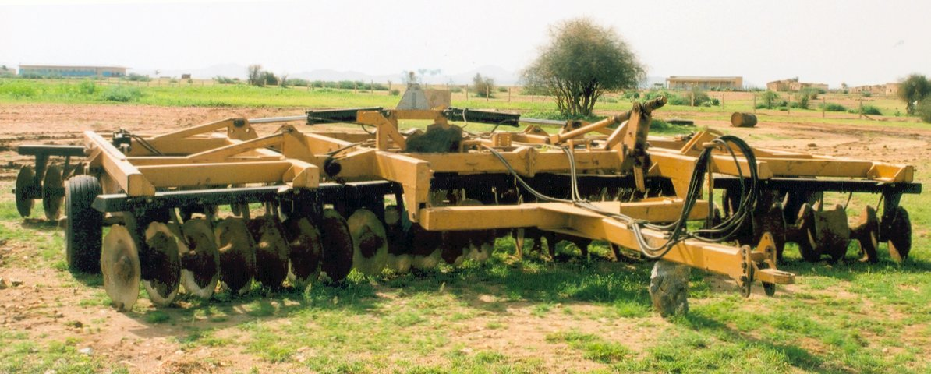

Slide 29
Ploughing of Vertisols and Mollisols
both Vertisols are Mollisols have high clay content and crack on drying
range of moisture conditions when workable very small – narrow window of opportunity
  if too dry – need high powered machinery
  if too wet – cannot bear weight of equipment
tillage when slightly dry better than when wet
deep ploughing not a good idea – brings large clods to surface

Slide 30
Contour ploughing
for permeable soils, plough along “exact” contour; for very
impermeable soils, plough at angle to contour with slope of
0.25 to 0.5 to encourage drainage;
can be mechanised, semi-mechanised or done by hand;
tractor ploughing on contour limited
- 17% for 2WD vehicles, 25% for 4WD.

Slide 31
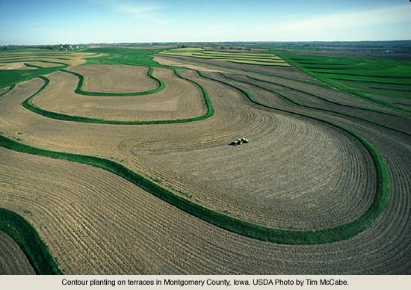

Slide 32
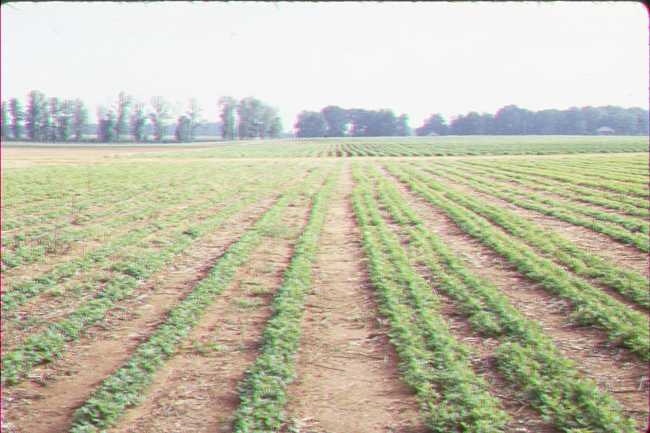
Strip tillage
effective in semi-arid areas – crop rows only
tines 75 cm spacing x 30 cm depth
inter-row shallow weeded only
functions as a water harvesting system
1st year tractor ? – subsequently ox-drawn

Slide 33
Harrowing and final seedbed preparation
close contact – fine tilth – ideal is to achieve same
average aggregate size as seed size - not too dense
fine tilth important for good growth – coarse structure
not conducive to good establishment – maize seedlings
grown in 9 ± 3.5 mm aggregates were <60% of those grown
in 2.4 ± 0.8 mm aggregates
rapid deterioration after rain – low OM – best timing is
just before planting to avoid erosion caused by effect of
rain on very loose soil or decrease in infiltration rate
caused by crusting

Slide 34
plough planting efficient – machine, hand, funnel
- more suitable for large seed crops
accurate plough – planting – lines – easier weeding
ridging can sometimes adversely effect establishment
many farmers only dig or plough the soil though in the
latter case sometimes a cross-ploughing is performed
- India – planking to break down clods

Slide 35
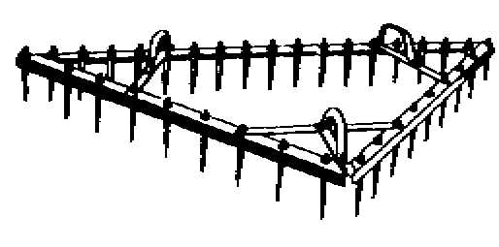
Harrow

Slide 36
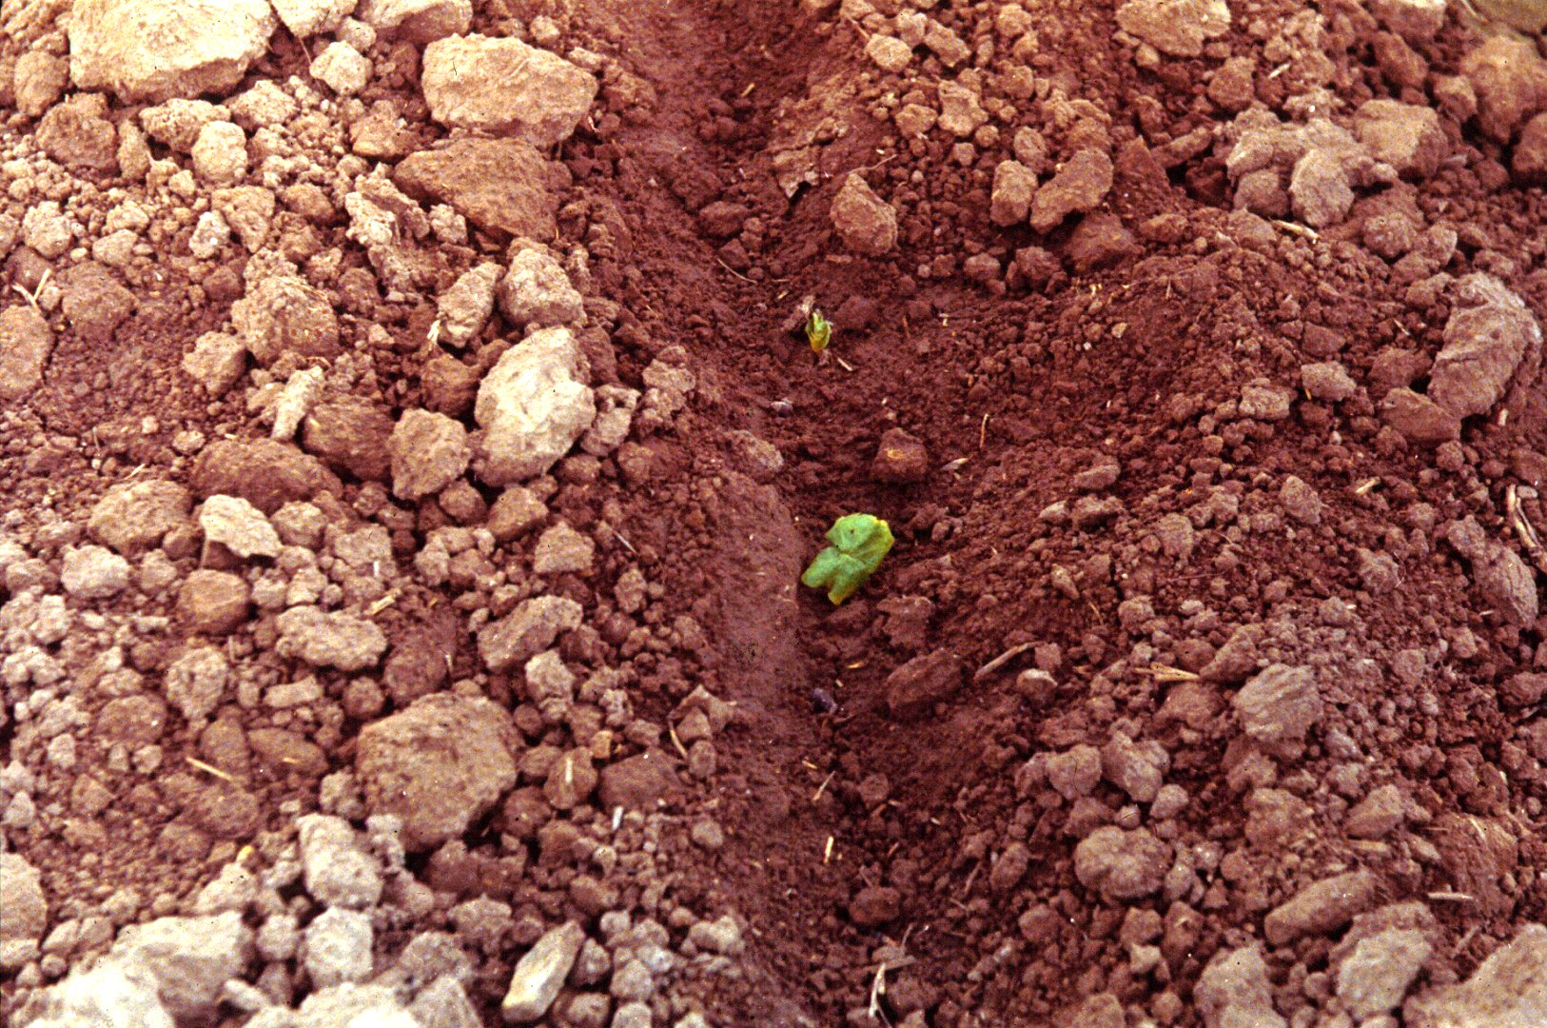

Slide 37
Compaction
Compaction is usually deleterious but may have beneficial
effects on some loose textured soils - AWC may be increased

Slide 38
Minimum tillage
Spectrum of meanings from:
  machines to plant through stubble and use herbicides
  to kill weeds;
        TO
  burn & hand planting with digging stick
Results have been disappointing in developing countries, e.g. in N. Ghana, it was found that minimum tillage was not
as effective as ridging, mulching, or even traditional mixed cropping.
More research required.
Analyse each situation independently

Slide 39
Planting methods
press-wheel in semi-arid / sandy areas
wheel track planting in some places – clods crushed by wheel – planter follows behind

Slide 40
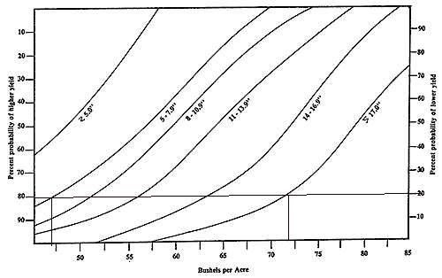
Moisture at planting
Strong correlation with yield (maize - Nebraska)
If pre-season rain is 5 to 7.9”, there is 80% probability
that yield will be over 44, over 74 if > 17”

Slide 41
Depth of sowing
  in India, groundnuts sown deep by farmers to use
  moisture though in some experiments this has given
  lower yields
  plant too shallow and seed dries out - too deep &
  seedling cannot emerge
  some maize varieties can be planted up to 15 cm deep
  – seeds wait for rain to percolate down, by which time,
  there is more probability that rains have really
  started.

Slide 42
Plant population
  Spacing inversely proportional to aridity.
  May be better to accept lower yields and higher densities
  for Soil Conservation - ground cover - and fodder
  Farmers may overplant to allow for losses from drought
  or pests.
  In India, purposely overplanted to obtain thinnings to
  feed to cattle
  fertile soil + ample moisture → dense – but weeding
  important
  infertile soil + low moisture → low density

Slide 43
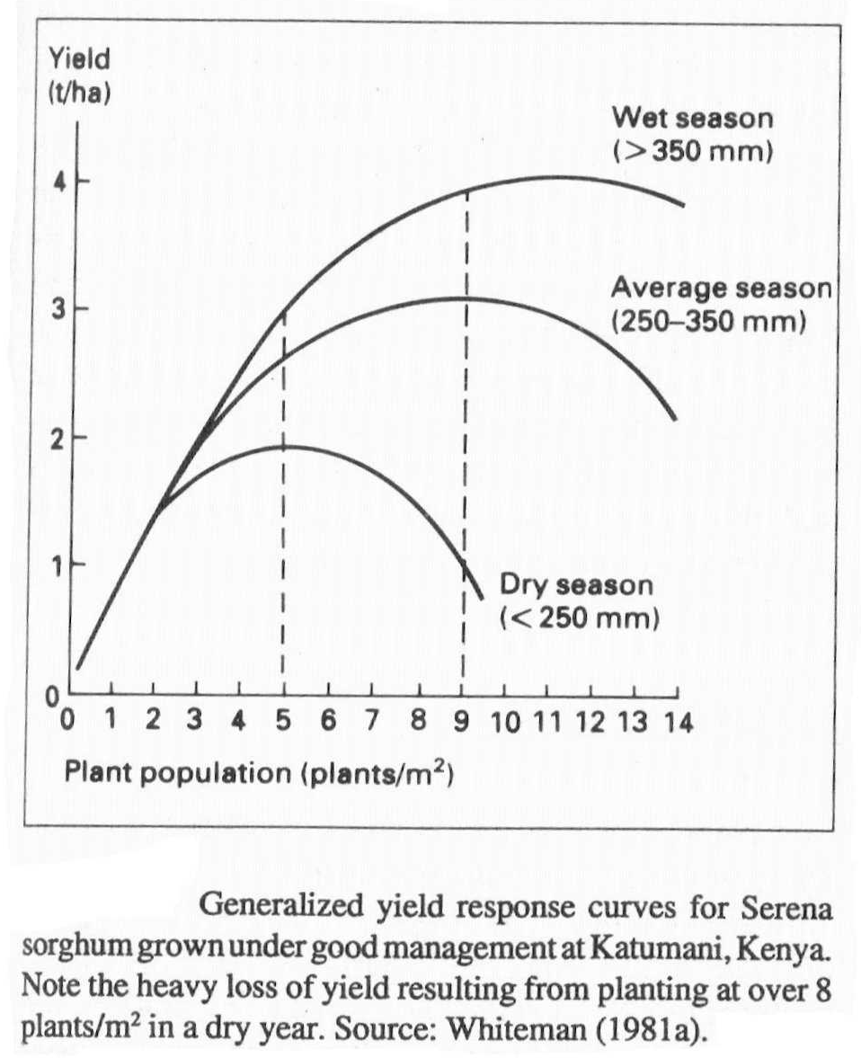

Slide 44
farmers may sacrifice yield in better years for better crop
in drier years; e.g. 70,000 plants ha⁻¹ maize gives good
yields when adequate rain but 20,000 plants ha⁻¹ give 30%
higher yields in dry years – when prices are also higher –
aim high or aim low – debatable
population depends on species / seed size / varieties habit
(dwarf v. tall; spreading v. erect) – see figure

Slide 45
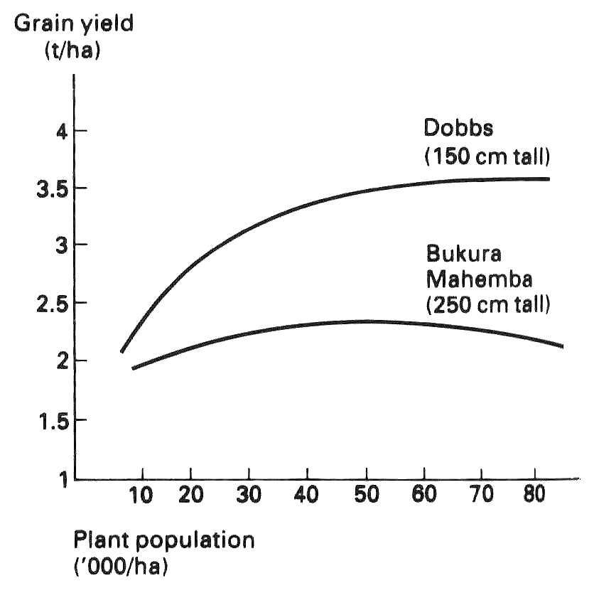

Slide 46
stover has lower sensitivity to population than grain so
seed rates which are too high for the moisture conditions
reduces grain : stover ratio
if fodder is important, farmers may deliberately sacrifice
grain by using high populations
grain or fruit quality e.g. groundnuts for seed better if
medium sized – obtained if higher populations; pineapples
– spacing adjusted for fruit size as well as yield (high
populations produce too many small fruit though yields
may be higher)

Slide 47
Plant geometry within the field
promoting competition by e.g. double rows may increase
grain yield even with same population – sorghum produces
fewer heads / area but panicles have more & larger grains
– result is higher yield
in cotton double rows encourage boll formation on open
sides – wide spacing especially important in lower light areas
as boll number is a function of light available
groundnuts – aphids (mosaic virus vector) prefer wide rows
– but in dry areas, wider spaced rows can benefit yield
if no aphids
hill planting e.g. groundnuts may increase yield by
encouraging competition and reduce labour requirements

Slide 48
mounds also used for growing upland crops on poorly
drained soils (also ridges)
mechanised (motorised or ox-drawn) planters, weeders,
harvesting equipment may require specific row spacing –
yields may have to be sacrificed or adjust intra
– row spacing for ease of harvesting
hand harvesting of sorghum easier if large heads -
- produced at wider row spacing
wider rows save time if hand or ox-planting
for mechanised harvesting smaller more uniform
heads better – closer spacing

Slide 49
wider spacing may reduce insect & diseases damage
wide spacing encourages more weeds
(and also their removal)
several seeds per hole (maize) – indigenous practice
– helps overcome crusting as well as reducing labour
requirements
lodging less serious in sorghum if wider rows
relay planting easier if wider spacing

Slide 50
Time of planting
General principles
Early establishment of crop canopy helps to absorb
raindrop energy early in season and so reduce splash erosion
and surface sealing.
Also helps to maintain porosity & infiltration rate increases
brought about by ploughing.
Early establishment makes best use of available rain.

Slide 51
Dry planting
makes optimum use of early rain
spreads work load
agroclimatic analysis to determine best (called “trigger”)
dates very important
However, there are risks and problems:
large variation in start date for rain from year to year
if late, seed can be lost and so replanting will be required
(but will seed be available)
animals (e.g. ground squirrels) may eat dry seed so guards
may be necessary
delay in replanting waiting for rain to “re-start” may
lower eventual yield
increased weed problem (as crop & weeds germinate
at the same time)

Slide 52
Planting after start of rain
May be essential on hard soils and/or if cultivation is
performed with digging stick or hand hoe
Avoids weed problem of above, weeds germinate first,
then hoed
Usually wastes rain & time (i.e. reduces possible growing
period (often correlated with yield) )

Slide 53
Phased planting
plant part of field/farm then later on (after a week?),
plant next part - maybe some before, some after rain
leads to lack of uniformity
leads to increased risk of pest damage
(pests that only feed on the crop at certain stages can
proceed to the next "phase" as it becomes ready to eat)
but spreads labour load - maybe OK if different crops

Slide 54
Relay or sequence planting
Plant second crop underneath first crop before first is
harvested so that it gets off to a good start
- residual moisture or second peak in rainfall
Grows up through first crop
Symbiosis (nitrogen of second crop may provide nitrogen
to first crop, first crop provides shade to second crop,
first crop may provide physical support - not the same
as parasitism which implies feeding or using moisture,
each may help prevent spread of pests to the other)

Slide 55
Other factors affecting time of planting
Birds / pests may arrive at certain time & may be best
to avoid having grain ready at that time even if late
planting means yield is less than ideal
Air temperatures affect soil temperatures and these
affect mineralisation of Nitrogen - may be best to avoid
high temperatures at times when crop susceptible to
nitrogen supply
Radiation varies throughout year according to angle of
sun. This has direct affect on potential for photosynthesis

Slide 56
Weed growth reaches maximum at certain time - may
get better yields if avoid maximum crop growth at that
time by adjusting planting date
Crop physiology may require avoidance of rain or drought
at certain stages of growth
Viruses only attack under certain climatic conditions
(e.g. groundnuts will suffer from mosaic virus if planted
late)
Fungus similarly (e.g. millet more susceptible to “smut”
if it flowers in heavy rain)

Slide 57
Response farming
Optimists - aim at high production and then thin or remove
alternate rows if season has low rainfall
Pessimists - aim low, but add nitrogen, relay sow, plant
short season -inter-crop or catch crop if
rainfall is better than feared
Some attempts to formalise this approach using
climate analysis

Slide 58
Weeding
weeds cause:
  competition for nutrients and water – particularly
  serious in early growth stages (first ¼ to 1/3 of life)
  - best use of available water is not being made
  loss of yield - may be 20 to 50% in dryland conditions
  limitation of cropped area - labour for clearing
  land and in-season weeding - labour is major
  bottleneck for subsistence farming - 40% to 60%
  of total labour input (person days) on weeding

Slide 59
contamination of harvested crops
pest hosts
toxic secretions inhibit crop growth
increased irrigation needs because of water demand
& clogging of water ways / pumps
poisonous, e.g. Datura stramonium or cuts & skin reactions

Slide 60
benefits are:
  soil protection – clean weeding can increase soil
  erosion on slopes over 2% - weeds may have soil
  conservation benefits, especially on steep hillsides
  may be leguminous & encourage N fixing bacteria
  food for animals or people – may be important
  emergency food supply – be wary of criticising weedy
  fields – there may be a reason

Slide 61
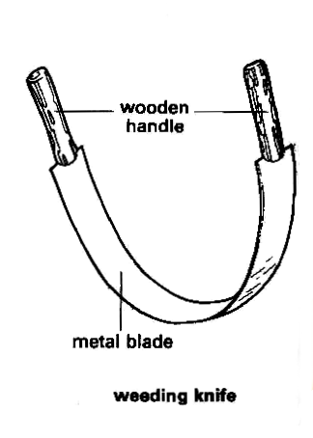

Slide 62
in addition to cultivation, weeds may be controlled by:
  clean seed
  remove or cut weeds before setting seed
  control livestock if evidence of seed transport in dung
  burning
  biological – animals such as goats or geese or insects
  that selectively attack weed spp.
  chemical
  agronomy

Slide 63
agronomic methods include:-
  vigorous crop
  close spacing
  mulching – treated under water conservation
  relay cropping
  plant crop at time which favours rapid growth
  place fertilisers near crop – band placement
  rotations
  mowing – OK for pasture but does not eradicate

Slide 64
tillage treatments may involve :-
  ploughing and seedbed preparation - deep ploughing if
  rhizomatous weeds
  blind tillage (after planting and before emergence
  – better with larger seeded crops )
  minimum tillage techniques
    OK in drier areas where fewer weeds at start of
    season
    some weeds spread by tillage
    may need to use herbicides – usually not feasible in
    DCs
  cultivation during growing

Slide 65
cultivation during growing:
  hand weeding
  mechanical – best when weeds are small
  use of ox-power helps to reduce effort of weeding
  many ox-drawn or manual implements exist which would
  lighten the work load if they were accessible
  (often would require rural credit and better advertising
  /extension from research stations) - often not enough
  profit in simple farm implements
  sometimes it is recommended to let weeds grow after
  1st rains, then plough & plant - over 80% reduction in
  labour may result using this approach

Slide 66
usual recommendation is 2 to 3 hoe weedings at 2 to 3,
5 to 6 & 8 to 9 wap for 90 to 100 day crops – maybe
replacing 3rd with ridger (ox) cultivation if possible;
alternatively, commence 4 to 6 weeks after planting &
follow-up @ flowering / reproductive stage of weeds
- timing of weeding is critical
weeding easier if line planted
hoeing at some stages, e.g. flowering in g-nuts may cause
damage and yield reductions
525 person – hours / ha for typical crop such as maize cf
110 with an ox-drawn ridger or weeder
weeding often done by hand, usually by women & children
post - harvest tillage kills weeds & as well as helping to
builds up store of moisture

Slide 67
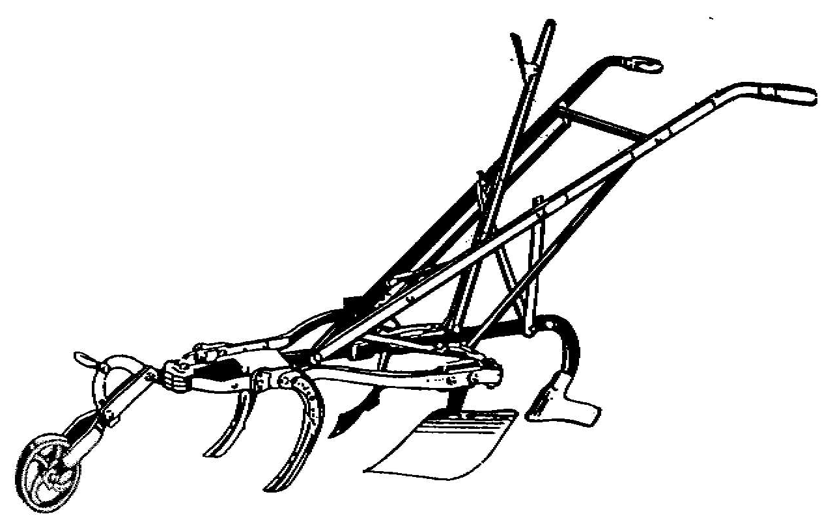
Ox-drawn ridger

Slide 68
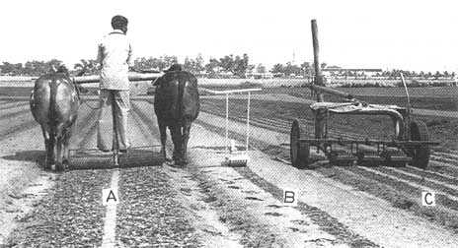
Crust - breakers

Slide 69
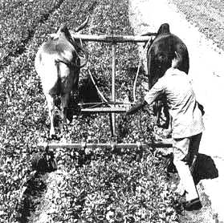
Broad-bed
cultivator

