Slide 1
To too or two ?
To
I am going to the shops.

Slide 2
Too (meaning number 1)
Too
The cat ate too much.

Slide 3
Too (meaning number 2)
Too
Can I come too?

Slide 4
Two
Two
There were two fish.

Slide 5
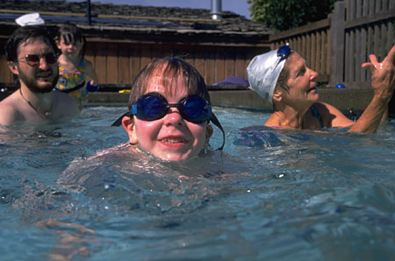
Complete the sentence.
There were ____ many flies.
Let’s go ___ the swimming baths.
I ate ____ bars of chocolate.
Tom walks ___ school.
I want some trifle ____ please.

