Slide 1
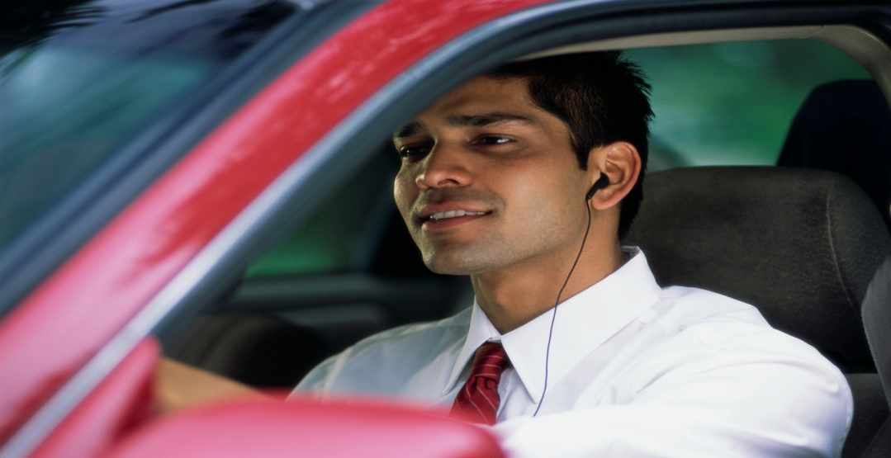
Traffic in Cambridge

Slide 2
What do I think about traffic in Cambridge ?
I am a businessman working in the centre of Cambridge.
I drive into the city from Monday to Friday.
I start work at 9a.m. and finish work at 5p.m.
I park in a car park in the city centre.

Slide 3
What do I think about traffic in Cambridge ?
I drop my pre-school children at the child minder’s house.
Then I take my older children to school.
Lastly I go to work at Addenbrooke’s Hospital.

Slide 4
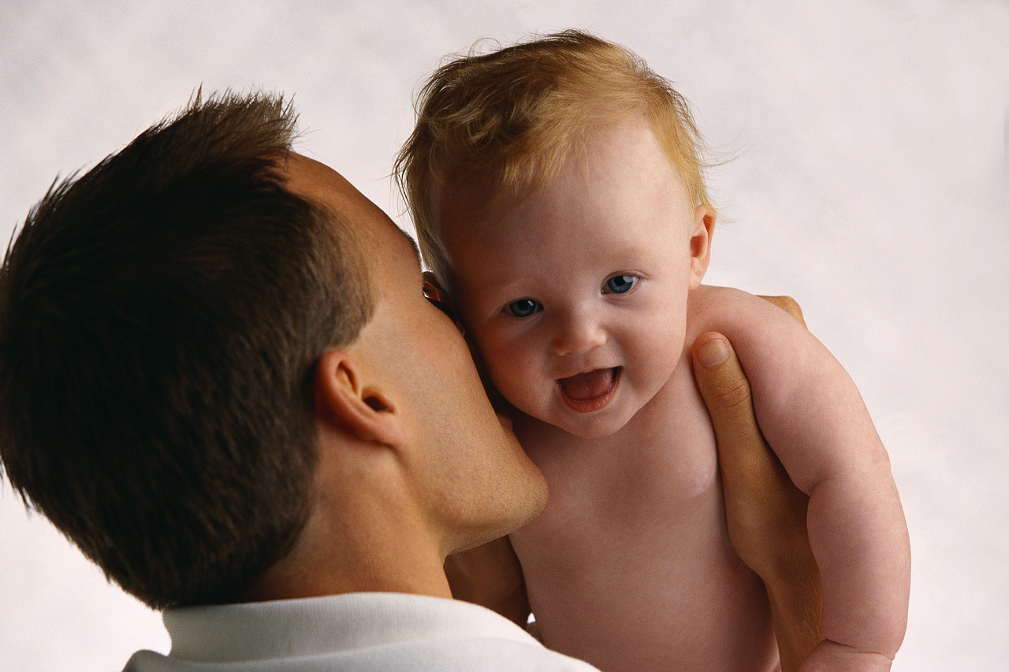
What do I think about traffic in Cambridge ?
I say goodbye to my family every morning and then cycle to work in the city from Histon.
I like to keep fit and healthy.

Slide 5
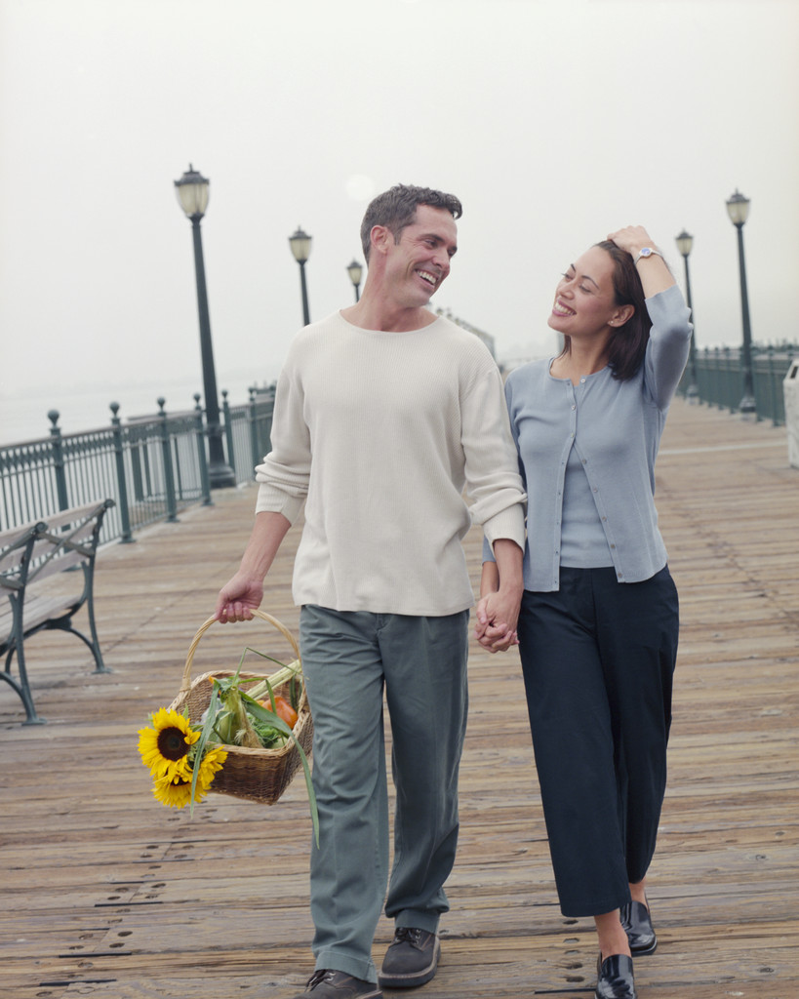
What do I think about traffic in Cambridge ?
We park our car in the Park and Ride car park and then catch the bus into the city.

Slide 6
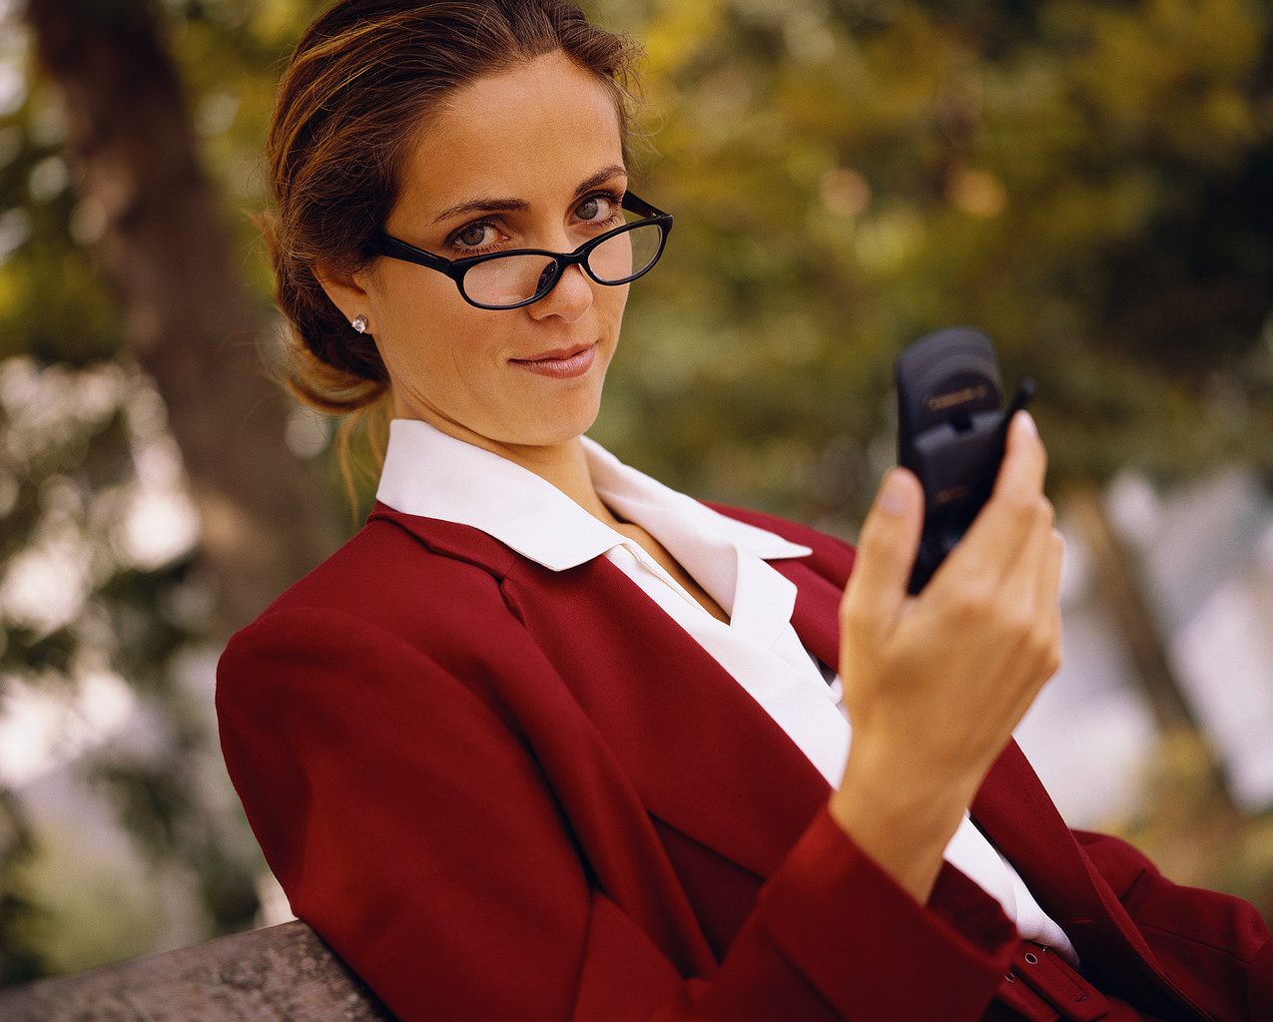
What do I think about traffic in Cambridge ?
I drive to Cambridge every morning along the A14 from Huntingdon.

Slide 7
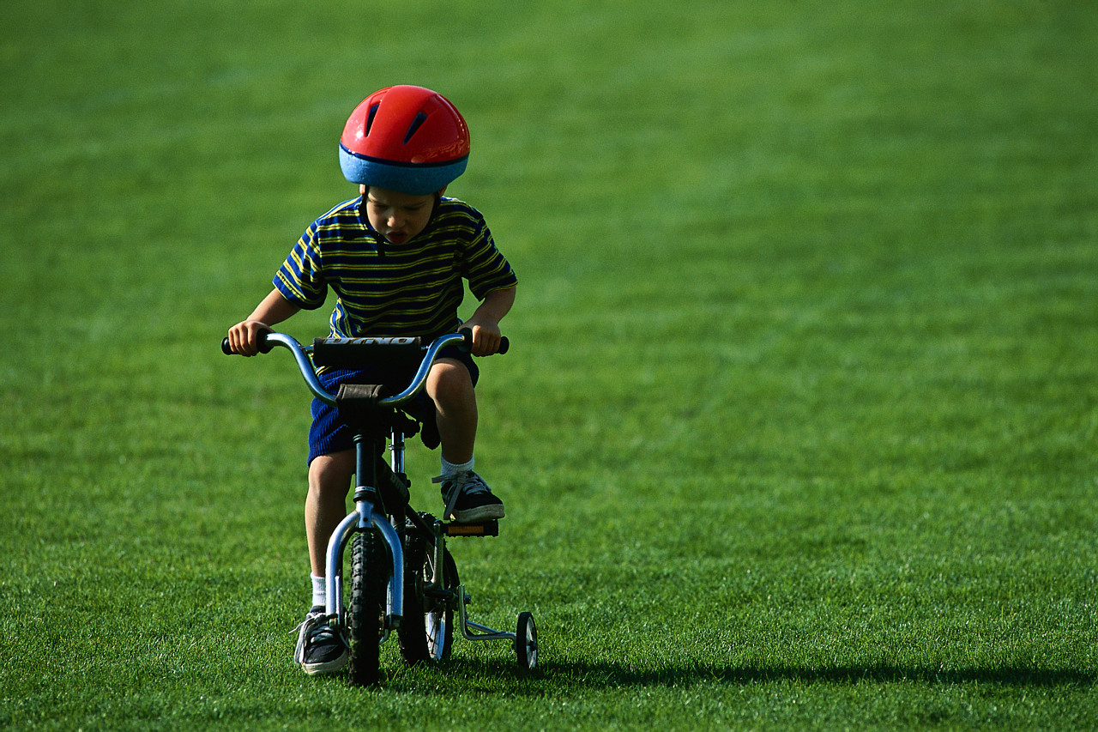
What do I think about traffic in Cambridge ?
I enjoy cycling near my home.

Slide 8
In groups of two or three, list some traffic problems in Cambridge
Now can you think of some possible solutions for each problem.
Would your solutions suit everyone ?

Slide 9
Homework
Ask your parents what they think of traffic in Cambridge or on the A14 / M11.
Can any of your family think of any possible solutions to any problems ?

