Slide 1
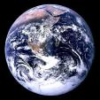
Transport from around the World

Slide 2
We have been thinking about transport from the past and present.
Can you name any modes of transport?

Slide 3
Around the World people use very different modes of transport.
Would you like to find out about transport used around the World?

Slide 4
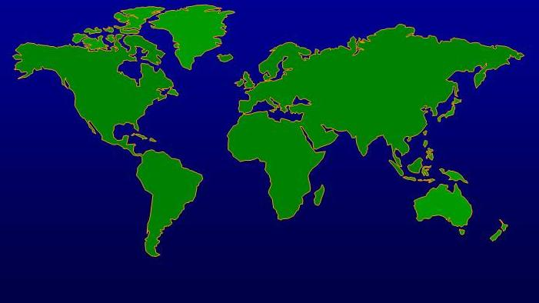
Here is a map of our World.
Can you see the United Kingdom?

Slide 5
Here is Venice, it is a city in Italy.
People say Venice is a floating city.

Slide 6
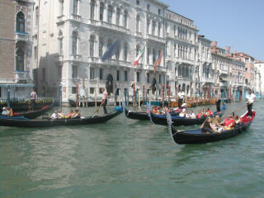
In Venice people use gondolas. These are long, narrow boats.

Slide 7
Here is Bangkok it is a city in Thailand.
Thailand is in the Far East.

Slide 8
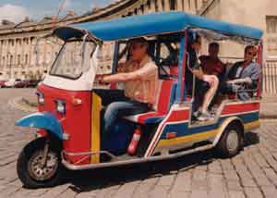
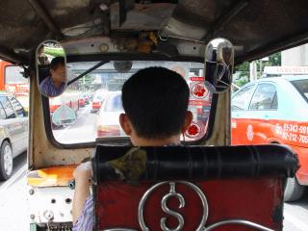
In Thailand some people use tuk-tuks to get around the city.
It is like a taxi. Here is the view from the drivers seat!

Slide 9
Here is San Francisco it is a city in North America.

Slide 10
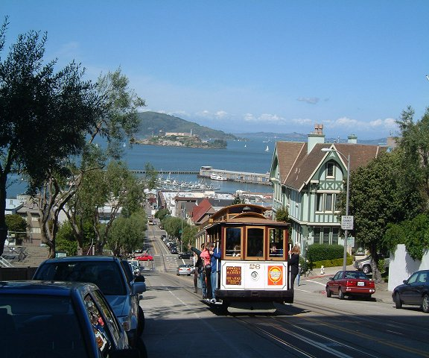
In San Francisco there are many steep hills. So some people use trams.

Slide 11
Here is Alaska.

Slide 12

Alaska has alot of snow every year and is very cold.
What mode of transport do you think people use in Alaska?

Slide 13
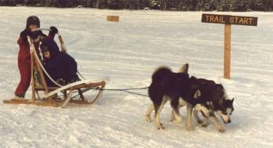

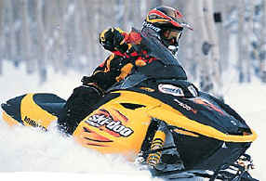
They use:
Dogs!
Skidoos

Slide 14
Here are the Maldives.
They are a group of tiny islands.

Slide 15
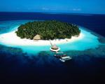
The Maldives are lots and lots of little islands in the sea.

Slide 16
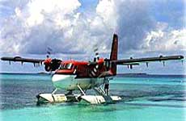
To reach another island people would use a boat. But if they needed to get to another island quickly, they would use a sea plane.
A sea plane can take off and land on water. It can only carry 15 people!!

Slide 17
Can you remember the names of any transport used around the World?
Which modes of transport would you like to go on?

