Slide 1
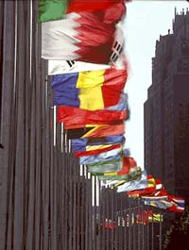
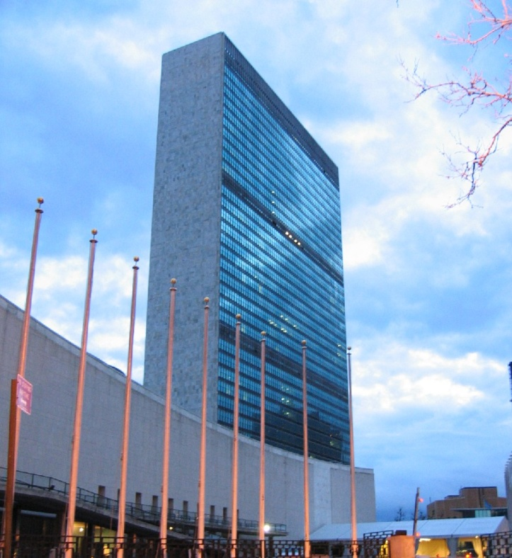

The United Nations

Slide 2
Why do we have the UN?
After World War I, the League of Nations was created to prevent another world war.
During World War II, the League of Nations was eliminated because it failed to prevent another war.
In 1945, with the end of WWII nearing, the United Nations was created to replace the failed League of Nations.

Slide 3
History of the United Nations
In 1945, San Francisco hosted the United Nations Conference on International Organizations.
There were 50 countries represented at the United Nations Conference including: United States, France, United Kingdom, Soviet Union (now Russia), and China.
These five countries are known as the “Permanent Five” members.

Slide 4
What does the United Nations Do?
The UN was created to maintain international peace and security.
It also works to maintain friendly relationships between countries.
Lastly, it works to promote economic development of member nations.

Slide 5
Who and Where?
Almost all countries in the world are members of the UN.
There are currently 191 countries in the UN.
The headquarters is in New York City.
The International Court of Justice (ICJ) is located in The Hague in the Netherlands.

Slide 6
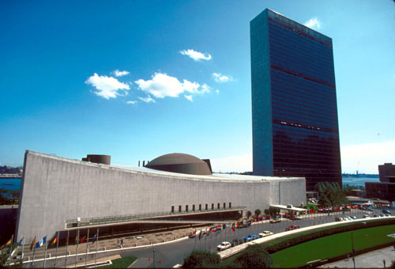
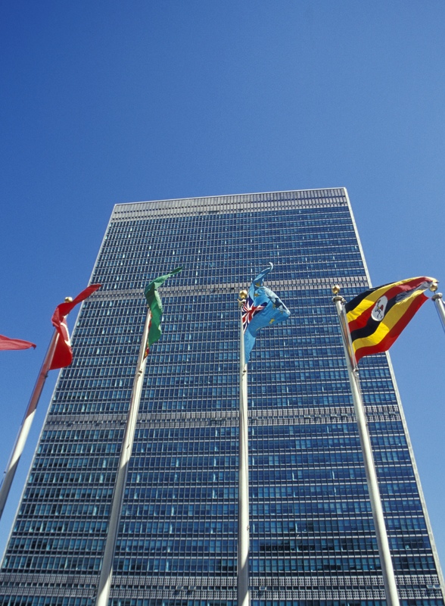
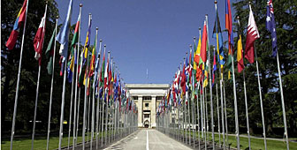
UN World Headquarters
New York

Slide 7
Parts of the United Nations
1. The General Assembly – the ‘town meeting’ of the world.
2. UN Security Council – maintains world peace (most powerful branch)
3. Economic and Social Council - works with the UN’s economic, cultural, health and educational activities.
4. Trusteeship Council - territories
5. ICJ – International Court of Justice
6. The Secretariat – administrative duties and can bring any topic before the SC.

Slide 8
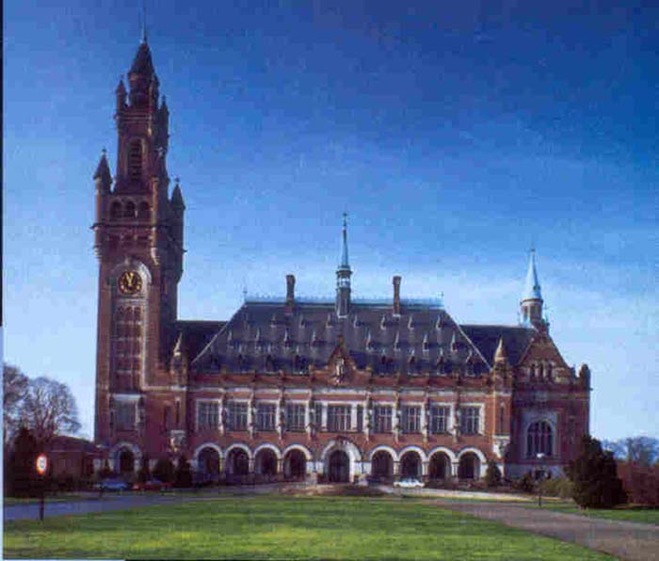
International Court of Justice
The Hague, Netherlands

Slide 9
The General Assembly
Every member nation has a seat at the General Assembly.
Brings up international issues that they want the Security Council to deal with
Holds elections for Security Council members and other leaders

Slide 10
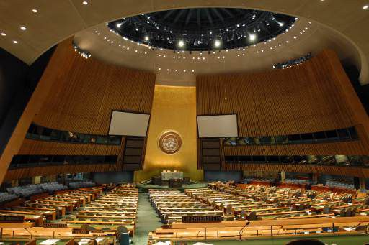
The General Assembly
Inside UN Headquarters

Slide 11

President Reagan Addressing the General Assembly

Slide 12
UN Security Council
Made up of 15 countries:
  The “Permanent Five” countries
  10 non-permanent countries (elected every two years)
The strong-arm of the UN
Maintains international peace
How does it do this:
  Recommends peaceful negotiations (peace talks)
  Can use Economic Sanctions
  Can use Military Sanctions

Slide 13
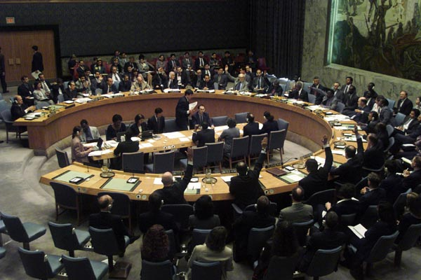
The UN Security Council
Inside World Headquarters

Slide 14
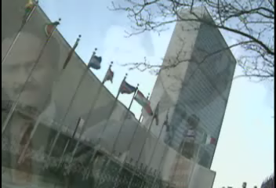
Security Council Speaking on a Solution for Haiti’s Violence

Slide 15
Sanctions
Sanctions are used to punish a country for violating international law. They can be used to force a country to follow a law.
In order for sanctions to be used by the UN Security Council, ALL FIVE permanent members must have a unanimous vote.

Slide 16
Types of Sanctions
Diplomatic Sanctions – removal of all political ties (like embassies)
Economic Sanctions – ban on all trade with a country (except food)
Military Sanctions – using a military to force compliance.

Slide 17
Military Sanctions
UN Peacekeepers – a group of armed soldiers sent to a hostile area to promote peace. They ARE NOT COMBAT TROOPS.
These soldiers maintain peace.
They don’t go on combat missions.
They are not an ‘army’
UN Military Force – an army made up of soldiers from more than one UN country that can serve as combat troops.
  They are not very effective and are not used very often.

Slide 18
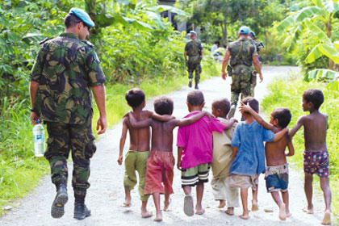
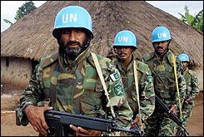
UN Peacekeepers
They always wear blue berets or blue helmets to identify themselves.

Slide 19

Serbs Attack U.N.
Peacekeeping Forces

Slide 20
Major UN Missions
East Timor (Asia) – the UN supervised the independence of this country
Iraq (Middle East) – UN tried to cut all trade with Iraq after it failed to comply with international law, but some nations continued to trade with them.
Somalia (Africa) – UN humanitarian mission to get food and supplies to people in need
Haiti (Caribbean) – UN helped strengthen government, army, and hold elections

Slide 21
Strengths of the UN
Provides a forum for almost all of the world’s nations to discuss international issues
Humanitarian efforts
  AIDS
  Landmine removal
  Food and supply organization
Peacekeeping forces
Will get involved with messes that no one else will

Slide 22
Weaknesses of the UN
Sanctions are only effective if ALL countries follow them (Iraq example)
Military force is rarely used and is usually ineffective
ALL permanent members of the security council have to vote unanimously (one country can stop a sanction)
Inadequate funding by member nations
  14 Countries Pay 85% of the subscriptions (membership fee)
Big gap between developing and industrialized nations

Slide 23
UN Analysis Questions
Some of the weaknesses of the UN are caused by flaws in the structure of the organization. Would it be better to start from scratch, or spend time and money solving the problems from within.
What do you think the world would be like without the United Nations?

Slide 24
UN Analysis Questions (cont)
Which part of the Untied Nations would you put the most money towards? Why?
What are some alternatives to economic and military sanctions if they don’t work?

