Slide 1
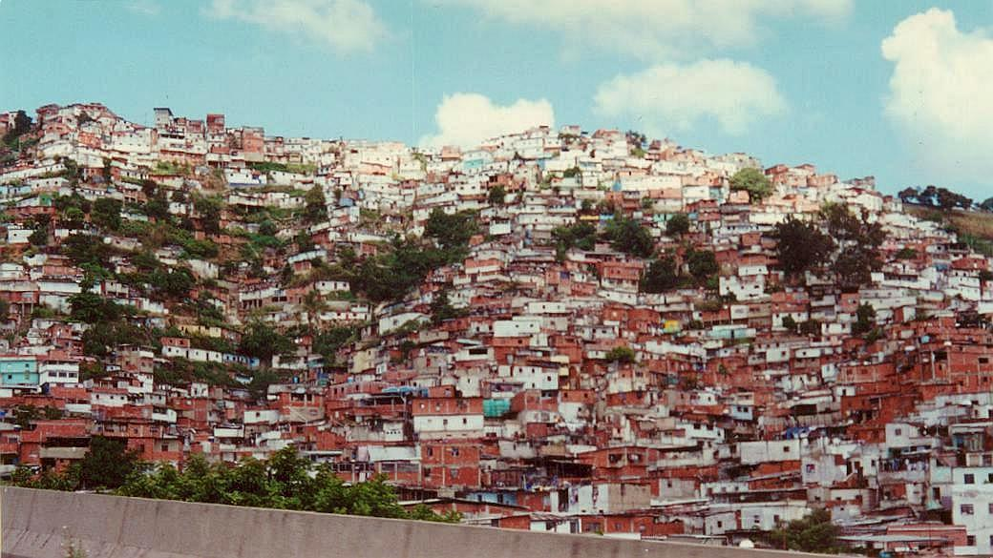
URBANIZATION
http://cityguides.salsaweb.com/belgium/reports/2001/20010120venezuelatravel/venezimages/caracas03.jpg

Slide 2
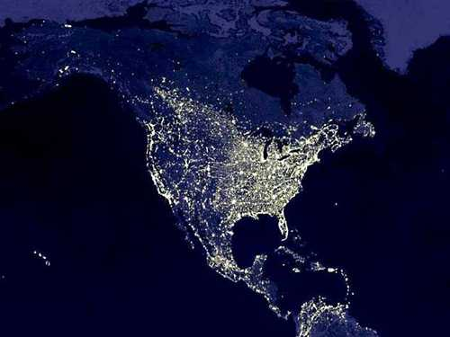
http://america.scientium.com/bush2004/mission.htm

Slide 3
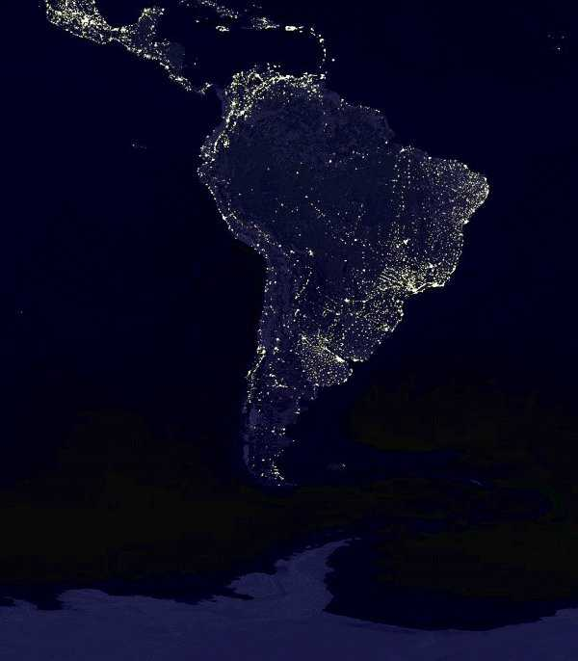
http://www.nwhiker.com/SAnight.html

Slide 4
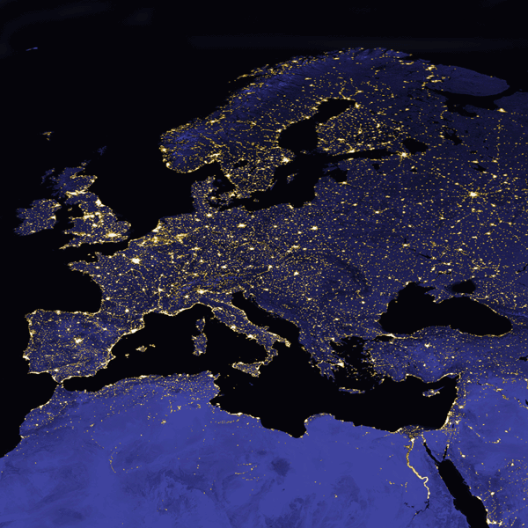
http://www.caf.dlr.de/caf/aktuelles/news-archiv/bilderarchiv/sonstiges/night-europe_600b_
600h_web.gif;internal&action=printview.action

Slide 5
http://chengdu.usconsulate.gov/img/night_lites_asia.jpg

Slide 6
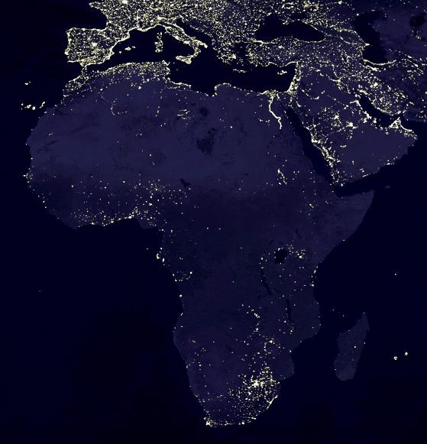
http://www.oilcrisis.com/africa/

Slide 7
What is urbanization
It is the growth of cities, brought about by a population shift from rural areas and small communities to large ones, and the change from a largely agricultural economy to an industrial one.
This results in the development of cities and towns on formerly agricultural or natural lands.

Slide 8
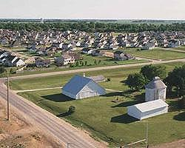
http://www.nationalaglawcenter.org/readingrooms/urbanization/

Slide 9
History of Urbanization
Through most of history, the human population has lived a rural lifestyle, dependent on agriculture and hunting for survival.
In 1800, only 3 percent of the world's population lived in urban areas.
By 1900, almost 14 percent were urbanites, although only 12 cities had 1 million or more inhabitants.
In 1950, 30 percent of the world's population resided in urban centers. The number of cities with over 1 million people had grown to 83.

Slide 10
The world has experienced unprecedented urban growth in recent decades.
In May 2007 for the first time in history over 50% of the world's population lived in urban areas.
There are 411 cities over 1 million.
More developed nations are about 76 percent urban, while 40 percent of residents of less developed countries live in urban areas.
It is expected that 60 percent of the world population will be urban by 2030, and that most urban growth will occur in less developed countries

Slide 11
http://news.bbc.co.uk/2/hi/in_depth/world/2006/urbanisation/
http://news.bbc.co.uk/2/shared/spl/hi/world/06/urbanisation/html/urbanisation.stm

Slide 12
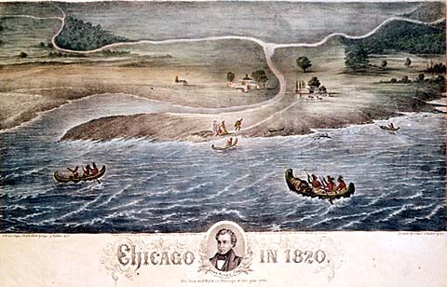

Slide 13
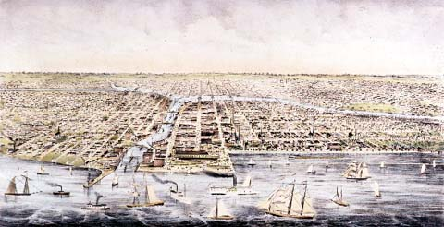

Slide 14
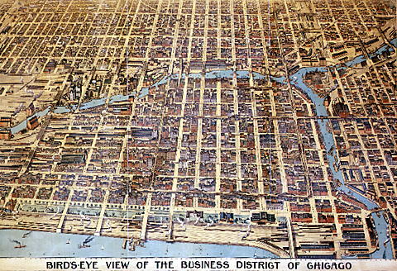

Slide 15
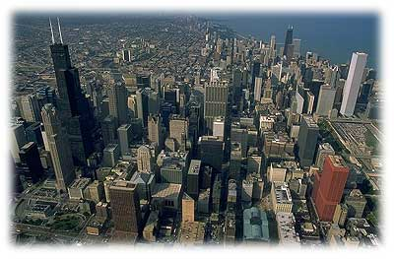

Slide 16
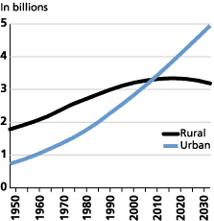
Figure 1 Urban and Rural Populations, 1950-2030
Source: UN, World Urbanization Prospects: The 2003 Revision (2004).

Slide 17
Causes of urbanization
A city grows through natural increase — the excess of births over deaths and the in-migration of people from rural areas.
MDCS and LDCs differ in the way in which urbanization is occurring.

Slide 18
MDCs : During the 19th and early 20th centuries, urbanization resulted due to industrialization.
New job opportunities in the cities encouraged the mass movement of population away from the countryside.
At the same time, migrants provided cheap, plentiful labor for the emerging factories.
High death rates in the cities slowed urban growth. Cities were unhealthy places because of crowded living conditions, the prevalence of contagious diseases, and the lack of sanitation. Until the mid-1800s, the number of deaths exceeded births in many large European cities.
Migration accounted for as much as 90 percent of city growth during this period

Slide 19
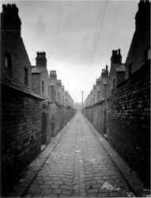
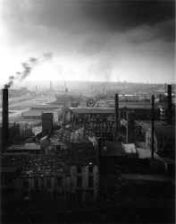

Slide 20
City life 1800s
To remove household waste and garbage, privies, also known as outhouses, were small wooden sheds that served as a receptacle for human waste. However, privies tended to leak their contents into the rear yards, where the household well was also located, thereby contaminating the water supply. To remedy the problem, Newark employed scavengers who drove their wagons through the city during the middle of the night and removed the contents of the privies. The “night soil” from the privies was carted to farms on the outskirts of the city, but this only worsened the problem as waste spilled onto streets from their uncovered wagons, garbage was dumped in vacant lots and the outlying districts were neglected.

Slide 21
Meanwhile, living conditions deteriorated. Pigs roamed the streets in search of garbage, animal carcasses littered the streets, and the waterways that traversed the city carried away household wastes in full view for all to see. The poor and immigrant classes lived in dark, wretched tenements without running water or basic sanitary amenities. Consequently, Newark, like most northeastern cities, was periodically plagued by outbreaks of epidemics. Infectious diseases such as cholera, typhoid, yellow fever, dysentery and small pox claimed thousands of lives, mostly the poor. For years, the medical profession believed that these infectious diseases were caused by the inhalation of poisonous gases known as “miasmas-” noxious fumes emanating from rotting animal and vegetable matter.
http://www.usgennet.org/usa/nj/state/EssexNewarkSewer.htm

Slide 22
LDCs
Urbanization in LDCs
Urbanization in most less developed countries in the past 50 years contrasts sharply with the experience of the more developed countries.
Death rates have fallen faster in urban areas because of greater access to health services.
Because birth rates are relatively high in most less developed countries, the rates of natural increase are also quite high in cities.
Migration also fuels urban growth in less developed countries as people leave the countryside in search of better jobs

Slide 23
Global differences in urbanization
New York and London are typical of large cities in more developed countries that arose in the 1800s and early 1900s, reached their current size mid-century, and have since experienced slow growth or decline.
Cities in some less developed countries, such as Mexico City, grew very rapidly between 1950 and 1980, and are growing more slowly now.
Many Asian and African cities, such as Lagos and Bombay, are experiencing very rapid growth now and are projected to continue at this pace.

Slide 24
Much of urban migration is driven by rural populations' desire for the advantages that urban areas offer.
Urban advantages include greater opportunities to receive education, health care, and services such as entertainment. The urban poor have less opportunity for education than the urban nonpoor, but still they have more chance than rural populations.

Slide 25
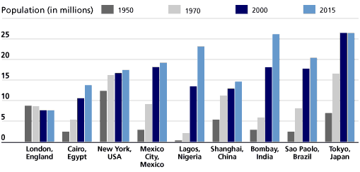

Slide 26
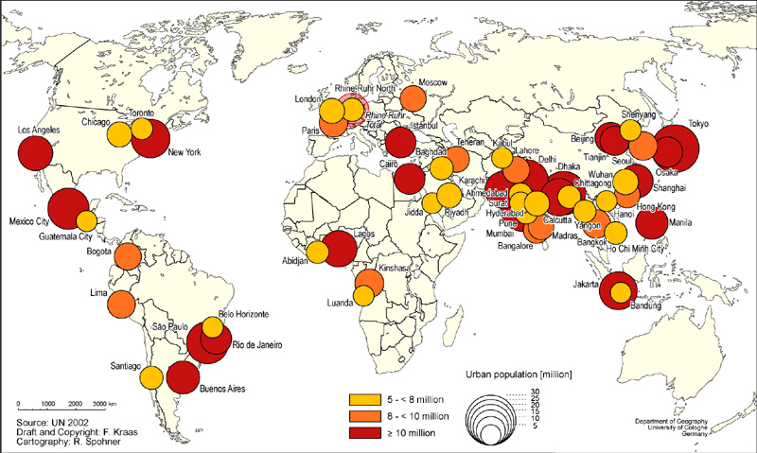

Slide 27
MEGACITIES
As the population increases, more people will live in large cities. Many people will live in the growing number of cities with over 10 million habitants known as megacities. shows,
In 1950 just eight cities had populations of 5 million or more, two of them in less developed countries.
There were 41 megacities in 2000.
By 2015, 59 megacities will exist, 48 in less developed countries.

Slide 28
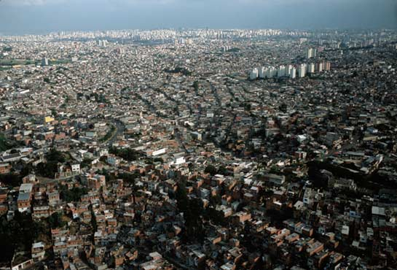
Sao Paolo
Photograph by Stuart Franklin http://magma.nationalgeographic.com/ngm/0211/feature3/zoom1.html

Slide 29
Urbanization and the Environment
The growth in world population has an important human-environmental interaction: While the world's population is doubling, the world's urban population is tripling.
Within the next few years, more than half the world's population will be living in urban areas

Slide 30
Both the increase in and the redistribution of the earth's population are likely to affect the natural systems of the earth and the interactions between the urban environments and populations.

Slide 31
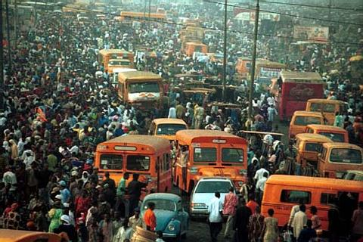
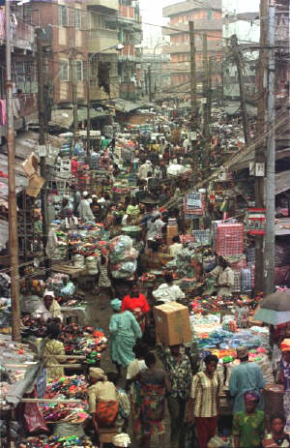
http://realnigeria.org/photos3.asp

Slide 32
Urban populations interact with their environment. Urban people change their environment through their consumption of food, energy, water, and land. And in turn, the polluted urban environment affects the health and quality of life of the urban population.

Slide 33
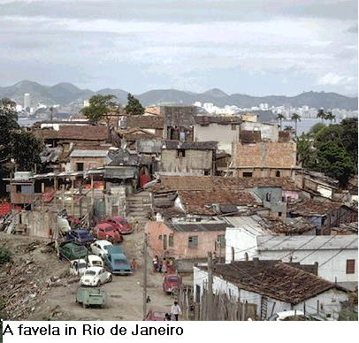

Slide 34
People who live in urban areas have very different consumption patterns than residents in rural areas.
For example, urban populations consume much more food, energy, and durable goods than rural populations. In China during the 1970s, the urban populations consumed more than twice as much pork as the rural populations who were raising the pigs.
In India where many urban residents are vegetarians, greater prosperity is seen in higher consumption of milk.

Slide 35
Urban populations not only consume more food, but they also consume more durable goods. In the early 1990s, Chinese households in urban areas were two times more likely to have a TV, eight times more likely to have a washing machine, and 25 times more likely to have a refrigerator than rural.

Slide 36
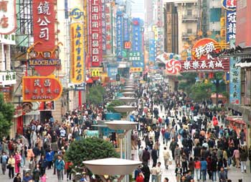
http://www2.chinadaily.com.cn/english/doc/2004-09/27/content_377978.htm

Slide 37
Energy consumption for electricity, transportation, cooking, and heating is much higher in urban areas than in rural villages. For example, urban populations have many more cars than rural populations per capita.
In China the per capita consumption of coal in towns and cities is over three times the consumption in rural areas.

Slide 38
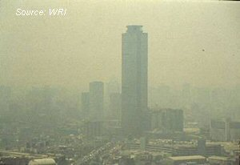

Slide 39
Effects on Weather
Urban consumption of energy helps create heat islands that can change local weather patterns and weather downwind from the heat islands.
The heat island phenomenon is created because cities radiate heat back into the atmosphere at a rate 15 percent to 30 percent less than rural areas.
The combination of the increased energy consumption and difference in albedo (radiation) means that cities are warmer than rural areas (0.6 to 1.3 C).16
And these heat islands become traps for atmospheric pollutants. Cloudiness and fog occur with greater frequency.
Precipitation is 5 percent to 10 percent higher in cities; thunderstorms and hailstorms are much more frequent, but snow days in cities are less common.

Slide 40
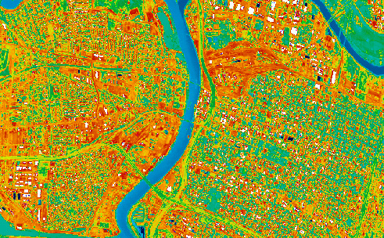
White and red are hot, and blue and green are cool. From surface temperature estimates,
the white areas are about 60 degrees C (140 degrees F),Dark areas (vegetation)
are approximately 29 to 36 degrees C (85-96 degrees F).
http://science.nasa.gov/headlines/y2000/essd16mar_1m.htm

Slide 41
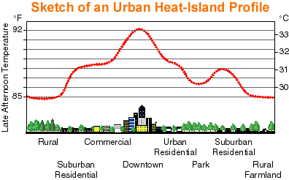
http://eande.lbl.gov/HeatIsland/

Slide 42
Urbanization and Health
Some urban environmental problems include inadequate water and sanitation, lack of rubbish disposal, and industrial
The health implications of these environmental problems include respiratory infections and other infectious and parasitic diseases.
Because urban land prices are so high costs for building cleaner public transportation systems and for building more hospitals and clinics are higher in cities.

Slide 43
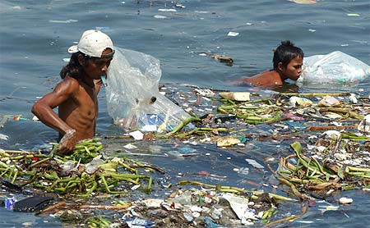
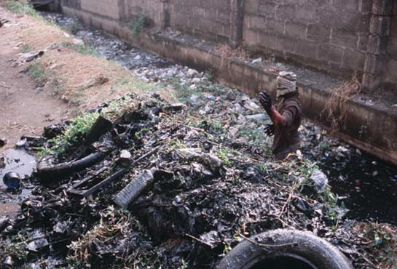
http://magma.nationalgeographic.com/ngm/0211/feature3/zoom2.html

Slide 44
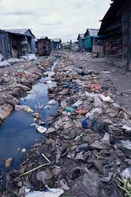
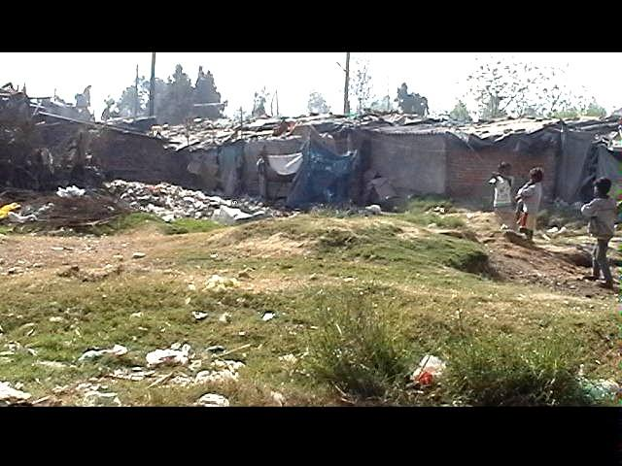
http://newswire.indymedia.org/en/newswire/2004/03/800756.shtml

Slide 45
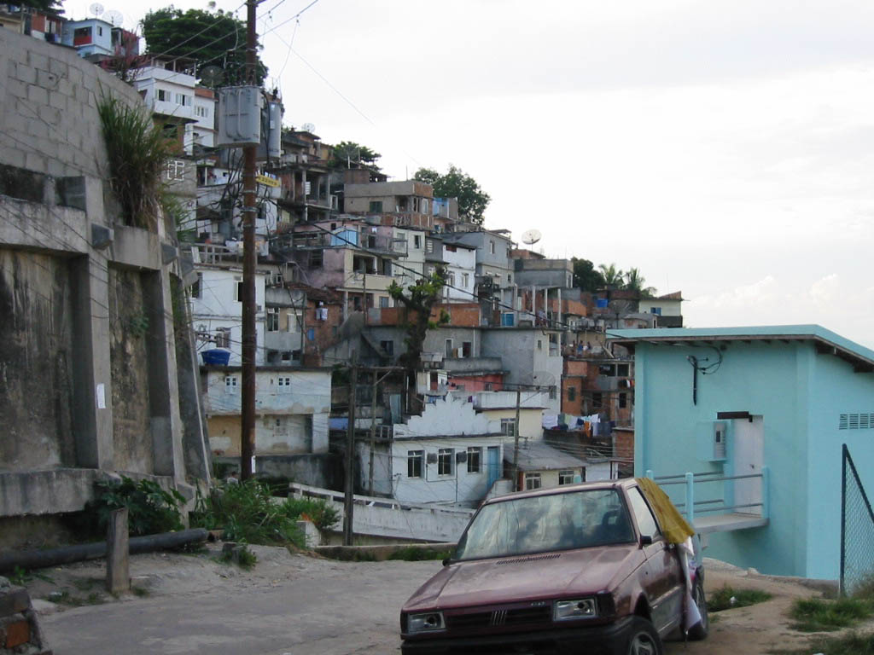
http://www.askadavid.org/photos/photos17/favelamorrodosprazeres.jpg

Slide 46
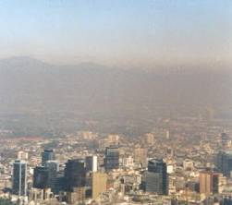
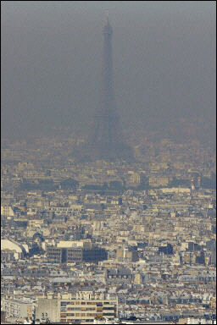
Urban air pollution kills more than 5,000 people per year in France
http://www.zapworld.com/about/news/watch_francepollution.asp

Slide 47
CANADA
http://globalis.gvu.unu.edu/indicator_detail.cfm?IndicatorID=30&Country=CA
http://www40.statcan.gc.ca/l01/cst01/demo62a-eng.htm

