Slide 1


Using
Speech Marks

Slide 2
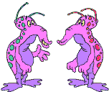
Speech marks go around the bits of a sentence actually being spoken.
Hello, Blab!
Hello, Blob! What a surprise seeing you here!
“Hello, Blab!” exclaimed Blob.
“Hello, Blob!” replied Blab. “What a surprise seeing you here!”

Slide 3
We also need to put some punctuation at the end of each piece of dialogue before we close the speech marks - ! ? , .
“Do you believe it?” Charlie asked.
“I don’t believe it!” cried Kate.
“Believe it or not,” Ben shrugged, “it’s true.”
Amy nodded. “I believe it.”

Slide 4
Where should the speech marks and closing punctuation go in these sentences?
a. Would you like a sweet Tom asked.
“Would you like a sweet?” Tom asked.
b. I’d love to come to your party Sam exclaimed.
“I’d love to come to your party!” Sam exclaimed.
c. That was a really sad story sniffed John.
“That was a really sad story,” sniffed John.
d. If you’d like it Alice murmured have it.
“If you’d like it,” Alice murmured, “have it.”

Slide 5


We also need to start a new line every time a different character speaks.
“Hello, Mr. Batt!” called James.
“Hello there!” replied Mr. Batt.
“How are you feeling today?” James asked, stopping at Mr. Batt’s gate.
“I’m fine, thanks James,” smiled Mr. Batt, “just no more football for a while!”

Slide 6
Oh. I’ve always wanted my own kitten.
Remember, it won’t stay a kitten for long!
Try to turn this speech into dialogue.

Slide 7
Now, you need to think about the speech too.

Slide 8
Now, think about the speech in this situation.

Slide 9
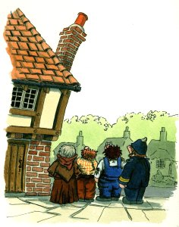
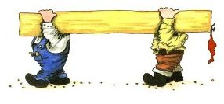
Try punctuating this dialogue:
Bodget and Brown looked hard at the chimney. It was leaning a very long way over. It will have to be pulled down said Bodget, as he and the constable looked up at the chimney. It can not be left in that state said the constable. You had better get started. I have told Mrs. Worth about it. We will go and get some ladders and scaffolding from the lorry said Bodget and off he went.

Slide 10
Now, check your dialogue punctuation:
Bodget and Brown looked hard at the chimney. It was leaning a very long way over.
"It will have to be pulled down," said Bodget, as he and the constable looked up at the chimney.
"It can not be left in that state," said the constable. "You had better get started. I have told Mrs. Worth about it."
"We will go and get some ladders and scaffolding from the lorry," said Bodget and off he went.

Slide 11
We need to remember:
Put speech marks around the words being spoken.
Punctuate the speech before closing speech marks.
Start a new line for each new speaker.
Don’t use too much dialogue to tell stories.

